Slide 1

Multicast Based Resource Information Synchronization for Distributed NFV Orchestration Devan Nair Matr. Nr : 1274369
Project 18
Summer Semester – 2020
Notes:
NFV Resource Advertisement and Discovery Protocol for a Distributed NFV Orchestration in a WMN-based Disaster Network
https://ieeexplore.ieee.org/document/8903694

Slide 2
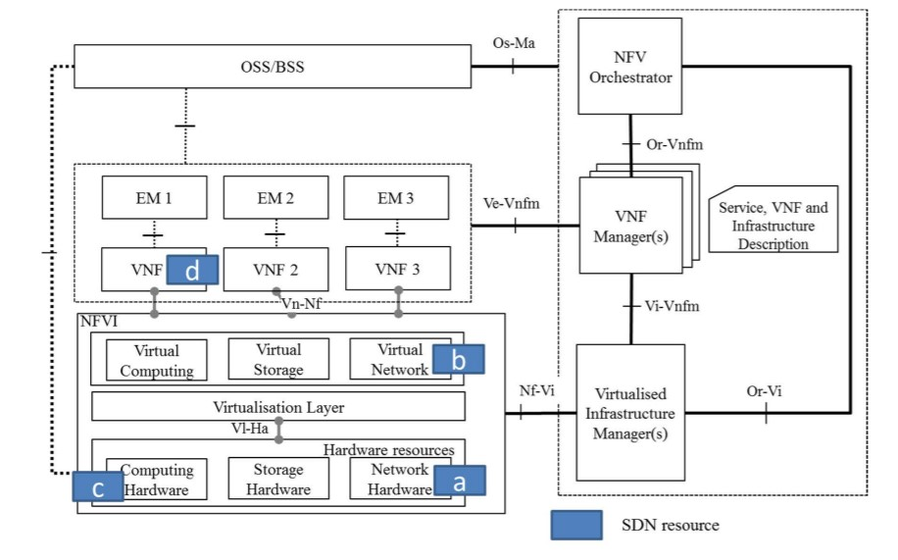
ETSI NFV Architecture
[ETSI]

Slide 3
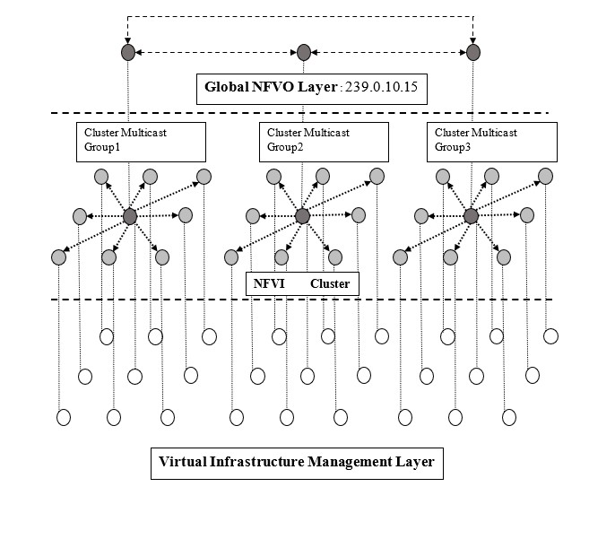
Wireless Mesh Network Architecture
[Frick]

Slide 4
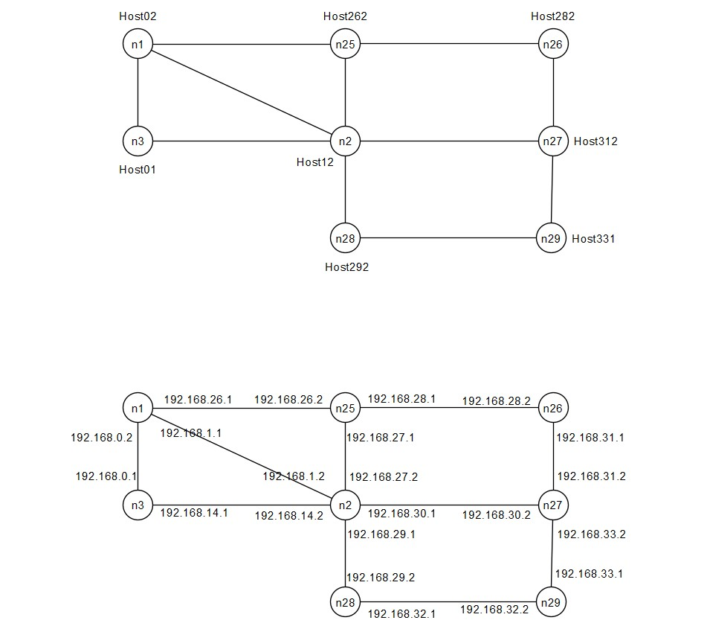
Cluster NFVO Topology

Slide 5
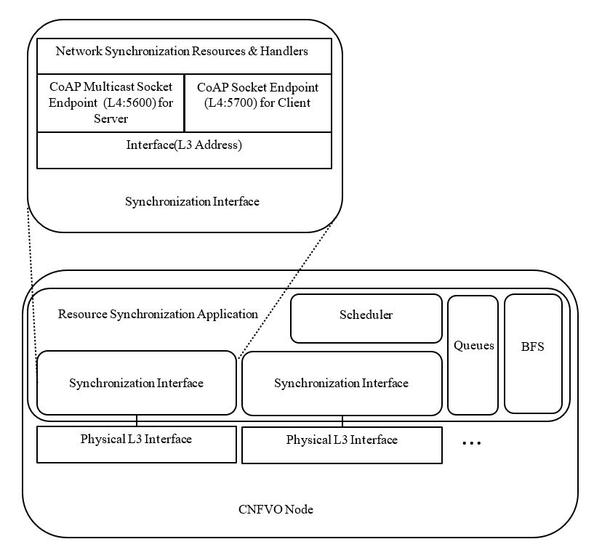
Solution Architecture

Slide 6
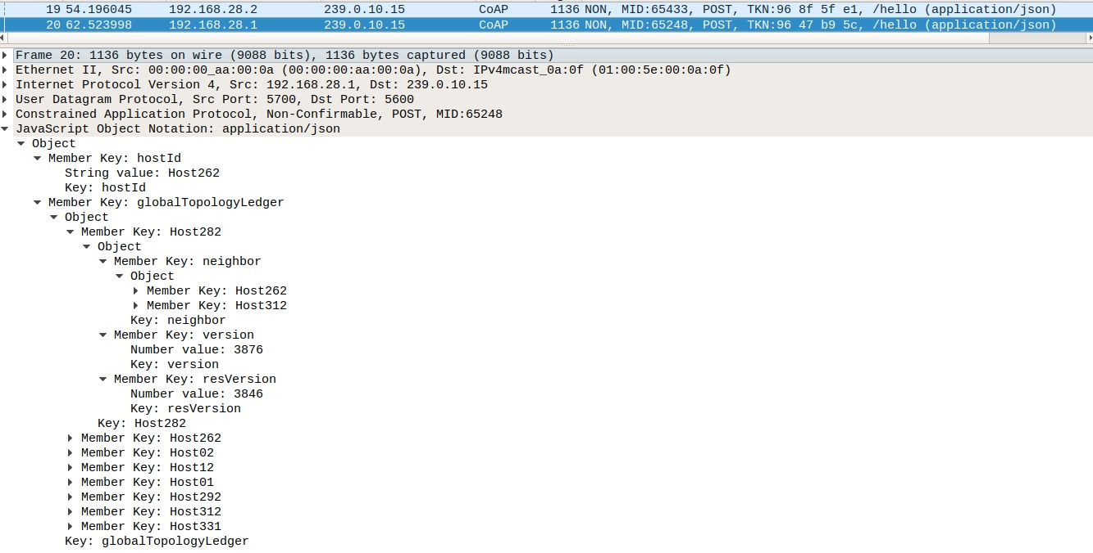
Messages & Transactions : NS-Hello

Slide 7
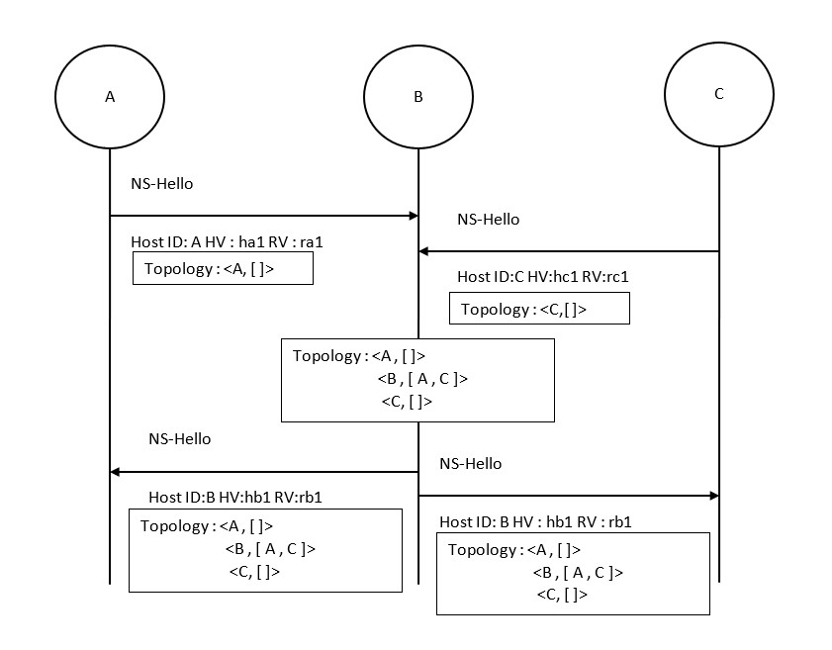
Messages & Transactions : NS-Hello
Notes:
When states of queues of adjacent nodes update/change: Transaction.
When states of queues of partition gets synchronized to same state : Session.

Slide 8
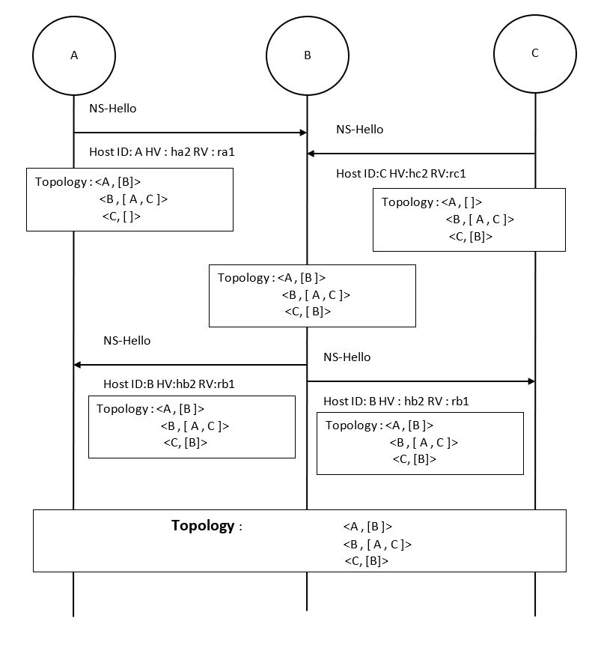
Messages & Transactions : NS-Hello

Slide 9
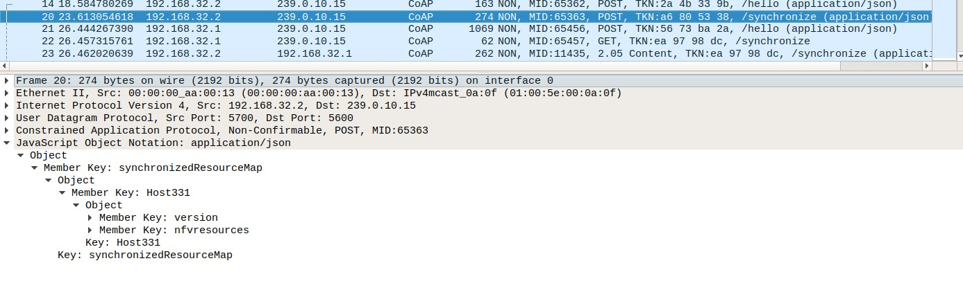
Messages & Transactions : NS-Synchronize

Slide 10
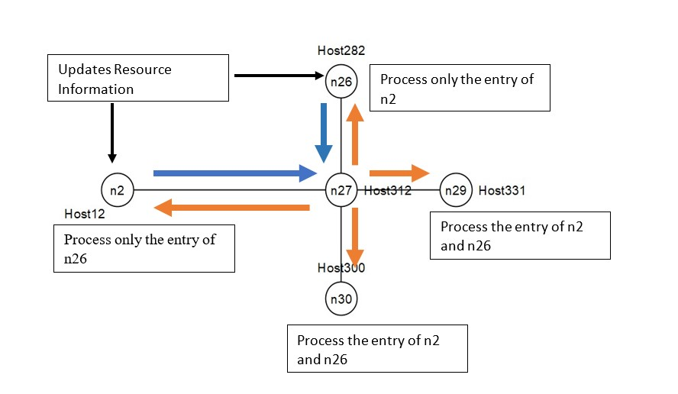
Messages & Transactions : NS-Synchronize

Slide 11
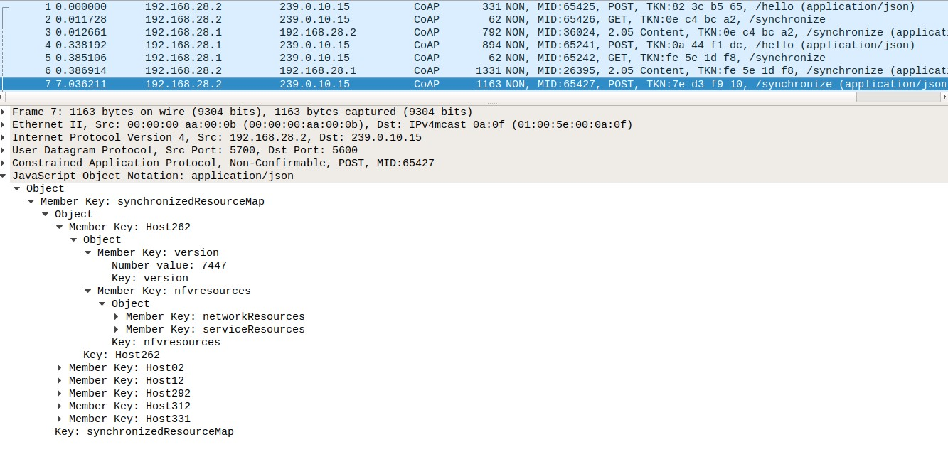
Messages & Transactions : NS-Synchronize

Slide 12
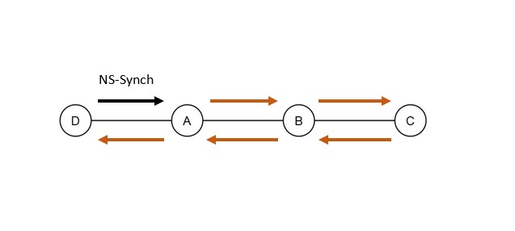
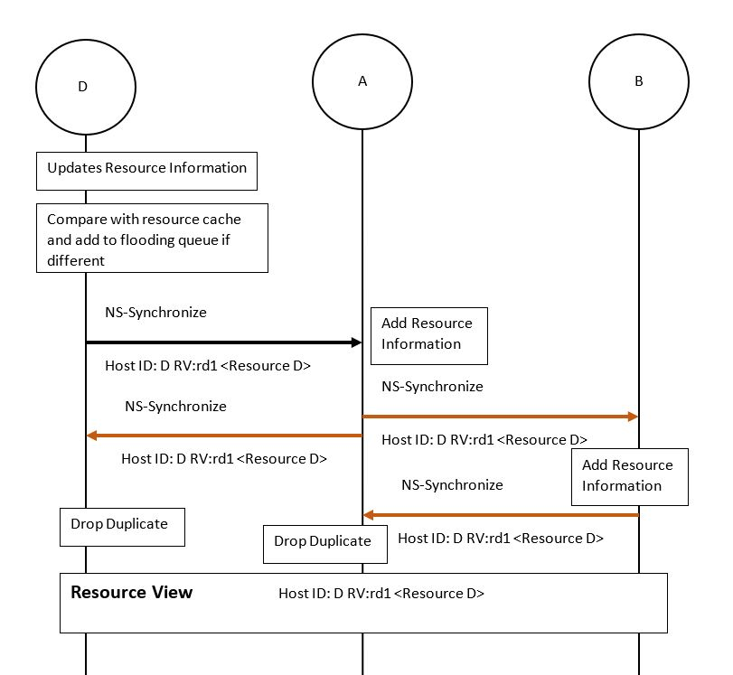
Messages & Transactions : NS-Synchronize

Slide 13
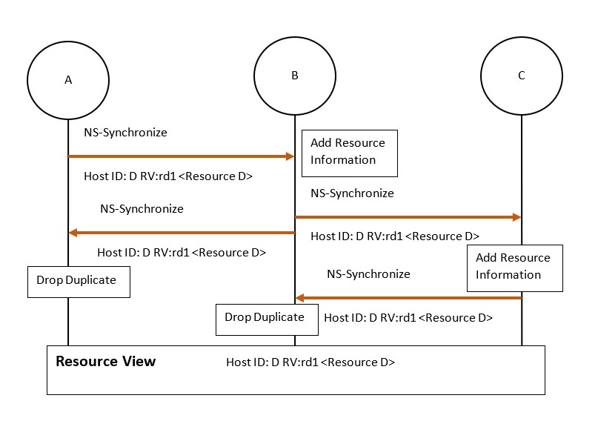
Messages & Transactions : NS-Synchronize

Slide 14
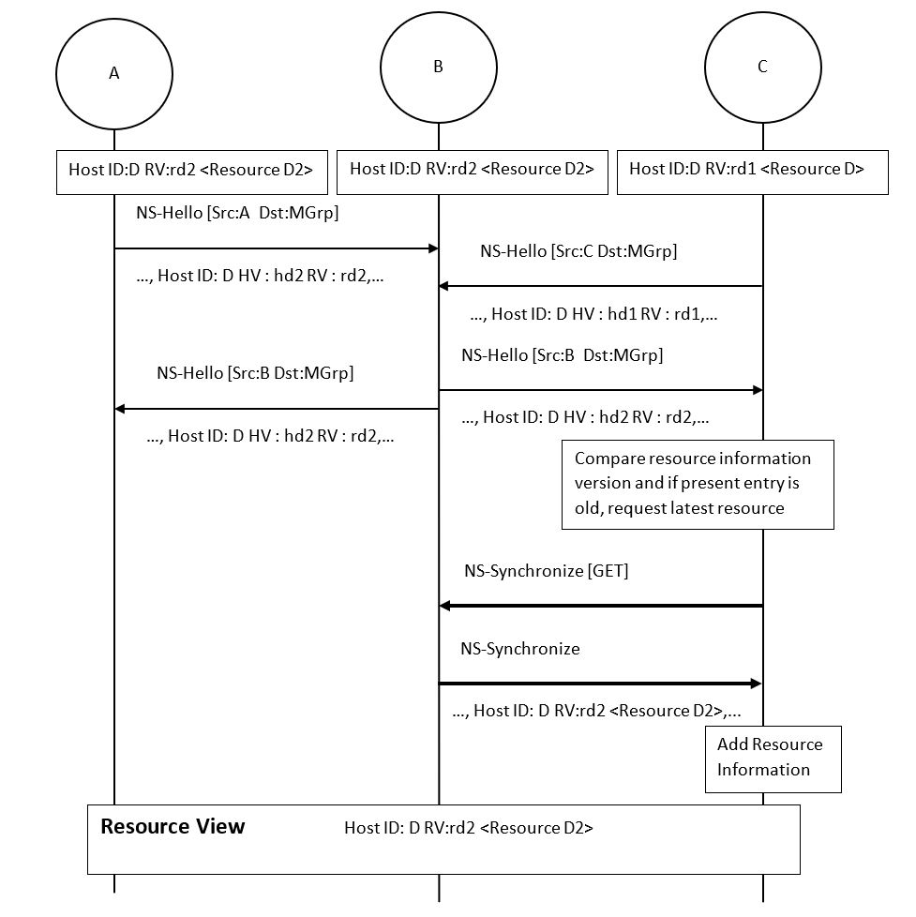
Messages & Transactions : NS-Synchronize

Slide 15
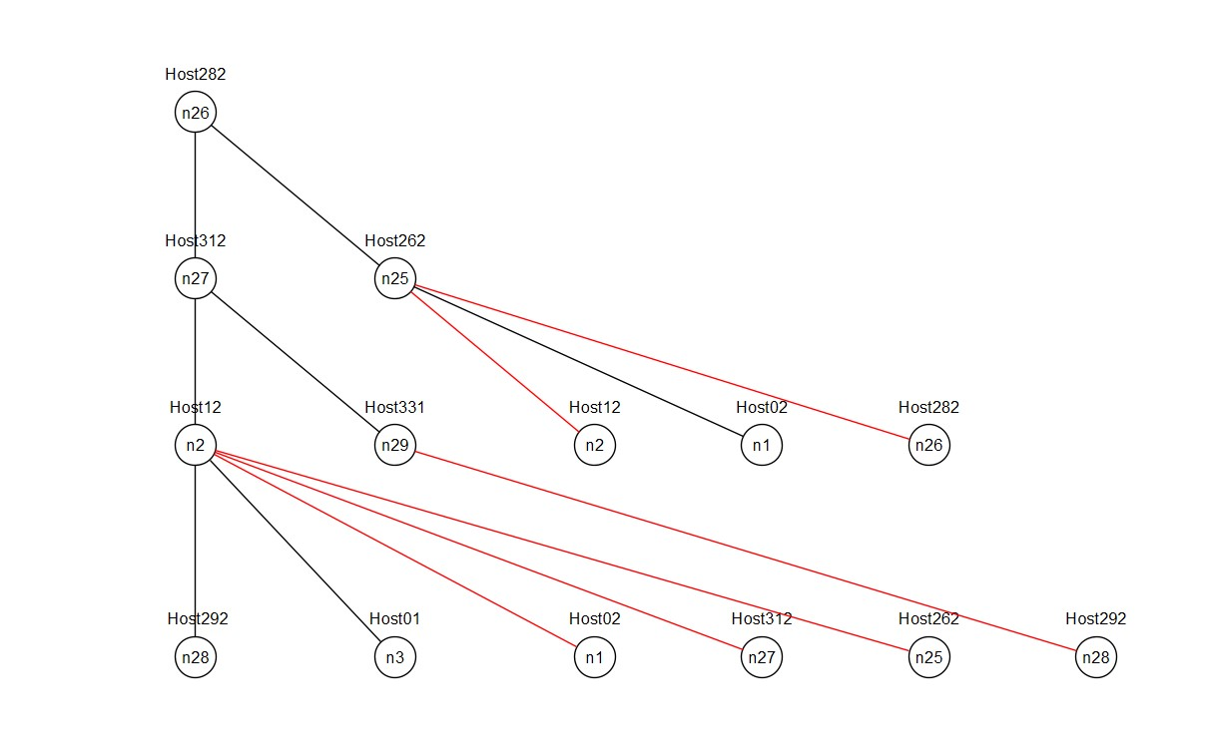
Graph Pruning – Breadth First Search Algorithm

Slide 16
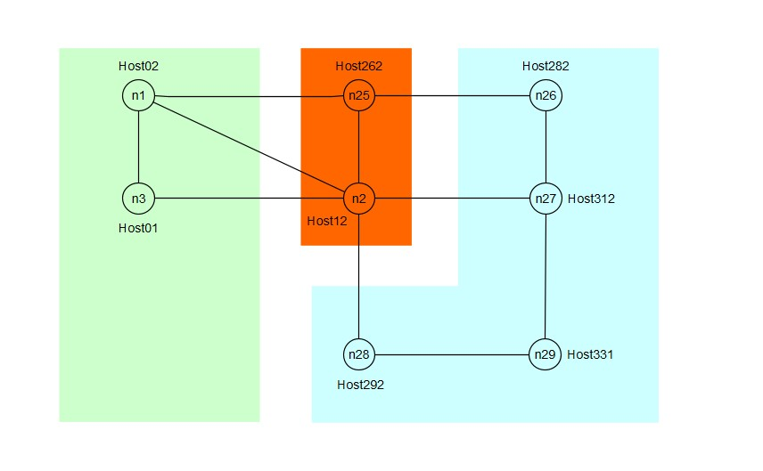
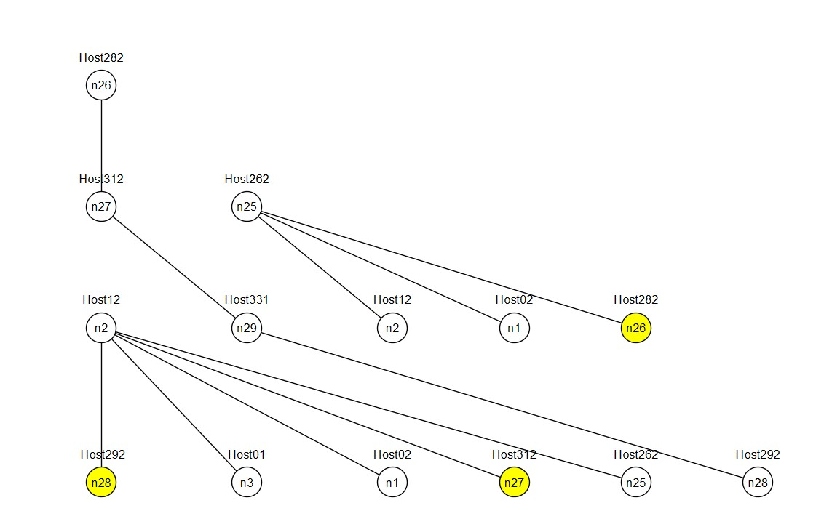
Analyzing a Use Case : Network Partition

Slide 17
References
[Frick] NFV Resource Advertisement and Discovery Protocol for a Distributed NFV Orchestration in a WMN-based Disaster Network.
[ETSI] ETSI Report on SDN Usage in NFV Architectural Framework. ETSI GS NFV-EVE 005 v1.1.1 (2015-12)

