Slide 1

Multicast Based Resource Information Synchronization for Distributed NFV Orchestration Devan Nair Matr. Nr : 1274369
Project 18
Summer Semester – 2020
Notes:
NFV Resource Advertisement and Discovery Protocol for a Distributed NFV Orchestration in a WMN-based Disaster Network
https://ieeexplore.ieee.org/document/8903694

Slide 2
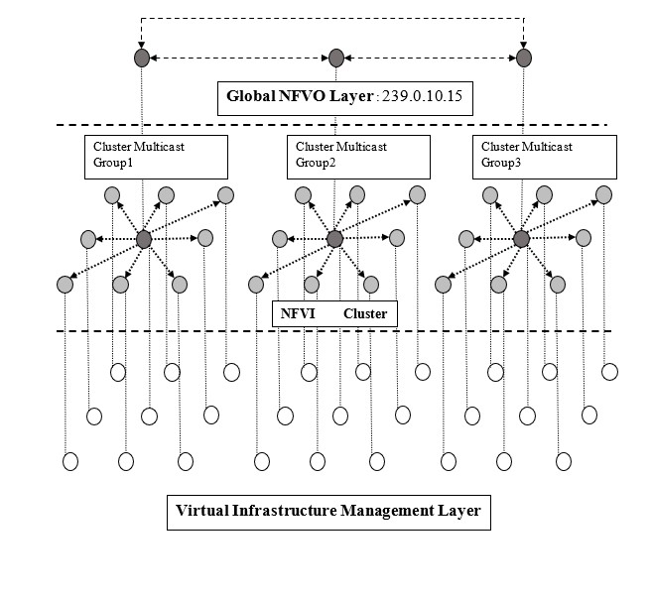
Wireless Mesh Network Architecture
[Frick]

Slide 3
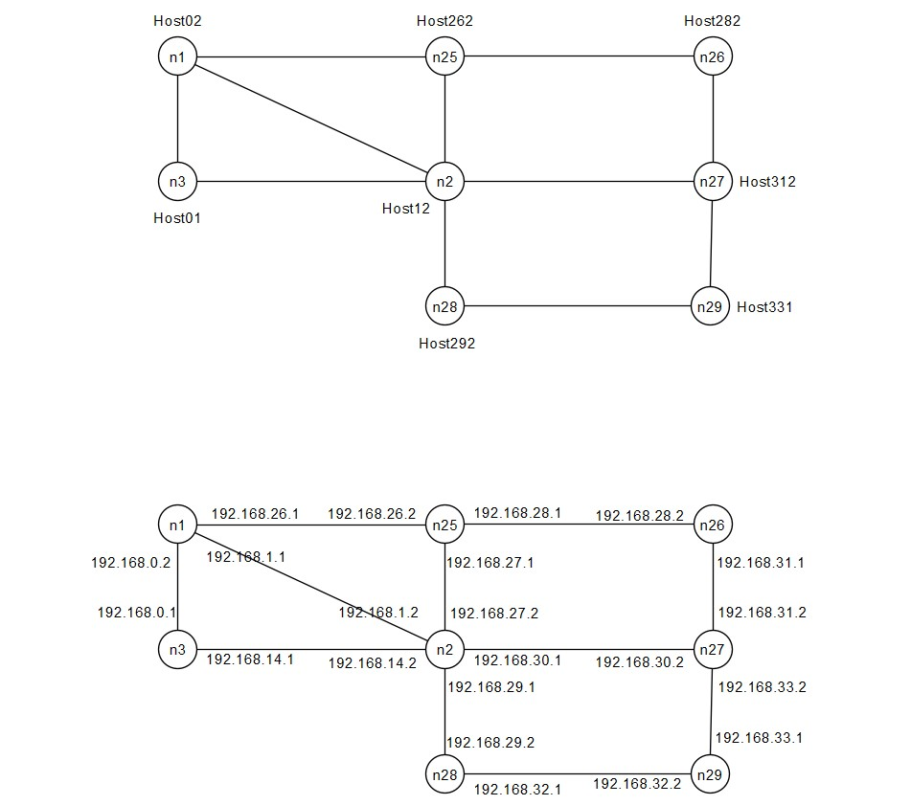
Cluster NFVO Topology

Slide 4
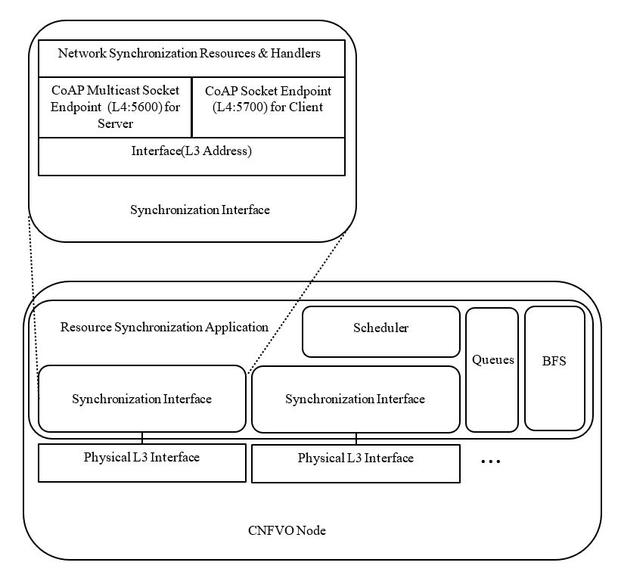
Solution Architecture

Slide 5
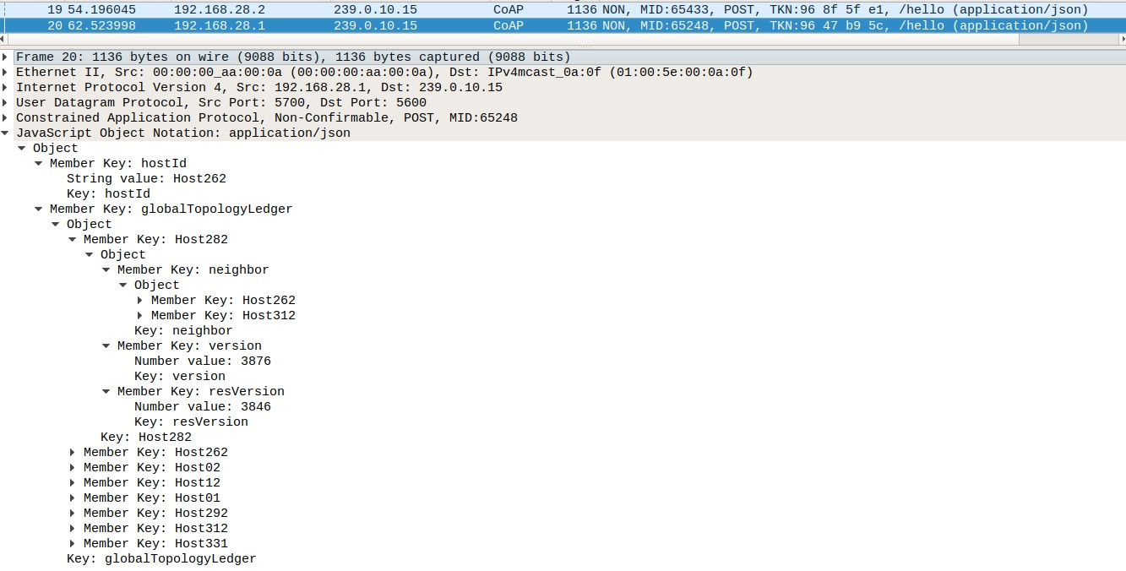
Messages & Transactions : NS-Hello

Slide 6
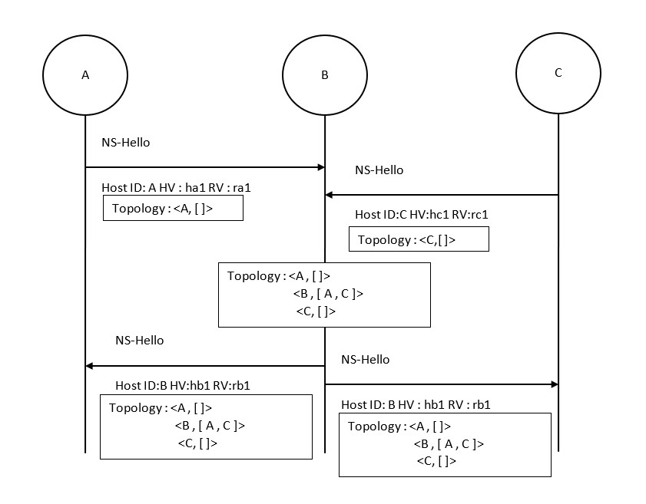
Messages & Transactions : NS-Hello
Notes:
When states of queues of adjacent nodes update/change: Transaction.
When states of queues of partition gets synchronized to same state : Session.

Slide 7
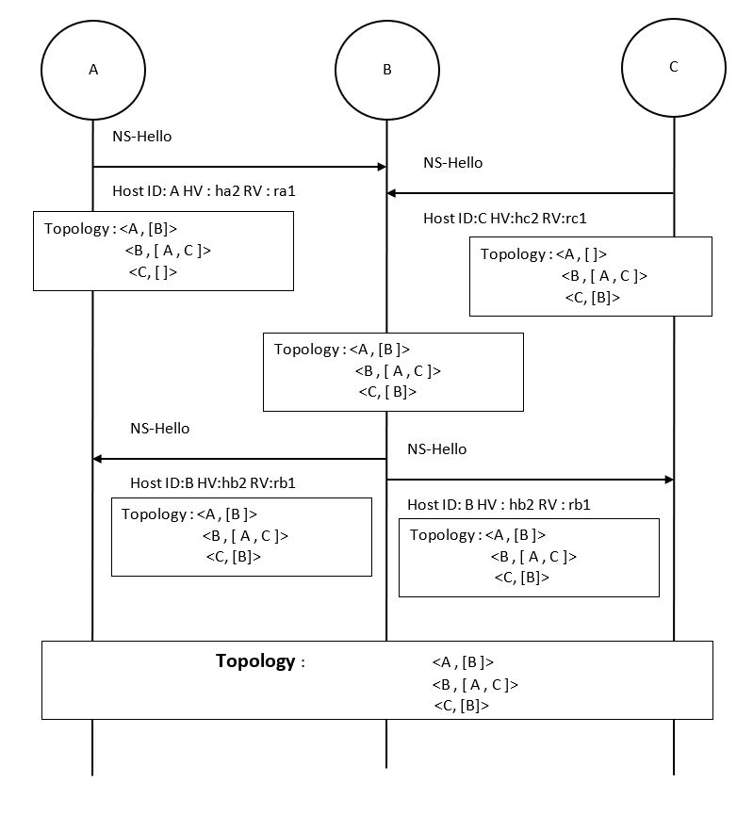
Messages & Transactions : NS-Hello

Slide 8
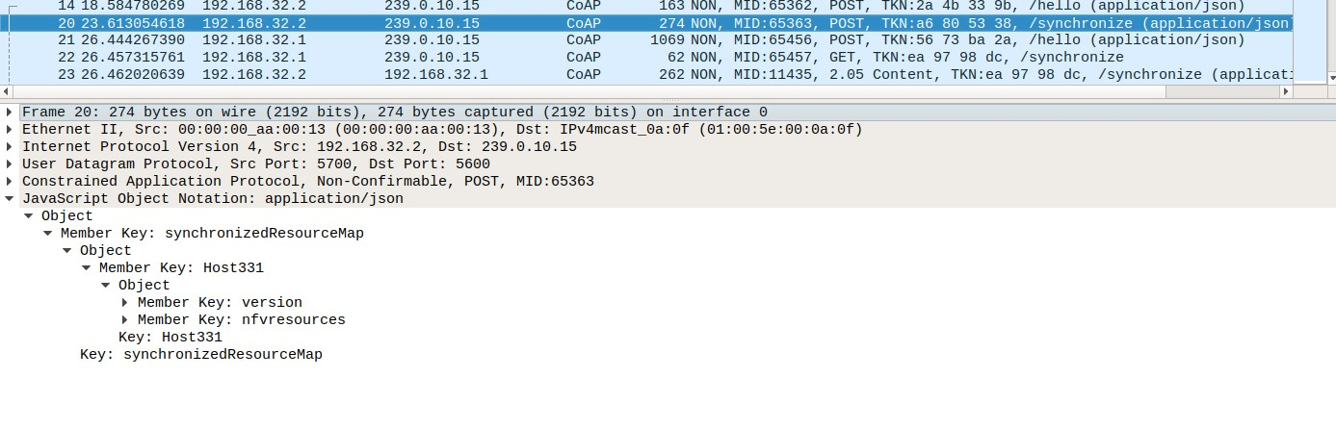
Messages & Transactions : NS-Synchronize

Slide 9
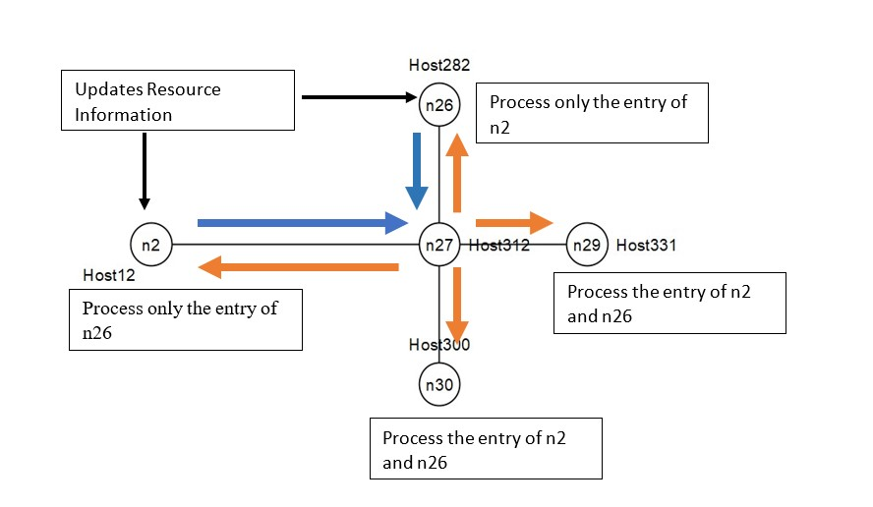
Messages & Transactions : NS-Synchronize

Slide 10
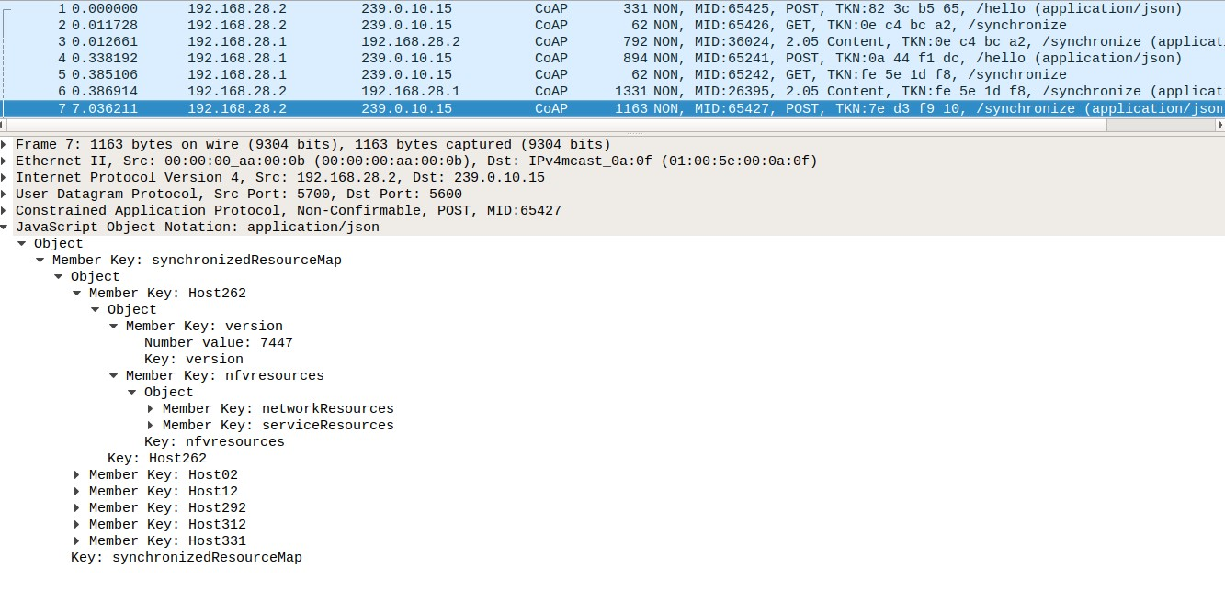
Messages & Transactions : NS-Synchronize

Slide 11
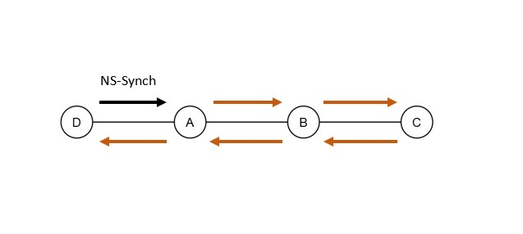
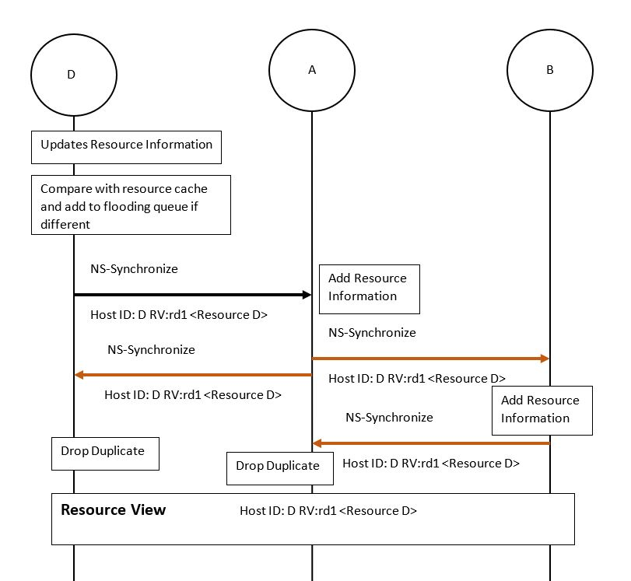
Messages & Transactions : NS-Synchronize

Slide 12
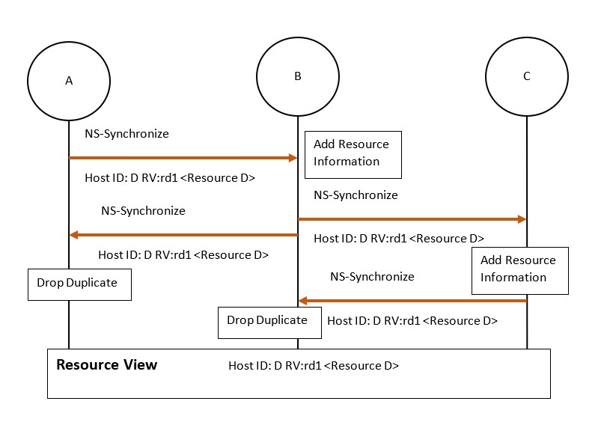
Messages & Transactions : NS-Synchronize

Slide 13
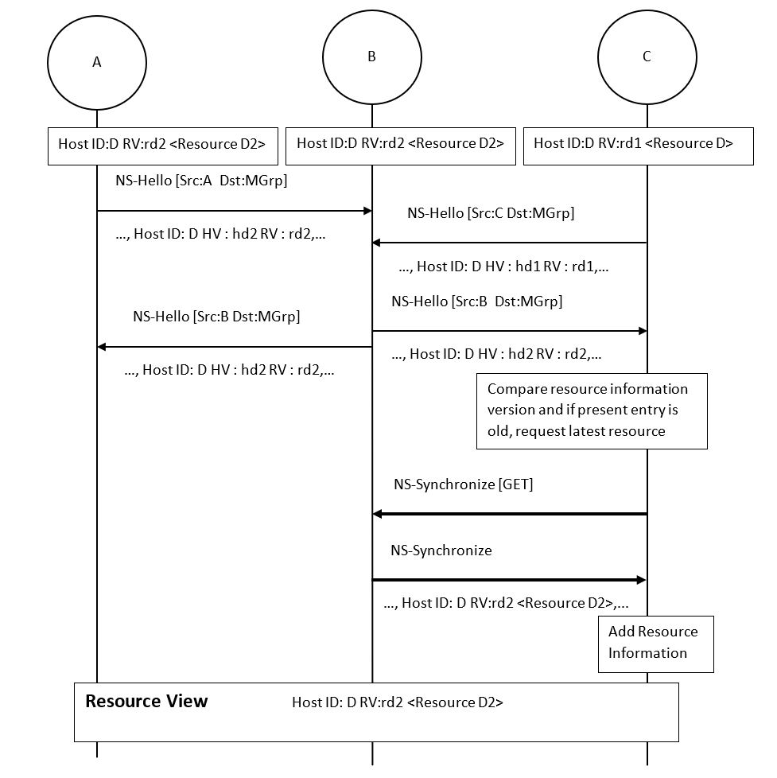
Messages & Transactions : NS-Synchronize

Slide 14
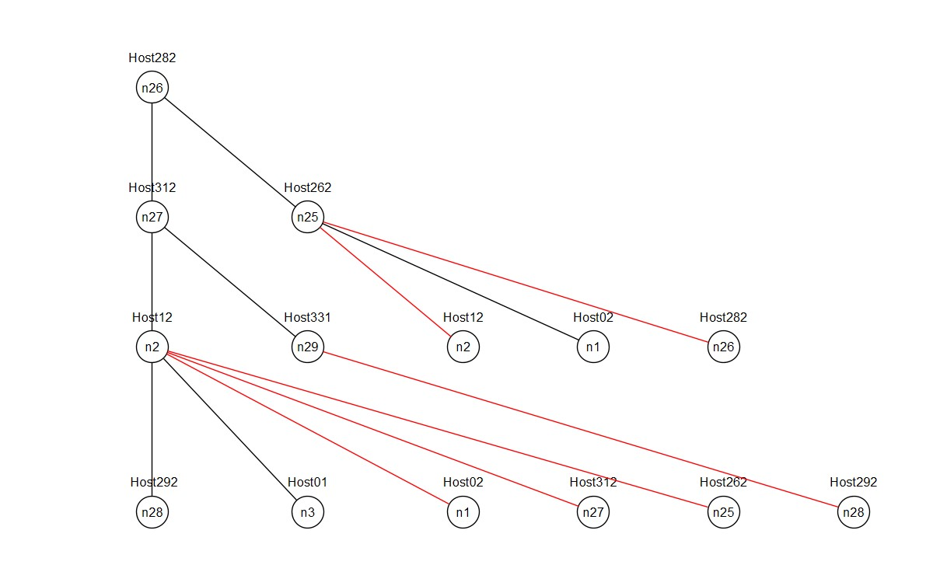
Graph Pruning – Breadth First Search Algorithm

Slide 15
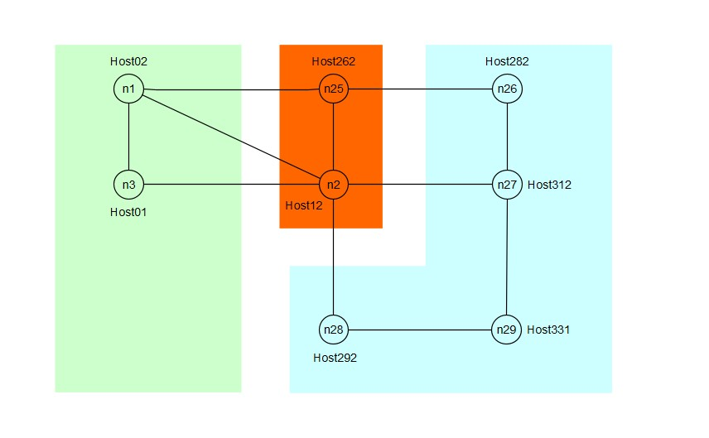
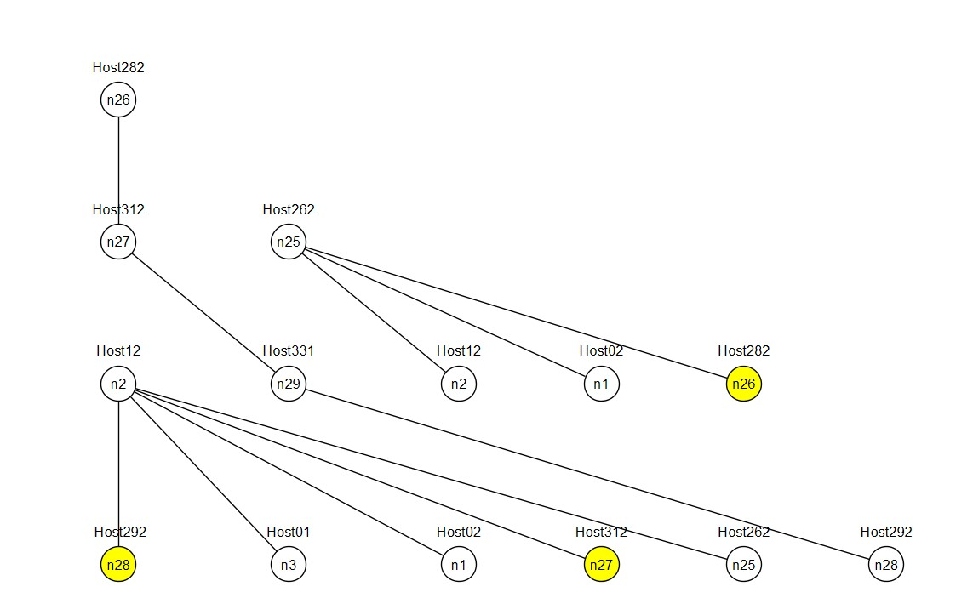
Analyzing a Use Case : Network Partition

Slide 16
References
[Frick] NFV Resource Advertisement and Discovery Protocol for a Distributed NFV Orchestration in a WMN-based Disaster Network.

