Slide 1

KALMAN AND BAYESIAN SIGNAL FILTERING ALGORITHMS

Slide 2
Getting the FUNDAMENTALS
SIGNAL FILTERING
Completely or partially, suppresses unwanted components or features from a signal in consideration.
BAYESIAN STATISTICS
An updating mechanism to repeatedly update the probability of an event when and where a new information is available for the event.
KALMAN FILTER
The Kalman filter keeps track of the estimated state of the system and the variance or uncertainty of the estimate. The estimate is updated using a state transition model and measurements.
MONTE CARLO SAMPLING
Using a finite number of randomly sampled points to compute a statistical result is called as the Monte Carlo Method.

Slide 3
Bayesian Monte Carlo technique
Kalman and Bayesian filters blend our noisy and limited knowledge of how a system behaves with the noisy and limited sensor readings to produce the best possible estimate of the state of the system.
The Bayesian Technique for Filtering depends on multiple iterations –
Prediction Step
Update Step
State Estimation of a Step
Particle Resampling

Slide 4
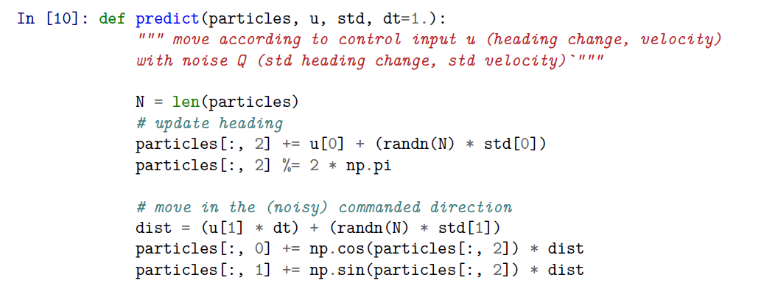
THE FILTERING ALGORITHM
Prediction Step
We have a set of samples which are believed to be the current position of the object to be tracked. We add a gaussian noise to it (as there would be some noise to the motion of object so we can have a fairly good chance for the samples to track the motion).

Slide 5
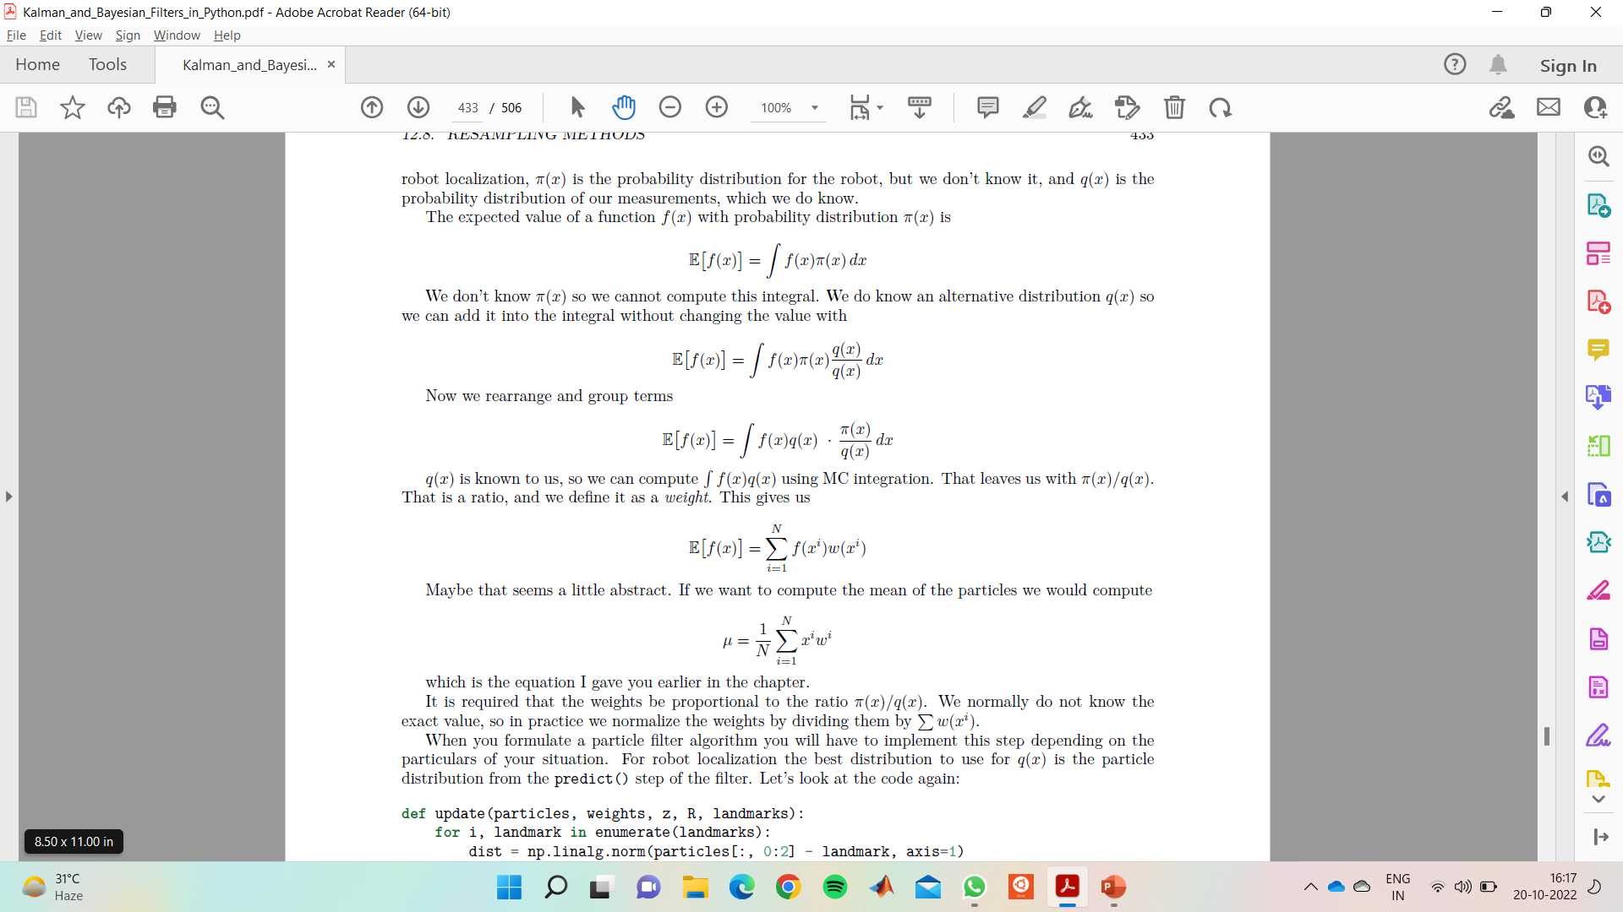
THE FILTERING ALGORITHM
Importance Sampling
Many times, the probability distribution to sample from is unknown and thus we cannot make a set of samples which qualitatively describes the particle of interest.
Importance Sampling gives us a way to draw samples from a different and known probability distribution and use those to compute the properties of the unknown one.
The idea is simple – We weight the samples drawn from a known probability distribution such that the statistical properties match with the unknown.

Slide 6
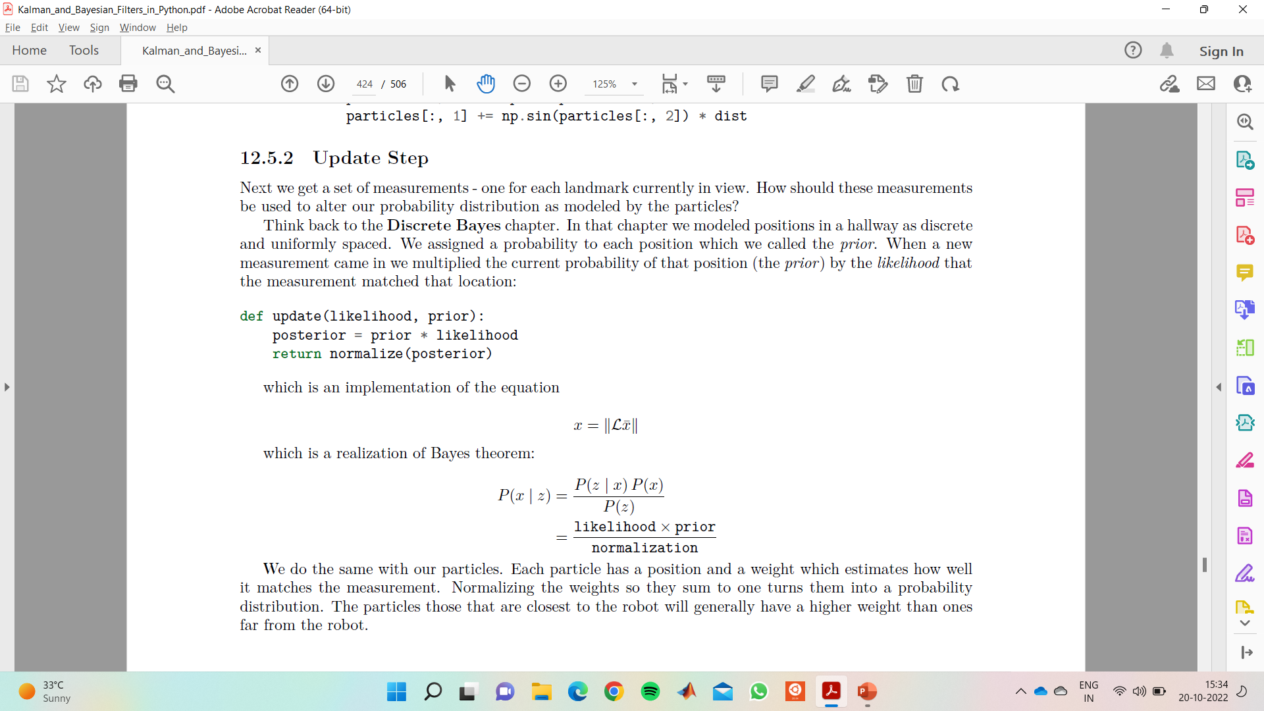
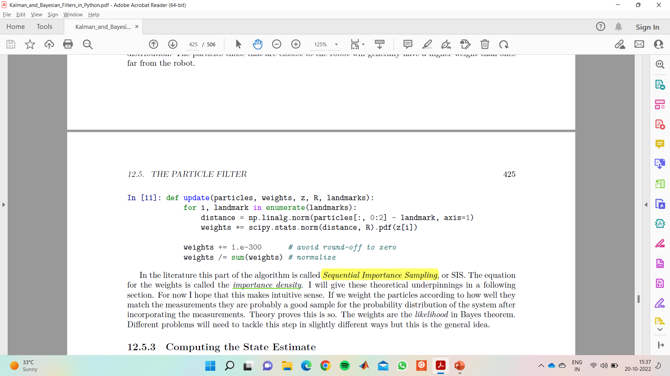
THE FILTERING ALGORITHM
Update Step
Updating the weights requires a realisation of the Bayes Theorem.
Weights are assigned to all the samples according to the amount by which they differ from the actual measurements and the weights are then normalized (this is to keep the equations consistent and maintain the efficiency of the algorithm).
Sequential Importance Sampling (SIS) Algorithm

Slide 7
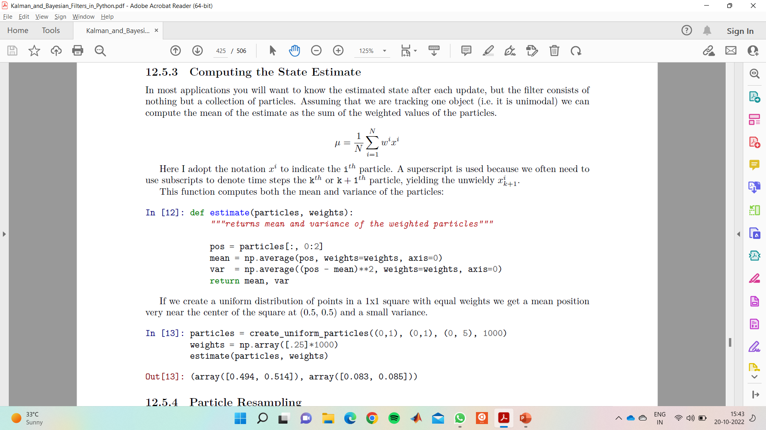
THE FILTERING ALGORITHM
State Estimation of Step
For any particular iteration of the
Algorithm we can check the progress by
Computing the mean position of the samples which are present
During the current iteration.
The mean and standard deviation are calculated simply and its distance from the actual measurements gives us an idea of the accuracy of the model.
After every iteration we try to ensure that the distance of the mean position of samples decreases as compared to the actual location.

Slide 8
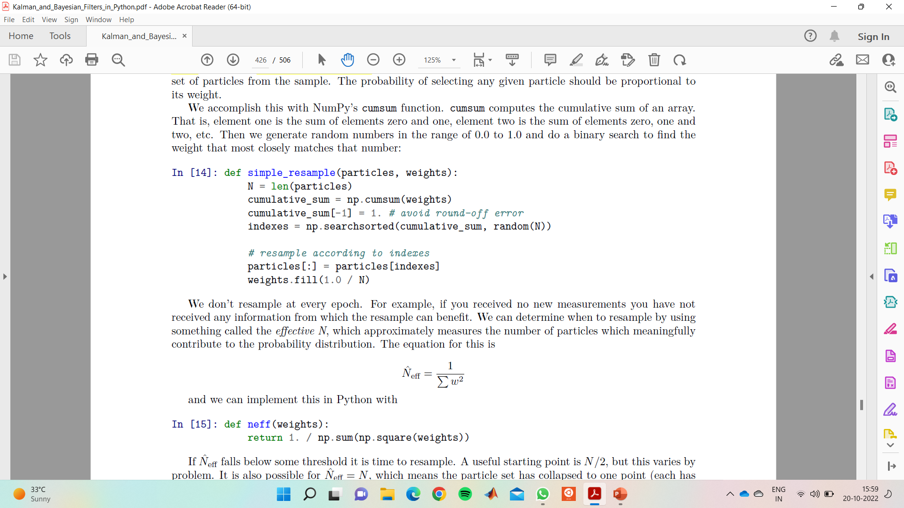
THE FILTERING ALGORITHM
Particle Resampling Methods
The SIS Algorithm has an inherent weakness of degeneracy problem. As the algorithm moves ahead it might happen that many samples provide no significant contribution to the overall prediction.
So, after each iteration we resample the predictions and remove all points with very low probability.
One of the most basic sampling algorithm is Simple Random Resampling or Multinomial Resampling Algorithm.
To decide the frequency of resampling put a
Minimum threshold limit on effective N (number of samples)

Slide 9
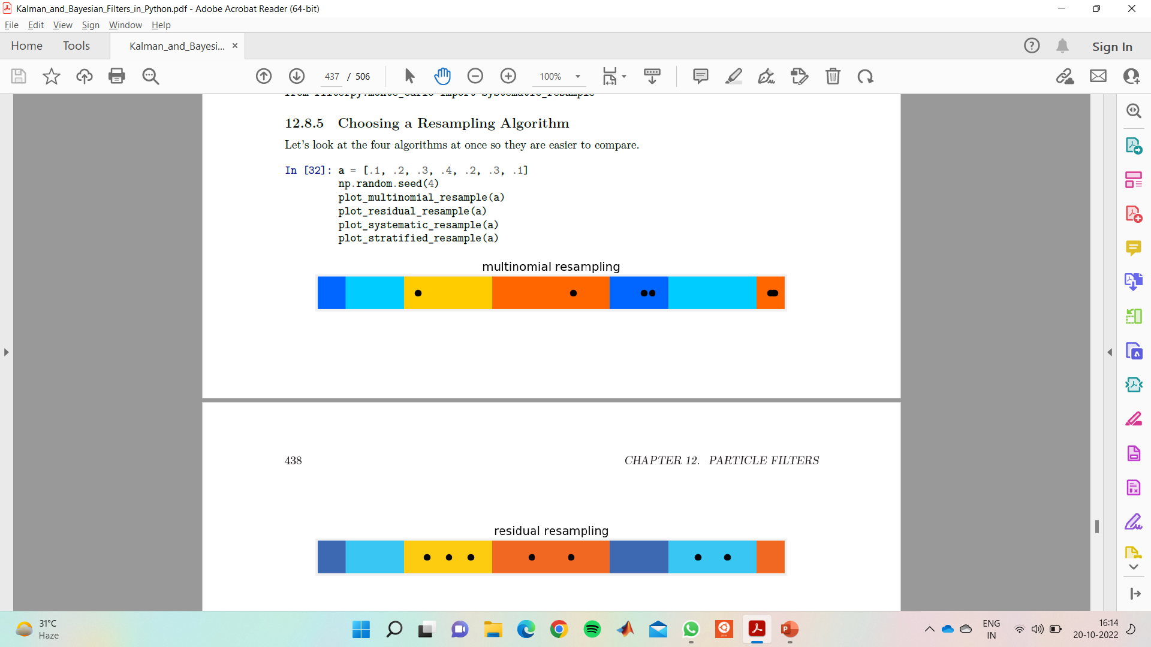
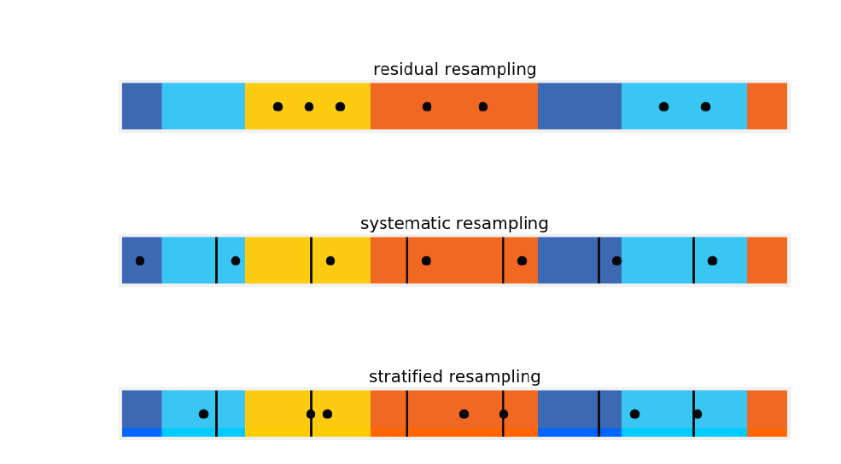
THE FILTERING ALGORITHM
Other Resampling Algorithms
Other algorithms for resampling consists of various theoretical formulations on a threshold on which the points which are not significant to the algorithm anymore are removed. Some of them are –
– Multinomial Resampling
- Residual Resampling
- Stratified Resampling
- Systematic Resampling

