Slide 1
Capstone Project 1 Mutual Fund Analytics
Bluestock Fintech Pvt. Ltd. | Industrial ETL, EDA & Performance Analytics
Prepared by: Devansh Mittal Project Manager: Yash Kale June 2026

Slide 2
Problem & Objective
Indian mutual fund industry manages Rs 81L+ Cr AUM with 26 Cr+ folios — data is fragmented across AMFI, AMCs, and RTAs.
Objective: Build an end-to-end analytics platform covering ETL, SQL warehousing, EDA, performance metrics, and dashboard-ready outputs.
Focus universe: Six large-cap equity direct plans (HDFC, SBI, ICICI, Nippon, Axis, Kotak).
Deliverables: Python pipeline, SQLite DB, 15+ charts, fund scorecard, VaR report, PDF report, and presentation.

Slide 3
Data Sources
10 AMFI-style CSV datasets: fund master, NAV history, AUM, SIP inflows, category flows, folios, performance, transactions, holdings, benchmarks.
Live NAV API: mfapi.in — daily refresh for 6 anchor schemes (AMFI codes 125497, 119551, 120503, 118632, 119092, 120841).
32,000+ synthetic investor transactions with demographics (state, age, gender, city tier, KYC).
Educational use only — not investment advice.

Slide 4
Architecture & ETL Pipeline
Medallion pattern: data/raw/ -> data/processed/ -> SQLite (bluestock_mf.db).
Scripts: live_nav_fetch.py, data_ingestion.py, etl_pipeline.py, compute_metrics.py, export_eda_charts.py, advanced_analytics.py.
Star schema: dim_fund, dim_date, fact_nav, fact_transactions, fact_performance, fact_aum, fact_sip_industry.
One-command execution: python run_pipeline.py

Slide 5
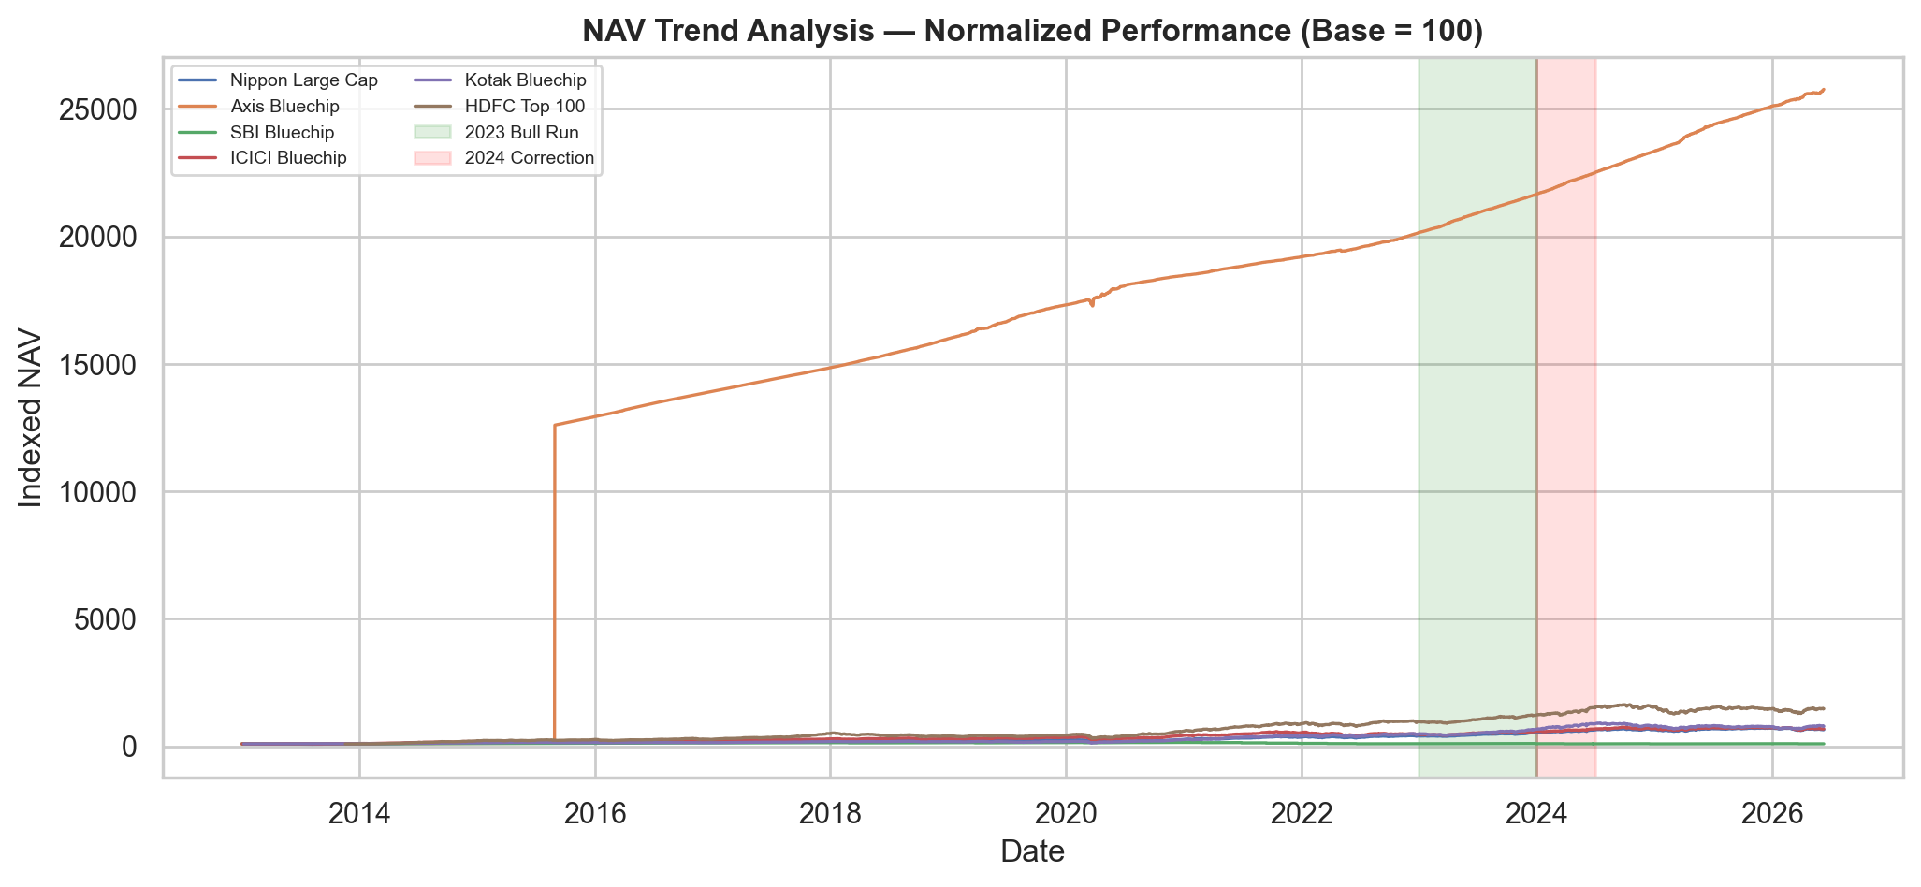
EDA: NAV Trends & Market Cycles
2023 bull run and 2024 correction visible across all six large-cap funds.

Slide 6
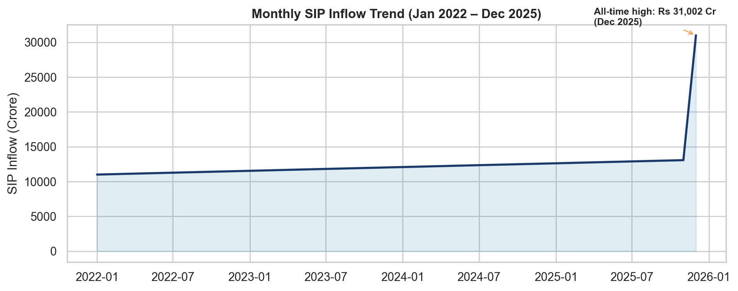
EDA: SIP Inflows & Industry Growth
Monthly SIP inflows peaked at Rs 31,002 Cr in December 2025.

Slide 7
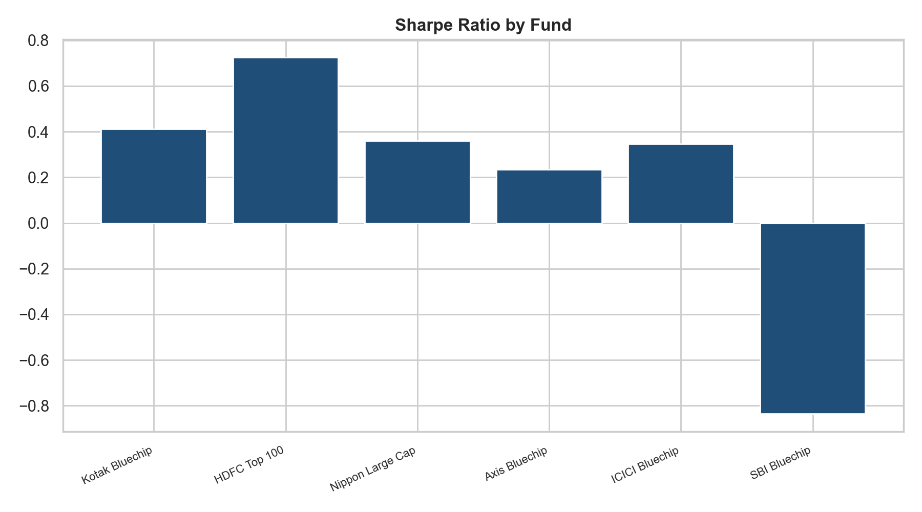
Performance Metrics
CAGR (1Y/3Y/5Y), Sharpe, Sortino, Alpha, Beta, Max Drawdown, Tracking Error.
Risk-free rate: 6.5% (RBI repo proxy). Benchmark: Nifty 100 via peer regression.
Top composite score: Kotak Bluechip (Score 81.2/100).
Fund scorecard weights: 30% 3Y return + 25% Sharpe + 20% Alpha + 15% expense + 10% drawdown.

Slide 8
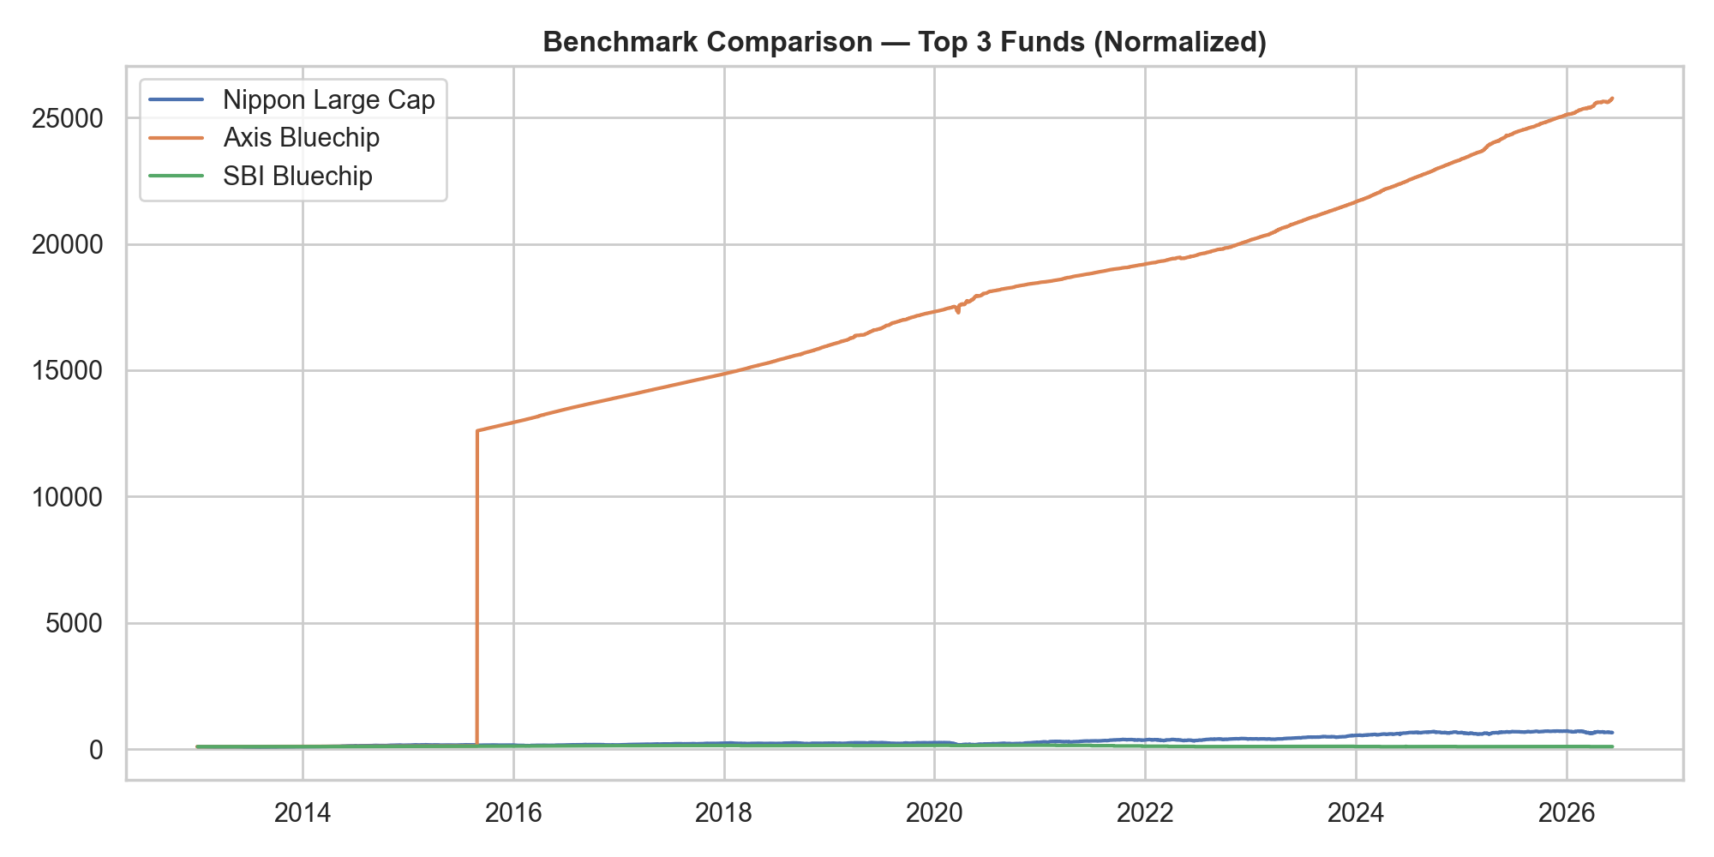
Benchmark Comparison — Top Funds
Normalized NAV vs benchmark over observation period.

Slide 9
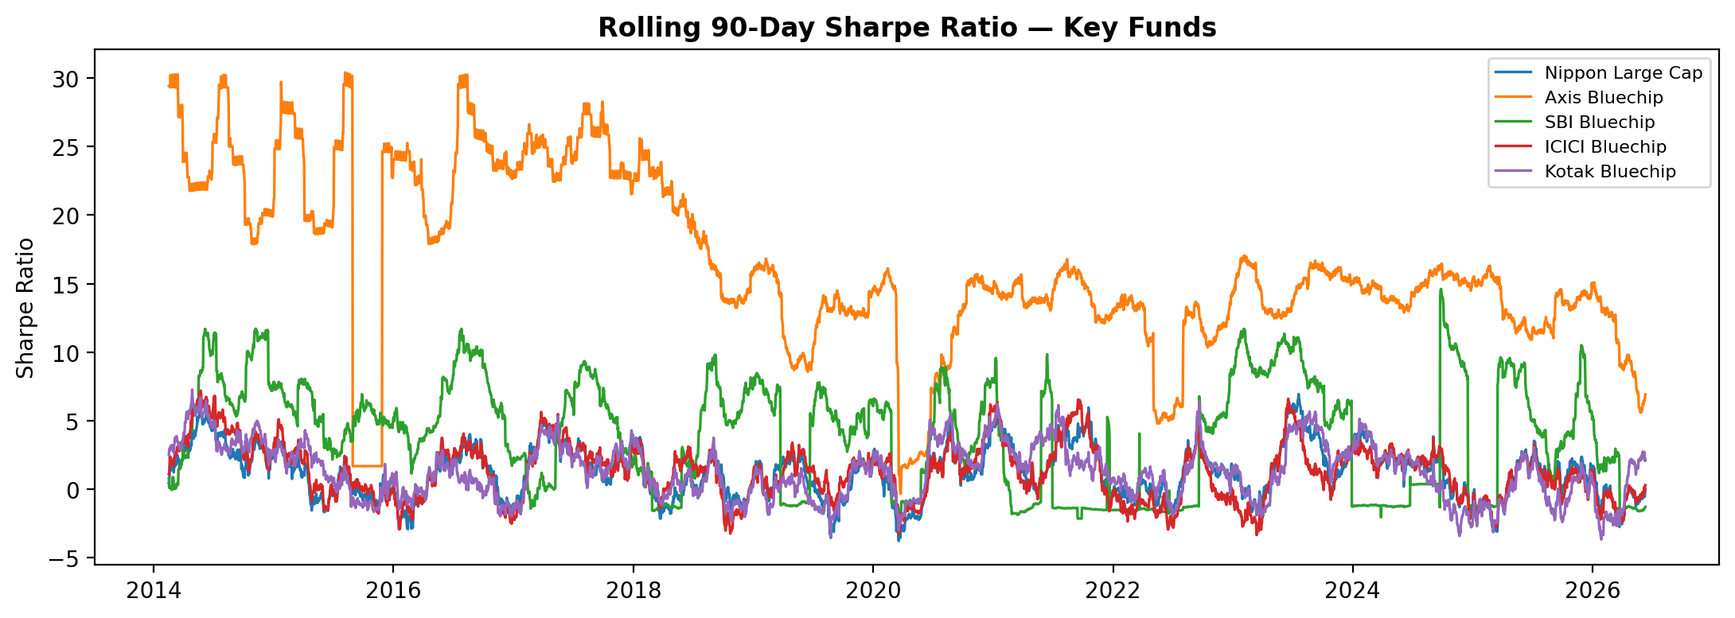
Advanced Risk: Rolling 90-Day Sharpe
VaR (95%), CVaR, SIP continuity, cohort analysis, and sector HHI in advanced_analytics.py.

Slide 10
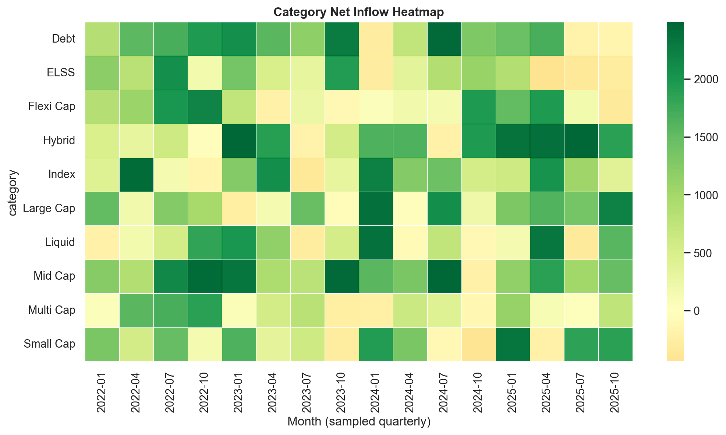
Dashboard (Power BI Ready)
Page 1 — Industry Overview: AUM KPIs, SIP inflows, folio count, AMC bar chart.
Page 2 — Fund Performance: Return vs risk scatter, scorecard table, NAV vs benchmark.
Page 3 — Investor Analytics: State-wise SIP, age/gender demographics, transaction mix.
Page 4 — SIP & Market Trends: Dual-axis SIP + Nifty, category heatmap.
Connect via SQLite (bluestock_mf.db) or processed CSVs in data/processed/.

Slide 11
Key Findings
SIP dominates investor behaviour — systematic investing is the primary retail channel.
Large-cap funds show high pairwise correlation (>0.85) due to shared benchmark exposure.
SBI Mutual Fund leads industry AUM at Rs 12.5L Cr (2025), reflecting AMC scale advantage.
Rolling Sharpe and VaR identify regime shifts during 2020 COVID and 2022 rate-hike cycles.
Fund recommender maps risk appetite to Sharpe-ranked schemes within matching risk grade.

Slide 12
Thank You
Devansh Mittal | Project Manager: Yash Kale Bluestock Fintech — Capstone Project 1

