Slide 1
COVID VACCINE REGISTRATION
BY:
20BCE055 – DEVANSH SHAH
20BCE061 – DHRUV PRAJAPATI
20BCE080 – KARAN GONDALIYA

Slide 2
Concepts used
Class
Constructors
Methods
Strings
Random Number Generation
Local Date & Time Display
Method Overloading
Inheritance
Thread
Exception handling (Try-Catch)
File handling

Slide 3
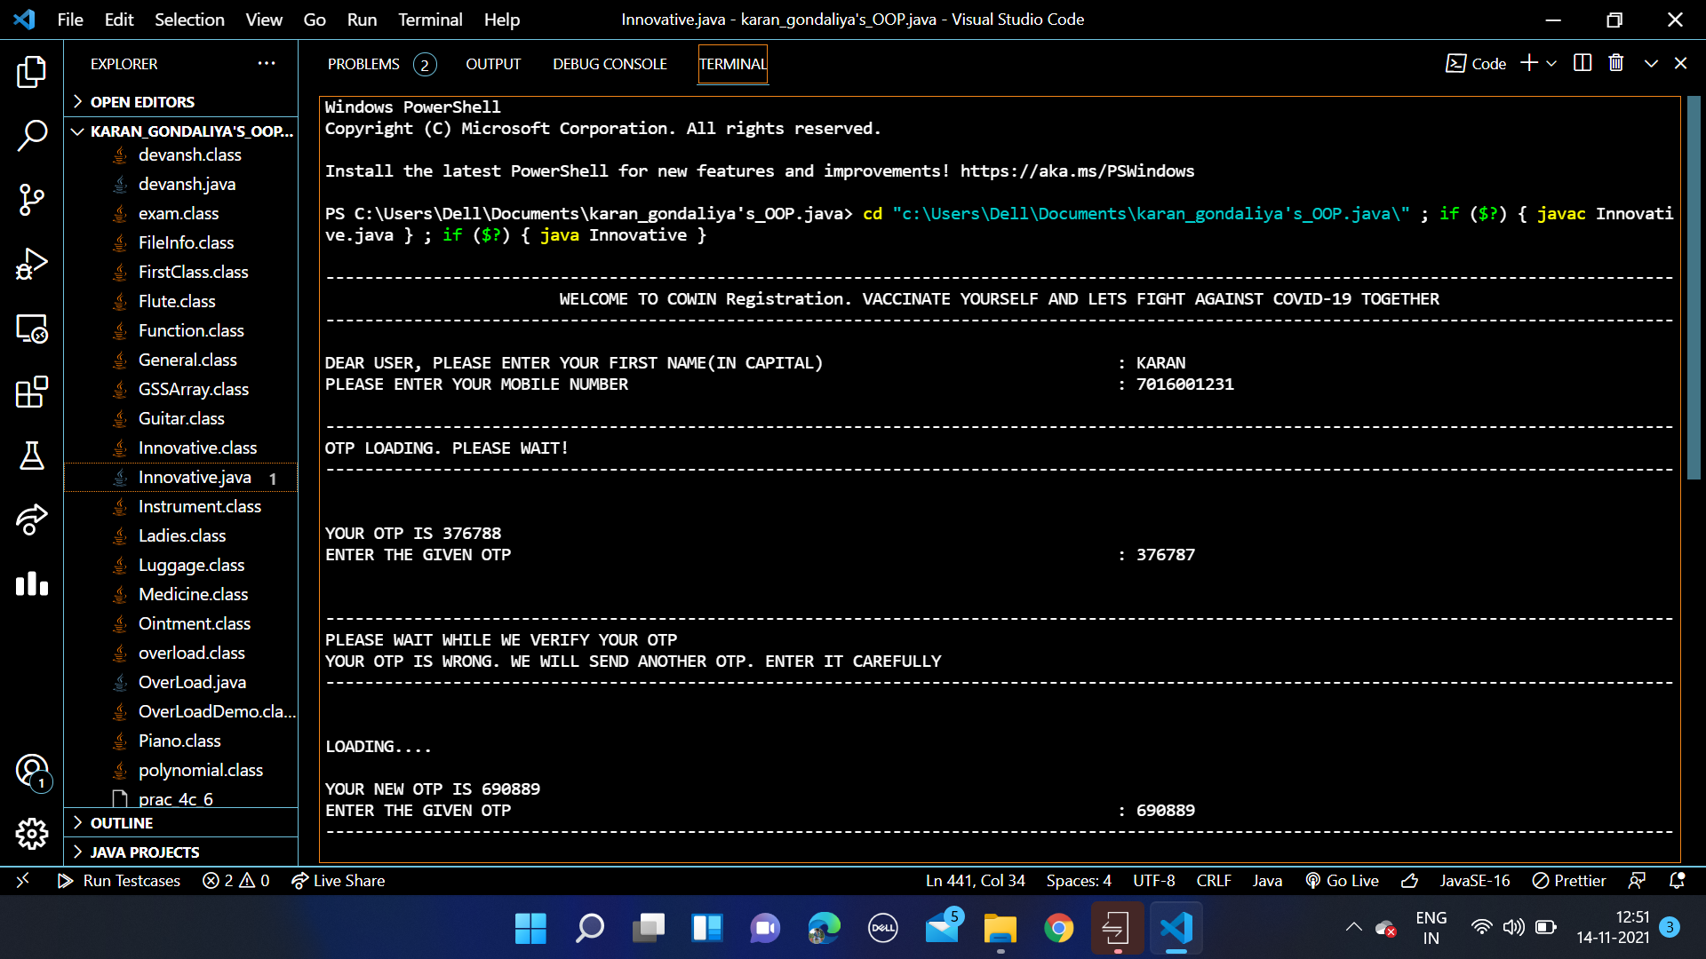
We start running the program – 1st, we call the Registration class where within the method : void Details() – we take input of Name and Mobile Number. There are 2 other methods in class Registration – namely void OTPGeneration() & void OTPVerification().
Using Random Number Generation concept – an OTP is generated. Before the OTP is displayed, we have used Thread.sleep wherein we give a delay of 5 seconds. Once you enter the OTP, void OTPVerification() method verifies if it is correct or not. We give 1 more try to the user if it is incorrectly entered. If correctly entered, we proceed further ahead.

Slide 4
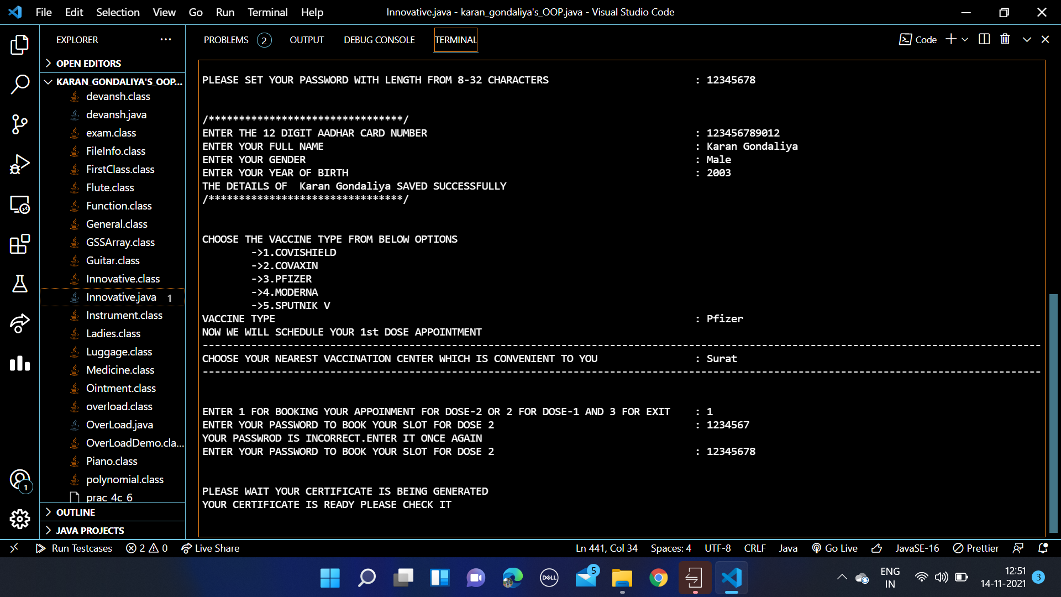
Next, in the class SlotBooking() which inherits class Registration– in the method void PasswordSet() - The user is asked to set the password between 8-32 characters. We have validated it, i.e if <8 or >32 characters – user has to enter it again – total 3 tries are given. Only if valid syntax of password, we proceed to void Booking() where other important details like Aadhar Card Number, Gender, Birth year are stored. The user is asked for his choice of vaccine in the void Slot() method and place of vaccination in void Appointment() – in the same method – using random numbers – date and time of appointment is also fixed. Now using void DisplayOtherDetails() – wherein we have used file handling, the certificate is printed in a text file which is shown on the next page – user is given a choice whether to schedule 1st dose for a family member or 2nd dose for himself.
Here, we see that user has clicked on scheduling dose 2 – he is asked for password through method- void Dose2() – if he enters correct password, automatically his 2nd dose is scheduled approximately 3 months from the 2nd dose and again using file handling, we print the final vaccination certificate

Slide 5
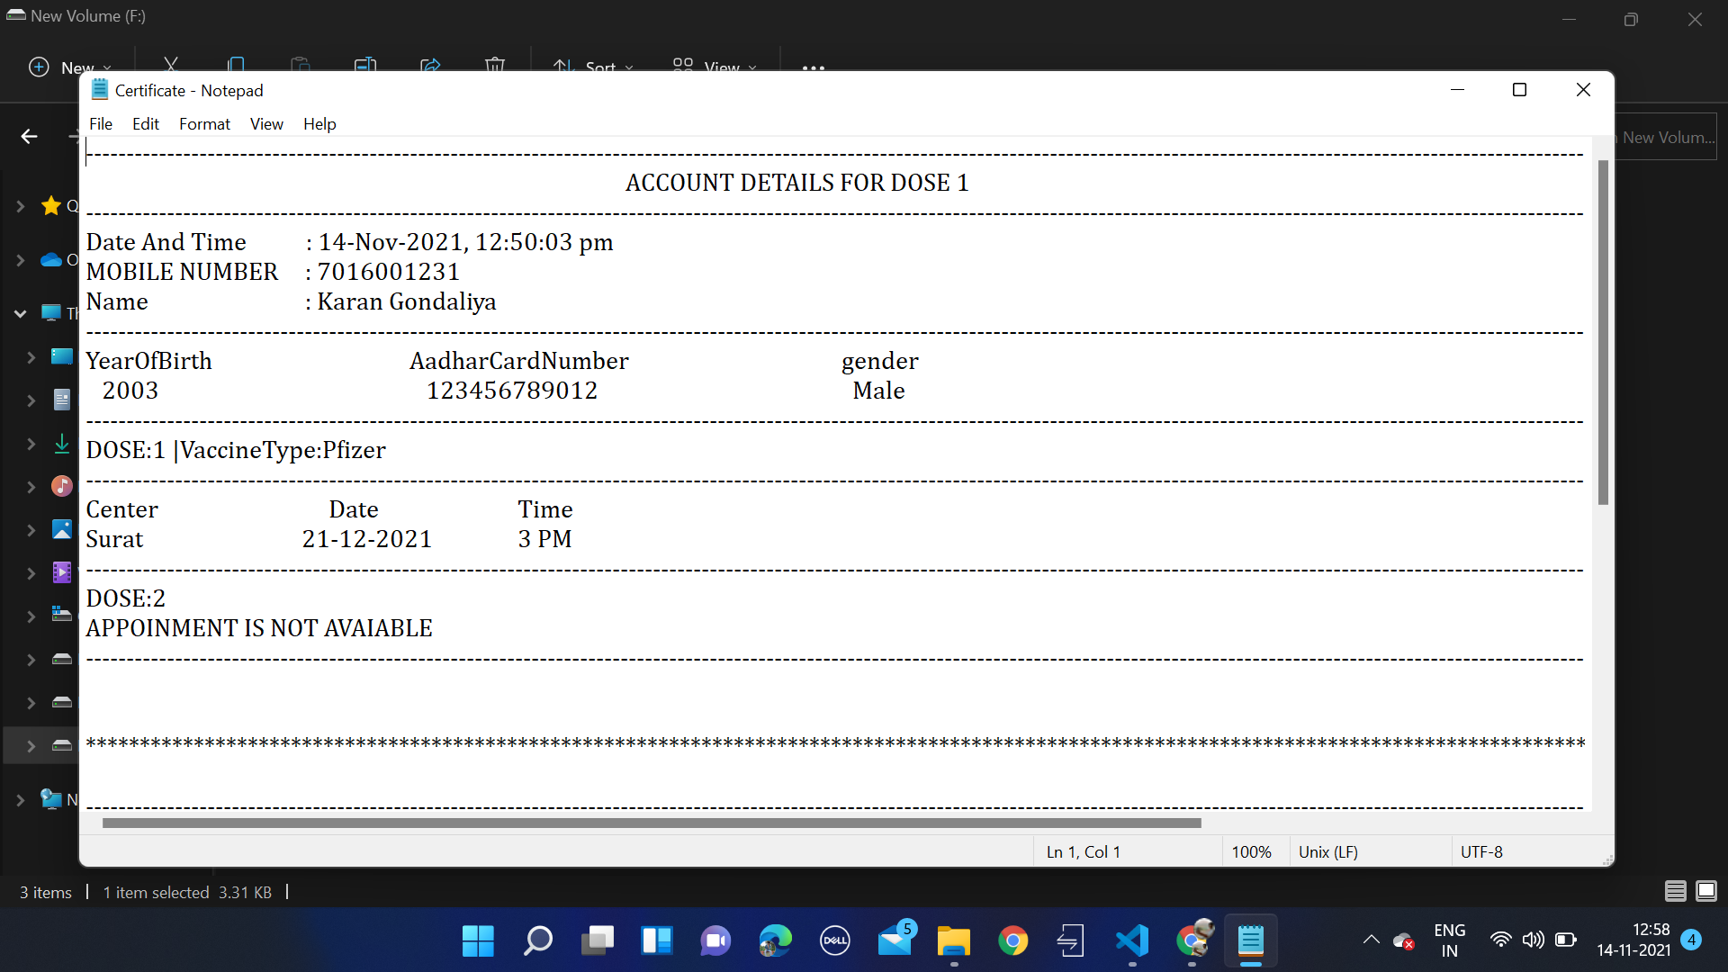
Now using void DisplayOtherDetails() – wherein we have used file handling, the certificate is printed in a text file.

Slide 6
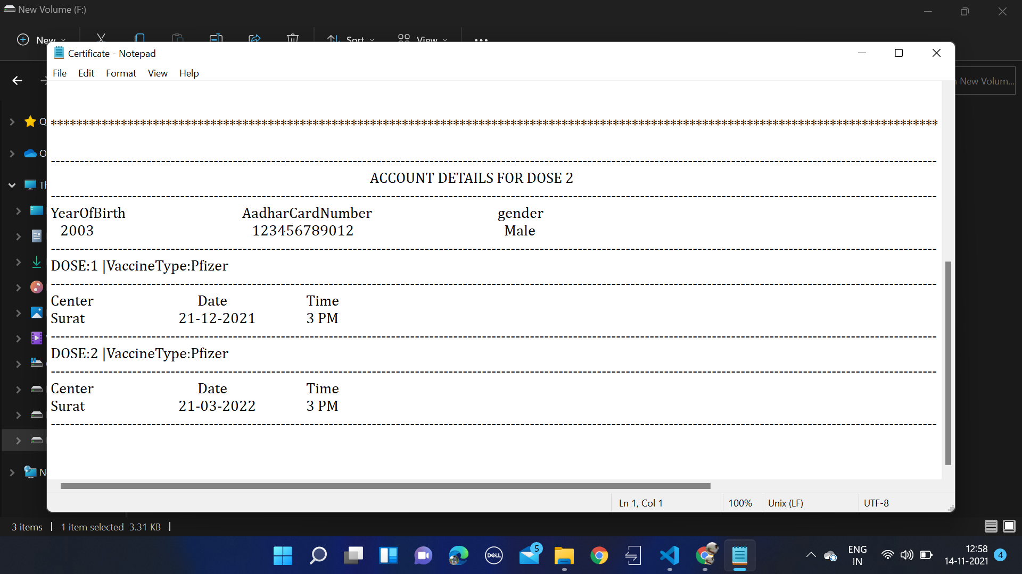

Slide 7
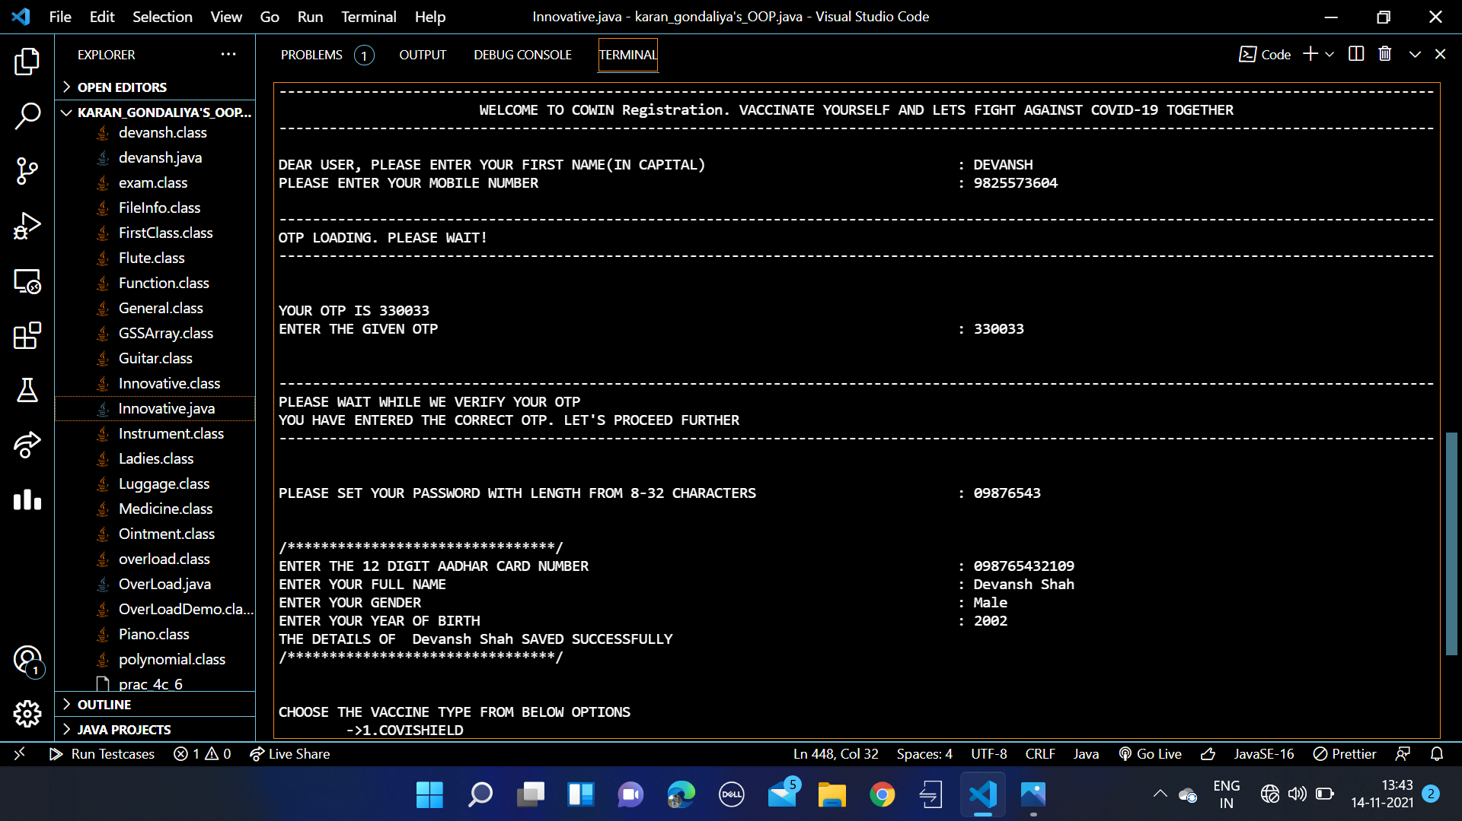

Slide 8
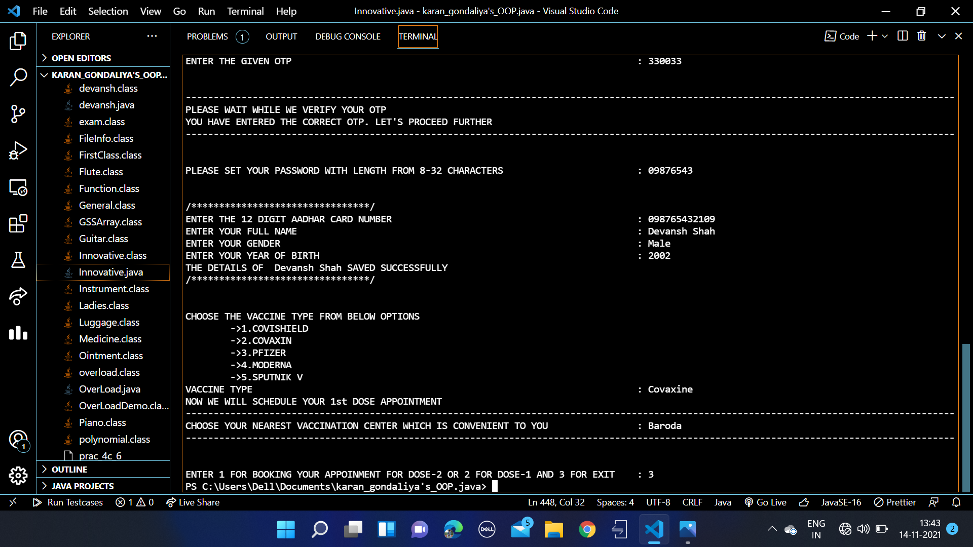

Slide 9
