Slide 1
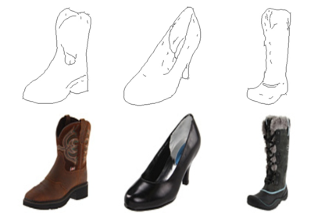
Sketch-to-Image Generator
A Pix2Pix conditional GAN that turns line sketches into realistic images, served through a drawing web app
Input sketches (top) and the photos they correspond to (bottom)
Track A · Generative Adversarial Networks (Unit 3) | PyTorch · FastAPI · RTX 3050
Notes:
Project: a sketch-to-image generator built on Pix2Pix. A user draws an outline; a conditional GAN fills in colour, shading and texture. The deck covers the method, training, results and the web app.

Slide 2
The project at a glance
Goal: learn a mapping G: sketch → photo from paired examples, so that any new outline drawn by a user becomes a plausible, coloured image.
3,000
41.8 M
~12 min
0.695
paired training images
(edges2shoes subset, 200 for validation)
generator parameters
(U‑Net, 128 × 128 px)
to train 20 epochs
on an RTX 3050 6 GB laptop GPU
validation SSIM
(PSNR 16.5 dB, FID 184)
Delivered: model code, training and evaluation pipeline, ablation baseline, web app, concepts PDF and this summary.
Repository: github.com/devansh-vashisth/sketch-to-image-generator
Notes:
Four headline numbers. The model was trained on a reduced budget (3k images, 128 px) so it fits a laptop GPU in about 12 minutes.

Slide 3
Architecture: a generator and a judge
Sketch x
1 × 128 × 128
line drawing
U‑Net generator G
7 down / 7 up blocks, skip links,
dropout · 41.8 M params
Generated G(x)
3 × 128 × 128
RGB image
Each step
1 update of D, then 1 update of G
Real photo y
ground truth
from dataset
Concatenate
sketch + (fake or real)
4 channels
PatchGAN D
70 × 70 receptive field
2.8 M params
14 × 14 map
real / fake score
per image patch
Generator: an encoder compresses the sketch, a decoder rebuilds an image; skip connections carry edge positions straight across.
Discriminator: sees the sketch together with an image and judges every 70 × 70 patch, which pushes G towards locally sharp, realistic texture.
Notes:
G is a U‑Net. D is a PatchGAN conditioned on the sketch: it receives sketch plus image as 4 channels and outputs a grid of real/fake logits, one per overlapping patch.

Slide 4
Training objective and setup
Generator loss
L_G = BCE(D(x, G(x)), 1) + 100 · ‖y − G(x)‖₁
Fool the discriminator, while staying close to the real photo pixel by pixel. The L1 term fixes shape and colour; the adversarial term adds sharpness.
Setting | Value used
Image size | 128 × 128 px, scaled to [−1, 1]
Data | 3,000 train / 200 val pairs
Batch size | 8
Schedule | 12 epochs constant + 8 linear decay
Optimiser | Adam, lr 2e-4, β = (0.5, 0.999)
Weights | λ_L1 = 100, λ_GAN = 1
Normalisation | BatchNorm, N(0, 0.02) init
Precision | Mixed fp16 (AMP)
Hardware | RTX 3050 6 GB · ~35 s / epoch
Discriminator loss
L_D = ½ [BCE(D(x, y), 1) + BCE(D(x, G(x)), 0)]
Score real pairs as real and generated pairs as fake. Halving the loss slows D relative to G, as in the original Pix2Pix.
Notes:
Loss functions on the left, exact hyper-parameters of the training run on the right. λ_L1 = 100 is the Pix2Pix default.

Slide 5
Data: paired sketches and photos
1
Dataset
edges2shoes: 50,025 UT-Zappos50K shoe photos with HED edge maps. Each file is 512 × 256 (sketch left, photo right). A 3,000-image subset was used.
2
Augmentation
Resize, random crop and horizontal flip, applied identically to the sketch and its photo so they stay aligned.
3
Your own domain
prepare_dataset.py turns any photo folder into pairs using XDoG or Canny edge extraction.
edges2shoes validation pairs: sketch (top), photo (bottom)
4
User sketches
Before inference, drawings are cropped, centred and binarised to look like the training sketches.
Notes:
Paired data is required by Pix2Pix. The same random crop and flip go to both halves of a pair.

Slide 6
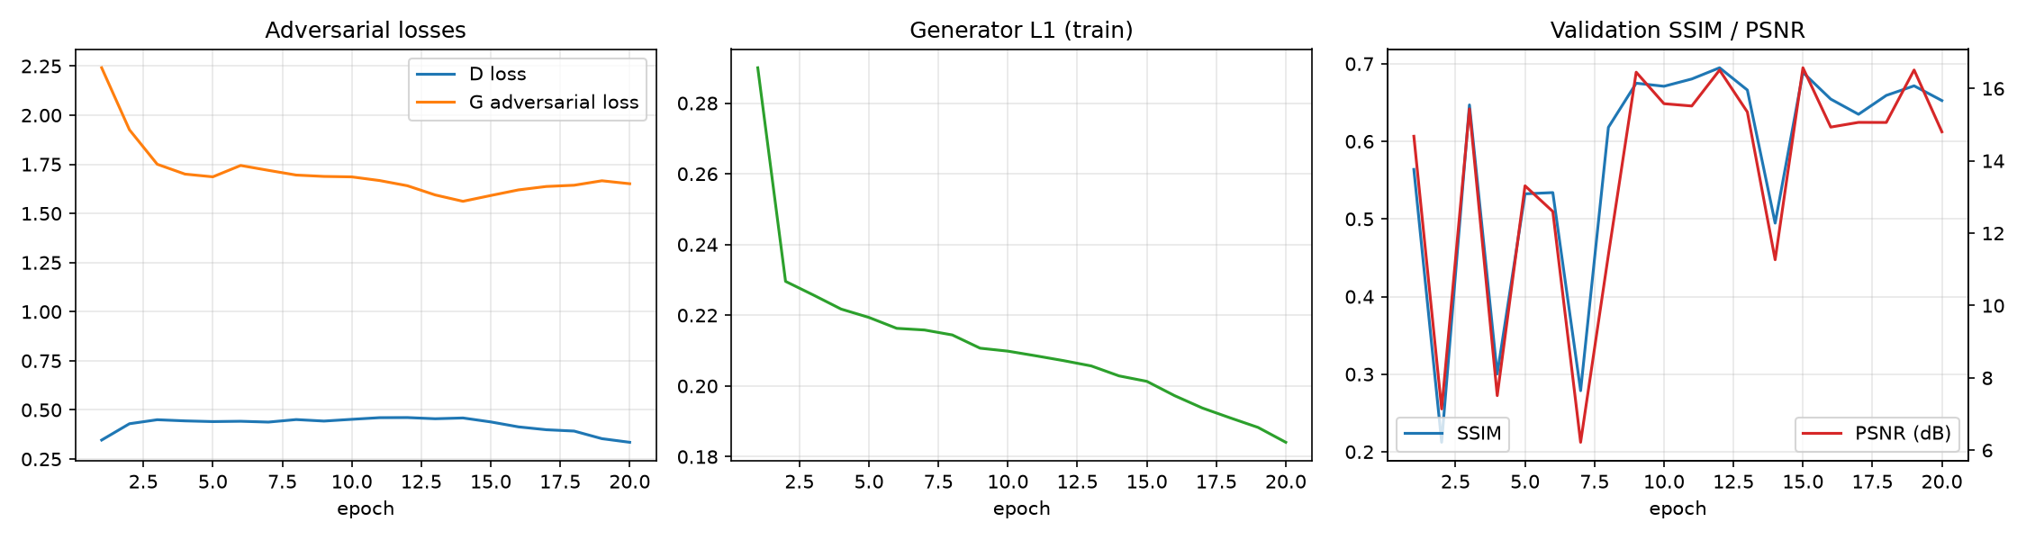
Training dynamics
Stable adversarial game
D loss stays near 0.4–0.45 and never collapses to 0, so G keeps receiving useful gradients.
Steady reconstruction
Train L1 falls from 0.29 to 0.18, fastest once the learning rate starts decaying at epoch 13.
Noisy validation
Val SSIM swings between epochs: BatchNorm running statistics with batch 8 are unstable in eval mode.
Notes:
Curves from runs/pix2pix/log.csv. The discriminator never wins outright, which is the healthy regime for a GAN.

Slide 7
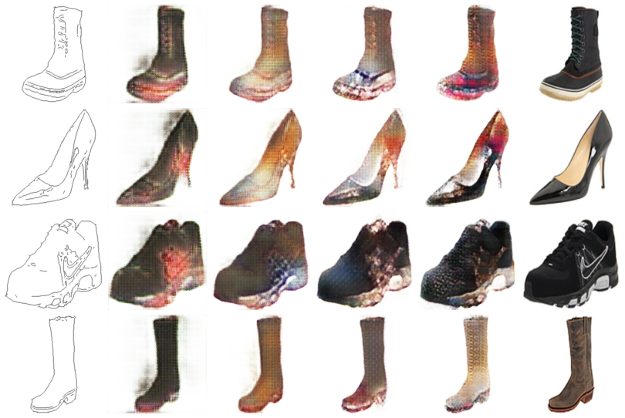
What the generator learns over time
Sketch
Epoch 1
Epoch 3
Epoch 9
Epoch 20
Real
Epoch 1: the silhouette is already filled in. The L1 term learns shape first.
Epochs 3–9: shading appears and the soles and uppers get different tones.
Epoch 20: texture, highlights and colour variation. The GAN term adds detail, with some checkerboard noise.
Colour is a guess: a sketch does not fix the colour, so the model picks a plausible one.
Notes:
Same four validation sketches, generated at epochs 1, 3, 9 and 20.

Slide 8
Quantitative results: Pix2Pix vs L1-only baseline
Model | L1 ↓ | PSNR ↑ | SSIM ↑ | FID ↓
L1 only (λ_GAN = 0) | 0.0745 | 18.17 dB | 0.733 | 176.2
Pix2Pix (cGAN + L1) | 0.0862 | 16.51 dB | 0.695 | 184.0
All 200 edges2shoes validation images · best-SSIM checkpoint of each model (epoch 12)
1
Pixel metrics prefer blur
2
Pix2Pix trades pixels for realism
3
FID is inconclusive at n = 200
L1, PSNR and SSIM are highest when you predict the average of all plausible images. That average is a smooth, uniform shoe, so the L1-only model wins on these numbers.
The adversarial loss rewards sharp, varied texture. Texture that is plausible but not pixel-identical to the photo is penalised by L1, PSNR and SSIM.
FID needs thousands of samples. With 200 images it is high-variance and biased upwards, so an 8-point gap is within noise.
Notes:
This is the classic Pix2Pix finding: the L1-only ablation wins pixel metrics but looks worse. See the next slide.

Slide 9
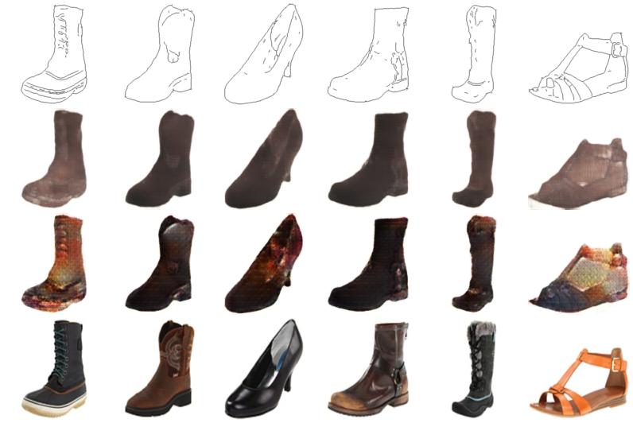
Qualitative comparison
Input sketch
L1 only: correct shape but flat, muddy brown, no texture.
Pix2Pix: laces, highlights and material texture. Still noisy after this short run.
Both keep the outline exactly, thanks to the U‑Net skip connections.
L1 only
Pix2Pix
Ground truth
Notes:
Six validation sketches. The cGAN output is what the metrics miss: it looks like a photo, not a blur.

Slide 10
The web app: draw, generate, download
1
Draw
2
Clean and infer
3
View and save
HTML canvas in the browser
FastAPI backend · POST /api/generate
Result panel
Pen and eraser, brush size
Undo and clear
Upload an existing sketch
Optional live mode: generate after each stroke
Crop, centre and binarise the sketch
Resize to the training resolution
Run the U‑Net generator on CUDA
GET /api/health reports model status
Generated image shown next to the canvas
One-click PNG download
CLI alternative: infer.py on a file or folder
$env:S2I_CHECKPOINT="runs/pix2pix/checkpoints/best.pt"; uvicorn app.server:app --port 8000
then open http://localhost:8000
Notes:
Tested end to end: the health endpoint reports the model loaded on CUDA, and /api/generate returns a PNG for a validation sketch.

Slide 11
Code structure and workflow
Module | Responsibility
s2i/models.py | U‑Net generator, PatchGAN discriminator
s2i/losses.py | BCE / LSGAN adversarial loss, VGG perceptual loss
s2i/dataset.py | Paired dataset, joint augmentation
s2i/sketch.py | XDoG / Canny extraction, sketch cleaning
s2i/metrics.py | L1, PSNR, SSIM, FID
train.py | Training loop, AMP, LR decay, checkpoints
evaluate.py | Test metrics and qualitative grids
app/ | FastAPI server and drawing canvas
1
Get data
python scripts/download_data.py edges2shoes
2
Train
python train.py --train-dir … --out runs/pix2pix
3
Evaluate
python evaluate.py --checkpoint … --fid
4
Plot and compare
scripts/plot_curves.py · scripts/make_comparison.py
5
Serve
uvicorn app.server:app --port 8000
Notes:
Library code lives in the s2i package; the top-level scripts are thin command-line wrappers.

Slide 12
Conclusion and next steps
Achieved
Limitations
Next steps
Complete Pix2Pix pipeline, from data to web app
Trained in ~12 min on a laptop GPU
Ablation reproduces the paper's finding: L1 alone is blurry, the GAN adds realism
Working draw-and-generate app
Short run: 3k images at 128 px, 20 epochs
Checkerboard noise in GAN output
Noisy validation from BatchNorm in eval mode
FID on 200 images is not reliable
Full schedule: 10k+ images at 256 px
InstanceNorm or train-mode BN at test time
Add perceptual loss (--lambda-vgg 10)
FID on ≥ 2k images; new domains via XDoG
github.com/devansh-vashisth/sketch-to-image-generator
Notes:
Summary of what was achieved, what limits the current results, and how to improve them.

