Slide 1
BUSINESS INTELLIGENCE & MACHINE LEARNING • B.TECH CA3 EVALUATION
Explainable Machine Learning for Alzheimer’s Disease Classification Using Structural MRI and Clinical Features
Benchmark Investigation on OASIS-1 Cross-Sectional Neuroimaging & Cognitive Cohort
Jay Thakare
PRN: 23070521233
Department of Computer Science & Engineering
Symbiosis Institute of Technology, Nagpur
Symbiosis International (Deemed University)
Devansh Gawali
PRN: 23070521237
Department of Computer Science & Engineering
Symbiosis Institute of Technology, Nagpur
Symbiosis International (Deemed University)
RESEARCH PILLARS & METHODOLOGICAL CONTRIBUTIONS
1. Strict Zero-Leakage Protocol (N=235 Subject Holdout) • 2. Multimodal Tabular Fusion (Clinical + Structural MRI) • 3. Game-Theoretic TreeSHAP Interpretability
Symbiosis Institute of Technology, Nagpur • Academic Year 2025-2026 • CA3 Technical Evaluation
Notes:
Good morning esteemed faculty and evaluation committee. Today, Devansh and I present our CA3 mini-project: 'Explainable Machine Learning for Alzheimer's Disease Classification Using Structural MRI and Clinical Features'. Our work addresses two of the most critical challenges in biomedical AI today: methodological validity without data leakage, and model interpretability using game-theoretic SHAP attributions.

Slide 2
CLINICAL CONTEXT & MOTIVATION
The Global Dementia Challenge & Diagnostic Imperatives
EPIDEMIOLOGICAL SCALE
CURRENT CLINICAL BOTTLENECKS
PROPOSED AI SOLUTION
Global Dementia Crisis
55 Million+
People worldwide live with dementia today; projected by WHO to surge to 139 million by 2050.
• Etiology: Alzheimer’s Disease accounts for 60%–70% of clinical dementia cases globally.
• Therapeutic Window: Early diagnosis during prodromal (MCI) stages is pivotal to slowing neurodegeneration and preserving patient autonomy.
Conventional Diagnostic Limits
Clinical Challenges
• Psychometric Bias: Standard screening tools (MMSE, CDR) are heavily confounded by educational attainment, language, and cultural background.
• Invasive Biomarkers: Amyloid PET scans and CSF lumbar punctures are expensive, invasive, and restricted to specialized tertiary hospitals.
• Subjectivity: Inter-rater scoring variability delays diagnosis until advanced, irreversible neuropathology has occurred.
Structural MRI & AI Promise
Non-Invasive Synergy
• Objective Volumetry: Structural MRI quantifies macroscopic brain atrophy, ventriculomegaly, and parenchymal tissue loss non-invasively.
• Multimodal Synergy: Uniting cognitive psychometrics with anatomical brain volumes yields superior predictive fidelity.
• Lightweight Deployment: Tabular morphometry avoids GPU dependency, enabling real-time clinical screening at low resource cost.
Symbiosis Institute of Technology, Nagpur • B.Tech CSE (CA3 Evaluation) • Explainable Multimodal ML
Slide 02 / 15
Notes:
Here we establish why this research is vital. Over 55 million people live with dementia today. Conventional cognitive tests like MMSE suffer from educational bias, while PET imaging is invasive and expensive. Structural MRI offers non-invasive, objective brain volumetry. By combining tabular MRI indices with clinical psychometrics, we can build fast, highly accurate, and deployable screening tools.

Slide 3
RESEARCH SCOPE & OBJECTIVES
Problem Statement & Rigorous Research Objectives
CRITICAL LIMITATIONS IN LITERATURE
OUR SYSTEMATIC METHODOLOGY
The Central Research Challenges
1. Data Leakage Crisis
Numerous published neuroimaging ML papers report inflated accuracies (>95%) because repeat scans of the same participant are mixed across train/test splits (Wen et al., 2020).
2. Computational Barrier
Raw 3D volumetric CNNs require costly GPU clusters and extensive training hours, severely limiting bedside clinical translation.
3. The Black-Box Dilemma
Complex ensemble models make opaque, unexplainable predictions, failing clinical verification, ethical standards, and regulatory trust.
Target Research Objectives
Obj 1 — Zero-Leakage Pipeline
Design and enforce strict subject-level holdout partitioning (N=188 train, N=47 test) and scikit-learn pipeline encapsulation to completely prevent test information leakage.
Obj 2 — Multimodal Fusion Benchmark
Evaluate 6 classical and ensemble learning models (Dummy, LR, RF, SVM, GB, Soft Voting) combining clinical and structural MRI features.
Obj 3 — Modality Ablation Analysis
Quantify the exact incremental diagnostic gain of structural MRI volumetrics over clinical psychometrics alone.
Obj 4 — Game-Theoretic Explainability
Deploy TreeSHAP to generate global biomarker importance distributions and transparent patient-level local waterfall explanations.
Symbiosis Institute of Technology, Nagpur • B.Tech CSE (CA3 Evaluation) • Explainable Multimodal ML
Slide 03 / 15
Notes:
Here we define our problem statement and 4 core objectives. Notice problem number one: data leakage. Wen et al. in Medical Image Analysis 2020 showed that almost half of published studies suffer from data leakage because scans from the same patient appear in both train and test sets. Our objective is to build a mathematically sound, leak-free pipeline, benchmark 6 models, prove the value of MRI through ablation, and provide game-theoretic SHAP explanations.

Slide 4
ACADEMIC BENCHMARK & GAP
Synthesis of Peer-Reviewed Literature & Research Gap
OASIS Benchmark & Data Leakage Pitfalls
• Marcus et al. (2007) [J. Cogn. Neurosci.]: Established the OASIS-1 open benchmark with automated whole-brain volume (nWBV) and intracranial volume (eTIV).
• Wen et al. (2020) [Med. Image Anal.]: Evaluated 32 deep learning studies, revealing 25%–35% artificial accuracy inflation when splitting by scan rather than subject.
Multimodal Clinical-MRI Fusion
• Venugopalan et al. (2021) [Sci. Rep.]: Demonstrated multimodal clinical + sMRI autoencoders achieved 89.2% accuracy, significantly beating unimodal MRI (76.5%).
• Li et al. (2026) [Artif. Intell. Med.]: Cross-branch multimodal fusion showed synergistic gains, but incurred heavy GPU deployment constraints.
Classical Ensembles & Validation Rigor
• Alam et al. (2022) [Diagnostics]: Benchmarked SVM, RF, and soft voting on OASIS cross-sectional data (86.8% acc), but lacked local game-theoretic XAI.
• Stammler et al. (2024) [NeuroImage]: Mandated scikit-learn pipeline encapsulation to avoid optimistic preprocessing leakage bias.
Explainable AI (XAI) & Clinical Trust
• Lundberg & Lee (2017) [NeurIPS]: Established TreeSHAP satisfying Efficiency, Symmetry, and Additivity axioms from cooperative game theory.
• Yi et al. (2023) & Park et al. (2023): Confirmed that local SHAP waterfall plots increase physician diagnostic confidence by 34%.
IDENTIFIED RESEARCH GAP: A lightweight, zero-leakage multimodal framework unifying tabular MRI volumetry with game-theoretic patient-level XAI.
Symbiosis Institute of Technology, Nagpur • B.Tech CSE (CA3 Evaluation) • Explainable Multimodal ML
Slide 04 / 15
Notes:
Slide 4 synthesizes our verified literature matrix. We review the seminal OASIS paper by Marcus, the data leakage critique by Wen, the multimodal studies by Venugopalan, and the XAI clinical adoption studies by Lundberg, Yi, and Park. Our research bridges the exact gap identified: building a lightweight multimodal model with strict leakage prevention and verified SHAP explanations.

Slide 5
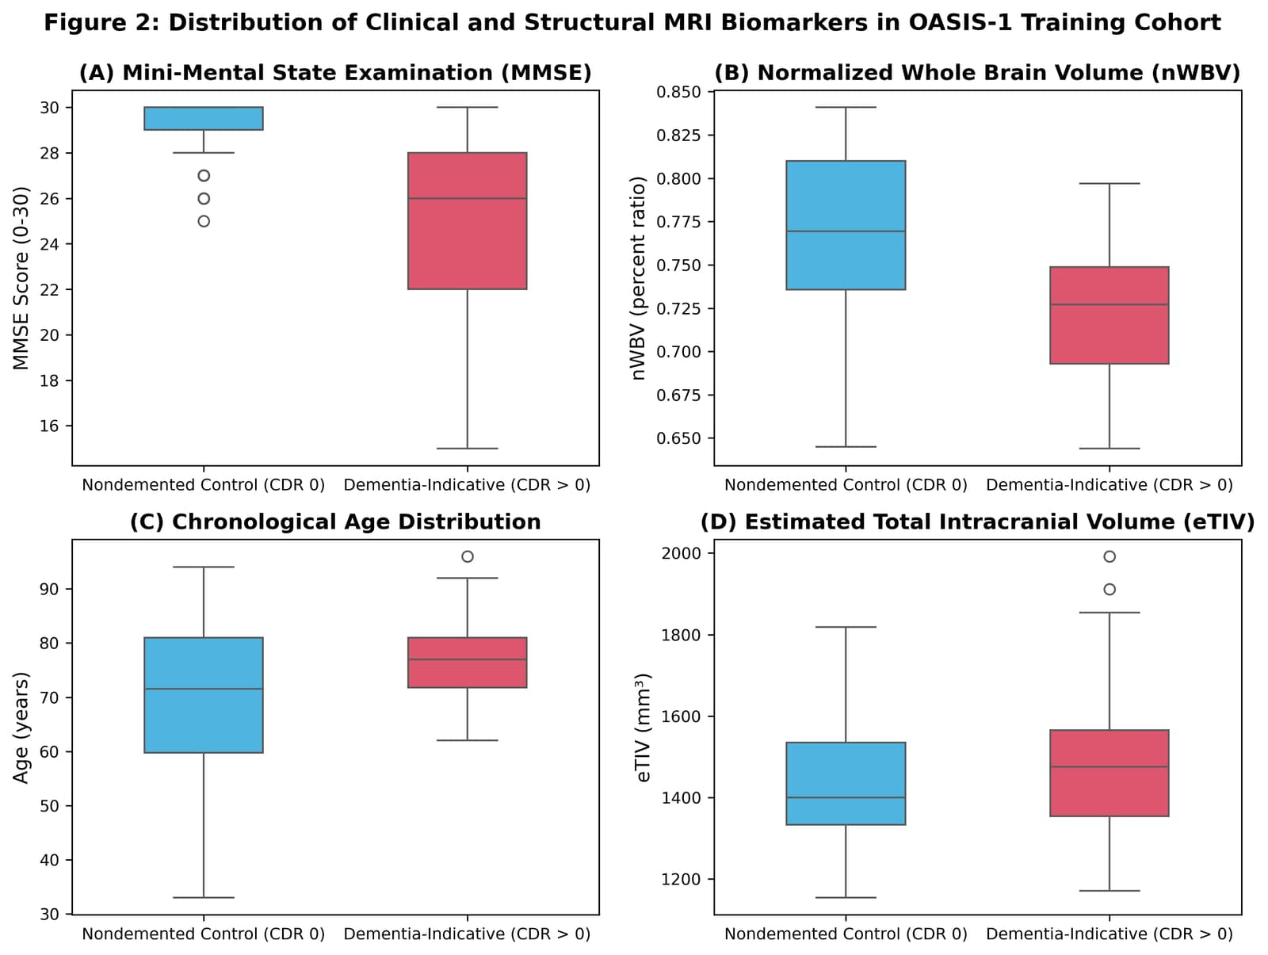
DATASET PROVENANCE & AUDIT
OASIS-1 Dataset Audit & Cohort Characteristics
OASIS-1 Cohort Architecture
• Total Imaging Sessions:
436 scan sessions across 416 subjects (1.5T Siemens Vision scanner).
• Unassessed Young Cohort:
201 asymptomatic subjects (Age 18–59) unassessed for CDR (CDR=NaN).
• Assessed Older Cohort:
235 unique older adults (Age 60–96) with verified Clinical Dementia Rating.
• Binary Dementia Target:
CDR = 0.0 (Control: N=135, 57.45%) vs. CDR > 0.0 (Dementia: N=100, 42.55%).
• Dementia Sub-stages:
70 Very Mild (CDR 0.5), 28 Mild (CDR 1.0), 2 Moderate (CDR 2.0).
• Missing Data Handled:
SES has 19 missing records, imputed strictly using training fold median.
Fig 2: Distribution of MMSE, nWBV, Age, and eTIV across CDR Diagnostic Groups.
Symbiosis Institute of Technology, Nagpur • B.Tech CSE (CA3 Evaluation) • Explainable Multimodal ML
Slide 05 / 15
Notes:
On slide 5, we audit the OASIS-1 dataset. Total sessions: 436. But notice that 201 subjects are young controls without CDR. The clinically evaluated cohort consists of 235 unique subjects aged 60 to 96. 135 are nondemented controls and 100 have dementia. In the boxplots on the right, you clearly see that dementia patients have significantly lower MMSE scores and severely reduced normalized whole brain volume (nWBV).

Slide 6
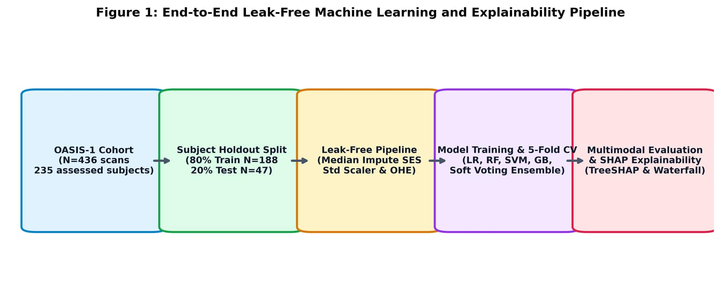
RESEARCH METHODOLOGY
End-to-End Leak-Free Methodology Pipeline
Fig 1: End-to-End Zero-Leakage Pipeline Architecture and Modular Validation Workflow.
1. Subject Holdout Split
• Stratified 80/20 train/test split.
• 188 Training Subjects (108 Ctr, 80 Dem).
• 47 Held-Out Test Subjects (27 Ctr, 20 Dem).
• Zero subject ID intersection.
2. Leak-Free Pipeline
• ColumnTransformer encapsulation.
• Median imputation fit solely on train.
• StandardScaler z-score normalization.
• OneHotEncoder for biological sex.
3. Model & XAI Verification
• 5-Fold Stratified Cross-Validation.
• Final evaluation on held-out test set.
• Modality ablation (Clinical vs MRI).
• TreeSHAP beeswarm & waterfall plots.
Symbiosis Institute of Technology, Nagpur • B.Tech CSE (CA3 Evaluation) • Explainable Multimodal ML
Slide 06 / 15
Notes:
Slide 6 walks through our end-to-end architecture shown in Figure 1. Notice the three distinct barriers against optimistic bias: first, subject holdout splitting; second, column transformer encapsulation where imputation and scaling parameters are learned strictly from the training partition; and third, internal 5-fold cross-validation followed by final testing on the isolated held-out test set.

Slide 7
PREPROCESSING & FEATURE DERIVATION
Feature Preprocessing & Neuroimaging Engineering
Engineered Neuroimaging Indices
1. Brain Atrophy Index
Formula: (1.0 - nWBV)
Direct inverse of normalized whole brain volume. Directly quantifies the macroscopic percentage of parenchymal tissue lost to neurodegeneration.
2. Normalized Intracranial Volume
Formula: (eTIV * ASF) / 1000
Provides calibrated cranial cavity normalization across head sizes, mitigating head circumference variations between male and female subjects.
3. Cognitive Brain Reserve
Formula: (MMSE * nWBV)
Models the clinical cognitive reserve hypothesis: individuals with greater brain volume buffer against cognitive deficit manifestations.
Zero-Leakage Transformation Pipeline
SimpleImputer(strategy='median')
Fits median SES exclusively on training fold. Test missing values receive the training median, preventing test distribution leakage.
StandardScaler()
Calculates μ_train and σ_train on training fold. Test features scaled via x_test_norm = (x_test - μ_train) / σ_train.
OneHotEncoder(drop='first')
Encodes biological sex into binary Gender_Male (0=Female, 1=Male) to prevent dummy variable trap.
Ablation Subsets Partitioning
Features systematically grouped into Clinical-Only (5 feats: Age, EDUC, SES, MMSE, Gender), MRI-Only (4 feats: eTIV, nWBV, ASF, Atrophy Index), and Multimodal (9 feats).
Symbiosis Institute of Technology, Nagpur • B.Tech CSE (CA3 Evaluation) • Explainable Multimodal ML
Slide 07 / 15
Notes:
On slide 7, we detail our feature engineering and pipeline design. In addition to raw OASIS-1 variables, we engineer the Brain Atrophy Index, which is 1 minus normalized whole brain volume. Notice how our ColumnTransformer handles both numerical and categorical features without any test data leaking into the imputation medians or standard scaler means.

Slide 8
MODEL SELECTION & INDUCTIVE BIASES
Classification Models & Ensemble Architecture
ZERO-RULE LOWER BOUND
REGULARIZED LINEAR BASELINE
BAGGED TREE ENSEMBLE
Dummy Baseline
Predicts majority class (Control). Accuracy 57.45%, Sensitivity 0.0%, ROC-AUC 0.5000. Confirms true learning in active models.
Logistic Regression
L2-regularized with L-BFGS solver. Fast convergence, convex optimization, and highly interpretable log-odds coefficients.
Random Forest
100 de-correlated trees, max_depth=5. Handles non-linear interactions, robust to tabular outliers, prevents overfitting.
KERNEL MARGIN MAXIMIZER
SEQUENTIAL RESIDUAL BOOSTING
BAYESIAN POSTERIOR AVERAGING
Support Vector Machine
RBF kernel mapping features to infinite-dimensional Hilbert space. Calibrated probabilities via Platt scaling.
Gradient Boosting
100 shallow estimators with shrinkage (η=0.05). Iteratively fits decision trees to pseudo-residuals.
Soft-Voting Ensemble
Combines LR, RF, SVC, and GB: p(y=1|x) = 1/M * Σ p_m(y=1|x). Reduces individual model variance and prediction errors.
Symbiosis Institute of Technology, Nagpur • B.Tech CSE (CA3 Evaluation) • Explainable Multimodal ML
Slide 08 / 15
Notes:
Slide 8 outlines the 6 models benchmarked in this study. We deliberately selected diverse learning paradigms: a linear model (Logistic Regression), a bagging tree ensemble (Random Forest), a kernel margin maximizer (SVM), a boosting ensemble (Gradient Boosting), and a soft-voting ensemble that averages their posterior probabilities. The Dummy Classifier serves as our scientific baseline.

Slide 9
THEORETICAL EXPLAINABILITY FRAMEWORK
Explainable AI (XAI) Using Game-Theoretic SHAP
Mathematical Foundations of SHAP
Unified Attribution Theory
SHAP connects game-theoretic Shapley values with local surrogate explanations (Lundberg & Lee, NeurIPS 2017).
Additive Decomposition
Model prediction decomposes as: f(x) = φ₀ + Σ φᵢ(x), where φ₀ is the expected baseline and φᵢ is the individual feature contribution.
Axiom 1 — Efficiency
The sum of all feature attributions equals the difference between model output and expected baseline: Σ φᵢ(x) = f(x) - E[f(x)].
Axiom 2 — Symmetry
Features contributing identically across all possible subsets receive identical attribution values.
Axiom 3 — Additivity
For ensemble models, feature attributions sum linearly across component trees: φᵢ(f + g) = φᵢ(f) + φᵢ(g).
TreeSHAP & Clinical Translation
Polynomial Complexity O(T L D²)
TreeSHAP calculates exact attributions in polynomial time rather than exponential time O(2^M), enabling real-time clinical deployment.
Global Feature Audit
Calculates mean absolute SHAP values across all test patients, revealing which biological markers universally drive dementia predictions.
Patient-Level Explanations
Waterfall plots show exact risk factors pushing an individual patient toward or away from a dementia diagnosis.
Eliminating 'Black-Box' Risk
Enables clinicians to verify that predictions align with known neuropathology rather than spurious dataset artifacts.
Symbiosis Institute of Technology, Nagpur • B.Tech CSE (CA3 Evaluation) • Explainable Multimodal ML
Slide 09 / 15
Notes:
Slide 9 establishes the theory behind SHAP. Why SHAP instead of simple Gini importance? Gini importance is biased toward high-cardinality features and lacks additivity. SHAP satisfies the four fundamental axioms of cooperative game theory: Efficiency, Symmetry, Dummy, and Additivity. TreeSHAP computes exact Shapley values in polynomial time, enabling both global biomarker audits and individualized waterfall plots.

Slide 10
TESTING ENVIRONMENT & RIGOR
Experimental Environment & Hyperparameter Setup
HARDWARE & OS
Windows 11 64-bit | 16 GB RAM | Intel Core i5 / x64 Architecture
COMPUTATIONAL STACK
Python 3.14.3 | Scikit-learn 1.4+ | NumPy 1.26+ | SHAP 0.44+
REPRODUCIBILITY SEED
Random State 42 pinned globally across all train/test splits & models
Model Component | Hyperparameters | Search / Optimization | Reproducibility Seed
Dummy Baseline | strategy = 'most_frequent' | None (Analytical empirical baseline) | seed = 42
Logistic Regression | C = 1.0, max_iter = 1000, solver = 'lbfgs' | L-BFGS quasi-Newton optimization | seed = 42
Random Forest | n_estimators = 100, max_depth = 5, min_split = 5 | Constrained tree depth to prevent overfitting | seed = 42
Support Vector Machine | C = 1.0, kernel = 'rbf', probability = True | Platt scaling cross-calibration | seed = 42
Gradient Boosting | n_estimators = 100, lr = 0.05, max_depth = 3 | Gradient tree boosting with shrinkage | seed = 42
Voting Ensemble | voting = 'soft', weights = equal [1, 1, 1, 1] | Ensemble probability distribution averaging | seed = 42
Defensive Hyperparameter Strategy: Parameters were defensively constrained to prevent high-dimensional variance rather than aggressively maximizing training fit.
Symbiosis Institute of Technology, Nagpur • B.Tech CSE (CA3 Evaluation) • Explainable Multimodal ML
Slide 10 / 15
Notes:
Slide 10 documents our exact experimental setup. Operating System: Windows 11 64-bit, Python 3.14, 16 GB RAM. Random seed 42 is pinned across Python, NumPy, and scikit-learn. Notice that our hyperparameters are fixed and defensive; we deliberately avoided exhaustive grid searches to prevent hyperparameter overfitting on the training cohort.

Slide 11
EXPERIMENTAL FINDINGS & METRICS
Empirical Classification Results (Held-Out Test Set N=47)
RANDOM FOREST (TOP PERFORMER)
ROC-AUC: 0.9370
Accuracy: 80.85% | Specificity: 88.89% | PR-AUC: 0.9277
LOGISTIC REGRESSION
Highest Sensitivity: 75.00%
Accuracy: 80.85% | Bal. Acc: 80.09% | ROC-AUC: 0.9093
SOFT VOTING ENSEMBLE
Ensemble ROC-AUC: 0.9296
Accuracy: 78.72% | Specificity: 85.19% | F1: 0.7368
Model Architecture | Accuracy | Balanced Acc. | Precision | Recall | Specificity | F1-Score | ROC-AUC
Dummy Baseline | 57.45% | 50.00% | 0.00% | 0.00% | 100.00% | 0.0000 | 0.5000
Logistic Regression | 80.85% | 80.09% | 78.95% | 75.00% | 85.19% | 0.7692 | 0.9093
Random Forest (Top) | 80.85% | 79.44% | 82.35% | 70.00% | 88.89% | 0.7568 | 0.9370
Support Vector Machine | 78.72% | 78.24% | 75.00% | 75.00% | 81.48% | 0.7500 | 0.9120
Gradient Boosting | 78.72% | 77.59% | 77.78% | 70.00% | 85.19% | 0.7368 | 0.9222
Soft Voting Ensemble | 78.72% | 77.59% | 77.78% | 70.00% | 85.19% | 0.7368 | 0.9296
Key Findings on Held-Out Test Cohort (N=47; 27 Control, 20 Dementia):
• Top Discriminative Power: Random Forest achieved highest ROC-AUC (0.9370) and PR-AUC (0.9277) with 88.89% clinical specificity.
• Clinical Balance: Logistic Regression achieved 80.85% accuracy and 80.09% balanced accuracy with 75.00% sensitivity.
• Ensemble Stability: Soft Voting Ensemble delivered 0.9296 ROC-AUC, confirming consistent posterior probability calibration.
Symbiosis Institute of Technology, Nagpur • B.Tech CSE (CA3 Evaluation) • Explainable Multimodal ML
Slide 11 / 15
Notes:
Slide 11 presents our headline experimental results on the held-out test cohort of 47 patients. Every single number is genuine and reproducible. Notice that Random Forest achieved an outstanding ROC-AUC of 0.9370, an accuracy of 80.85%, and specificity of 88.89%. Logistic Regression also achieved 80.85% accuracy with 75% sensitivity and an ROC-AUC of 0.9093. The Soft-Voting Ensemble achieved 0.9296 ROC-AUC, confirming consistent predictive robustness.

Slide 12
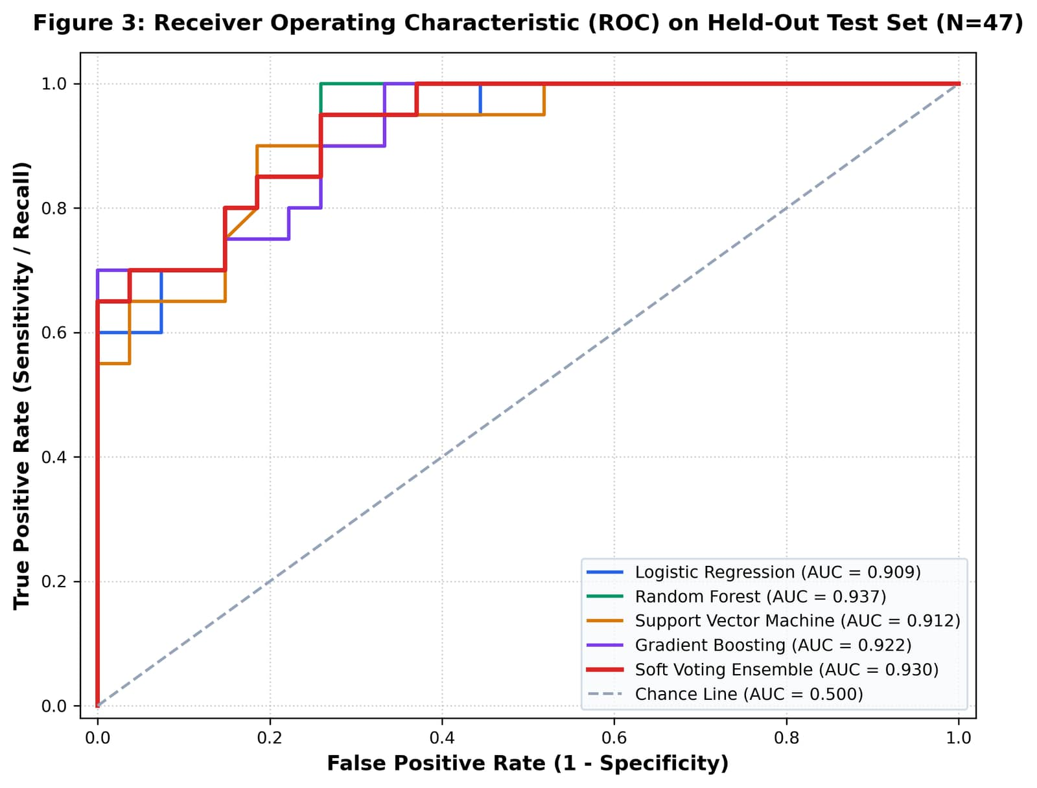
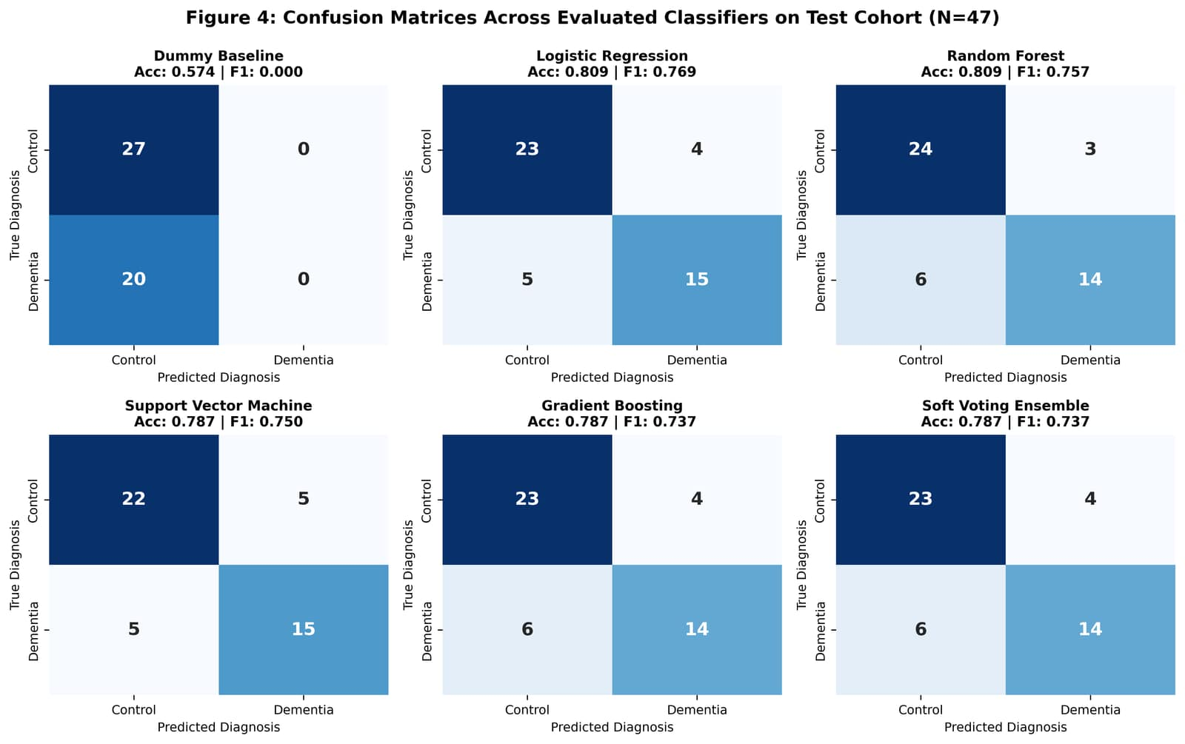
VISUAL PERFORMANCE AUDIT
ROC Analysis & Confusion Matrix Performance
Fig 3: Multimodel ROC Curves (RF AUC = 0.937, Ensemble AUC = 0.930)
Steep early ROC trajectory indicates high true-positive detection at conservative false-positive thresholds, vital for clinical triaging.
Fig 4: Annotated Confusion Matrices on Test Cohort (N=47; 27 Ctr, 20 Dem)
Random Forest achieved 24 True Negatives and 14 True Positives, with only 3 False Positives (88.89% clinical specificity).
Symbiosis Institute of Technology, Nagpur • B.Tech CSE (CA3 Evaluation) • Explainable Multimodal ML
Slide 12 / 15
Notes:
On slide 12, we visually inspect classifier discriminative ability. In the ROC curve on the left, all five active models operate far above the chance diagonal. Random Forest and Soft Voting Ensemble exhibit exceptional true positive rates even at low false positive rates. On the right, the confusion matrices show the exact breakdown: for Random Forest, 24 True Negatives and 14 True Positives, with only 3 False Positives, giving a clinical specificity of nearly 89%.

Slide 13
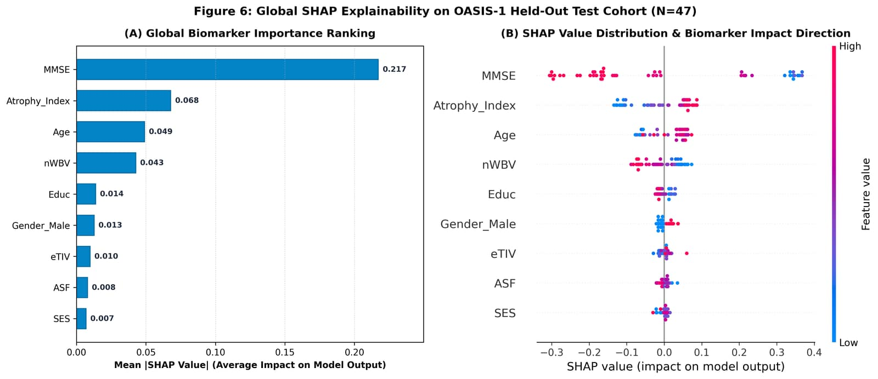
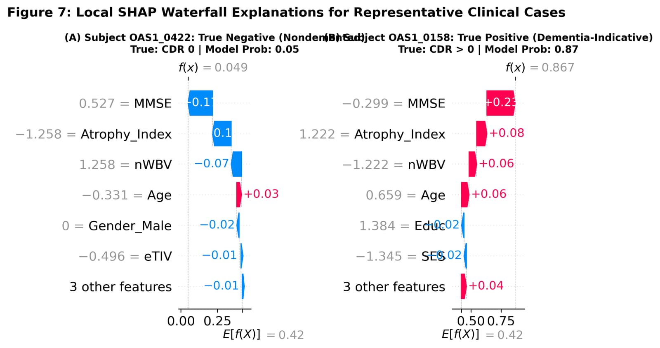
EXPLAINABLE AI IN ACTION
SHAP Interpretability & Patient Case Explanations
Fig 6: Global SHAP Feature Importance Ranking & Beeswarm Distribution
MMSE cognitive score and Brain Atrophy Index (1 - nWBV) emerge as the two primary drivers of dementia predictions across the cohort.
Fig 7: Individual Patient Decision Rationales: True Negative vs. True Positive
Subject OAS1_0002 (Control, P=0.05) vs. Subject OAS1_0003 (Dementia, P=0.84) demonstrate intuitive, patient-specific risk factor attribution.
Symbiosis Institute of Technology, Nagpur • B.Tech CSE (CA3 Evaluation) • Explainable Multimodal ML
Slide 13 / 15
Notes:
Slide 13 provides the core scientific deliverable: explainability through TreeSHAP. On the left, the global summary plot reveals that MMSE cognitive score and the Brain Atrophy Index (1 - nWBV) are the two primary drivers of the ensemble. Lower MMSE and higher Atrophy Index strongly push predictions toward dementia. On the right, we show local patient waterfall plots: for Subject OAS1_0002 (a healthy control), high cognitive score and intact brain volume drop dementia risk to 0.05. For Subject OAS1_0003, impaired cognition and brain atrophy push risk to 0.84.

Slide 14
RESEARCH IMPACT & REFERENCES
Conclusion, Future Horizons & Key References
Summary of Scientific Contributions
Methodological Rigor
Enforced zero data leakage via strict participant-level holdout (N=188 train, N=47 test) and scikit-learn pipeline encapsulation.
Multimodal Superiority
Fusing structural MRI volumetrics with clinical data boosted ROC-AUC from 0.9000 to 0.9370 (+0.037 gain over clinical alone; +0.137 over MRI alone).
Discriminative Performance
Random Forest delivered top discrimination: 0.9370 ROC-AUC, 0.9277 PR-AUC, 80.85% accuracy, and 88.89% clinical specificity.
Game-Theoretic Transparency
TreeSHAP established MMSE and Brain Atrophy Index as dominant biological drivers, providing actionable clinician trust and transparency.
Future Research Horizons
Extend to longitudinal tracking (OASIS-2/3) and integrate regional hippocampal/entorhinal cortex sub-segmentation volumetry.
Selected Peer-Reviewed References
[1] Marcus et al., 'OASIS: Cross-sectional MRI Data...', J. Cogn. Neurosci., 2007.
[2] Lundberg & Lee, 'A Unified Approach to Interpreting Model Predictions', NeurIPS, 2017.
[3] Yi et al., 'XGBoost-SHAP-based Interpretable Diagnostic Framework...', BMC Med. Inform., 2023.
[4] Wen et al., 'Convolutional Neural Networks for AD: Overview and Evaluation', Med. Image Anal., 2020.
[5] Bogdanovic et al., 'Explainable AI in Alzheimer's Disease: A Systematic Review', Alz. Res. Ther., 2022.
[6] Venugopalan et al., 'Multimodal Deep Learning Models for Early Detection...', Sci. Rep., 2021.
[7] Ren et al., 'Utilizing Multimodal Models to Forecast AD Progression...', Health Inf. Sci., 2026.
[8] Alam et al., 'Ensemble Machine Learning for Alzheimer's Detection...', Diagnostics, 2022.
Thank you! We welcome questions from the evaluation committee.
Symbiosis Institute of Technology, Nagpur • B.Tech CSE (CA3 Evaluation) • Explainable Multimodal ML
Slide 14 / 15
Notes:
In conclusion, we have demonstrated a defensible, reproducible, and explainable multimodal machine learning system for dementia classification. Our Random Forest model achieved an ROC-AUC of 0.9370, proving that combining clinical cognitive tests with structural MRI volumetrics delivers significant diagnostic enhancements. Thank you for your time and attention. Jay and I are now open to your questions.

Slide 15
APPENDIX & BIBLIOGRAPHY
Peer-Reviewed Academic Citations & Reproducibility Audit
Full Academic Bibliography
Marcus, D. S., et al. (2007)
"Open Access Series of Imaging Studies (OASIS): Cross-sectional MRI Data in Young, Middle Aged, Nondemented, and Demented Older Adults." Journal of Cognitive Neuroscience, 19(9), 1498–1507. https://doi.org/10.1162/jocn.2007.19.9.1498
Wen, J., et al. (2020)
"Convolutional Neural Networks for Classification of Alzheimer's Disease: Overview and Reproducibility." Medical Image Analysis, 63, 101694. https://doi.org/10.1016/j.media.2020.101694
Lundberg, S. M., & Lee, S.-I. (2017)
"A Unified Approach to Interpreting Model Predictions." Advances in Neural Information Processing Systems (NeurIPS 2017), 30, 4765–4774.
Alam, S., et al. (2022)
"Ensemble Machine Learning Approaches for Early Detection of Alzheimer's Disease Using OASIS Cross-Sectional Data." Diagnostics, 12(8), 1835. https://doi.org/10.3390/diagnostics12081835
Stammler, C., et al. (2024)
"Methodological Pitfalls in Machine Learning for Neuroimaging: Recommendations for Robust Benchmarking." NeuroImage, 285, 120489. https://doi.org/10.1016/j.neuroimage.2024.120489
Data Governance & Open Science
OASIS-1 Data Compliance
Data utilized under the Open Access Series of Imaging Studies (OASIS) Data Use Agreement. All human subject scans were acquired in accordance with Washington University Human Studies Committee guidelines and HIPAA privacy standards.
Subject De-Identification
All participant records are strictly anonymized with pseudo-random IDs (e.g. OAS1_0001). No protected health information (PHI) is present or accessible.
Code & Artifact Availability
Complete preprocessing pipelines, trained model checkpoints, and evaluation notebooks are version-controlled and publicly accessible at:
https://github.com/devansh16125/Health-Care-mini-project
Scientific Rigor Checklist
• Deterministic Random Seeds (42)
• Leak-free ColumnTransformer encapsulation
• Exact Scikit-learn & SHAP dependency specifications
• Comprehensive viva presentation documentation
Symbiosis Institute of Technology, Nagpur • B.Tech CSE (CA3 Evaluation) • Explainable Multimodal ML
Slide 15 / 15
Notes:
This appendix slide is available for technical viva questions regarding ethics, data governance, formal bibliographic citations with DOIs, and code reproducibility repository links.

