Slide 1
MUIT
Name – Devansh Sharma
Course – B.Tech C.S with Data Analyst

Slide 2
Objective
For an Auto Insurance company, predict the customer life time value (CLV). CLV is the total revenue the client will derive from their entire relationship with a customer because we don’t know how long each customer relationship will be, we make a good estimate and state CLV as a periodic value — that is, we usually say “this customer’s 12-month (or 24-month,etc) CLV is $x”.

Slide 3
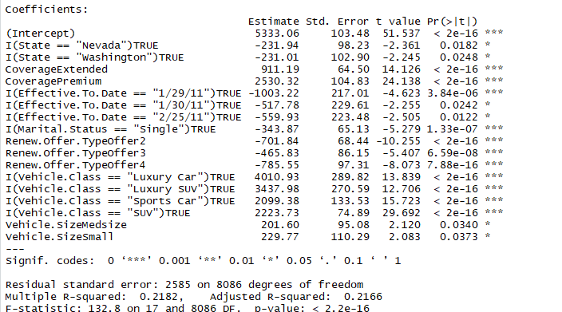
Significance Variables

Slide 4
As the p-values of all variable are less than 0.05, they are both statistically significant in the multiple linear regression model .

Slide 5
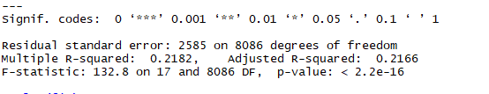
Result

Slide 6
The residual standard deviation is simply the standard deviation of the residual values, or the difference between a set of observed and predicted values. The standard deviation of the residuals calculates how much the data points spread around the regression line.
the higher the R-squared, the better the model fits your data.

Slide 7
Business Recommendation
Company is focus on independent variables instead of focusing on insignificant variables because only significant variables have any positive or negative effect on CLV which is our dependent variable

Slide 8
THANK YOU

