Slide 1
Are Changes In SDP Associated with GWQ?

Slide 2
BACKGROUND
India, a country characterized by diverse geography and rapid economic development, faces significant challenges in managing its groundwater resources and ensuring environmental sustainability.
The Environmental Kuznets Curve (EKC) hypothesis posits a non-linear relationship between environmental degradation and economic growth, suggesting that environmental quality initially worsens with economic development but improves beyond a certain level of affluence.
In the Indian context, where economic growth has been rapid but unevenly distributed across regions, examining the nexus between economic output (measured by State Domestic Product, SDP) and GWQ can provide valuable insights into environmental sustainability and the effectiveness of policy interventions.
Electrical conductivity (EC) is one of indicators of GWQ. It is a measure of a solution's ability to conduct electrical current, which is influenced by the concentration of dissolved ions in the water. In the context of GWQ assessment, EC serves as an essential parameter due to its sensitivity to the presence of dissolved salts, minerals, and other contaminants.

Slide 3
PROBLEM STATEMENT
Through this project, we aim to address the following question:
Does economic growth impact groundwater quality in Indian districts?
Thus, we want to investigate whether there exists a statistically significant relationship between State Domestic Project (SDP) and GWQ indicators, and whether this relationship follows any discernible patterns and trends in this over the study period (2000-01 – 2018-19).
Among the various GWQ indicators, our group was allotted electrical conductivity. Thus, we are trying to find whether there exists a positive relationship between changes in economic output (SDP) and EC levels in groundwater across various Indian districts.
Moreover, we are testing whether our data supports the EKC hypothesis, i.e., we examine whether the relationship between SDP and groundwater quality indicator (electrical conductivity) follows an inverted U-shape. We also intend to find out whether the results differ by year, and whether examine if there are differences in the estimates of the Kuznets curve across regions within India.

Slide 4
We are given the electrical conductivity levels in ground water for various districts of various Indian states and also the net State Domestic Product (SDP) of these states.
For the data we have used, there are 29 states each with various districts, with each district having an electrical conductivity level for its ground water along with its SDP as the SDP of the state. In total, we have 110005 districts and the EC and SDP stats for them.
Given below are the statistics for the electrical conductivity and SDP variables:
Statistic | Electrical Conductivity | State Domestic Product
Min. | 31.0 | 1248
1st Quartile | 574.0 | 147482
Median | 854.9 | 281266
Mean | 1107.4 | 358674
3rd Quartile | 1336.5 | 488433
Max. | 11855.0 | 1728578

Slide 5
Regression
Null Hypothesis (H₀): There is no significant relationship between changes in economic output (SDP) and electrical conductivity levels in groundwater across various Indian districts. (i.e., 𝞫₁ = 0)
Alternate Hypothesis (H₁): There is a significant positive relationship between changes in economic output (SDP) and electrical conductivity levels in groundwater across various Indian districts. (i.e., 𝞫₁ > 0)
To test our null and alternate hypothesis, we run the following regression:
GWQ_{i,t}= 𝞫₀+𝞫₁SDP_{i,t}+ u_{i,t}
Here, GWQ_{i,t} represents the groundwater quality indicator (specifically, electrical conductivity) for district i in year t and SDP_{i,t} represents the net State Domestic Product (SDP) for the same district and year.
We get these results:
Variable Name | Coefficient (Standard Error) | t-value | p-value
𝞫₀ | 918.7515790418 (12.5268338934) | 73.7426807489 | 0.0000000000
𝞫₁ | 0.0005258857 (0.0000268276) | 19.6024384879 | 0.0000000000
Adjusted R² = 0.03366, Sample Size (N) = 110005

Slide 6
Interpretation
The intercept (𝞫₀) is ~918.7515 and represents the estimated GWQ (electrical conductivity level in groundwater) when SDP is 0.
The coefficient (𝞫₁) = 0.0005258857 represents the estimated change in GWQ (electrical conductivity) for a one-unit increase in net state domestic product (SDP). In our case, this suggests that for every one unit increase in SDP, the electrical conductivity is estimated to increase by approximately 0.0005259 units (keeping other variables constant).
Since 𝞫₁ is positive, it aligns with our hypothesis that higher economic output is associated with higher electrical conductivity (better groundwater quality).
The S.E. (𝞫₁ ) is 19.6, whereas the p-value is essentially 0. For a significance level of 0.05, this suggests that the p value is less than the significance level and hence the coefficient is statistically significant.
Thus, we reject the null hypothesis that there is no relationship between SDP and electrical conductivity. Instead, we have strong evidence to suggest that there is a statistically significant positive relationship between economic output (SDP) and electrical conductivity levels in groundwater in various Indian districts.

Slide 7
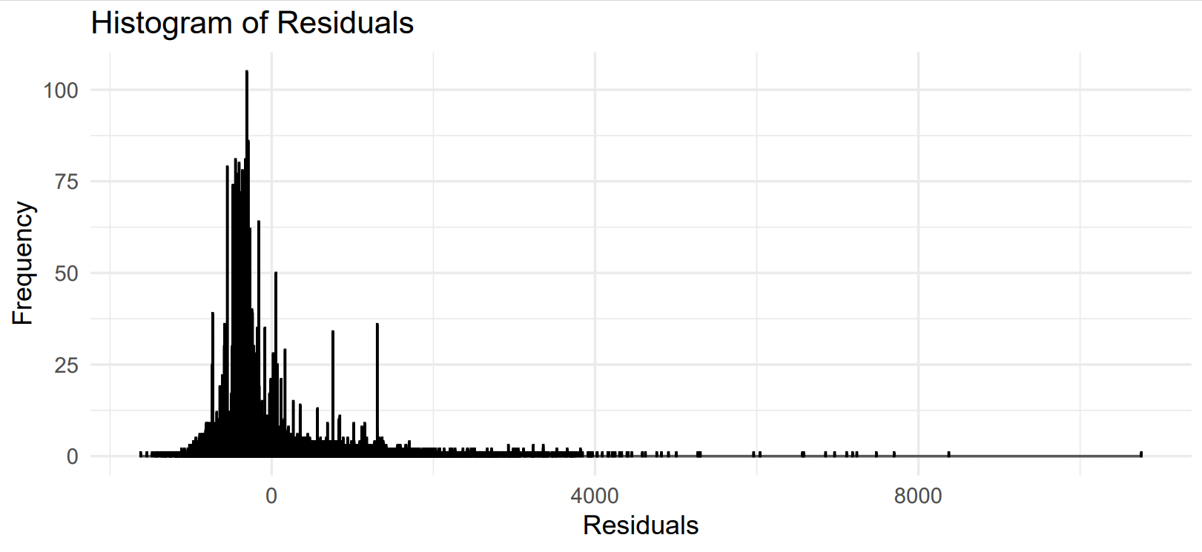
The model residuals
We already know that the sum of model residuals s (∑û_{i,t}) should be 0. Under our regression model, the sum of model residuals comes out to be 5.75191450025159e-10, which is basically 0 when considered upto 9 decimal places thus confirming that ∑û_{i,t} = 0.

Slide 8
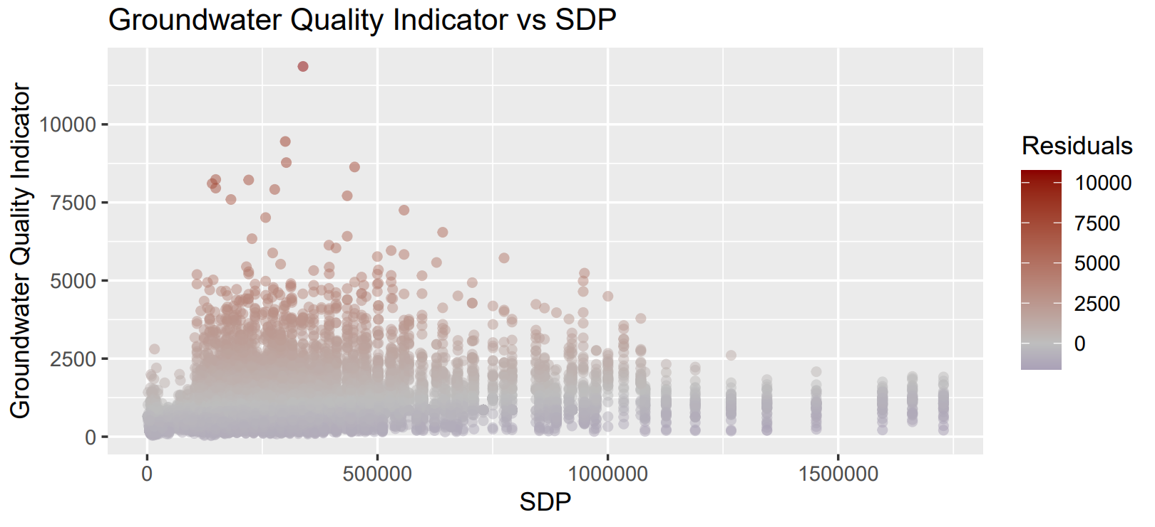
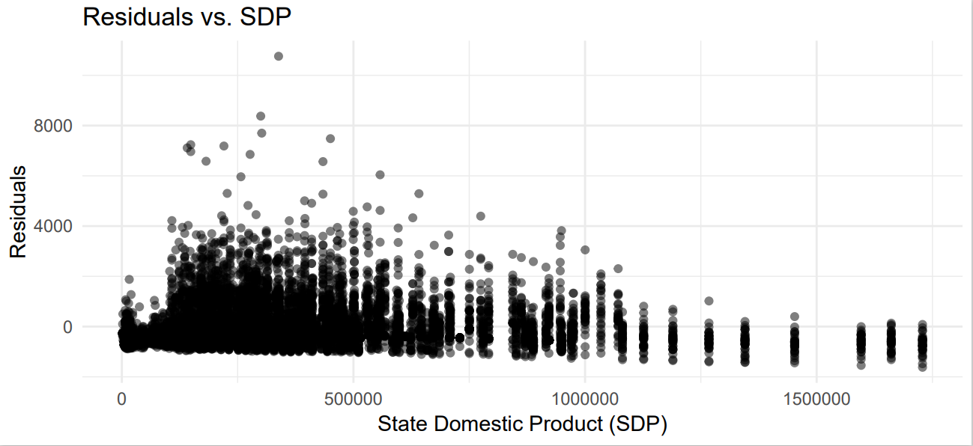
The model residuals
When we construct a plot having the GWQ indicator (electrical conductivity) on the Y-axis and SDP on the X-axis and another plot having ∑û_{i,t} on Y-axis and SDP on x-axis, we find that the plots look similar.
Plot 1
Plot 2

Slide 9
Towards the EKC
To test whether our data follows the EKC hypothesis, we enhance our previous regression model to:
GWQ_{i,t}= 𝞫₀+𝞫₁SDP_{i,t}+ 𝞫₂(SDP_{i,t})² + u_{i,t}
We enhanced our regression model by adding a quadratic term for SDP.
The coefficient 𝞫₂ captures the curvature in the relationship.
We get these results:
Variable Name | Coefficient (Standard Error) | t-value | p-value
𝞫₀ | 658.9 (16.72) | 39.4 | 0.0000000000
𝞫₁ | 0.001989 (0.00006929) | 28.7 | 0.0000000000
𝞫₂ | -0.000000001215 (0.00000000005326) | -22.81 | 0.0000000000
Adjusted R² = 0.0772, Sample Size (N) = 110005

Slide 10
Interpretation
Null Hypothesis (H₀): There is no significant relationship between changes in SDP and electrical conductivity levels in groundwater across various Indian districts, considering both linear and quadratic effects (i.e., 𝞫₁ = 𝞫₂ = 0)
Alternate Hypothesis (H₁): There is a significant relationship between changes in SDP and electrical conductivity levels in groundwater across various Indian districts, considering both linear and quadratic effects (i.e., at least one of 𝞫₁ or 𝞫₂ is not equal to zero)
The intercept (𝞫₀) is 658.9 and represents the estimated GWQ (electrical conductivity level in groundwater) when SDP is 0.
The coefficient (𝞫₁) = 0.0005258857 represents that for every one-unit increase in SDP, the estimated change in electrical conductivity is approximately 0.001989 units (keeping other variables constant). Since it is positive, it suggests that higher economic output is associated with higher electrical conductivity (better groundwater quality).
The quadratic term captures the curvature in the relationship between SDP and electrical conductivity. Since is 𝞫₂ is negative, it implies that beyond a certain level of SDP, electrical conductivity starts decreasing.
We set the significance level of 0.05. All t-values are large, indicating that the coefficients are significantly different from zero. The p-values are essentially zero and thus less than the significance level, providing strong evidence against the null hypothesis.

Slide 11
Interpretation
Since 𝞫₂ is negative, in practical terms, this means that as economic growth accelerates beyond a certain point, the rate of improvement in groundwater quality may slow down or even reverse, resulting in a deterioration of GWQ.
Overall, the relationship between economic growth (SDP) and groundwater quality, as predicted from the regression model, can be summarized as follows:
Initially, as economic growth (SDP) increases, there is a positive effect on groundwater quality (GWQ). This may be attributed to improvements in environmental regulations, technological advancements, and resource management practices.
However, beyond a certain threshold of economic development, the rate of improvement in groundwater quality begins to decline. This is indicated by the negative coefficient of the quadratic term, suggesting that further economic growth may lead to diminishing returns or even degradation of GWQ.
Therefore, the relationship between economic growth and groundwater quality is not linear but follows a curvilinear pattern, indicating the presence of an inverted U-shaped curve, as hypothesized. This highlights the importance of sustainable development strategies and environmental policies to balance economic growth with environmental conservation and resource management.

Slide 12
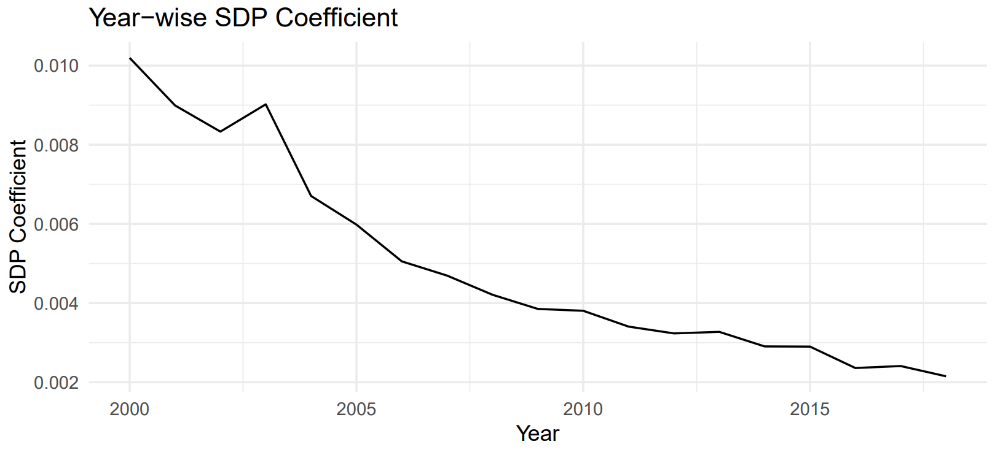
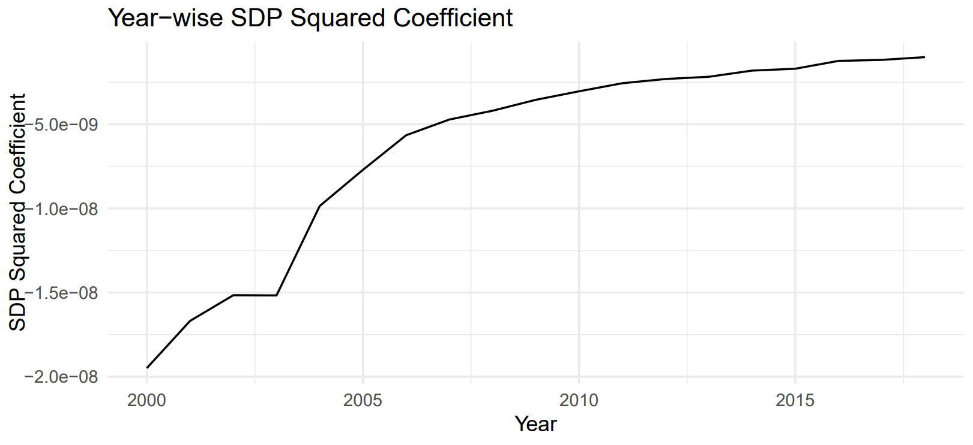
Do the results differ by year?
To determine whether the results of the regression analysis differ by year, we can examine the coefficients of the linear and quadratic terms for economic growth (SDP and SDP²) across different years. If there are significant variations in these coefficients from year to year, it suggests that the relationship between economic growth and groundwater quality may vary over time.

Slide 13
Interpretation
The falling SDP coefficient and the rising SDP squared coefficient over the years suggest that the relationship between economic growth (as measured by SDP) and groundwater quality is changing over time. More specifically, it suggests that the impact of economic growth on groundwater quality is becoming less linear and more quadratic over time.
In the context of the environmental Kuznets curve, this could suggest that as economic growth (SDP) increases, groundwater quality initially improves but then starts to decline after a certain point. The turning point, where the impact of economic growth on groundwater quality changes from positive to negative, is likely changing over time.
This could be due to various factors, such as changes in environmental regulations, technological advancements, shifts in the types of industries contributing to economic growth, changes in public awareness about environmental issues, and so on.

Slide 14
Are there differences in the estimates of the EKC across regions within India?
To examine if there are differences in the estimates of the Kuznets curve across regions within India, we can create dummy variables for each region and include them in your regression model.
Our model thus becomes:
GWQ_{i,t}= 𝞫₀+𝞫₁SDP_{i,t}+ 𝞫₂(SDP_{i,t})² + 𝞫₃NorthernRegion_{i} + 𝞫₄NorthEasternRegion_{i} + 𝞫₅EasternRegion_{i} + 𝞫₆CentralRegion + 𝞫₇WesternRegion + 𝞫₈SouthernRegion
where the regions are dummy variables indicating whether district i belongs to the respective region.
However, there might be perfect multicollinearity in this model. Perfect multicollinearity occurs when one independent variable is a perfect linear function of one or more other independent variables.
In the context of this model, this could happen if all the observations in the Southern Region are perfectly predictable by a combination of the other regions (Northern, North-Eastern, Eastern, Central, and Western). In other words, if a district is not in the Northern, North-Eastern, Eastern, Central, or Western regions, then it must be in the Southern Region.
To handle this issue, we can exclude one region from the model to serve as the reference category. The coefficients of the other regions will then represent the difference between that region and the reference category. For example, we could exclude the Southern Region from the model, and the coefficients of the other regions would represent the difference between those regions and the Southern Region.
So, the model becomes: GWQ_{i,t}= 𝞫₀+𝞫₁SDP_{i,t}+ 𝞫₂(SDP_{i,t})² + 𝞫₃NorthernRegion_{i} + 𝞫₄NorthEasternRegion_{i} + 𝞫₅EasternRegion_{i} + 𝞫₆CentralRegion + 𝞫₇WesternRegion

Slide 15
Variable Name | Coefficient (Standard Error) | t-value | p-value
𝞫₀ | 963.0 (26.66) | 36.115 | 0.00
𝞫₁ | 0.001642 (0.00006960) | 23.594 | 0.00
𝞫₂ | -0.000000001153 (0.00000000005085) | -22.666 | 0.00
𝞫₃ | 465.2 (24.59) | 18.564 | 0.00
𝞫₄ | -758.9 (33.26) | -22.819 | 0.00
𝞫₅ | -490.3 (24.29) | -20.180 | 0.00
𝞫₆ | -524.9 (21.60) | 24.304 | 0.00
𝞫₇ | 189.8 (28.82) | 6.586 | 0.00
Adjusted R² = 0.3026

Slide 16
Interpretation
If the coefficients for the regional dummy variables are statistically significant, it suggests that there are there are differences in the estimates of the Kuznets curve across regions within India.
Set the significance level as 0.05. Considering that for the coefficients of all the dummy variables, the p-values are less than 0.05, this suggests that the effect of SDP or SDP^2 on groundwater quality differs between the a respective region and the Southern Region. In other words, the shape of the Kuznets curve differs between the two regions.

Slide 17
Findings
So all in all, we had tried to answer Does economic growth impact groundwater quality in Indian districts?
Since we were really only looking at electrical conductivity as the factor affecting GWQ, we could also frame the question as Does economic growth impact electrical conductivity levels in groundwater in Indian districts?
Using regression analysis, we found that:
There is a significant positive relationship between changes in economic output (SDP) and electrical conductivity levels in groundwater across various Indian districts.
There is a significant relationship between changes in SDP and electrical conductivity levels in groundwater across various Indian districts, considering both linear and quadratic effects. More precisely, the relationship between economic growth and groundwater quality is not linear but follows a curvilinear pattern, indicating the presence of an inverted U-shaped curve, as hypothesized by EKC.
The results differ by year.
There are differences in the estimates of the EKC across regions within India.

Slide 18
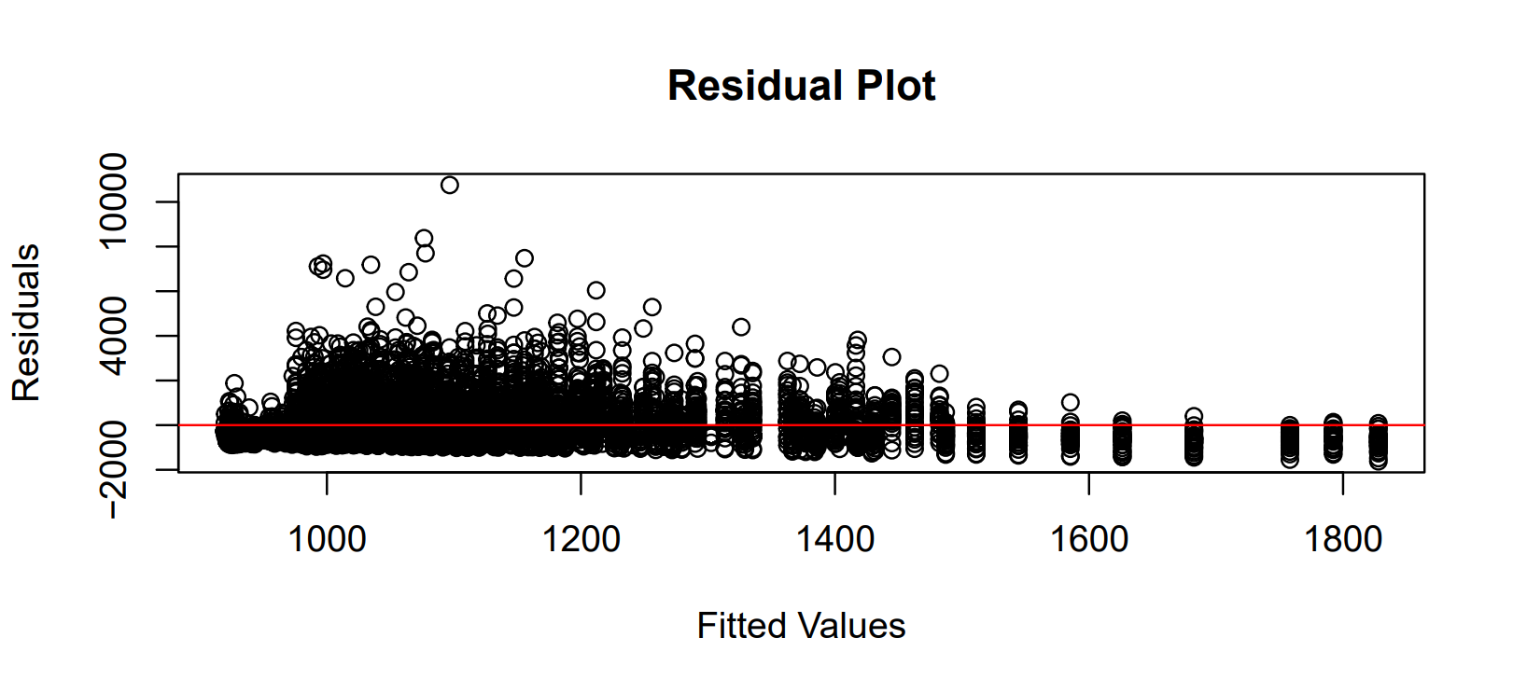
Limitations of our Analysis
Missing Values For the missing electrical conductivity values for districts of various states, we used Group-specific Mean Imputation, as in, we calculated the mean of non-missing electrical conductivity values separately for each state. Then, used the state-specific mean to replace missing values within that state. This approach assumes that the missing values are missing at random within each state and that the mean conductivity value varies between states.
We could have also used Overall Mean Imputation: Calculate the mean of all non-missing electrical conductivity values across all states and districts combined. Then, use this overall mean to replace all missing values. This approach assumes that the missing values are missing completely at random (MCAR) and that the mean conductivity value is representative of the entire dataset.
Outliers
There are outliers in our analysis.
They can be visualized using the following plot,
some values are way more than the others and are
clearly visible isolated in the plot. To get rid of outliers,
we could identify them and remove them entirely.
Or, we could replace outliers with less extreme values.

