Slide 1

Dynamic Pricing Model for Airlines
Team 2:
Abhishek Ramchandani
Devansh Thard

Slide 2
Introduction
In the U.S. airline industry, dynamic pricing is a crucial strategy that leverages advanced machine learning algorithms to adjust ticket prices in real time based on demand, competition, and market trends. This approach integrates data from various sources like historical sales, search frequency, and passenger booking patterns. By using predictive models such as regression analysis and machine learning techniques like random forests, airlines can accurately forecast demand and optimize both load factors and profitability. This shift toward data-driven pricing reflects the industry's adaptation to the digital age, where quick analysis and action on large volumes of data are essential for competitive advantage.

Slide 3

Goals
Our project aims to create a dynamic pricing model for the U.S. airline industry by analyzing a vast dataset. We seek to identify the key factors influencing flight pricing and build a predictive model for accurate ticket price forecasting. By leveraging machine learning algorithms, we aim to offer airlines actionable insights for real-time pricing adjustments, enhancing profitability and market agility. Our goal is to develop a model that drives revenue growth for airlines while ensuring fair and responsive pricing for consumers.

Slide 4
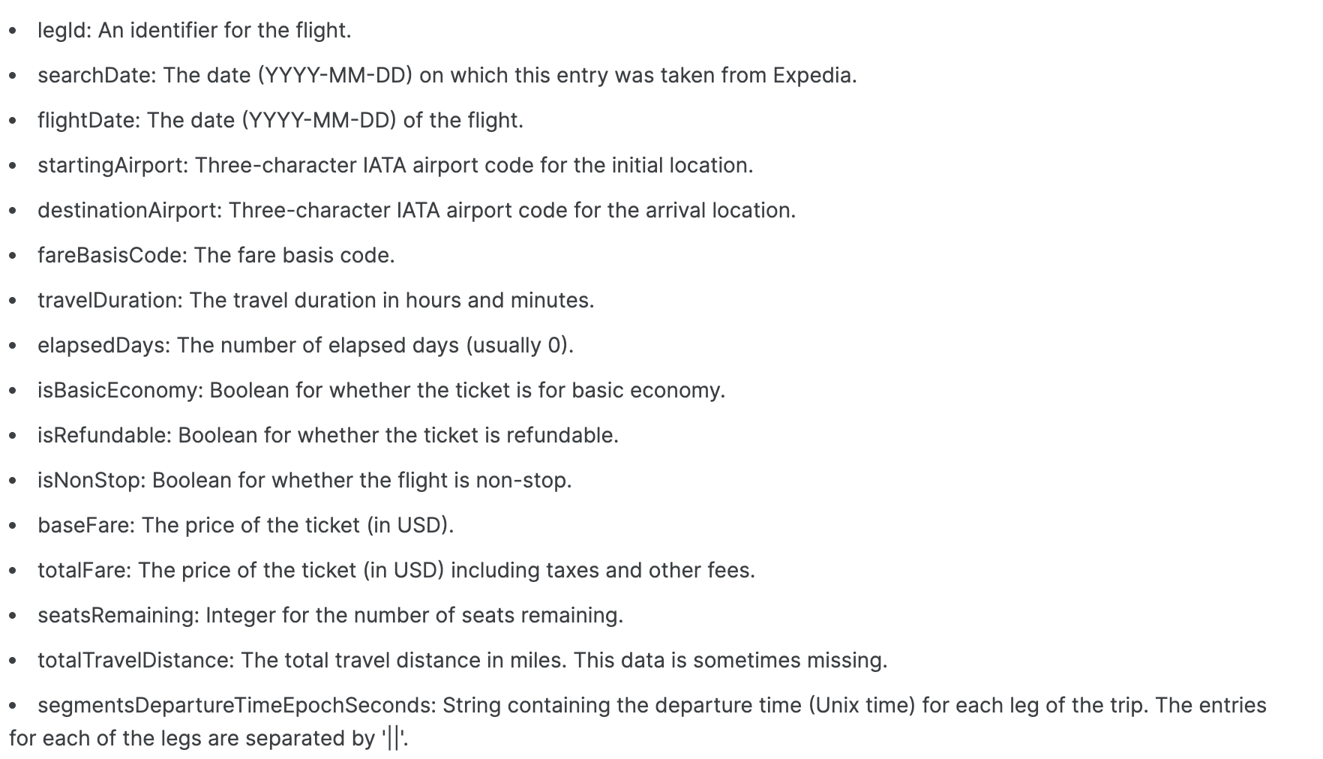
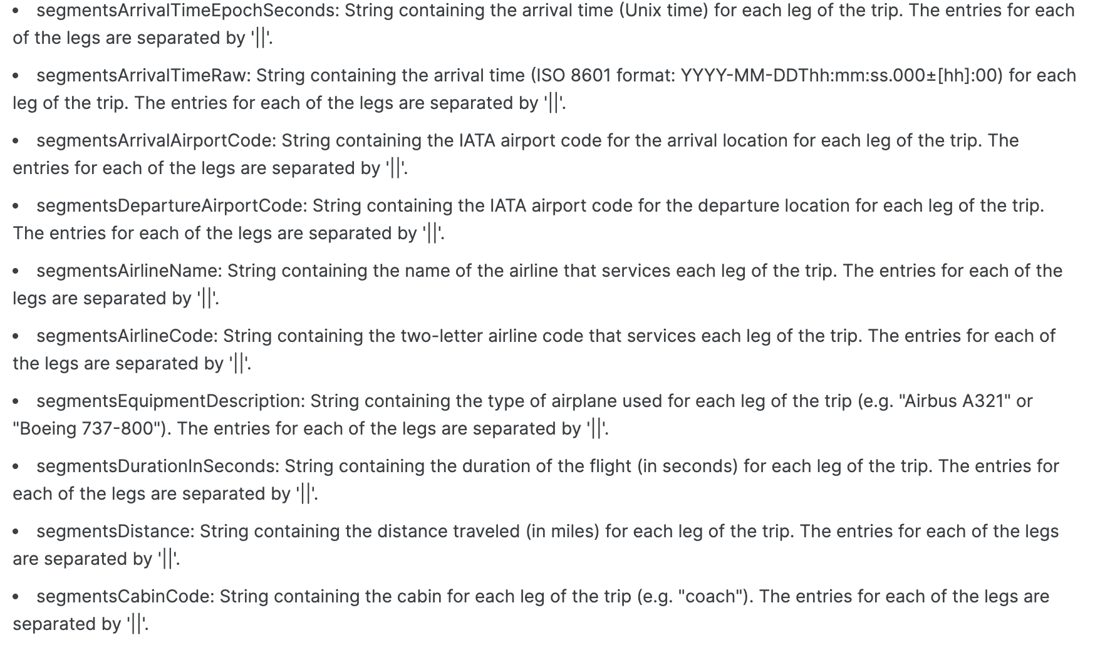
What are we trying to do?
Datapoints we are dealing with
We wish to correlate features with the price to see which features are strongly related to price variation.
Pearson’s correlation coefficient for Linear Model.
Spearman’s Rank correlation for the advanced models
Build new features based on time-series related data.
Find and execute suitable models that return optimal results for our testing and training data.

Slide 5
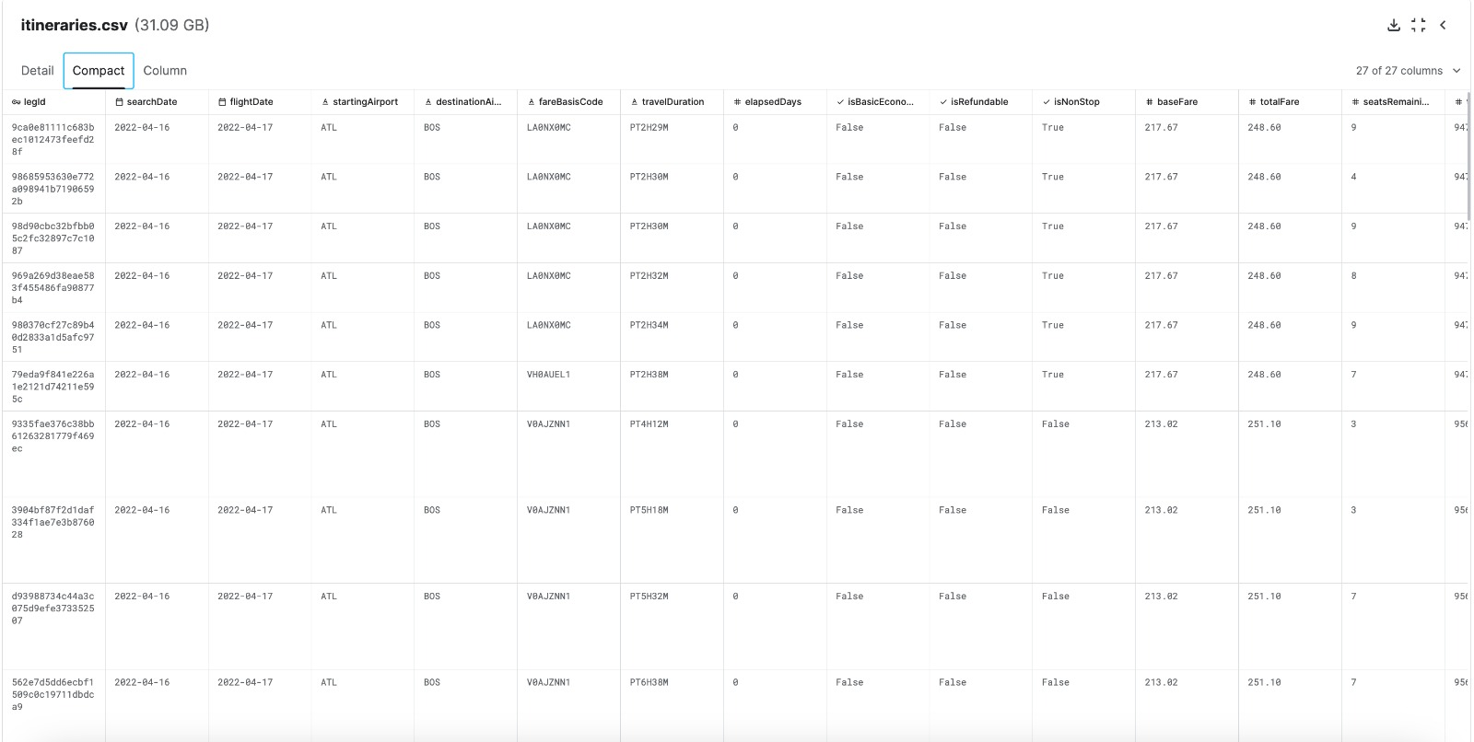
What do we have so far?
A Feature Rich dataset that can perform and prove to be a good resource if refined further, as we intended to do.
We reduced dimensionality of the data to ensure model accuracy alongside encoding all data using label & frequency encoding and z-scale normalization.

Slide 6

How do we go on about it?
EDA & Data cleaning
Handling Categorical Data
Feature Engineering
Data Sampling and Model selection

Slide 7
Data Cleaning Methods Used
Handling the missing values by :
Imputation: Filling in missing values using statistical methods.
Deletion: Removing rows or columns with missing values if they are deemed insignificant or cannot be reliably imputed.
Normalizing Fare Amounts
Z-score normalization: Standardizing fare values to have a mean of 0 and a standard deviation of 1.

Slide 8
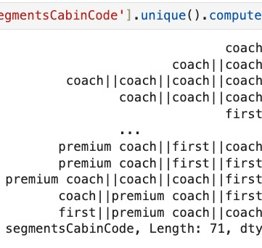
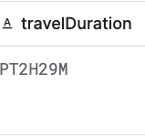
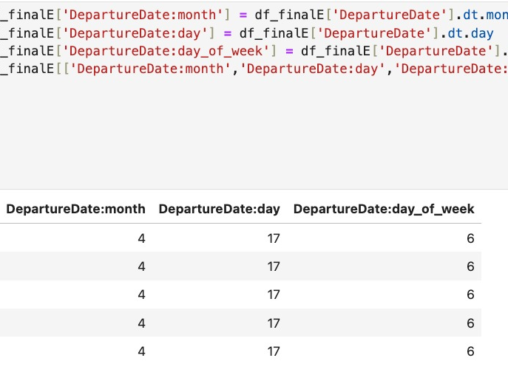
Data Cleaning
Data cleaning is the process of identifying and rectifying errors, inconsistencies, and inaccuracies within a dataset to ensure its integrity and usefulness for analysis. This involves handling missing or erroneous values, removing duplicate entries, standardizing data formats, and addressing outliers that could skew results.

Slide 9

Handeling Categorical Variables
Handling categorical variables involves converting qualitative data into a numerical format that can be utilized in statistical models and machine learning algorithms. This process, known as encoding, assigns a unique numerical value to each category within a variable. Common techniques include one-hot encoding, which creates binary columns for each category, and label encoding, which assigns integers to categories based on their frequency or some other criteria.

Slide 10
Handling Categorical Variables
Faced challenges encountered with one-hot encoding, leading to increased dimensionality.
Transitioned to label & frequency encoding technique for efficient resource management for categorical variables.
Made use of frequency encoding usage to make categorical data suitable for machine learning models by encoding them based on their frequency of occurrence.

Slide 11

Feature Engineering
Feature engineering is about selecting or creating the most relevant variables in a dataset to improve machine learning model performance. It involves identifying key predictors, crafting new features, and transforming variables for better prediction accuracy. Effective feature engineering is essential for extracting valuable patterns and relationships from data, leading to more accurate and interpretable models.

Slide 12
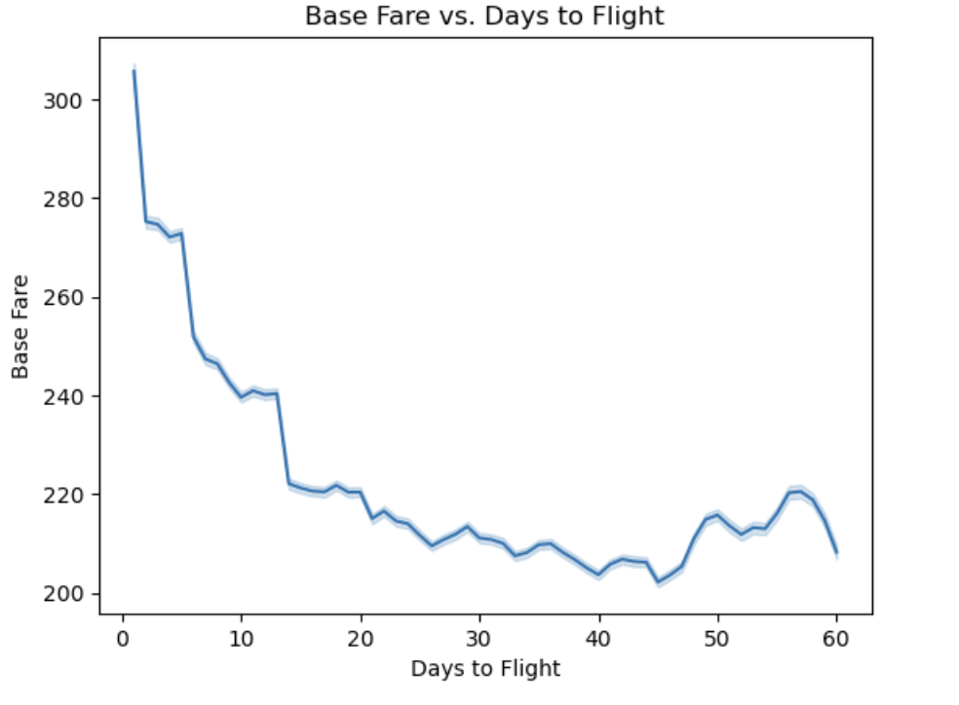
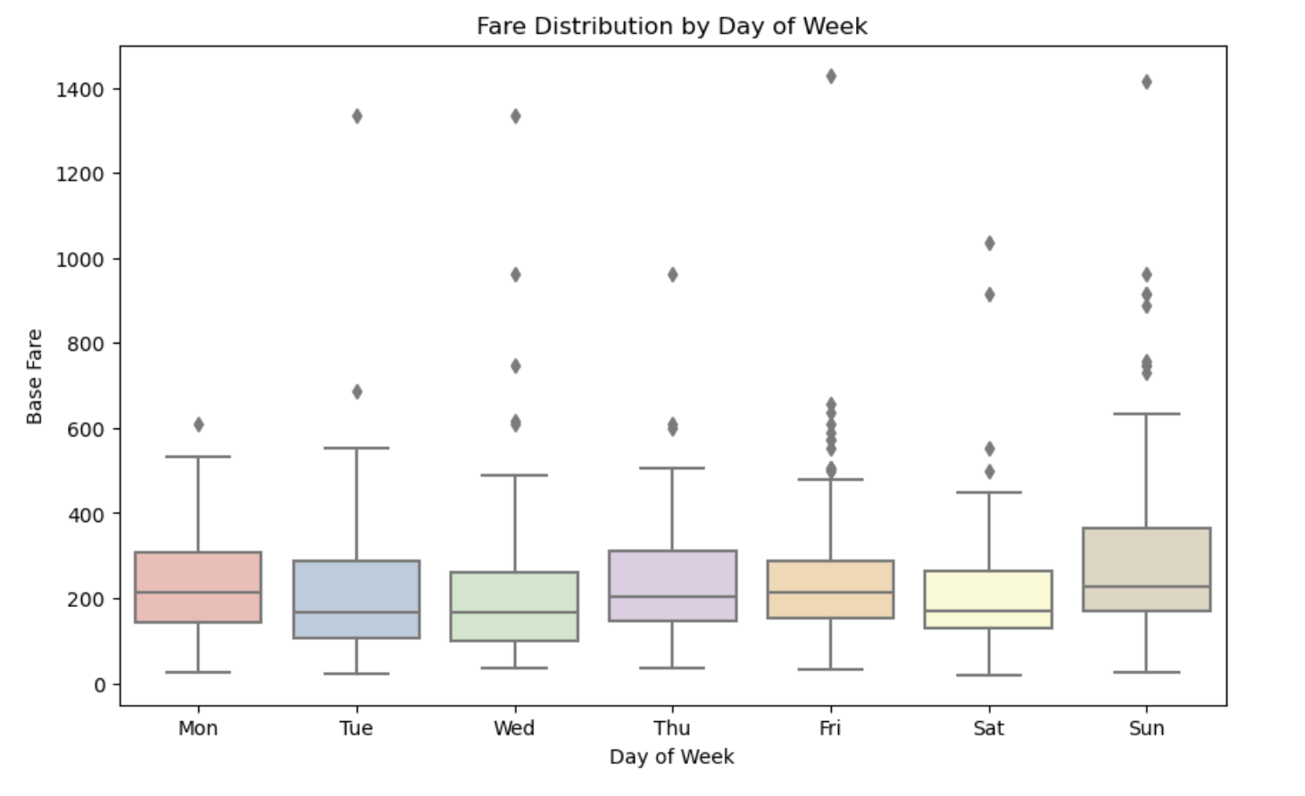
EDA:
As we can we see, the closer you are to the date of the flight the more expensive the flight price will be
Base Fare tends to be higher on Sundays, midweek and (surprisingly) Mondays indicating people like travelling during these days of the week

Slide 13
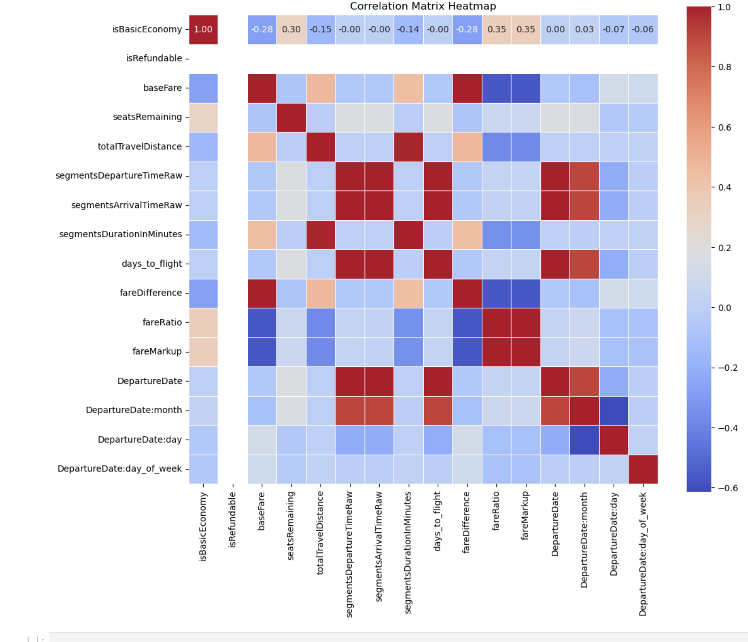
EDA:
As we can we see, the closer you are to the date of the flight the more expensive the flight price will be
Base Fare tends to be higher on Sundays, midweek and (surprisingly) Mondays indicating people like travelling during these days of the week

Slide 14

Feature Engineering
Detailed description of newly engineered features:
daysToFlight: Capturing time duration between search date and departure date
fareDifference, fareRatio, fareMarkup: Calculating variations and markup in fare prices.
DepartureDate: month, day & day_of_week: Extracting temporal features for analysis and store datetime information.
Encoding categorical variables related to airport, airline, equipment, and cabin to numerical format.
Extracting hour and minute information for departure and arrival times.
These emphasis on the role of feature engineering in enhancing model performance and capturing additional nuances in pricing data.

Slide 15

Data Sampeling and Model Selection
Data sampling involves selecting a representative subset from a larger dataset to train and evaluate machine learning models efficiently while mitigating biases. Model selection is the process of comparing and evaluating various algorithms' performance metrics, such as accuracy or error rates, to choose the most suitable one for a specific predictive task. These steps are essential for building robust machine learning models that generalize well to unseen data and effectively address the problem at hand.
Notes:
Data sampling has been really helpful in our project. We've used it to fix some problems we had with our data. For example, we might have had too much of one type of data or some unusual bits that messed up our results. By picking out specific parts of our data or making sure we have the right mix of examples, we've made our models work better. This means they can give us more accurate predictions

Slide 16

Data Sampling and Model Selection
The data sampling process involved selecting a representative subset of 5 million rows from the dataset to manage data size while preserving critical insights.
Made use of native xgB,lgbm,lr,ridge,lasso libraries for initial model evaluation and selection.
Model selection criteria and evaluation methods encompassed algorithms such as linear regression, lasso & ridge regression, light gradient boost, and XGBoost.
Evaluating models on the entire dataset was essential to accurately assess performance in terms of precision and generalization capabilities, guiding further refinement and optimization efforts.
Notes:
We started by picking a smaller but still representative chunk of data, about 5 million rows, to work with. Then, we tried out different algorithms like xgBoost, LightGBM, linear regression, ridge regression, and lasso regression to see which one works best for our job. We looked at things like how accurate they were and if they could handle new data well. This helped us figure out which algorithm was the best fit for our needs. We did all this testing on the whole dataset to make sure we got reliable results. It helped us fine-tune and improve our models until we found the one that worked best.

Slide 17
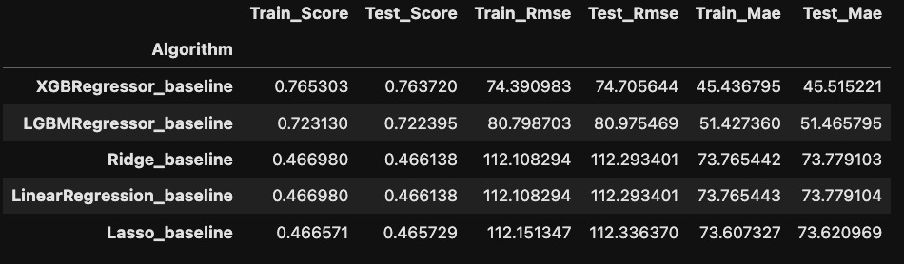
Results
Overview to show how XGBoost outperforms standard Ridge and Linear Regression by almost 60%
All models are probably being overtrained because of how rich in features the data is so we can see high accuracy in train and test scores
Notes:
since we are dealing with the regression problem metrix such as precision and recall do not convey the results we wish to achieve, so we made use of metriics such as root mean squared error, mean abs error and r-square.
R-square
Root mean squared
Mean abs error

Slide 18
Linear Regression
Linear regression helps us understand how different things like booking early or flight routes affect ticket prices by drawing a straight line on a graph.
It's a simple way to see which factors are most important for predicting prices, making it a good starting point before using more complex models.
Notes:
In our project, we used linear regression because it's easy to understand and shows how one thing affects another in a straight line. For example, we can see how factors like how far in advance you book or which airports you're flying between influence ticket prices. It's like drawing a straight line through a bunch of points on a graph to predict prices. Linear regression helps us figure out which factors matter the most for setting ticket prices. Even though it's simple, it's a good starting point for building more complicated models.

Slide 19
Linear Regression
Output
Problems faced:
Linear Regression struggles with non-straight relationships between features and the target.
It can be thrown off by unusual data points and when features are too similar to each other.
Notes:
Linear Regression is a simple but sometimes limited model. It struggles when the relationship between features and the target isn't straight, and it might not handle complex patterns well. It also needs certain conditions to be met to make good predictions, like the data needing to be in a certain shape. Plus, it can be thrown off by unusual data points and when features are too similar to each other. That's why, when our data is tricky, we often try other models like trees or neural networks. These models can handle more complex situations and might give us better predictions.

Slide 20
XGBoost
XGBoost is excellent at handling complex airline pricing data, finding patterns even in messy or incomplete information.
It helps us build a smart model that predicts ticket prices accurately and quickly adapts to changes in the market, maximizing airline revenue while ensuring fair prices for customers.
Notes:
We chose to use XGBoost in our project because it's really good at understanding complicated data like the kind we have in airline pricing. XGBoost is famous for being able to find patterns in data that aren't just simple lines or curves. It's also great at handling missing information and dealing with lots of different factors all at once. Basically, it's like having a smart system that learns from its mistakes to make better predictions. This helps us build a model that can predict ticket prices accurately, even when things are changing fast. With XGBoost, airlines can set prices that make the most money while still giving customers good deals.

Slide 21
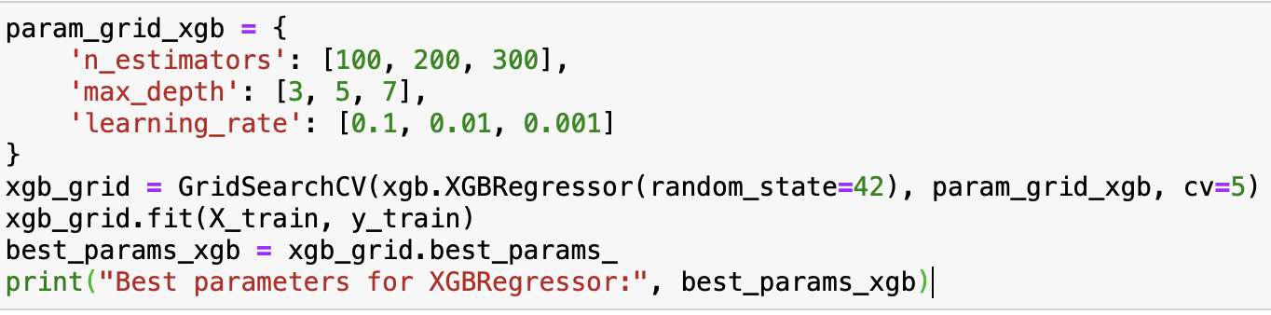
XGBoost
Hyperparameter Tuning:
n_estimators: The grid search evaluates the model performance with 100, 200, and 300 boosting rounds.
max_depth: The grid search considers trees with maximum depths of 3, 5, and 7.
learning_rate: The grid search tests learning rates of 0.1, 0.01, and 0.001.
Notes:
In the code, we're trying to make XGBoost work its best by adjusting some settings. We're trying different values for things like how many "trees" it uses (n_estimators), how deep each tree can grow (max_depth), and how fast it learns from its mistakes (learning_rate). We're testing lots of combinations of these settings to see which one gives the best results when we check it against our data. Once we've tried them all, we pick the settings that make XGBoost perform the best. This helps XGBoost become really good at predicting things accurately.

Slide 22
LGBMBoost
LightGBM is chosen for its ability to handle large datasets efficiently and identify complex patterns quickly.
Its capability to learn from mistakes and improve predictions over time makes it ideal for real-time pricing adjustments in the dynamic airline industry.
Notes:
LightGBM is great for our project because it can learn from mistakes quickly and make better predictions over time. This is important for adjusting ticket prices in real-time, which is what we're aiming for in the airline industry. LightGBM also works well with different kinds of information, like airport codes or types of fares, which is helpful since there are many factors that affect flight prices.

Slide 23
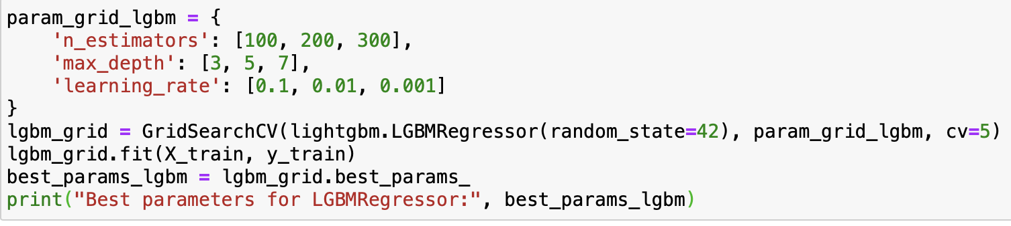
LGBMBoost
Hyperparameter Tuning:
n_estimators: LGBM will be tested with 100, 200, and 300 trees to determine which number works best.
max_depth: It will be tested with trees of maximum depths 3, 5, and 7 to find the optimal depth.
earning_rate: LGBM will be tested with learning rates of 0.1, 0.01, and 0.001 to determine which rate works best.
Notes:
In the code, we're trying to make LightGBM (LGBM) work better by finding the best settings by trying different combinations of settings, like how many trees it uses (n_estimators), how deep each tree can go (max_depth), and how fast it learns from its mistakes (learning_rate). We test these combinations using a method called cross-validation, which checks how well the model performs on parts of the training data it hasn't seen yet. After trying many combinations, we pick the ones that make the model perform the best, so it can make more accurate predictions.

Slide 24
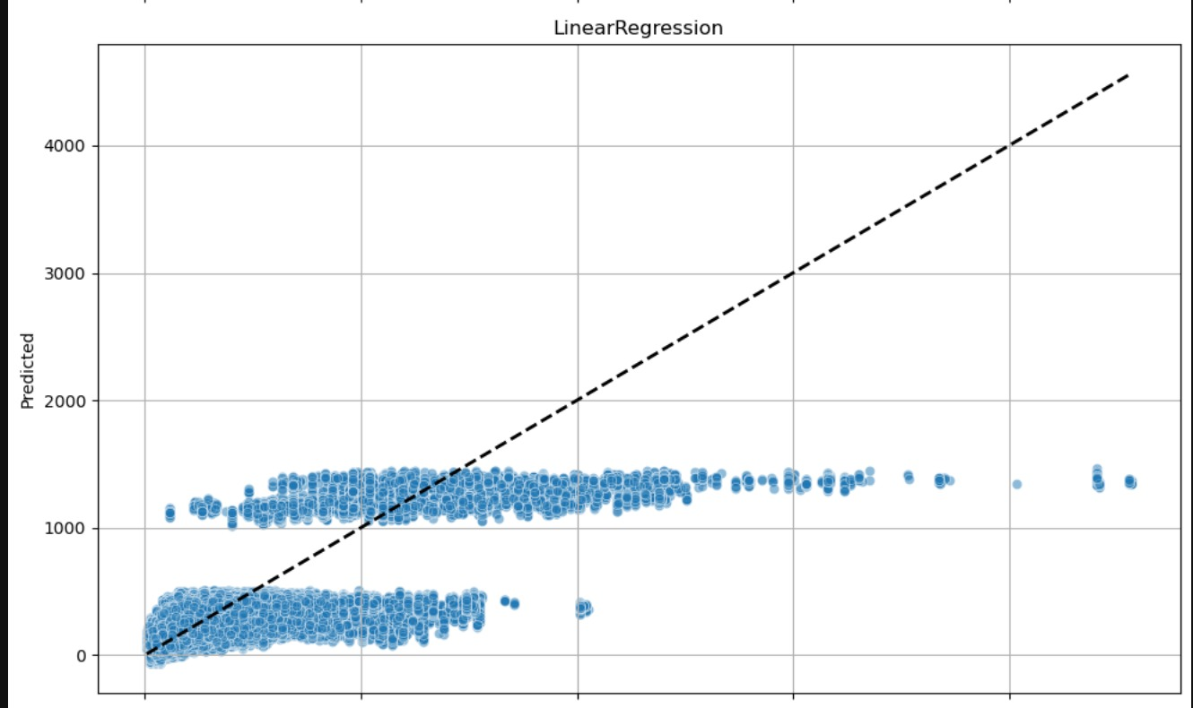
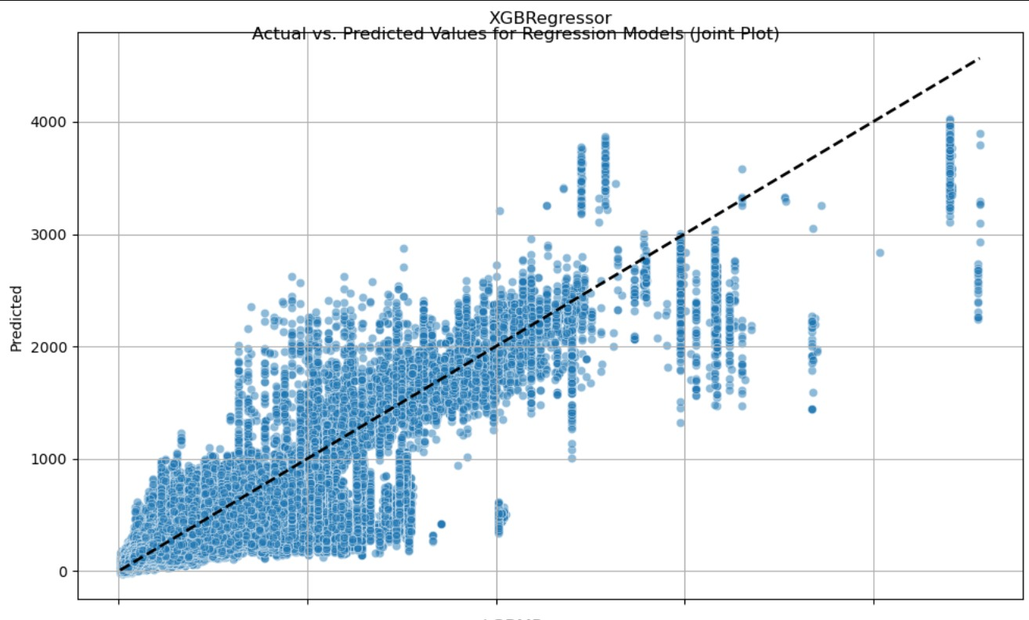
Results Visualization

Slide 25
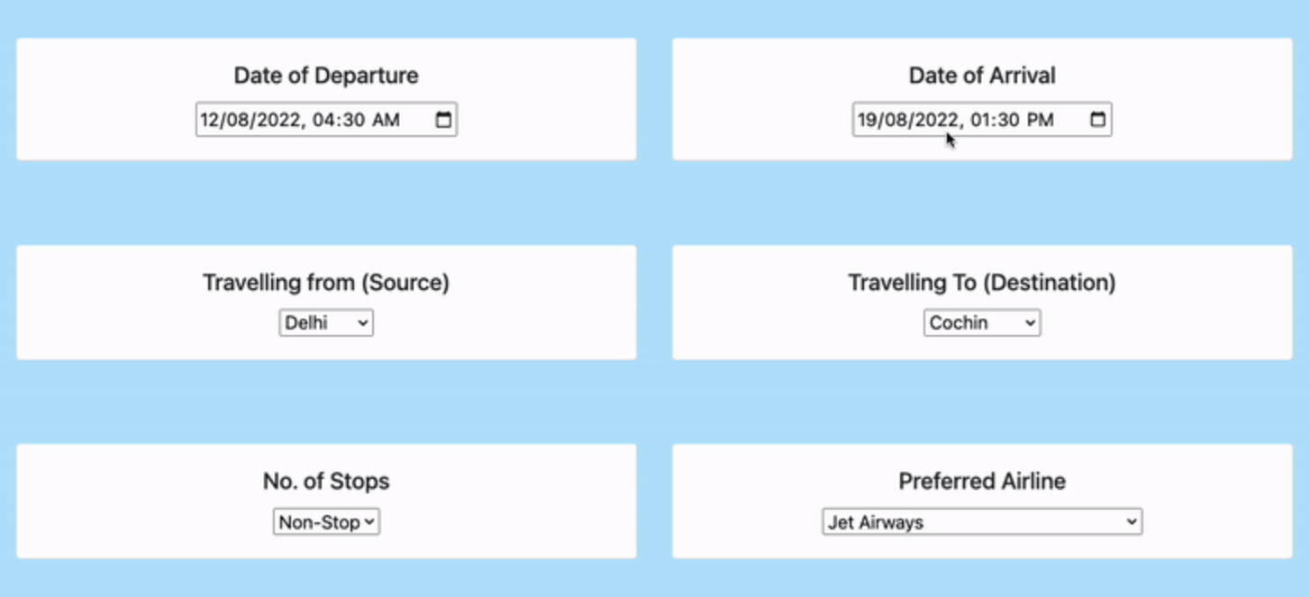
What do we wish to do?
If we get optimal results from the various models we wish to try:
Build a live Flask app that can take this model forward
Generate visualizations on PowerBI to understand patterns and further improvise on the system

Slide 26
Conclusion
Our project developed a dynamic pricing model for U.S. airlines, using advanced analytics and machine learning. We identified key predictors, employed ARIMA and Random Forest Regression for accurate price forecasting, and utilized Expedia data for real-time market response. Our model enhances profitability and consumer satisfaction, offering actionable insights for data-driven pricing strategies, improving industry efficiency and competitiveness.
Notes:
Our project created a smart pricing system for U.S. airlines. We used fancy math and computer tricks to figure out the best prices. By studying lots of data from Expedia, we can quickly adjust prices to match what people are willing to pay. This helps airlines make more money and keeps customers happy. Our system gives airlines useful advice on pricing, making them better at their job and more competitive.

Slide 27

Thank you!

