Slide 1




Presenting:
Techno-Firmo Intelligence Platform
Project Group 4
Shubham Agarwal Chinmay Deshpande Devansh Thard Ajay Reddy

Slide 2
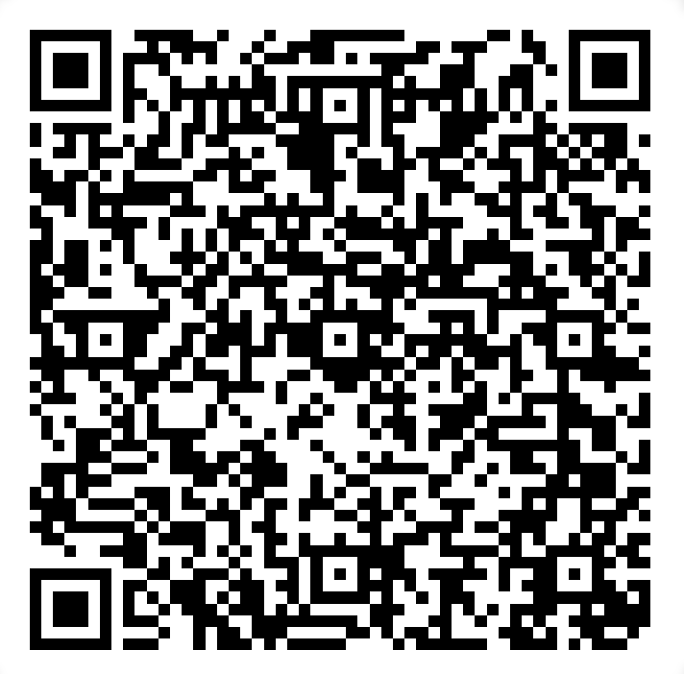
Design Document
Major Content:
ER-Diagram
Entities/Attributes
All SQL Scripts
Visualization - Tableau
User-Interface(Java, Swing, PHPMyadmin, XAMPP Control Panel)
Scan to Access

Slide 3
Introduction, purpose, scope
Introduction:
Utilizing firmographics and technographics data in constructing a database empowers the facilitation of diverse business operations and enhances the decision-making processes.
Purpose:
Developing a database providing Techno-Firmo Intelligence aids tech vendors in swift sales decisions and targeting high-potential customers.
Scope:
Using firmographics and technographics, yields tangible advantages: higher conversion rates, accelerated product development, precise market insights, better customer support, risk mitigation, and improved content engagement. These percentages indicate potential enhancements from employing these data-driven methods.

Slide 4
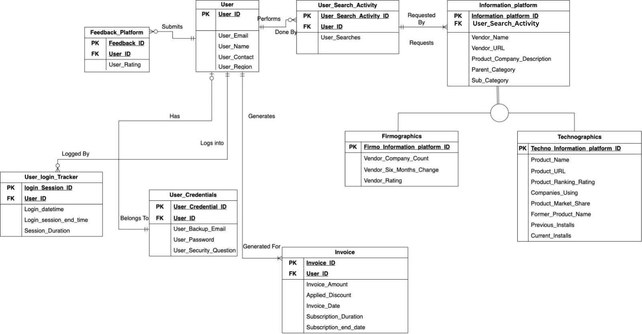
Enhanced Entity Relationship Diagram

Slide 5
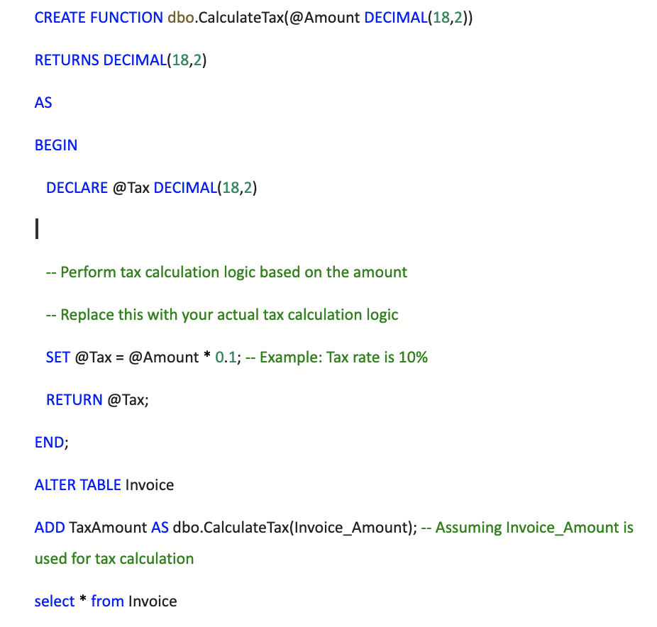
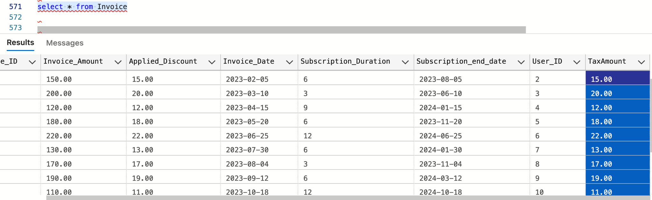
SQL #1
user defined function (UDF):
The UDF calculates TAX for a provided Invoice Amount Formula: Tax = Amount * 0.1

Slide 6
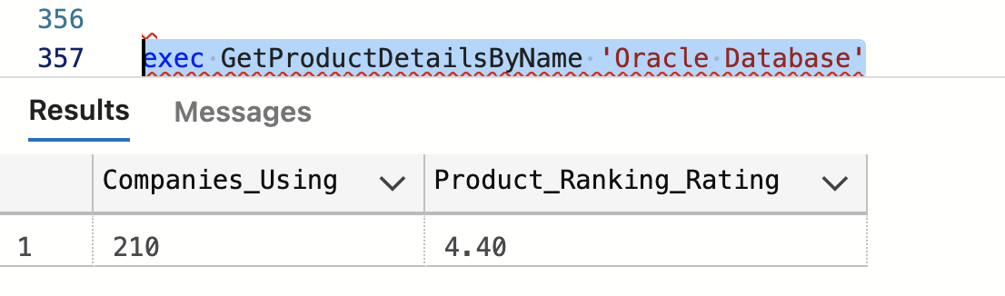
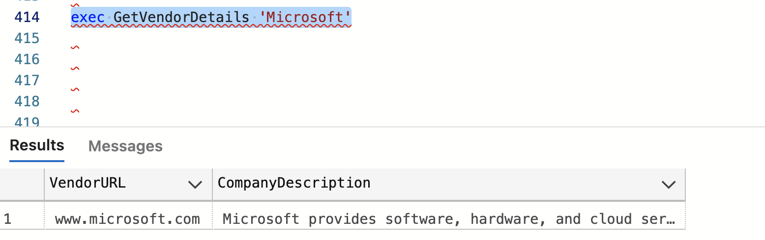
SQL #2
Stored Procedure #1
Get Product Details By Name
Takes product name as input and provides information of the respective product, companies using the product, product ranking and rating.
Stored Procedure #2
Get Vendor Details
Takes Vendor Name as an input and provides vendor url, and product/company description.

Slide 7
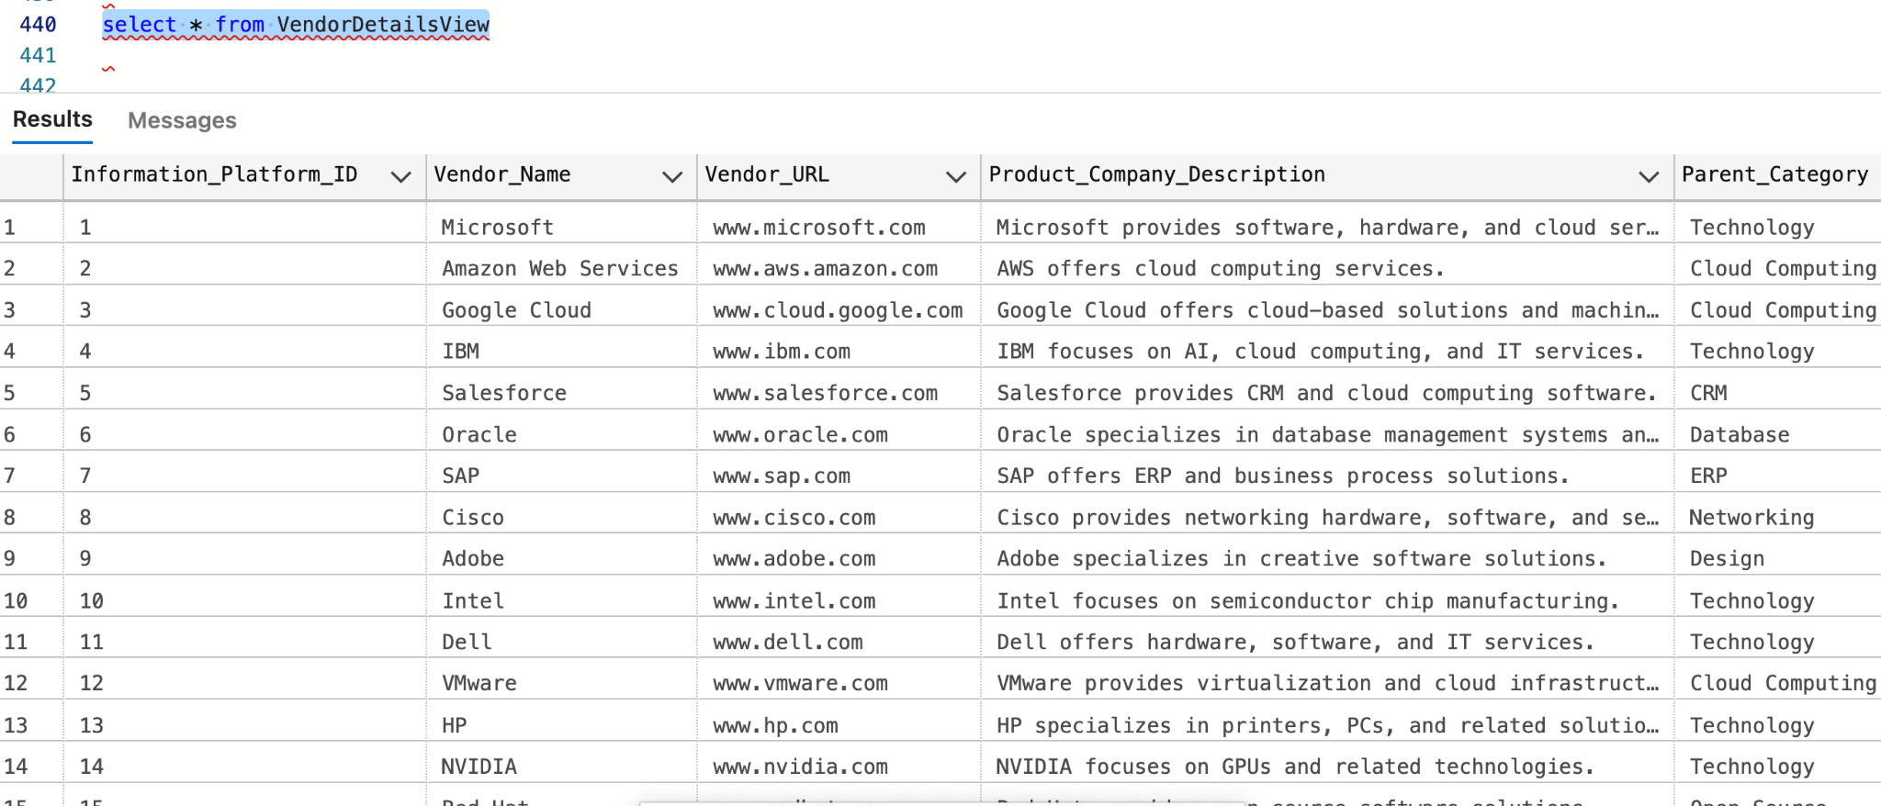
SQL #3
View
Vendor DetailsView
Provides all the related vendor information from Information platform
Trigger
Trg Information Platform History
If there are any updates made to the original Information platform table, this trigger will add all the original data to a seperate table so that the logs of pre-change can be preserved.

Slide 8
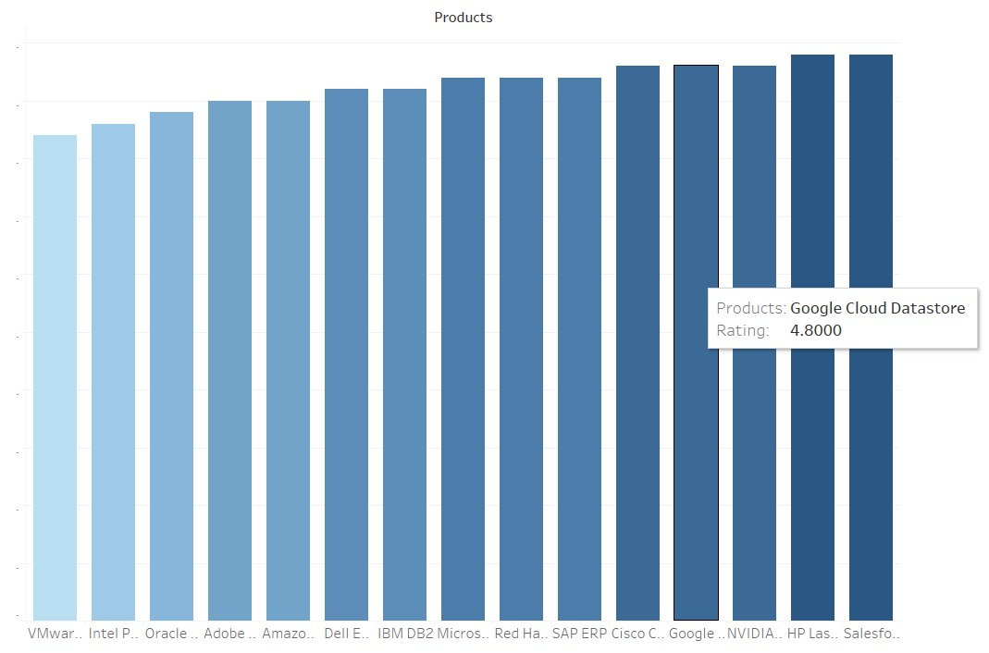
Project Visualization - Tableau #1
Bar chart represents Products and the corresponding ratings given by users.

Slide 9
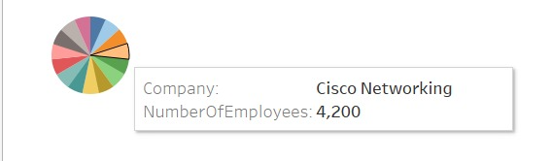
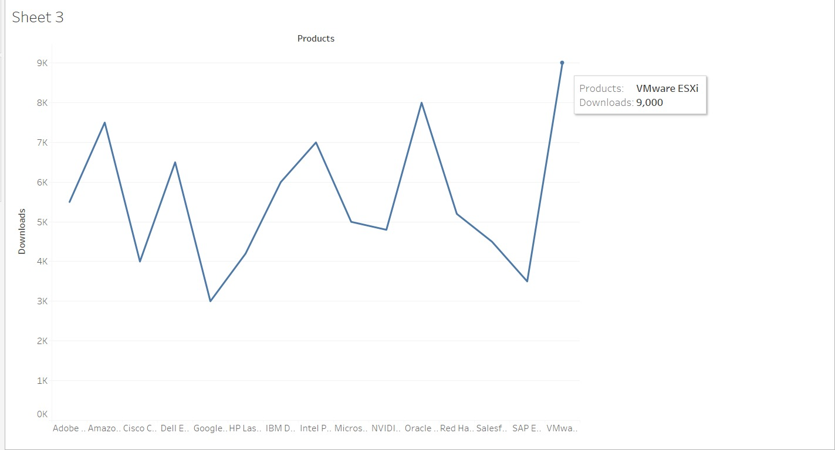
Project Visualization - Tableau #2
Pie Chart shows the number of employees working for a specific Vendor.
The Line Graph shows the surge in downloads of a specific Product and compares it to the other available products.

Slide 10
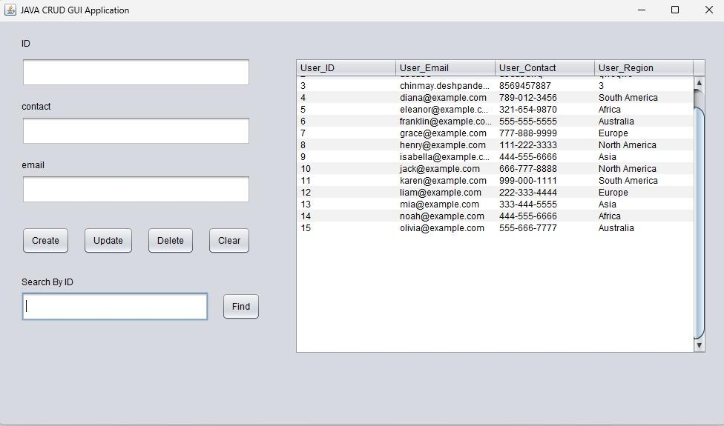
User Interface
Thank You
Through the User Interface, a database administrator has the capability to review the roster of current users, add new ones, modify existing user information, and remove users as needed.

