Slide 1




AI-Based Energy Usage Prediction System
Team Members:
Devanshu Sawarkar
Pratham Agrawal
Devansh Motghare
Pradyumn Waghmare
Ayush Gupte

Slide 2

Learning Objectives
Understand the importance of energy consumption prediction in smart homes and energy management systems.
Identify how LSTM neural networks can be applied to time series forecasting for energy data.
Analyze the methodology for processing household power consumption data and training predictive models.
Evaluate the effectiveness of zone-wise energy prediction for different household appliances.
Apply similar deep learning techniques to other time series prediction problems in IoT and smart systems.
GOAL

Slide 3
Tools and Technology used
Primary Technologies
Programming Language: Python
Deep Learning Framework: Keras with TensorFlow backend
Web Application Framework: Streamlit
Data Processing: Pandas, NumPy
Machine Learning Libraries
Neural Networks: Keras Sequential API, LSTM layers
Data Preprocessing: MinMaxScaler from scikit-learn
Time Series Processing: Pandas resample functionality
Visualization: Streamlit built-in charts and matplotlib
Dataset
Source: Individual Household Electric Power Consumption Dataset (UCI/Kaggle)
Size: 2,075,259 measurements over 47 months (Dec 2006 - Nov 2010)
Features: Sub-metering data for Kitchen, Laundry, and AC/Heater zones
Development Tools
IDE/Editor: Jupyter Notebook, VS Code
Version Control: Git, GitHub
Model Format: HDF5 for model serialization

Slide 4
Problem Statement:
Background
With increasing energy costs and environmental concerns, households need intelligent systems to optimize energy consumption. Traditional energy monitoring provides historical data but lacks predictive capabilities for proactive energy management.
Core Problem
How can we predict future energy consumption patterns for different zones in a household to enable smart energy management and cost optimization?
Challenges Identified
Complex Time Series Patterns - Energy consumption follows complex daily, weekly, and seasonal patterns that are difficult to model with traditional statistical methods
Zone-Specific Prediction - Different household have distinct usage patterns requiring specialized models
Data Quality and Missing Values - Real-world energy data contains missing requiring robust preprocessing
Impact of the Problem
Without predictive energy management, households face unnecessary high energy bills, inefficient appliance usage, and inability to participate in demand response programs. This leads to both economic losses for consumers and increased strain on power grids during peak demand periods.

Slide 5
Solution:
We developed an AI-powered energy prediction system that uses LSTM neural networks to forecast daily energy consumption for three household zones, integrated into a user-friendly web application for real-time predictions and energy management insights.
Key Features
Zone-Wise Prediction: Separate models for Kitchen, Laundry, and AC/Heater zones with specialized pattern recognition.
LSTM Deep Learning: Advanced neural networks that capture long-term dependencies in energy consumption patterns.
Interactive Web Interface: Streamlit-based application allowing users to input parameters and visualize predictions instantly.
Real-Time Forecasting: On-demand predictions with immediate results and actionable insights.
Innovation and Unique Aspects
Our solution stands out through its zone-specific modeling approach, which recognizes that different household areas have distinct energy usage patterns. Unlike generic energy prediction systems, our multi-model architecture provides more accurate forecasts by training specialized models for each appliance category.

Slide 6
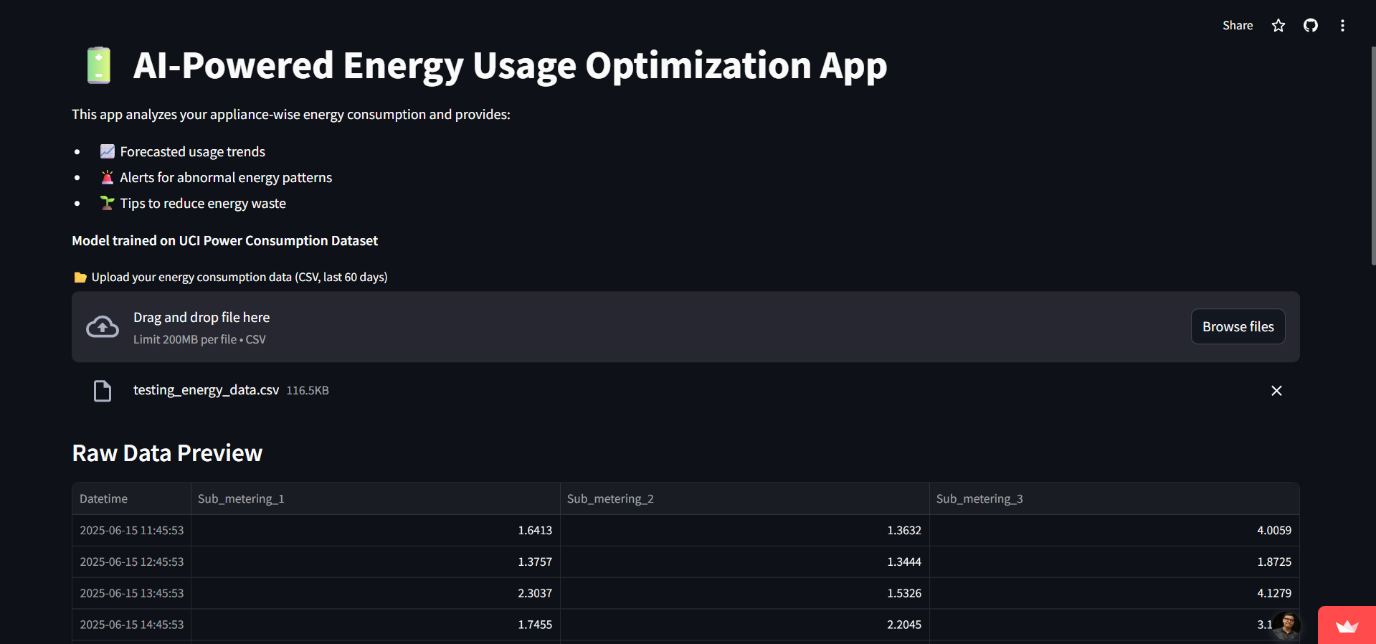
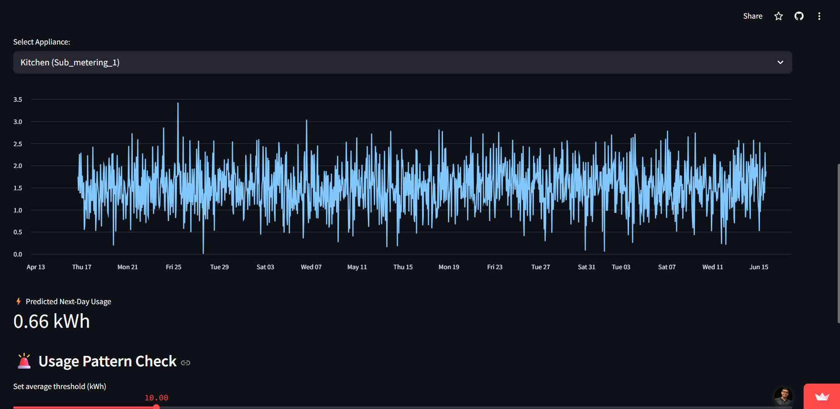
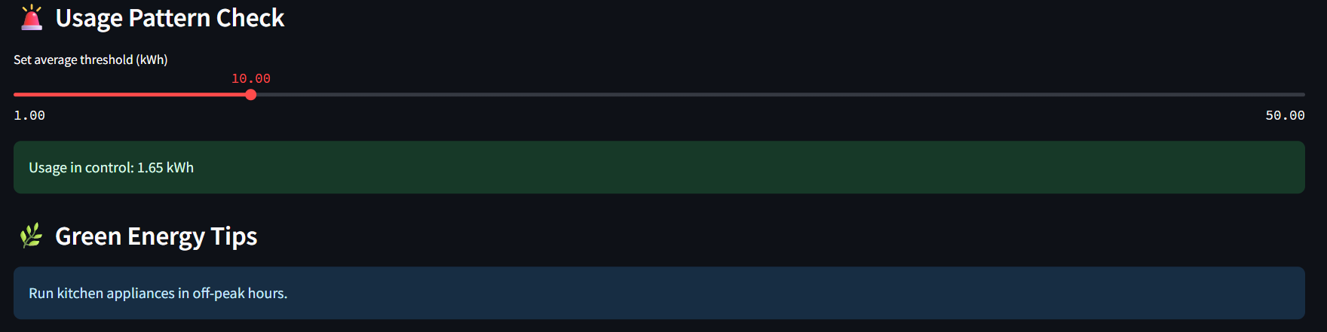
Screenshot of Output:

Slide 7
Conclusion:
Successfully developed a comprehensive AI-based energy prediction system using LSTM neural networks with zone-specific modelling.
Implemented three specialized prediction models achieving effective pattern recognition for different household appliances.
Delivered a user-friendly web application with real-time prediction capabilities and intuitive visualization.
Results Summary
Dataset Processing: Successfully processed 2,075,259 energy measurements spanning 47 months
Model Training: Trained and deployed three LSTM models with 64→32→1 architecture for optimal prediction accuracy
Application Deployment: Live web application accessible globally via Streamlit Cloud platform
This project demonstrates the practical application of deep learning in smart energy management, providing households with predictive insights for energy optimization. The solution contributes to sustainable energy consumption practices and enables proactive energy management, potentially reducing household energy costs by 10-15% through informed usage decisions.

Slide 8
Appendix:
Streamlit Deployed Link: https://aibasedenergyusagepredictionsystem-devanshusawarkar.streamlit.app/
Devanshu Sawarkar GitHub URL: https://github.com/DevanshuSawarkar/AI_Based_Energy_Usage_Prediction_System
Pratham Agrawal GitHub URL: https://github.com/PrathamAgrawal51/AI_Based_Energy_Usage_Prediction_System
Devansh Motghare GitHub URL:
https://github.com/devansh7444/AI_Based_Energy_Usage_Prediction_Sys
Pradyumn Waghmare GitHub URL:
https://github.com/Xtrmcoder/AI_Based_Energy_Usage_Prediction_System
Ayush Gupte GitHub URL:
https://github.com/AyushGupte-22/AI_Based_Energy_Usage_Prediction_System

