Slide 1

SOFE 4790U – Final Project: Resilient Weather System
Group Members: Miguel Arindaeng, Devan Shah

Slide 2
Agenda
Project Introduction
List of Stakeholders and Requirements
Architectural Design & Class Diagram
Implementation Details
Demonstration
Question Period

Slide 3
Project Introduction
A need for a resilient weather system that provides quick and non-complex updates
Through a simple client-server based distributed system, we can achieve a resilient weather system
Information is fetched from ATOM feeds of various cities through the Canadian government website and displayed to registered clients
Through the use of heartbeat monitoring, we can make our weather system resilient
Notes:
Right now there are many weather systems that provide a lot of information; this can overwhelm the user and our weather service looks to simplify the details of the weather
Priority is quick-glance information over detailed items of information
Based on techniques learned in class, we can implement an architecture that obtains live data from the Canadian government website and displays it in a minimalistic format
ATOM feeds are basically like RSS feeds that provide constant updates to the weather in various cities, with many types of ATOM feeds corresponding to different types of weather information (i.e. current weather, warnings feeds, marine feeds)
We thought the use of heartbeat (i.e. monitors checking the server to see if is still alive) was a perfect way to keep our weather system resilient

Slide 4
List of Stakeholders
Primary stakeholders would be:
Meteorologists
Canadian military personnel
National Park Staff
General public who need real-time, reliable, and quick weather information
Secondary stakeholders would be:
General public
Government employees maintaining the ATOM feeds on the government weather website
Notes:
- All these stakeholders have an interest in knowing what’s going on in the weather outside due to the nature of their jobs

Slide 5
List of Requirements
Constantly update feeds for:
Current conditions and forecast of selected city (less detailed than quick weather)
Warning feeds (i.e. public weather warnings from the Government of Canada)
Marine feeds (i.e. ice warnings, snow squalls, wind speed, visibility, outdoor pressure, for marine life)
Provide at-a-glance weather for selected city
Only important information (i.e. temperature, mini-picture of current weather, wind-chill, etc.) will be displayed

Slide 6
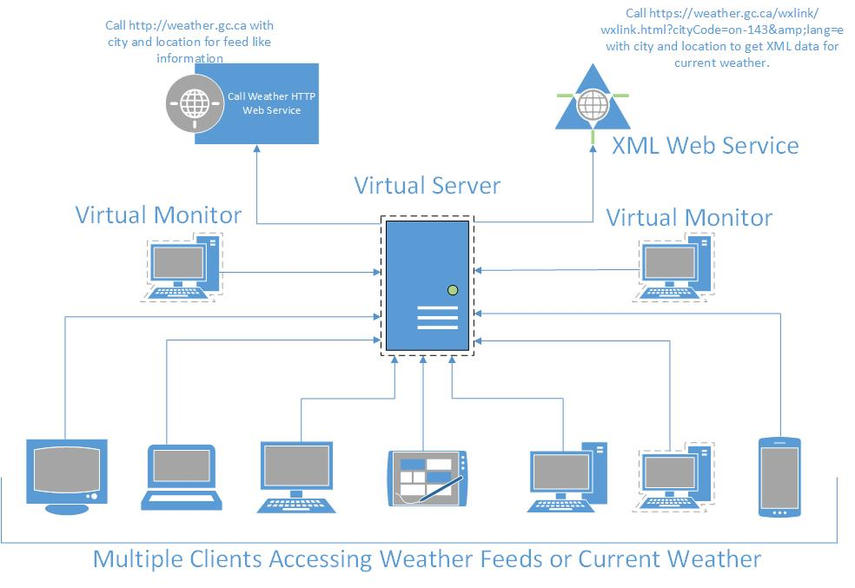
Architectural Design

Slide 7
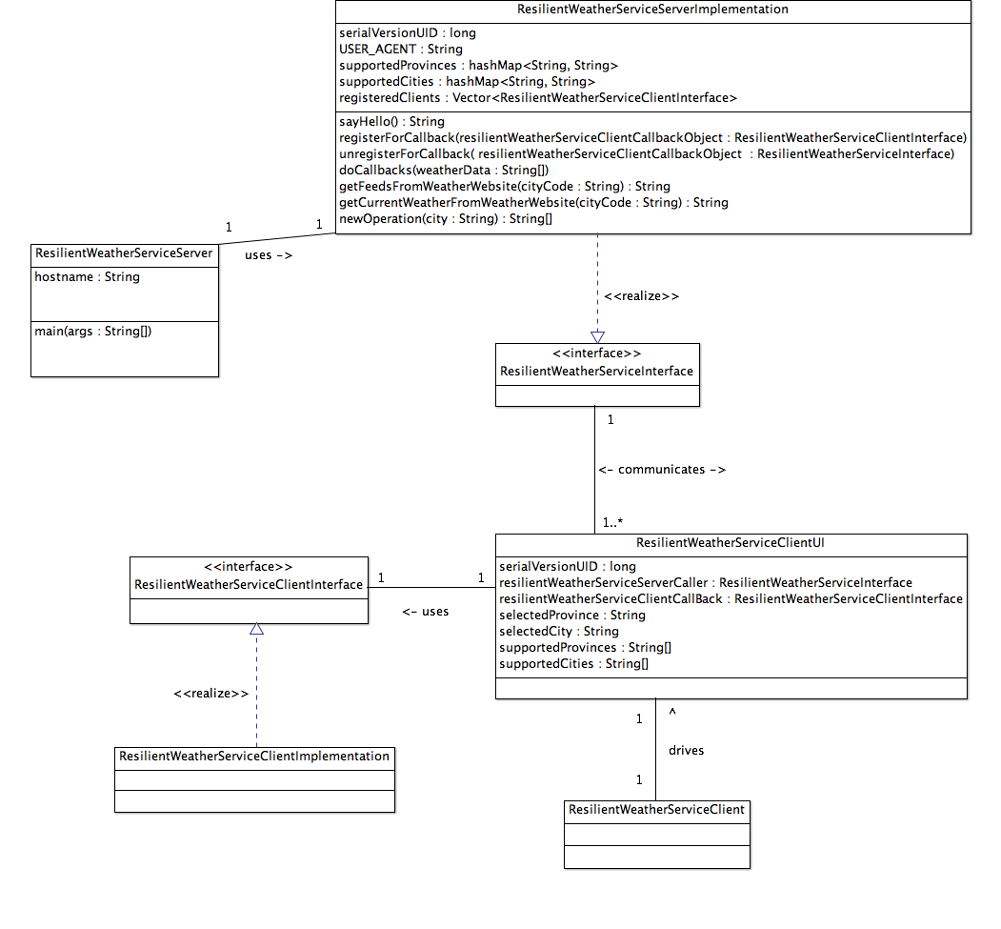
Class Diagram

Slide 8
Implementation Details
Use Java RMI b/w client and server and uses callbacks to send information between client and server
Two drop-down menus (in settings) used to select current city and province to get information
Feeds & Quick Weather information is updated with each button click
Using Java Swing package to implement client-side UI
When settings (i.e. location) are set Feeds and Quick Weather are automatically updated
Notes:
(put in screenshot of UI?)

Slide 9
Demonstration…

Slide 10
Thanks for listening!
Question Period

