Slide 1
Inter Process Communication Mechanism
Devansh Awasthi (ENG17CS0065)
Deepak Purohit (ENG17CS0062)
BVM Anirudh (ENG17CS0048)
CV Vishwas (ENG17CS0054)

Slide 2
Introduction
Inter process communication (IPC) is used for exchanging data between multiple threads in one or more processes or programs. The Processes may be running on single or multiple computers connected by a network. The full form of IPC is Inter-process communication.
It is a set of programming interface which allow a programmer to coordinate activities among various program processes which can run concurrently in an operating system. This allows a specific program to handle many user requests at the same time.
Since every single user request may result in multiple processes running in the operating system, the process may require to communicate with each other. Each IPC protocol approach has its own advantage and limitation, so it is not unusual for a single program to use all of the IPC methods.

Slide 3
In most cases an IPC package is used to establish inter-process communication. Depending upon the nature of the chosen IPC, the package sets up a data structure in kernel space. These data structures are often persistent. So once the purpose of IPC has been fulfilled, this set-up needs to be deleted (a clean up operation). The usage pattern of the IPC package in a system (like system V Unix) can be seen by using explicit commands like ipcs. A user can also remove any unused kernel resources by using a command like ipcrm.

Slide 4
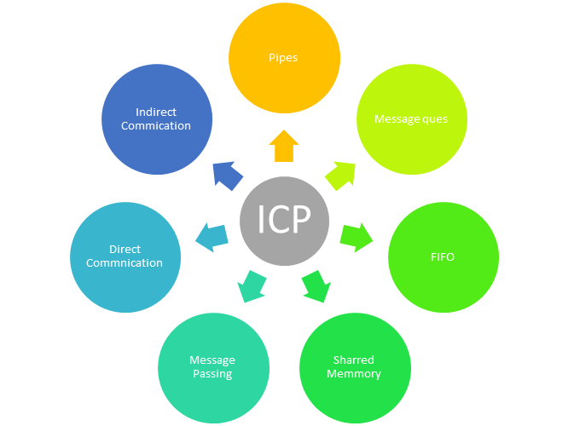
Approaches for Inter-Process Communication

Slide 5
Pipes:
Pipe is widely used for communication between two related processes. This is a half-duplex method, so the first process communicates with the second process. However, in order to achieve a full-duplex, another pipe is needed.
In reading the programs, the following interpretations have to be borne in mind:
1. The pipe is defined by the declaration pipe(p_des).
2. The dup command replaces the standard I/O channels by pipe descriptors.
3. The execlp command is used to populate the child process with the desired code.
4. The close command closes the appropriate ends of the pipe.
5. The get_str and rev_str processes are pre-compiled to yield the required executables
It is important to note the following about pipes as an IPC mechanism:
Unix pipes are buffers managed from within the kernel.
Pipes are useful when both the processes are schedulable and are resident on the same machine. So, pipes are not useful for processes across networks.
The read end of a pipe reads any way. It does not matter which process is connected to the write end of the pipe. Therefore, this is a very insecure mode of communication.
Pipes cannot support broadcast

Slide 6
Message Passing:
Message passing, refers to the sending of a message to a process which can be an object, parallel process, subroutine, function or thread. This message can be used to invoke another process, directly or indirectly. Message passing is especially useful in object-oriented programming and parallel programming when a single message (in the form of a signal, data packet or function) is sent to a recipient.
Message passing relies on the process and its supporting organization to call the actual code to run. It is basically communication between two processes, subroutines, or functions within a program. Modern computer software largely uses message passing to implement efficient programming techniques. In networks such as the Internet, where objects may also be working from various computers, the process of message passing plays an important role. Channels are an efficient way to implement message passing in modern systems.

Slide 7
Message Queues:
A message queue is a linked list of messages stored within the kernel. It is identified by a message queue identifier. This method offers communication between single or multiple processes with full-duplex capacity.
A new queue is created or an existing queue opened by msgget().
New messages are added to the end of a queue by msgsnd()
Messages are fetched from a queue by msgrcv().
ftok(): is use to generate a unique key.
All processes can exchange information through access to a common system message queue. The sending process places a message (via some (OS) message-passing module) onto a queue which can be read by another process. Each message is given an identification or type so that processes can select the appropriate message. Process must share a common key in order to gain access to the queue in the first place.

Slide 8
Shared Memory:
Shared memory is a memory shared between two or more processes that are established using shared memory between all the processes. This type of memory requires to protected from each other by synchronizing access across all the processes.
Inter-related process communication is performed using Pipes or Named Pipes. Unrelated processes (say one process running in one terminal and another process in another terminal) communication can be performed using Named Pipes or through popular IPC techniques of Shared Memory and Message Queues.
We know that to communicate between two or more processes, we use shared memory but before using the shared memory what needs to be done with the system calls, let us see this −
Create the shared memory segment or use an already created shared memory segment (shmget())
Attach the process to the already created shared memory segment (shmat())
Detach the process from the already attached shared memory segment (shmdt())
Control operations on the shared memory segment (shmctl())

Slide 9
Direct Communication:
In this type of inter-process communication process, should name each other explicitly. In this method, a link is established between one pair of communicating processes, and between each pair, only one link exists.
Processes must name each other explicitly: –
send (P, message) – send a message to process P
receive(Q, message) – receive a message from process Q
• Properties of communication link
– Links are established automatically.
– A link is associated with exactly one pair of communicating processes.
– The link may be unidirectional (e.g. signaling), but is usually bi-directional (e.g. sockets).

Slide 10
Indirect Communication:
Indirect communication establishes like only when processes share a common mailbox each pair of processes sharing several communication links. A link can communicate with many processes. The link may be bi-directional or unidirectional.
Properties of communication link
– A link may be associated with many processes.
– Each pair of processes may share several communication links.
– Link may be unidirectional or bi-directional.
Operations
– create a new mailbox
– send and receive messages through mailbox
– destroy a mailbox
• Primitives are defined as:
send(A, message) – send a message to mailbox A
receive(A, message) – receive a message from mailbox A

Slide 11
FIFO:
A FIFO(First In First Out) is similar to a pipe. The principal difference is that a FIFO has a name within the file system and is opened in the same way as a regular file. This allows a FIFO to be used for communication between unrelated processes.
Communication between two unrelated processes. It is a full-duplex method, which means that the first process can communicate with the second process, and the opposite can also happen.
It is an extension to the traditional pipe concept on Unix. A traditional pipe is “unnamed” and lasts only as long as the process.
A named pipe, however, can last as long as the system is up, beyond the life of the process. It can be deleted if no longer used.
Usually a named pipe appears as a file and generally processes attach to it for inter-process communication. A FIFO file is a special kind of file on the local storage which allows two or more processes to communicate with each other by reading/writing to/from this file.
A FIFO special file is entered into the filesystem by calling mkfifo() in C

Slide 12
Sockets – This method is mostly used to communicate over a network between a client and a server. It allows for a standard connection which is computer and OS independent.
Sockets are an endpoint of communication and a name can be bound to them. A socket can be associated with one or more processes.
Types of Sockets
The different types of sockets are given as follows −
Sequential Packet Socket: This type of socket provides a reliable connection for datagrams whose maximum length is fixed This connection is two-way as well as sequenced.
Datagram Socket: A two-way flow of messages is supported by the datagram socket. The receiver in a datagram socket may receive messages in a different order than that in which they were sent. The operation of datagram sockets is similar to that of passing letters from the source to the destination through a mail.
Stream Socket: Stream sockets operate like a telephone conversation and provide a two-way and reliable flow of data with no record boundaries. This data flow is also sequenced and unduplicated.
Raw Socket: The underlying communication protocols can be accessed using the raw sockets.

Slide 13
What Is The Need Of IPC?
It helps to speedup modularity
Computational
Privilege separation
Convenience
Helps operating system to communicate with each other and synchronize their actions.

Slide 14
THANK YOU

