Slide 1
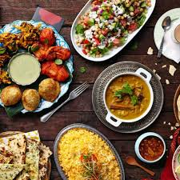
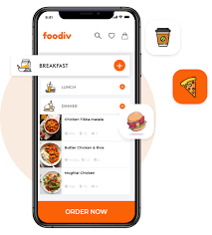
FOOD ORDERING SYSTEM
NAME: DEVANSH BISHT MENTOR NAME:MR.PRAMOD MEHRA
UNIVERSITY ROLL NO: 2018778
SECTION: B
CLASS ROLL NO: 22

Slide 2
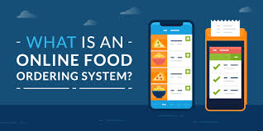
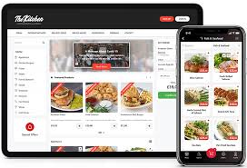
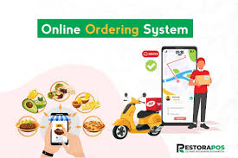
INTRODUCTION
We had created a project with the help of web development tools.
The project we had developed is a Food Ordering Application with the help of HTML, CSS, PHP , XAMMP for hosting server side.
Offline ordering systems in the food industry face several significant challenges. These include inefficiencies in handling high volumes of orders, which often lead to long waiting times and customer dissatisfaction. Additionally, the lack of real-time data on customer preferences and ordering patterns hampers targeted marketing and personalized customer service.

Slide 3
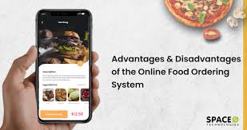
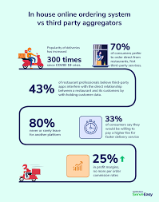
ADVANTAGES OF FOOD ORDERING SYSTEM:
User-Friendly Interface: Easy navigation, clear categories, and intuitive design to enhance user experience.
Comprehensive Menu: Detailed menu with images, descriptions, prices, and customization options.
Secure Payment Gateway: Integration with reliable and secure payment gateways for hassle-free transactions.
Order Tracking: Real-time tracking of orders from preparation to delivery.
Customer Support: Live chat, helpdesk, or contact forms for addressing customer queries and issues.
Mobile Compatibility: Mobile-friendly design or dedicated mobile app for users who prefer ordering on their smartphones.
Analytics and Reporting: Tools to monitor sales, customer behavior, and other key metrics.
Promotions and Discounts: Easily manageable promotional campaigns and discount codes.

Slide 4



Methodology
Creating Database:
Open the XAMPP Control Panel and start the Apache and MySQL modules. Next, open a web browser and navigate to http://localhost/phpmyadmin, which brings you to the phpMyAdmin interface. Here create a database naming food-order and 5 tables for admin, categories, food, order and contact.
Creating Frontend:
At start we created the frontend using HTML and CSS. Here we created the front page which shows the different categories and food items. Then we added different pages with each other as we made different pages so that it will be easy for the customer to choose their preferences from all the different menu items available.

Slide 5



Then we created a order page in which customer specify their orders and provide other details such as quantity, servings
and also fill their details so that there won’t be any problem to deliver their food.
Creating Backend:
Then by using PHP we created the backend which is being connected with the database.
Here we created the option to add admin and update their details if they want to remove an admin. For adding different categories present in our restaurant and also able to update the categories or remove them. We added food items so that they can be added category wise so they will be easily accessible to the user. Added the option where we can change the order details if requested by the customer and also change the order status accordingly so that restaurant will know if the order is delivered or not.

Slide 6

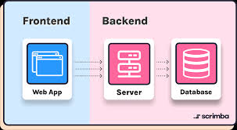
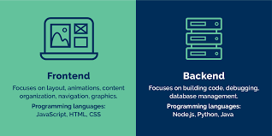
Integrating the back-end with front-end:
We integrate the back-end with front-end as we change all the HTML files in front-end to PHP files so that they can connect with database so they show all the options available in the database to the customers and admin can easily make changes in the website accordingly.
We also made a dashboard which shows the admin total categories present currently and total food items which are being served by the restaurant. It also shows total orders the restaurant got and total earning it did by calculating all the order values which had been delivered by adding all the order total prices.

Slide 7
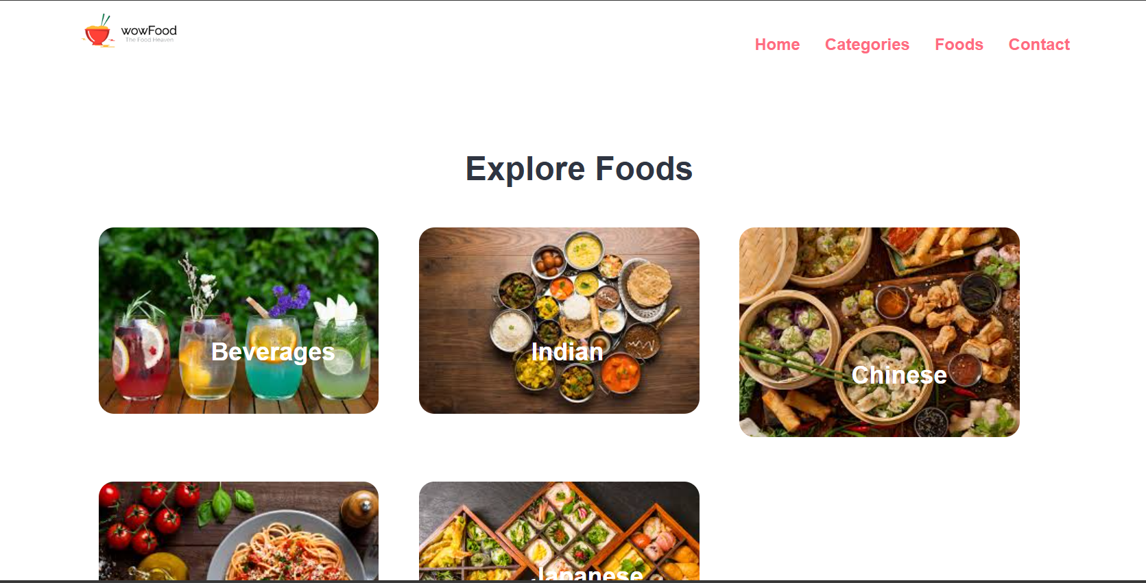
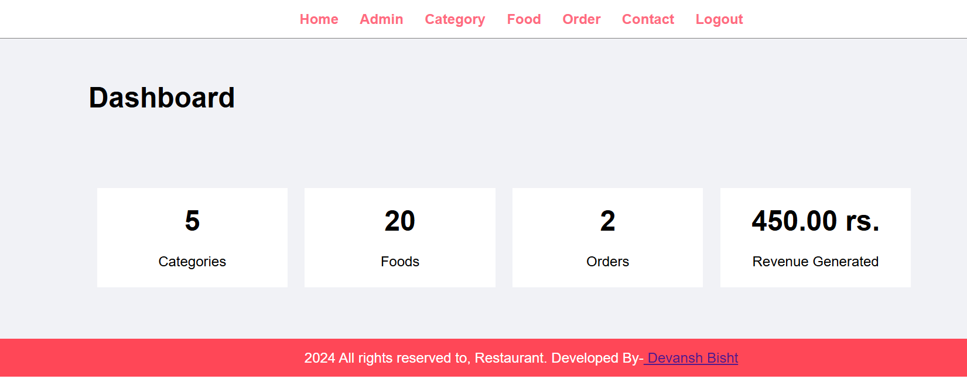
RESULTS

Slide 8
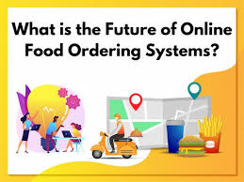
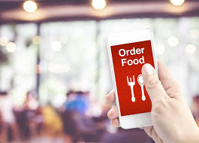
FUTURE WORKS
AI and Machine Learning Integration: Implementing AI to provide personalized recommendations based on user preferences, ordering history, and current trends.
Voice Ordering: Integrating voice recognition technology to allow customers to place orders using voice commands via smart speakers or mobile apps, offering a hands-free and convenient ordering experience.
Augmented Reality (AR) Menus: Utilizing AR to create interactive menus where customers can view 3D images of dishes, see nutritional information, and even visualize the meal on their table before ordering.
Blockchain for Transparency: Using blockchain technology to ensure transparency in the food supply chain, allowing customers to track the origin of ingredients and ensuring food safety and authenticity.
Advanced Analytics: Developing advanced analytics tools to provide deeper insights into customer behavior, market trends, and business performance, enabling data-driven decision-making and more targeted marketing strategies.

Slide 9
Sustainability Features: Incorporating features that promote sustainability, such as tracking carbon footprints of meals, offering eco-friendly packaging options, and providing customers with incentives for choosing sustainable options.
Subscription Models: Implementing subscription-based services for regular customers, offering them exclusive deals, faster delivery, and personalized meal plans.
Seamless Integration with Smart Appliances: Creating systems that integrate with smart kitchen appliances, allowing for automated cooking based on orders and ensuring consistent quality and efficiency.
Enhanced Security Measures: Developing more robust security protocols to protect customer data and transaction information, ensuring compliance with privacy regulations and building customer trust.
Multi-Channel Ordering: Expanding ordering options across various platforms, including social media, chatbots, and wearable devices, providing customers with multiple convenient ways to place orders.

Slide 10
DISCUSSION
Through this project we obtained an application by which we can easily do voting in more secured and easy manner by using blockchain technology and JavaScript applications with the help of solidity as a programming language.
CONCLUSION
I have completed this project and I am immensely grateful to our esteemed Mentor Mr. Pramod Mehra for his Supervision and guidance without which this work would not have been Possible. This project has contributed a lot to my knowledge that has proved to be a value addition for me.

