Slide 1
ROSHNI
The streetlight repair queue, reordered by who is actually walking.
Problem Statement 17 · Smart Cities: Night-Safety Dark-Zone Mapper · Bengaluru
Notes:
Read the subtitle out loud as your first sentence. Do not introduce yourselves first — lead with the idea.

Slide 2
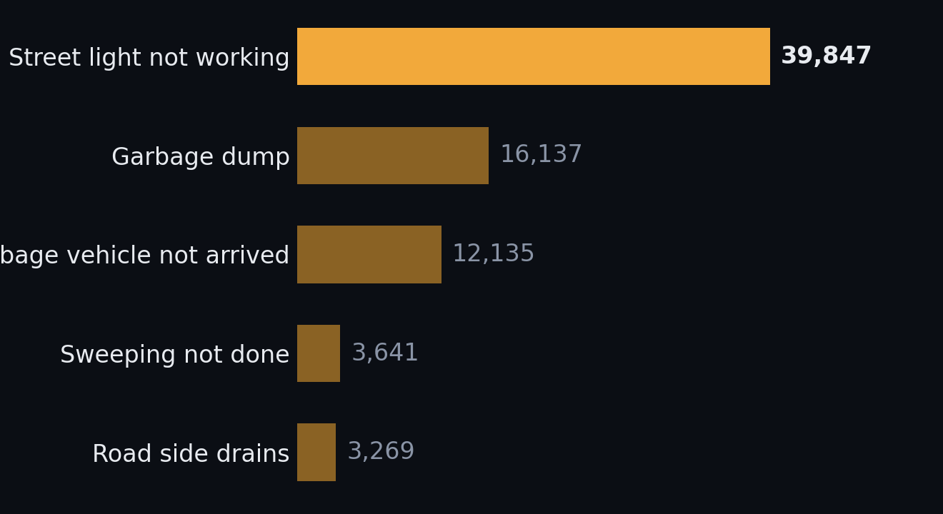
BENGALURU'S MOST-FILED COMPLAINT
31.4%
39,847 of the 126,974 civic complaints Bengaluru filed between 1 January and 19 June 2025 were “Street Light Not Working” — about 236 a day.
The largest complaint category in the city. Garbage is second, at 16,137.
BBMP grievance register, 1 Jan – 19 Jun 2025, via OpenCity. Recomputed from the raw CSV. n = 126,974.
Notes:
This is their number, not ours — and we recomputed it from the raw register rather than citing an analysis of it. Do not round to 'about a third'; the precision is the point.

Slide 3
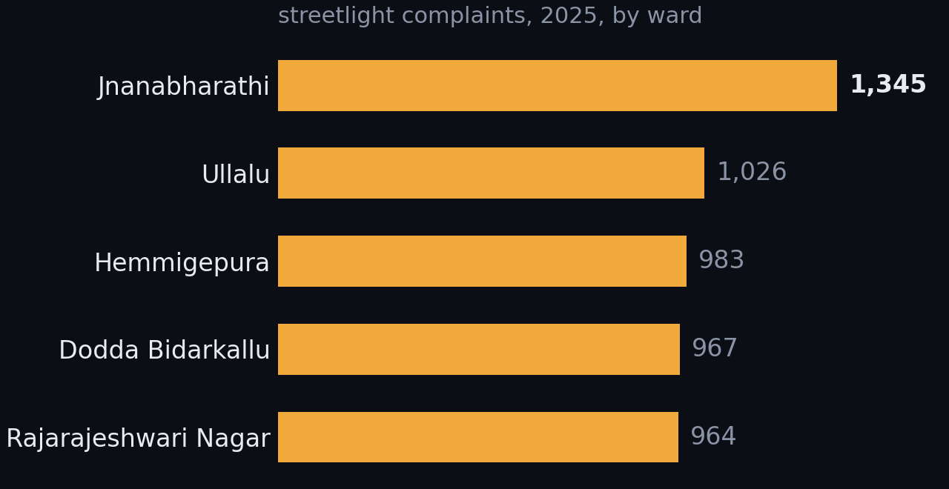
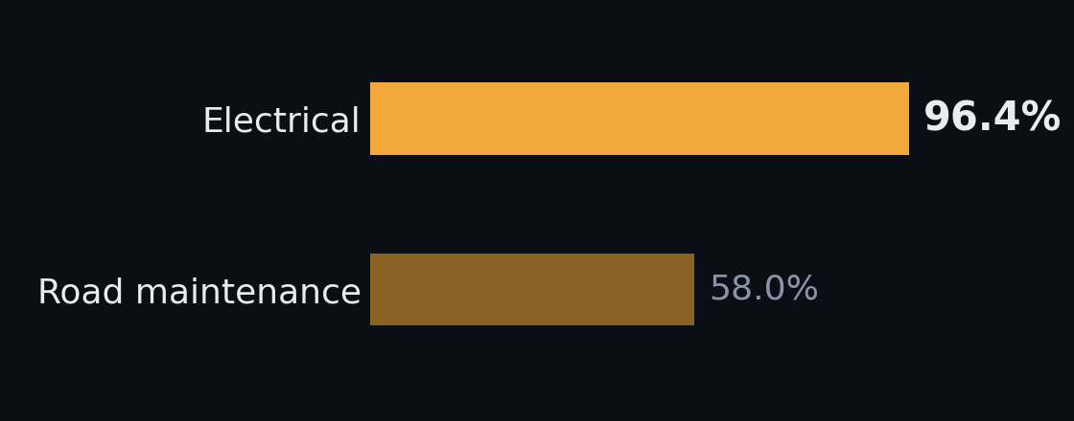
Not failing. Handed the wrong order.
96.4% of electrical complaints closed
And complaining is not the same as being exposed
40,632 of 42,138. Road maintenance closes 58%. They are not slow and not under-resourced. The queue is sorted by who complained first.
Newer, peripheral, more car-owning wards file most. Older, denser, more-walked wards file fewer — not because their lights work.
Same register. Left: Grievance Status field. Right: Sub Category = “Street Light Not Working”, grouped by Ward Name, 198 wards.
Notes:
The most important slide for a government judge. Never open by criticising the municipality — they will resent it and the data does not support it. Say the phrase: an efficient execution machine is being handed the wrong order. Do not use 'broken', 'failure', 'apathy', 'negligence'. Trap: these are streetlight-only ward counts, not all-category. Do not mix bases.

Slide 4
Three surfaces, one atom
Queue municipal THE HERO
Route citizen
Report citizen
A ranked worklist under a repair budget.
Safer and shortest walking route, side by side, always both.
One tap: “this stretch is dark.”
The atom is the road segment, not the lamp. A pedestrian at 23:00 does not care whether a street has eleven lamps or fourteen — they care whether the next 200 metres is lit. Darkness per segment is a quantity you can estimate. Lamp inventory is an enumeration you cannot obtain. BBMP does not have one either — their complaint records carry no coordinates and no pole IDs.
The atom choice is why the missing inventory stops being fatal — see slide 11.
Notes:
One modelling decision does most of the work here, and it is this one. The atom choice is why the missing inventory stops being fatal.

Slide 5
How it works
INPUTS
TWO MODELS
FOUR OUTPUTS
OSM walk graph
EXPOSURE
Municipal queue
95,557 nodes · 98.4% connected
knapsack under budget + counterfactual
BMTC GTFS
E(segment) = activity + structural
6,187 night departures
Safer route
Night-active POIs
DARKNESS
weighted walk graph · both routes always
3,417 of 9,199
Ward lamp density
Beta(α, β) per segment
mean = P(dark) · var = confidence
421,113 lamps · 198 wards
Confidence band
OSM working = yes / no
router refuses the least-certain fifth
1,128 labelled lamps
Estimated separately, from disjoint inputs.
That is what makes convergent validation possible.
Citizen reports
Report targeting
GPS + timestamp
upper confidence bound
IUDX telemetry
gated — see slide 13
Footfall enters the queue and the router with opposite signs — next slide.
Every element here exists in data/pipeline.py. No ML model, no cloud layer, no auth service.
Notes:
Three things, ten seconds each. One: two models, four products — darkness and exposure are estimated separately. Two: uncertainty is a first-class output; posterior variance drives the routing refusal and the report targeting. Three: the dashed line is gated — everything works without it and nothing needs rewriting when it opens. Do not walk the boxes left to right.

Slide 6
We didn’t pick these numbers. We measured them.
A citizen audit coded 469 Vasanthanagar lamps on two dates, 15 days apart, in 2019. That gives a measured repair rate and a measured failure rate — so the prior is calibrated, not chosen.
The prior it produces
P(lit) = coverage × 0.920
coverage = ward lamps/km ÷ 33.3
33.3 = 30 m standard pole spacing
0.920 = measured working rate
Beta(α₀, β₀) = (K·P(lit), K·(1−P(lit)))
K = 2, deliberately weak
2 July
17 June DEAD OK
DEAD 33 28 → 45.9% of dead
lamps repaired
OK 15 360 → 4.0% of working
lamps died
Mean P(dark) across all 11,029 segments: 27.6%
Equilibrium dead share = 0.040 / (0.040 + 0.459) = 8.0%
Two evidence weights worth naming: an OSM working=no tag moves β by 1.0; IUDX zero current after dusk would move it by 2.0. Everything decays on a 30-day half-life, so a repair clears a segment.
OpenCity — Vasanthanagar streetlights database 2019, citizen audit, 469 rows. Mean P(dark) from out/stats.json.
Notes:
We caught our own model producing an indefensible number and fixed it against a measured failure rate. Evidence updates alpha and beta: working=yes/no at 1.0, lit=no at 0.8, corroborated citizen report at 1.0, IUDX zero-current-after-dusk at 2.0 — each decayed with a 30-day half-life, so a confirmed repair genuinely clears a segment.

Slide 7
One variable, opposite signs
repair_priority = E · P(dark) · confidence E multiplies
route_penalty = L · (1 + λd·P(dark) + λe/E + λu·var) E divides
In the repair queue, footfall is EXPOSURE
In the router, footfall is PROTECTION
More people at risk on a dark street, so fix it first.
Eyes on the street, so prefer it. A bright empty road at 01:00 is not safe.
Same variable, opposite sign, depending on which surface consumes it. Use one sign in both and your router confidently sends a woman down an empty, brightly lit industrial road at one in the morning.
Jane Jacobs, The Death and Life of Great American Cities, 1961 — eyes on the street.
Notes:
Strongest intellectual slide in the deck and it costs nothing but clear thinking. Most teams use footfall with one sign in both places and never notice. Cite Jacobs by name — it lands.

Slide 8
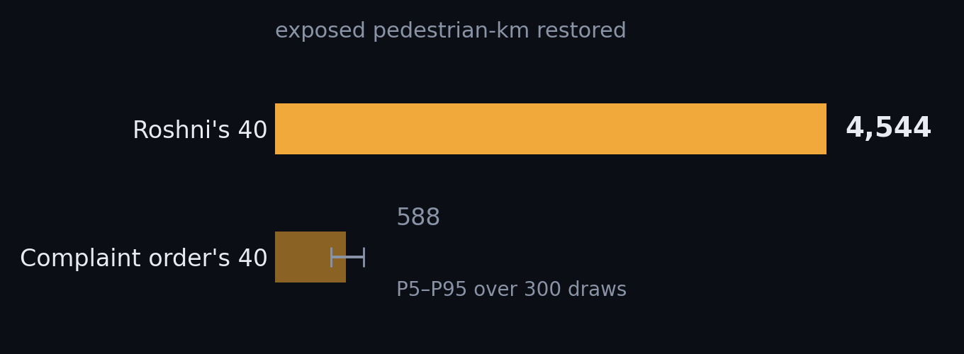
SAME CREW. SAME BUDGET. DIFFERENT ORDER.
7.7×
A crew can complete 40 repairs this week. Roshni’s 40 restore 7.7× the exposed pedestrian-kilometres that the complaint queue’s first 40 restore. The gain is not from being cleverer inside a ward.
It is from visiting the right wards.
Stress-tested four ways, volunteered
vs the luckiest of 300 complaint-order draws
4.9×
vs a steelman BBMP picking the worst segment in every ward it visits
1.9×
restricted to only the wards where we hold lamp labels
6.4×
every lamp label deleted — ward prior × exposure alone
5.4×
11,029 segments · 1,180 km · 33 wards · locked ORR demo bbox. Objective Σ exposure × P(dark) × length. 300 draws. out/stats.json.
Notes:
Land on the number, pause, then give the stress tests BEFORE anyone asks. The last line is the thesis of the whole project — say it slowly. Never quote 7.7x on its own: a sharp judge will say you are just beating random, and if you have already said 1.9x you win that exchange instead of losing it. The grievance file has no coordinates, so the baseline is Monte-Carlo'd over 300 draws: wards in complaint order, target inside the ward unknown.

Slide 9
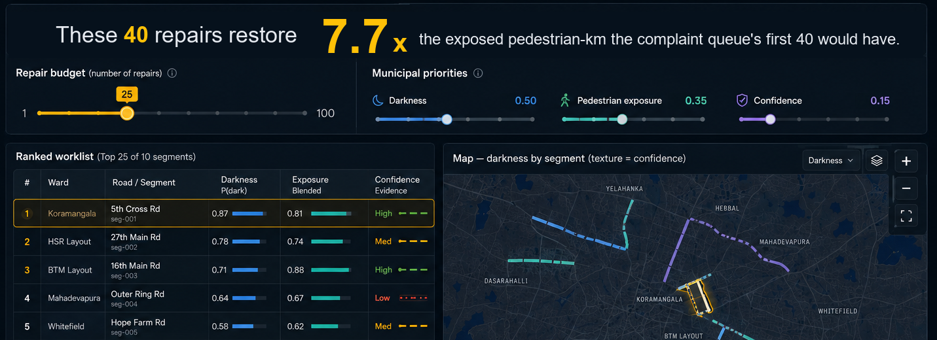
The municipal queue
The ratio, live — the budget slider recomputes in the browser. Municipal priorities — the municipality’s to set, not ours. Confidence is marked — low-confidence rows are hatched, not hidden.
Prototype, running client-side on the fixture export. No network call on the demo path.
Notes:
This is the screen a BBMP executive engineer would open on a Monday. Point at three things: the ratio, the municipal-priority sliders — the municipality owns those weights, not us — and a low-confidence row, which we mark rather than hide.

Slide 10
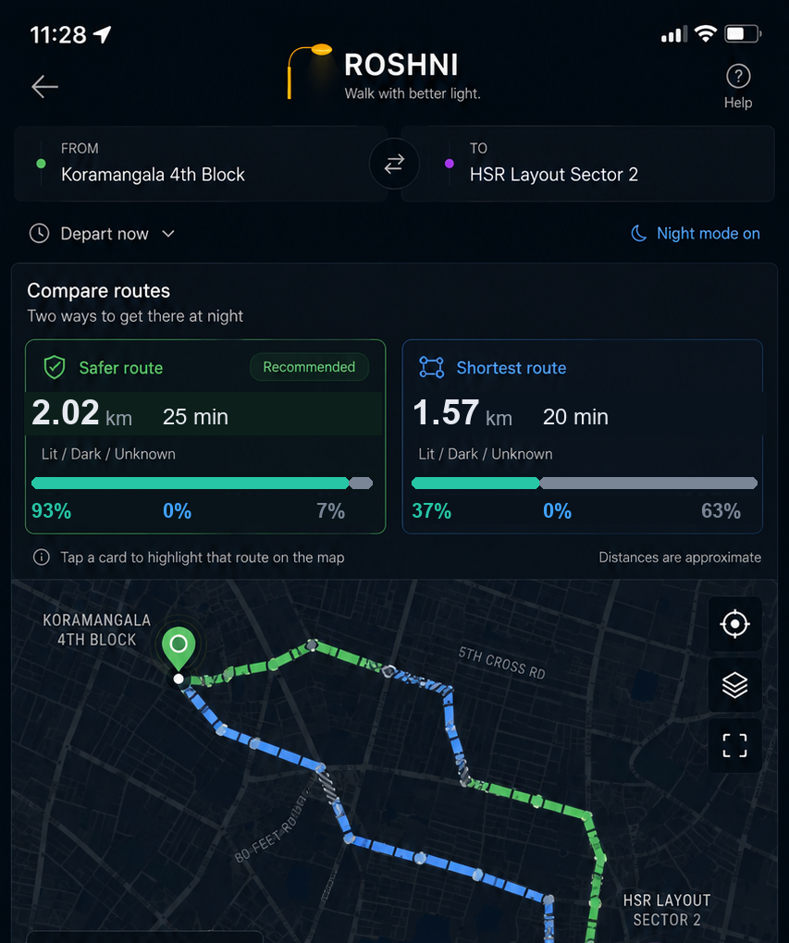
Both routes. Always.
Shortest: 1,575 m, and 63% of it crosses ground we are not confident about. Safer: 2,021 m, 7% unknown — it routes around 18 low-confidence segments. Six minutes to walk on ground we actually have data for.
Routing cannot fix the worst streets
Bypass test on the 25 worst segments: delete the segment, look for another way between its endpoints.
6 have no walkable alternative at all
The shortest route is always shown beside the safer one. We do not auto-select and we do not hide it — the choice is the walker’s, and we say plainly which stretches we have no data for.
19 have a bypass over 3× the segment’s length
17.9× median bypass · worst 206.9×
On the streets that most need fixing there is nowhere else to walk. Routing cannot solve them. Only repair can.
out/routes.json, query 1. Bypass test over the 25 highest-priority segments in the corridor.
Notes:
Say the bypass finding slowly — it is the measured answer to 'why not just build a safer-route app'. Then the duality on real geography: Haralur Road in Bellandur carries the widest confidence band in the corridor — no mapped lamps, almost no night bus service, zero streetlight complaints in the ward file. The router will not send you down it. The report screen sends you to it.

Slide 11
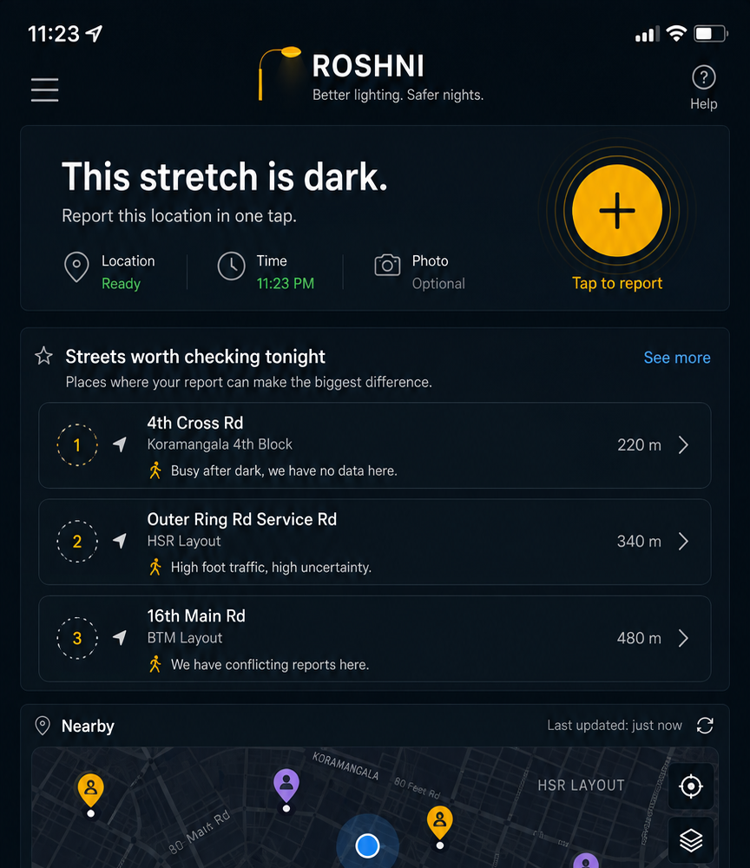
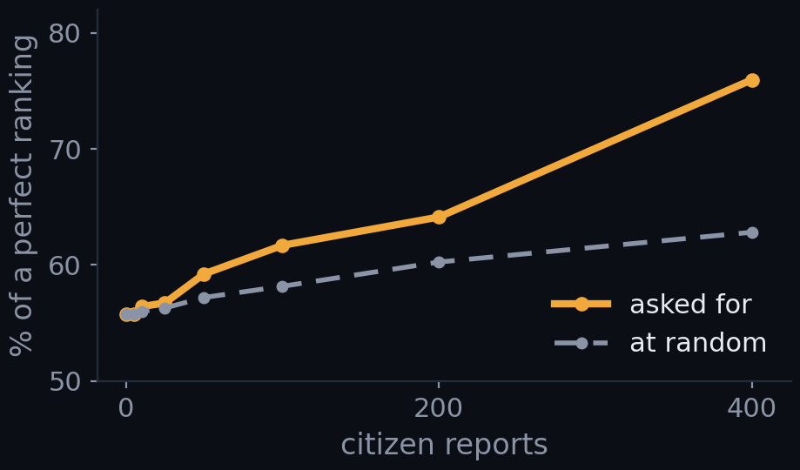
The empty state is the feature
The empty state is not “no reports yet.” It is “streets worth checking tonight” — so the app directs reporting instead of waiting for it. 93.7% of our 11,029 segments have no lamp evidence at all and run on the ward prior alone. That is not a flaw we are hiding — it is why every segment carries a variance, and it is what this screen is for.
With zero reports the prior-only ranking already captures 56% of what a perfectly-informed ranking would restore. 400 targeted reports takes it to 76%; 400 random reports reach only 63%.
A report is worth most exactly where we are least sure and most people walk. That is what this screen ranks by.
Simulation, not a field trial — labelled as one in out/curve.json.
690 of 11,029 segments carry any OSM lamp evidence. out/stats.json · out/curve.json.
Notes:
This slide pre-answers the hardest question we get — what does it do on day one with no data — before it is asked. Tell the targeting story: our first rule asked about the streets we knew least, and measured, it lost to random. Those are streets no crew would ever be sent to. The rule that works asks about streets whose optimistic darkness estimate would put them in the repair queue if it turned out true.

Slide 12
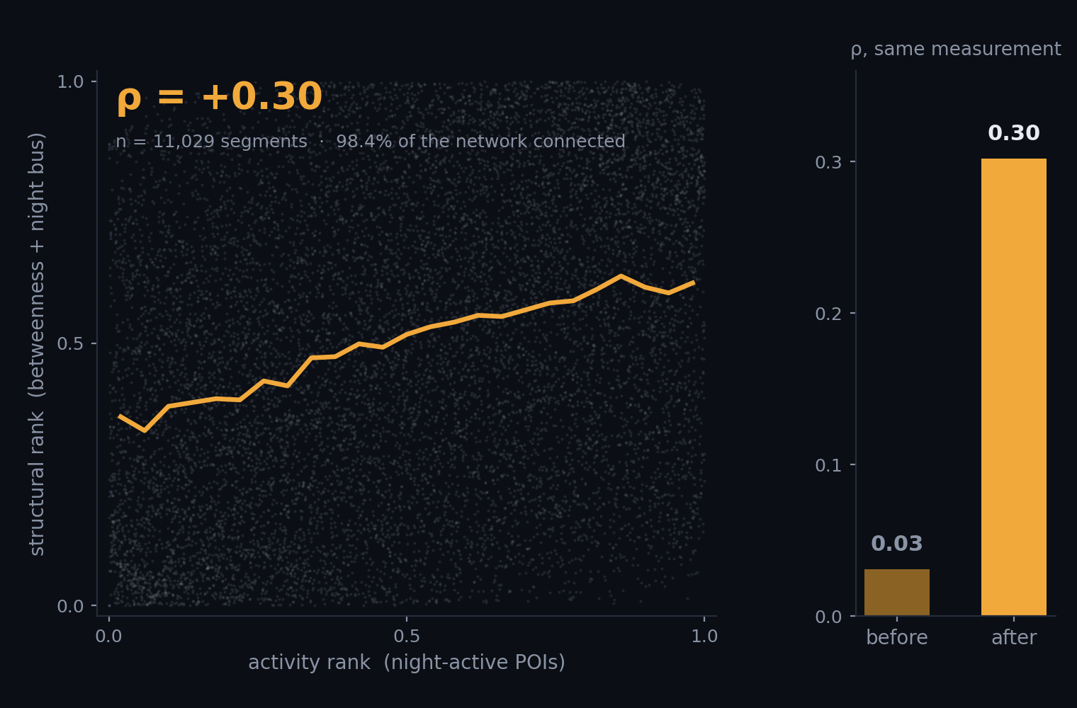
How would you validate a footfall estimate with no official data?
Validation needs a signal you did not use to build the estimate. And you are validating an ordering, not a magnitude — “412 pedestrians an hour” is unfalsifiable; “these streets rank above those” is checkable.
We got a null first, and went looking for why
The first answer was ρ = 0.03. Two proxies that should have agreed didn’t. So we went looking, and found we were keying the walk graph on rounded coordinates — junctions where two roads genuinely meet weren’t merging. The network had shattered, and the betweenness we were feeding the model was computed over 55% of the city. Keyed it on OSM node ids, re-ran over eight times the area. 98.4% now connects and ρ = 0.30 — and 0.44 against night bus departures.
Convergent
ρ = +0.30, and +0.44 vs night bus
Criterion — night pedestrian crashes
not yet measured
Ground truth — stratified field counts
not yet measured
out/stats.json · data/pipeline.py · BMTC GTFS via Vonter/bmtc-gtfs. Scatter is all 11,029 segments.
Notes:
This is the slide the problem author cares about — the challenge question is about validation, not features. Lead with the null, then the bug, then the corrected number. A team that gets a null, distrusts it, finds its own bug and re-runs is doing science. Do NOT hide the 0.03 — it is what makes the 0.30 believable. Also: the exposure blend leans structural at 0.75. On the broken numbers that looked like a finding. On the corrected numbers it is a choice, made because the problem statement names late-night commuters. Call it a choice.

Slide 13
The data exists. It’s one approval away.
HAVE — OPEN, IN HAND
GATED — CATALOGUED, ONE APPROVAL AWAY
126,974 grievances for 2025 · six years available
IUDX · Electronics City Industrial Township Authority “Streetlights Location Info in Electronic City, Bengaluru” — with an hourly current-and-voltage companion. Marked Private. The sample record is public:
1,508 mapped lamps · 1,128 labelled working / not working
Per-lamp KML for the ORR corridor and Bellandur/HSR
Lamp counts for all 198 wards — 421,113 lamps
{"deviceID": "L0302",
"location": {"type": "Point",
"coordinates": [77.666046, 12.841758]}}
BMTC GTFS with per-stop departure times
A two-date citizen lamp audit, 469 lamps
Roshni’s lamp record is that record, copied verbatim. “We plug into the municipal feed the day access is granted” is a schema fact, not a promise. When it opens, the prior is replaced by measurement and the bands collapse. The queue, the exposure model, the knapsack and all three screens are unchanged.
Night pedestrian crash reports
93 Indian cities publish streetlight counts through MoHUA’s Smart Cities portal. Zero publish coordinates — D24 is a KPI return, not an asset register.
Notes:
End this slide on: our ask is that someone approves the request. It reframes the missing data from a weakness into a call to action, and it is true.

Slide 14
Four things we get wrong, on purpose, out loud
1
93.7% of our segments run on a ward prior alone
690 of 11,029 carry any lamp evidence. Every other one carries a confidence band that says so — the router avoids the least-certain fifth of the network and the report screen targets it. But most of the map is an estimate, and we would rather say that than have you find it.
2
Our labelled lamps are geographically concentrated
OSM’s working tags come from citizen surveys, and those surveys walked some wards and not others. We tested whether that flatters the result: restricted to surveyed wards it is 6.4×, with every label deleted 5.4×. It survives — but the concentration is real.
3
We cannot filter night activity the way we designed
OSM records opening_hours for 6.7% of POIs in our corridor — 78 of 1,157 — so we weight by POI class instead. And Google’s review counts, which we do not have, undercount thelas and tea stalls: exactly the population most exposed to dark streets.
4
The working tags are survey-biased, and canopy is missing entirely
657 broken to 471 working is a property of who went out mapping, not Bengaluru’s outage rate — we use them as labels, never as a base rate. Tree canopy is a large effect here and we have no data for it at all.
And one we are asked about: VIIRS nighttime lights are 500 m per pixel — five to ten city blocks — so they cannot tell you a street is dark. We do not use them that way.
out/stats.json, pipeline run 22 Aug 2026. Volunteered before being asked, on purpose.
Notes:
Volunteering a limitation is worth more than defending one. Say all four briskly — thirty seconds total — and do not dwell. Tone is command of the material, not confession.

Slide 15
What another week buys
Answered with what we would try to learn, not with features.
THE ASK
Close the criterion-validation leg
The data exists, for our city, one approval away — and we already speak its schema.
Mine the Bengaluru Traffic Police crash reports for the night pedestrian split. It is the only non-circular validator we have left.
Find out whether the ordering is right
Approve the IUDX request.
Stratified field pedestrian counts at 21:30, and a rank correlation against what the model predicted.
Find out where the model stops transferring
Fit across wards of genuinely different urban form and report the degradation. Where it does not transfer, the system should refuse to guess and ask for a report — that behaviour is already built.
7.7×
Ask “closed, or fixed?”
BBMP closes 96.4% of electrical complaints. Roshni is the first thing that can verify a closure with the person who reported it — a metric a commissioner does not have today.
Same crew. Same budget. Different order.
First number they hear and the last.
Notes:
Do not answer 'what's next' with a feature list. Every team does. Answering with what you would try to learn is the differentiator, and it is the last thing they hear before scoring. Close on the number and stop talking.

Slide 16
Appendix — every number, and where it came from
126,974
civic complaints, 1 Jan – 19 Jun 2025
1,508 / 1,128
lamps in snapshot / labelled working=yes|no
39,847 · 31.4%
of them “Street Light Not Working”
690 · 6.3%
segments with any lamp evidence
96.4%
electrical closure rate (40,632 / 42,138)
27.6%
mean P(dark) across all segments
58.0%
road-maintenance closure rate
ρ +0.30 / +0.44
activity vs structural / vs night bus
421,113
streetlights across 198 BBMP wards
405 · 6,187
BMTC stops / departures after 21:00
11,029
segments scored · 1,180 km · 33 wards
3,417 / 9,199
night-active POIs of all POIs
95,557
walk-graph nodes · 98.4% one component
17.9×
median bypass, 25 worst segments
Counterfactual at a 40-repair budget: 4,544 vs 588 exposed pedestrian-km = 7.7×. Luckiest of 300 draws 4.9×. Steelman 1.9×. Surveyed wards only 6.4×. All lamp labels deleted 5.4×.
All figures out/stats.json, out/curve.json, out/routes.json — pipeline run 22 Aug 2026.
Notes:
Do not present this. It is here so that any number a judge asks about can be found in ten seconds.

