Slide 1
General Profit Scheduling on parallel processors
DEVANSH DALAL (2012CS10224)

Slide 2
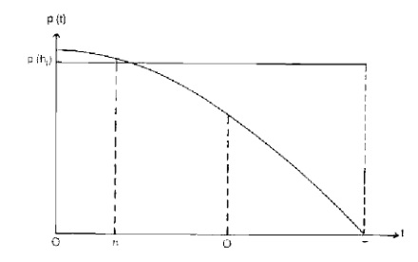
PROBLEM
Problem : Given m machines & n jobs with zeros release times and non-increasing profit functions for each job. Find a schedule with maximum profit.

Slide 3
Motivation
Can parameterize to incorporate various metrics

Slide 4
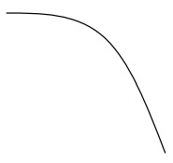
Motivation
Can parameterize to incorporate various metrics
Weighted Flow time: Linearly decreasing
Weighted Tardiness:
Weighted flow time squared
:
Hard deadlines

Slide 5

Maximize profit for single machine scheduling
Notation
$p_{i}$ : processing time for job i
$w_{i}(C_{i})$: profit/loss received if job i is finished at time $C_{i}$
$C_{i}$: finish time of job i
$T=\sum_{\left\{i=0\right\}}^{n}{p_{i}}$
Goal : Maximize $\sum_{i}{w_{i}(x_{i})}$

Slide 6
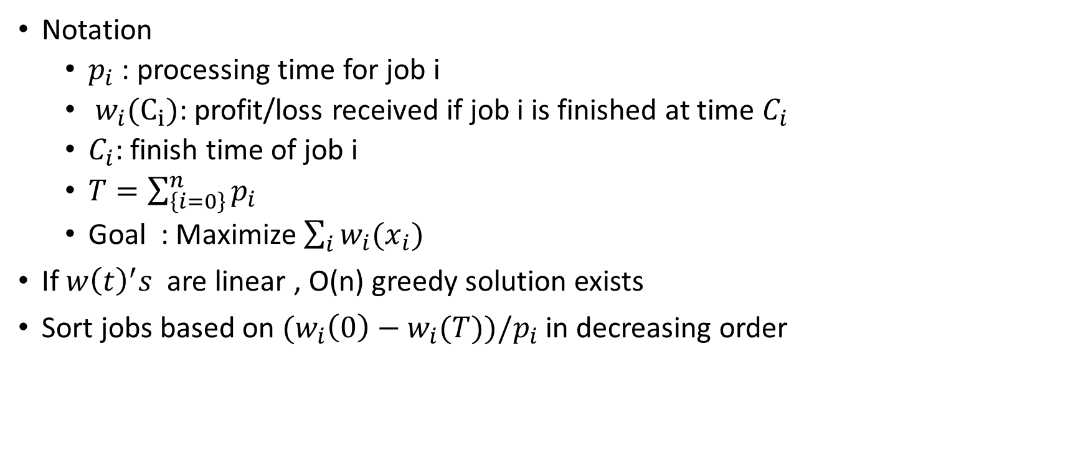
Maximize profit for single machine scheduling
Notation
$p_{i}$ : processing time for job i
$w_{i}(C_{i})$: profit/loss received if job i is finished at time $C_{i}$
$C_{i}$: finish time of job i
$T=\sum_{\left\{i=0\right\}}^{n}{p_{i}}$
Goal : Maximize $\sum_{i}{w_{i}(x_{i})}$
If $w{\left(t\right)}^{′}s$ are linear , O(n) greedy solution exists
Sort jobs based on ${(w}_{i}\left(0\right)−w_{i}(T))/p_{i}$ in decreasing order

Slide 7
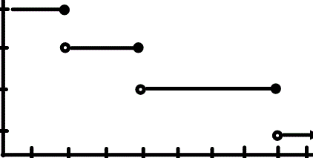

Solution for special profit functions
$w_{i}\left(C_{i} \right)=\left\{\begin{matrix}w_{i1} & 0<C_{i}≤d_{1} \\ \begin{aligned}w_{i2} \\ :\end{aligned} & \begin{aligned}d_{1}<C_{i}≤d_{2} \\ :\end{aligned} \\ w_{ik} & d_{k−1}≤C_{i}\end{matrix}\right\}$

Slide 8
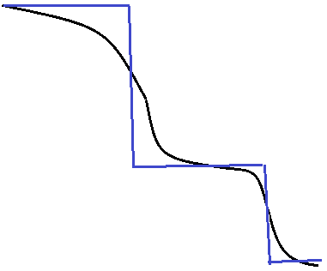

Solution for special profit functions
$w_{i}\left(C_{i} \right)=\left\{\begin{matrix}w_{i1} & 0<C_{i}≤d_{1} \\ \begin{aligned}w_{i2} \\ :\end{aligned} & \begin{aligned}d_{1}<C_{i}≤d_{2} \\ :\end{aligned} \\ w_{ik} & d_{k−1}≤C_{i}\end{matrix}\right\}$
Approximation to step function

Slide 9

DP formulation for special profit functions
Define sets of jobs $X_{1},X_{2},…,X_{k}$
$W_{i}(P_{1},P_{2},…,P_{k−1})$: maximum profit of first i jobs where the sum of processing times of jobs assigned to set $X_{i}$ is $P_{i}$

Slide 10
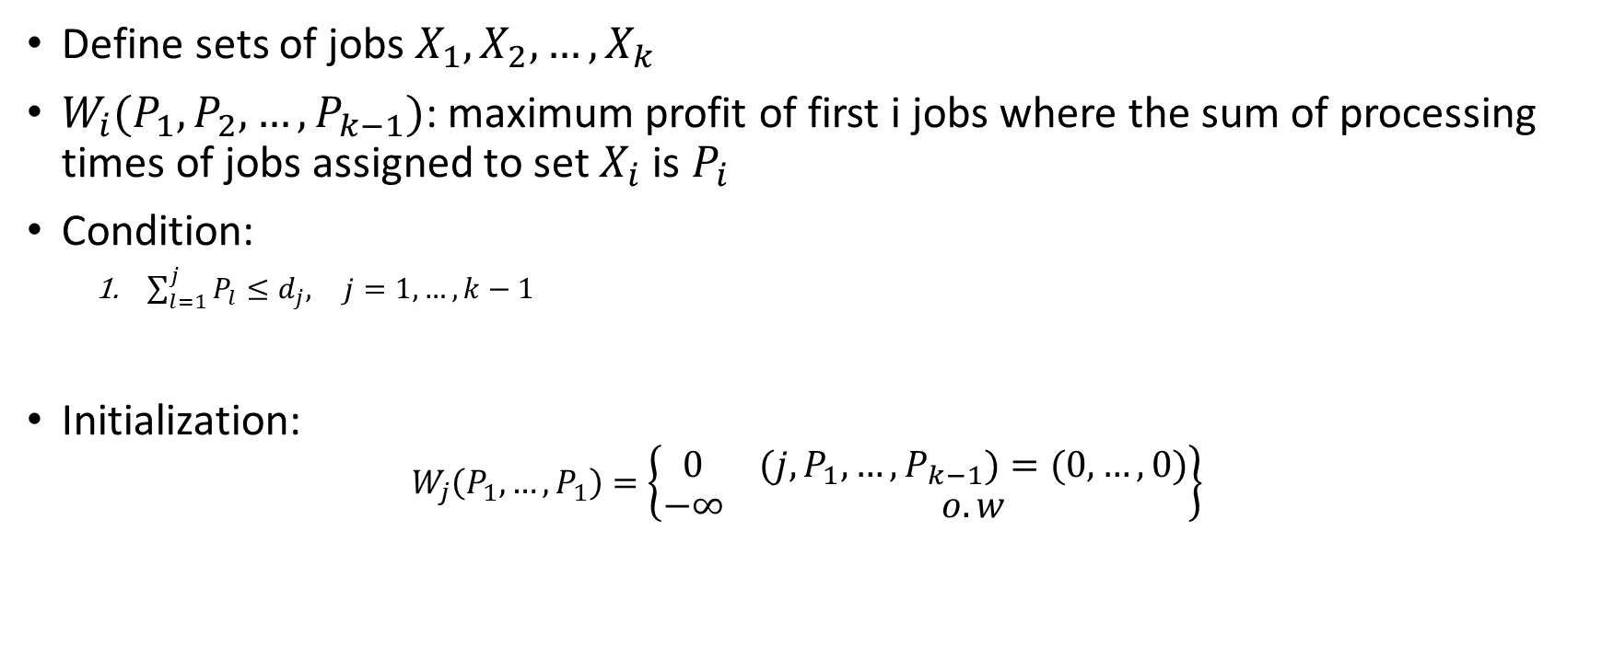
DP formulation for special profit functions
Define sets of jobs $X_{1},X_{2},…,X_{k}$
$W_{i}(P_{1},P_{2},…,P_{k−1})$: maximum profit of first i jobs where the sum of processing times of jobs assigned to set $X_{i}$ is $P_{i}$
Condition:
$\sum_{l=1}^{j}{P_{l}≤d_{j}, } j=1,…, k−1$
Initialization:
$$W_{j}\left(P_{1}, …, P_{1}\right)=\left\{\begin{matrix}0 & \left(j,P_{1},…,P_{k−1}\right)=(0,…,0) \\ −∞ & o.w\end{matrix}\right\}$$

Slide 11

DP formulation for special profit functions
$W_{j}(P_{1},…, P_{k−1})$=$\left\{\begin{matrix}\max\left\{\begin{matrix}W_{j−1}\left(P_{1}−p_{i},P_{2},…,P_{k−1}\right)+w_{j1} \\ : \\ \begin{matrix}W_{j−1}\left(P_{1},P_{2},…,P_{k−1}−p_{i}\right)+w_{j k−1} \\ W_{j−1}\left(P_{1},P_{2},…,P_{k−1}\right)\end{matrix}\end{matrix}\right\} & if cond. 1 \\ ∞ & o.w\end{matrix}\right\}$

Slide 12

Extension to multiple machines
Define sets of jobs $X_{1}^{1}, …,X_{k}^{1}$, $X_{1}^{2}, …,X_{k}^{2}$, … ,… , $X_{1}^{m}, …,X_{k}^{m}$
$W_{i}(P_{1}^{1}, …,P_{k}^{1}\text{,} P_{1}^{2}, …,P_{k}^{2}\text{, … ,… , }P_{1}^{m}, …,P_{k}^{m})$: maximum profit of first i jobs where the sum of processing times of jobs assigned to set $X_{j}^{i}$ is $P_{j}$

Slide 13
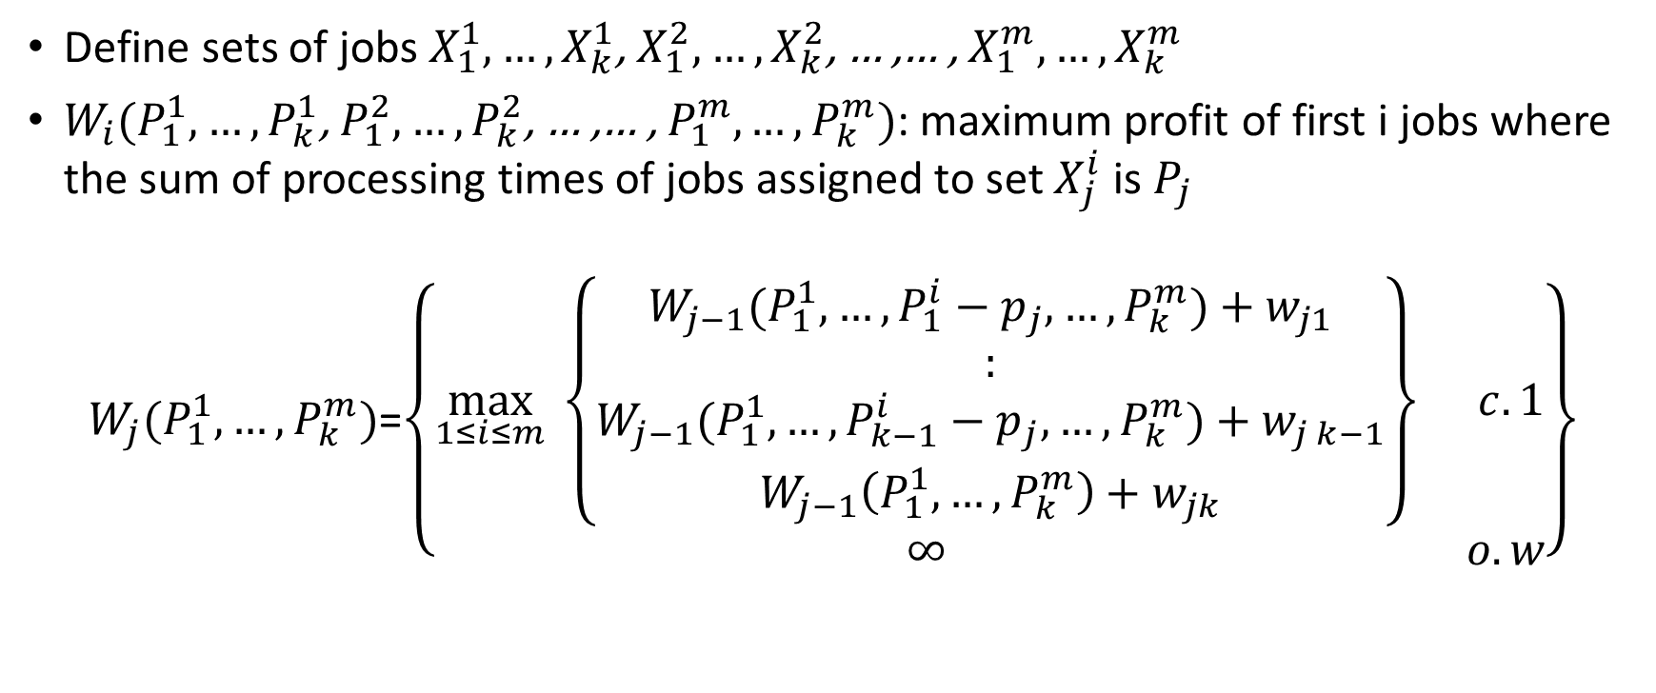
Extension to multiple machines
Define sets of jobs $X_{1}^{1}, …,X_{k}^{1}$, $X_{1}^{2}, …,X_{k}^{2}$, … ,… , $X_{1}^{m}, …,X_{k}^{m}$
$W_{i}(P_{1}^{1}, …,P_{k}^{1}\text{,} P_{1}^{2}, …,P_{k}^{2}\text{, … ,… , }P_{1}^{m}, …,P_{k}^{m})$: maximum profit of first i jobs where the sum of processing times of jobs assigned to set $X_{j}^{i}$ is $P_{j}$
$W_{j}(P_{1}^{1},…, P_{k}^{m})$=$\left\{\begin{matrix}\max_{1≤i≤m}\left\{\begin{matrix}W_{j−1}(P_{1}^{1},…,P_{1}^{i}−p_{j},…, P_{k}^{m})+w_{j1} \\ : \\ \begin{matrix}W_{j−1}(P_{1}^{1},…,P_{k−1}^{i}−p_{j},…, P_{k}^{m})+w_{j k−1} \\ W_{j−1}\left(P_{1}^{1},…, P_{k}^{m}\right)+w_{jk}\end{matrix}\end{matrix}\right\} & c. 1 \\ ∞ & o.w\end{matrix}\right\}$

Slide 14

Extension to multiple machines
Solution:
$$W^{∗}=\max\left(W_{n}\left(P_{1}^{1},…,P_{k−1}^{m}\right)\right)for all P_{q}^{i}∈[0,T_{n}]$$

Slide 15

Extension to multiple machines
Solution:
$$W^{∗}=\max\left(W_{n}\left(P_{1}^{1},…,P_{k−1}^{m}\right)\right)for all P_{q}^{i}∈[0,T_{n}]$$
Construct s$chedule C^{∗}$ using backtracking.

Slide 16

Extension to multiple machines
Solution:
$$W^{∗}=\max\left(W_{n}\left(P_{1}^{1},…,P_{k−1}^{m}\right)\right)for all P_{q}^{i}∈[0,T_{n}]$$
Construct s$chedule C^{∗}$ using backtracking.
Complexity: $O(km∗n∗\prod_{q=1}^{k−1}{{\min\left(T_{n},d_{q}\right)}^{m}} )$

Slide 17

Generalizations
Jobs can have different processing times($p_{ij}$) on different machines

Slide 18

Generalizations
Jobs can have different processing times($p_{ij}$) on different machines
Different profit functions on different machines for same job
Can handle non-zero release times

Slide 19

Reduction from GSP to R2C[2]
General Scheduling problem(GSP): loss function instead of profit function
$$cost of scheduling j_{th} job=\sum_{s=r_{j}}^{t}{w_{j}\left(t\right)}$$

Slide 20
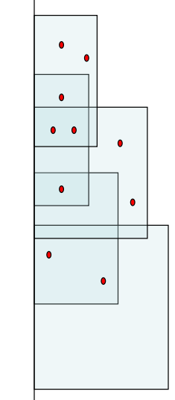
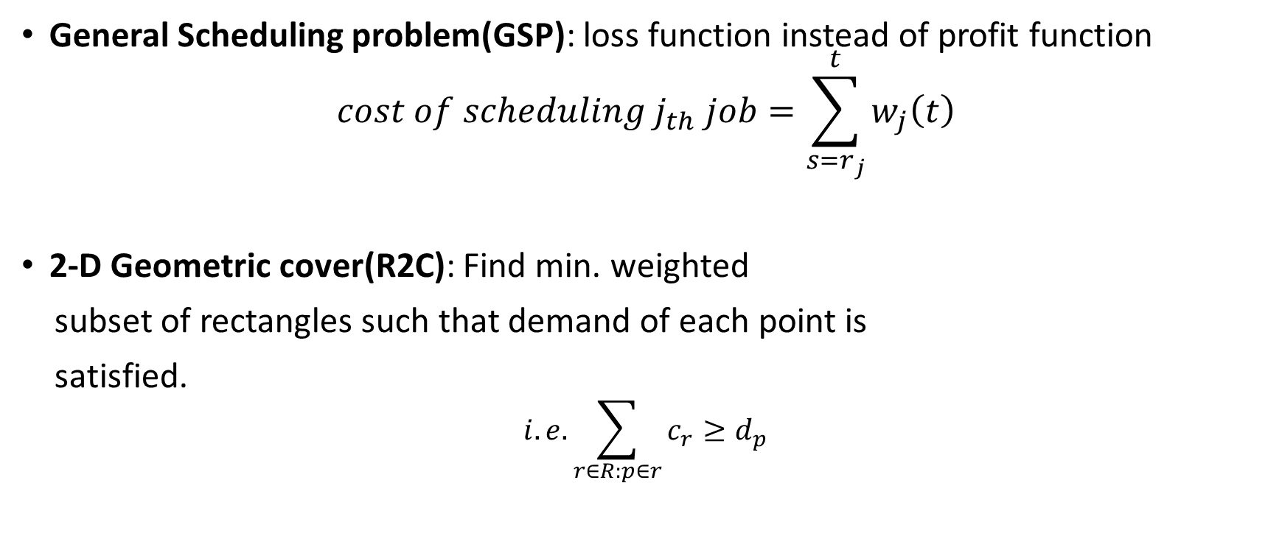
Reduction from GSP to R2C[2]
General Scheduling problem(GSP): loss function instead of profit function
$$cost of scheduling j_{th} job=\sum_{s=r_{j}}^{t}{w_{j}\left(t\right)}$$
2-D Geometric cover(R2C): Find min. weighted
subset of rectangles such that demand of each point is
satisfied.
$$i.e. \sum_{r∈R:p∈r}{c_{r}≥d_{p}}$$

Slide 21
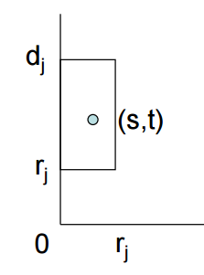
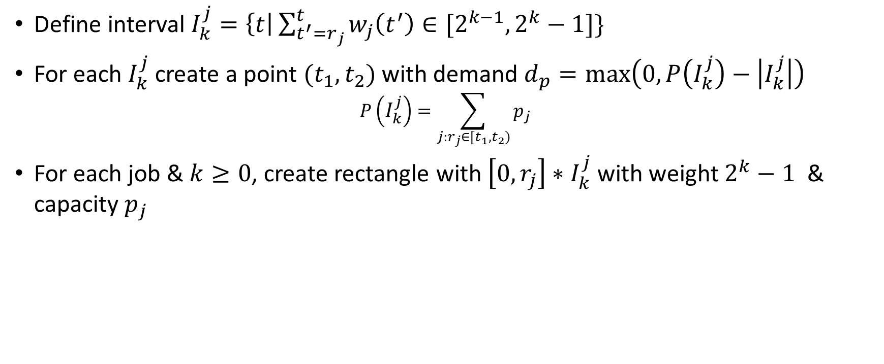
Reduction from GSP to R2C[2]
Define interval $I_{k}^{j}=\left\{t\right|\sum_{t^{′}=r_{j}}^{t}{w_{j}\left(t^{′}\right)∈[2^{k−1},2^{k}−1]}\}$
For each $I_{k}^{j}$ create a point ${(t}_{1},t_{2})$ with demand $d_{p}=\max\left(0,P\left(I_{k}^{j}\right)−\left|I_{k}^{j}\right|\right)$
$$P\left(I_{k}^{j}\right)=\sum_{j:r_{j}∈[t_{1},t_{2})}{p_{j}}$$
For each job & $k≥0$, create rectangle with $\left[0,r_{j}\right]∗I_{k}^{j}$ with weight $2^{k}−1$ & capacity $p_{j}$

Slide 22

With zero release times
$r_{j}=0, D=total size of jobs$
All relevant time points becomes of form $[0,t)$ & have demand $D−t$
Rectangles become intervals.

Slide 23

Generalized cache scheduling(off-line)
Demands d(t) at various time steps t = 1, . . . , T and Intervals I($t_{1},t_{2}$).
Find a minimum weight subset of intervals that covers the demand.

Slide 24
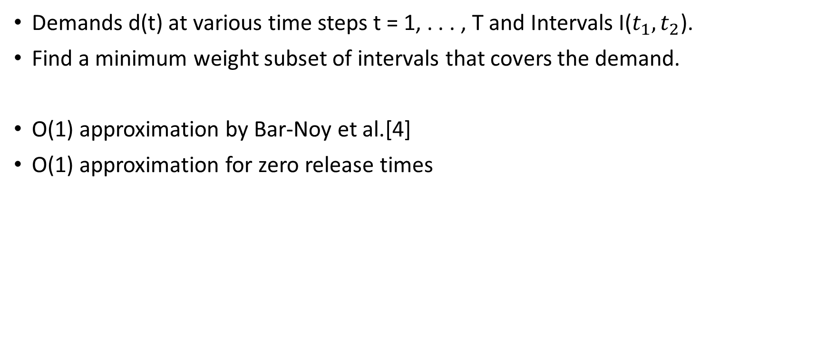
Generalized cache scheduling(off-line)
Demands d(t) at various time steps t = 1, . . . , T and Intervals I($t_{1},t_{2}$).
Find a minimum weight subset of intervals that covers the demand.
O(1) approximation by Bar-Noy et al.[4]
O(1) approximation for zero release times

Slide 25
Further work
No good results known for the multiple machine case still

Slide 26
Further work
No good results known for the multiple machine case still
Approximation for GSP to R2C problem can be improved
Can use better bounds for Generalized caching problem

Slide 27
Thank you

Slide 28
References
Janiak, Adam, and Tomasz Krysiak. "Single processor scheduling with job values depending on their completion times." Journal of Scheduling 10.2 (2007): 129-138.
Bansal, Nikhil, and Kirk Pruhs. "The geometry of scheduling." Foundations of Computer Science (FOCS), 2010 51st Annual IEEE Symposium on. IEEE, 2010.
https://people.mpi-inf.mpg.de/~nmegow/workshop-berlin-2012/files/TalkNikhilBansal.pdf
A unified approach to approximating resource allocation and scheduling. J. ACM, 48(5):1069–1090, 2001.

