Slide 1

Analysis of Algorithms CS 477/677
Heapsort
Instructor: George Bebis
(Chapter 6, Appendix B.5)

Slide 2
Special Types of Trees
Def: Full binary tree = a binary tree in which each node is either a leaf or has degree exactly 2.
Def: Complete binary tree = a binary tree in which all leaves are on the same level and all internal nodes have degree 2.
4
1
3
2
16
9
10
14
8
7
12
Full binary tree
4
1
3
2
16
9
10
Complete binary tree

Slide 3
Definitions
Height of a node = the number of edges on the longest simple path from the node down to a leaf
Level of a node = the length of a path from the root to the node
Height of tree = height of root node
4
Height of root = 3
1
3
Height of (2)= 1
2
16
9
10
Level of (10)= 2
14
8

Slide 4
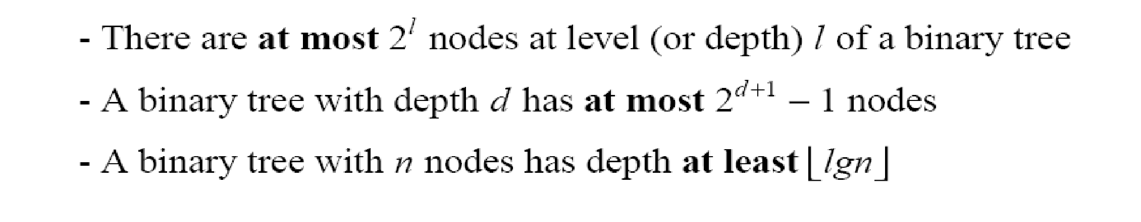
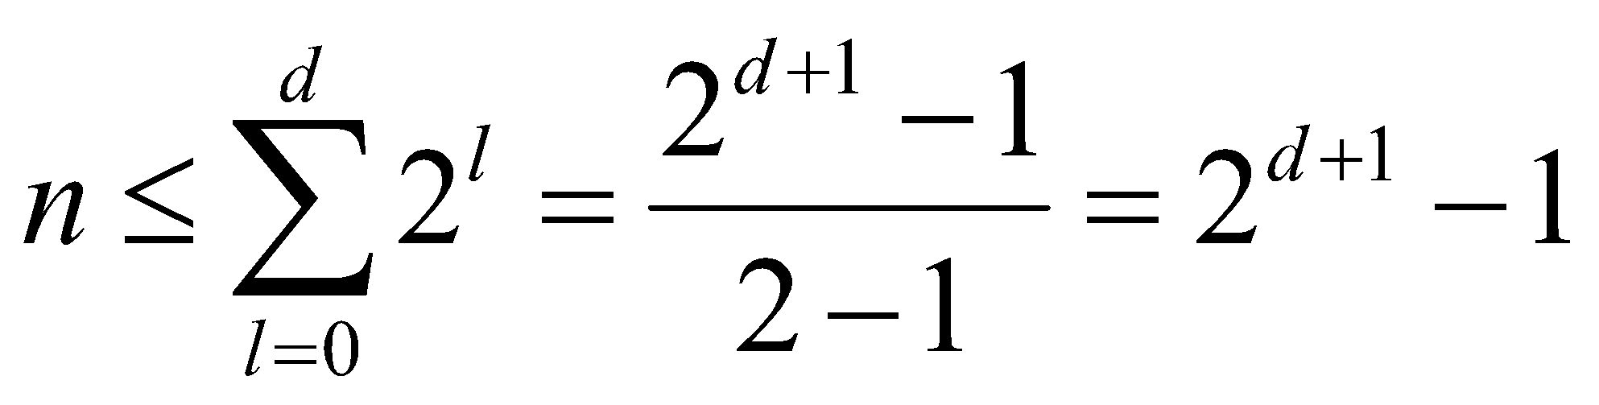
Useful Properties
height
height
(see Ex 6.1-2, page 129)
4
Height of root = 3
1
3
Height of (2)= 1
2
16
9
10
Level of (10)= 2
14
8

Slide 5
The Heap Data Structure
Def: A heap is a nearly complete binary tree with the following two properties:
Structural property: all levels are full, except possibly the last one, which is filled from left to right
Order (heap) property: for any node x
Parent(x) ≥ x
From the heap property, it follows that:
“The root is the maximum
element of the heap!”
8
7
4
5
2
Heap
A heap is a binary tree that is filled in order

Slide 6
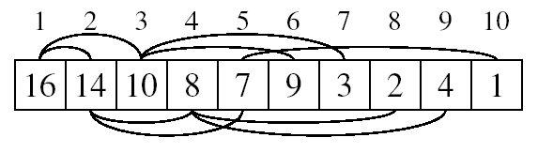
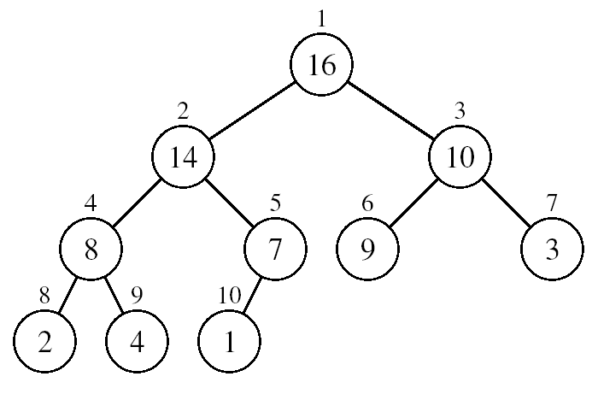
Array Representation of Heaps
A heap can be stored as an array A.
Root of tree is A[1]
Left child of A[i] = A[2i]
Right child of A[i] = A[2i + 1]
Parent of A[i] = A[ ⎣i/2⎦ ]
Heapsize[A] ≤ length[A]
The elements in the subarray A[(⎣n/2⎦+1) .. n] are leaves

Slide 7
Heap Types
Max-heaps (largest element at root), have the max-heap property:
for all nodes i, excluding the root:
A[PARENT(i)] ≥ A[i]
Min-heaps (smallest element at root), have the min-heap property:
for all nodes i, excluding the root:
A[PARENT(i)] ≤ A[i]

Slide 8
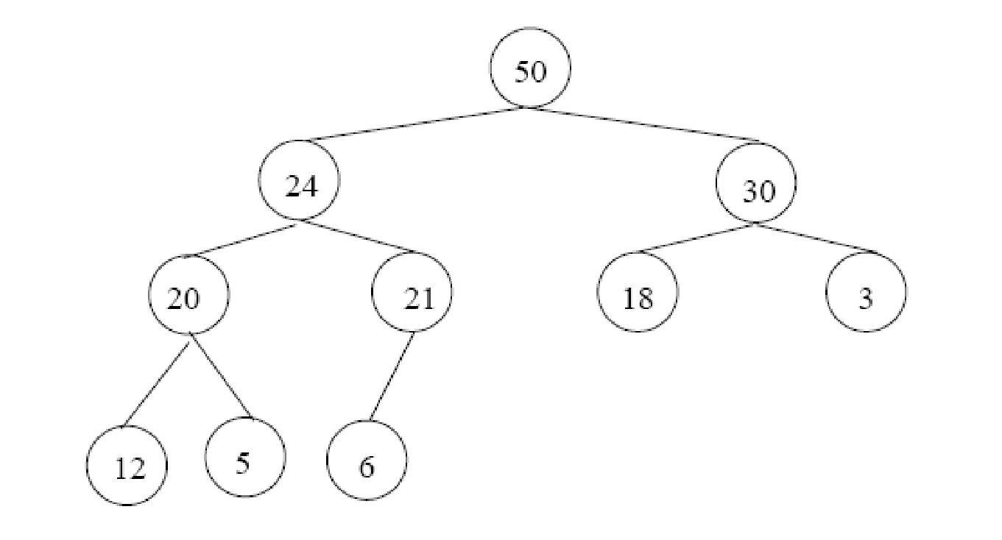
Adding/Deleting Nodes
New nodes are always inserted at the bottom level (left to right)
Nodes are removed from the bottom level (right to left)

Slide 9
Operations on Heaps
Maintain/Restore the max-heap property
MAX-HEAPIFY
Create a max-heap from an unordered array
BUILD-MAX-HEAP
Sort an array in place
HEAPSORT
Priority queues

Slide 10
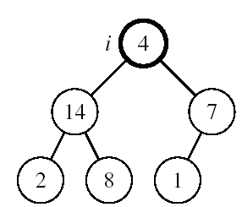
Maintaining the Heap Property
Suppose a node is smaller than a child
Left and Right subtrees of i are max-heaps
To eliminate the violation:
Exchange with larger child
Move down the tree
Continue until node is not smaller than children

Slide 11
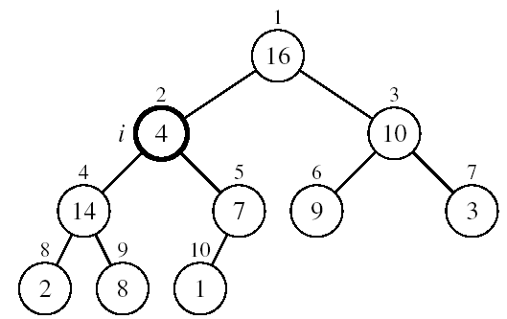
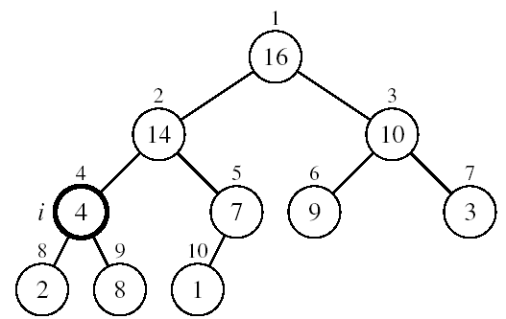
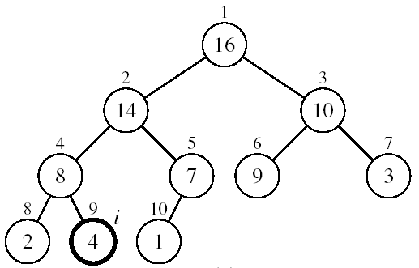
Example
MAX-HEAPIFY(A, 2, 10)
A[2] ↔ A[4]
A[2] violates the heap property
A[4] violates the heap property
A[4] ↔ A[9]
Heap property restored

Slide 12
Maintaining the Heap Property
Alg: MAX-HEAPIFY(A, i, n)
l ← LEFT(i)
r ← RIGHT(i)
if l ≤ n and A[l] > A[i]
then largest ←l
else largest ←i
if r ≤ n and A[r] > A[largest]
then largest ←r
if largest ≠ i
then exchange A[i] ↔ A[largest]
MAX-HEAPIFY(A, largest, n)
Assumptions:
Left and Right subtrees of i are max-heaps
A[i] may be smaller than its children

Slide 13
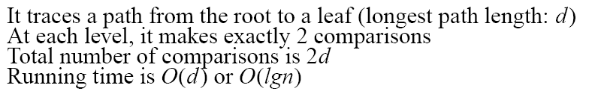
MAX-HEAPIFY Running Time
Intuitively:
Running time of MAX-HEAPIFY is O(lgn)
Can be written in terms of the height of the heap, as being O(h)
Since the height of the heap is ⎣lgn⎦
-
h
-
-
-
2h
O(h)

Slide 14
Building a Heap
Convert an array A[1 … n] into a max-heap (n = length[A])
The elements in the subarray A[(⎣n/2⎦+1) .. n] are leaves
Apply MAX-HEAPIFY on elements between 1 and ⎣n/2⎦
Alg: BUILD-MAX-HEAP(A)
n = length[A]
for i ← ⎣n/2⎦ downto 1
do MAX-HEAPIFY(A, i, n)
1
4
2
3
1
3
4
5
6
7
2
16
9
10
8
9
10
14
8
7
A:
4 | 1 | 3 | 2 | 16 | 9 | 10 | 14 | 8 | 7

Slide 15
Example: A
4
1
3
2
16
9
10
14
8
7
i = 5
i = 4
i = 3
1
1
1
4
4
4
2
3
2
3
2
3
1
3
1
3
1
3
4
5
6
7
4
5
6
7
4
5
6
7
2
16
9
10
2
16
9
10
14
16
9
10
8
9
10
8
9
10
8
9
10
14
8
7
14
8
7
2
8
7
i = 2
i = 1
1
1
1
4
4
16
2
3
2
3
2
3
1
10
16
10
14
10
4
5
6
7
4
5
6
7
4
5
6
7
14
16
9
3
14
7
9
3
8
7
9
3
8
9
10
8
9
10
8
9
10
2
8
7
2
8
1
2
4
1

Slide 16
Running Time of BUILD MAX HEAP
Alg: BUILD-MAX-HEAP(A)
n = length[A]
for i ← ⎣n/2⎦ downto 1
do MAX-HEAPIFY(A, i, n)
O(n)
O(lgn)
⇒ Running time: O(nlgn)
This is not an asymptotically tight upper bound

Slide 17
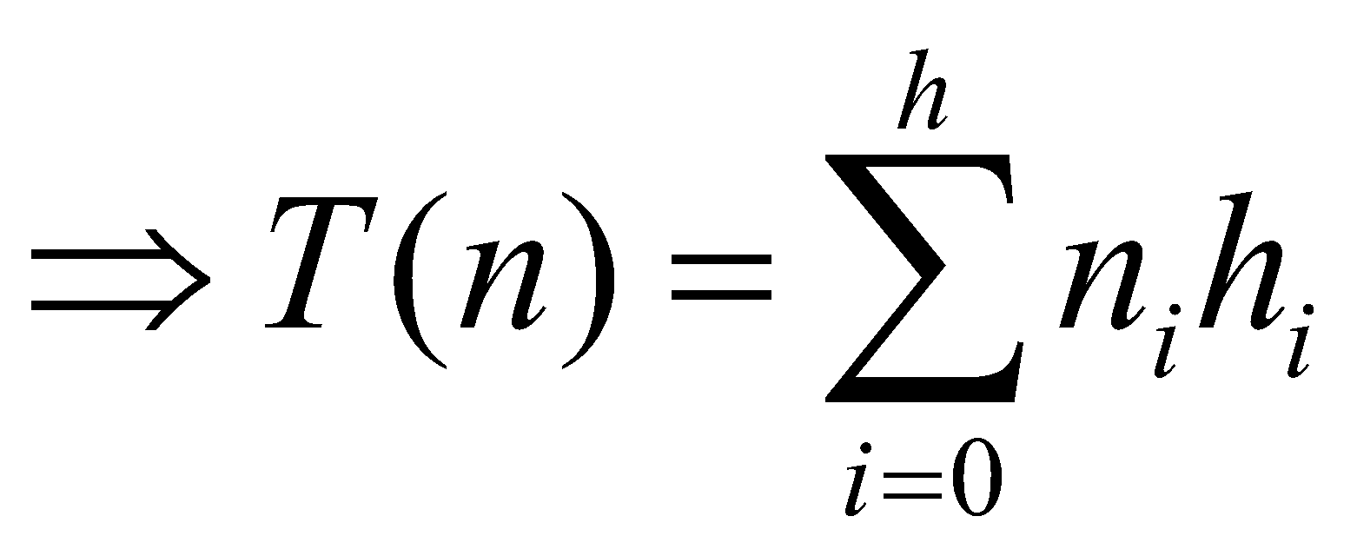
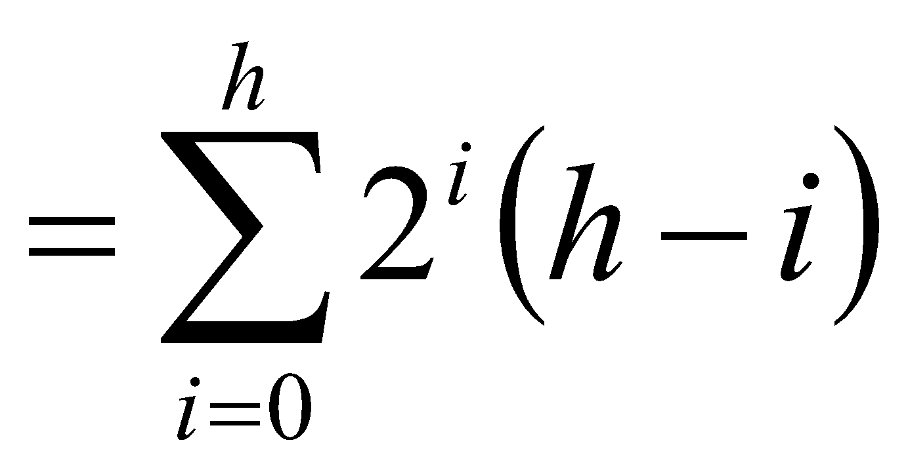
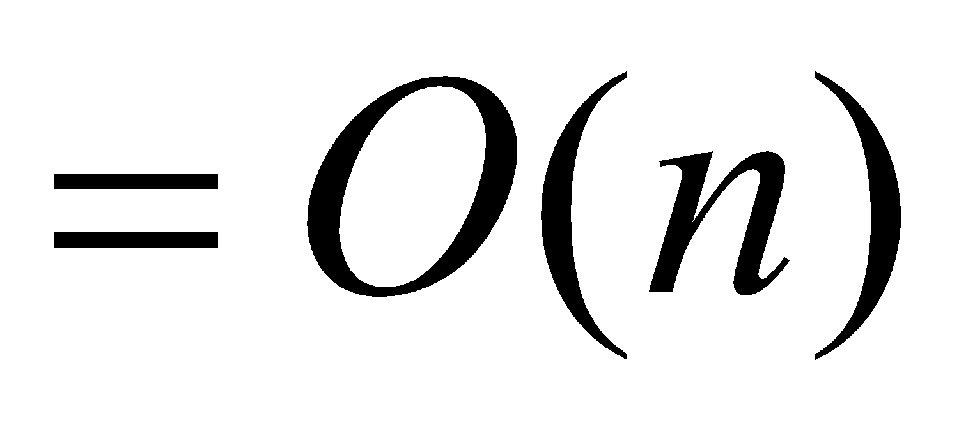
Running Time of BUILD MAX HEAP
HEAPIFY takes O(h) ⇒ the cost of HEAPIFY on a node i is proportional to the height of the node i in the tree
Height
Level
No. of nodes
h₀ = 3 (⎣lgn⎦)
i = 0
2⁰
h₁ = 2
i = 1
2¹
h₂ = 1
i = 2
2²
h₃ = 0
i = 3 (⎣lgn⎦)
2³
h_{i} = h – i height of the heap rooted at level i
n_{i} = 2^{i} number of nodes at level i

Slide 18
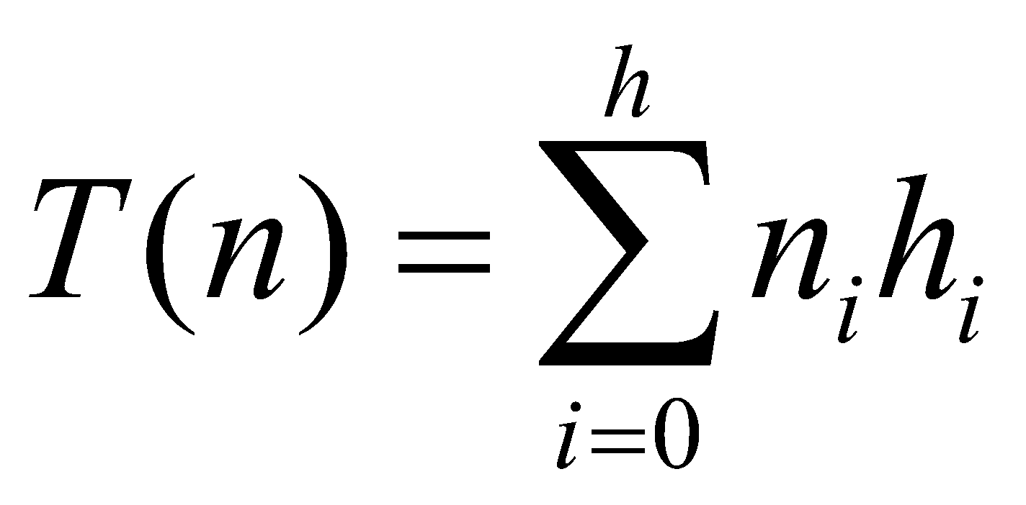
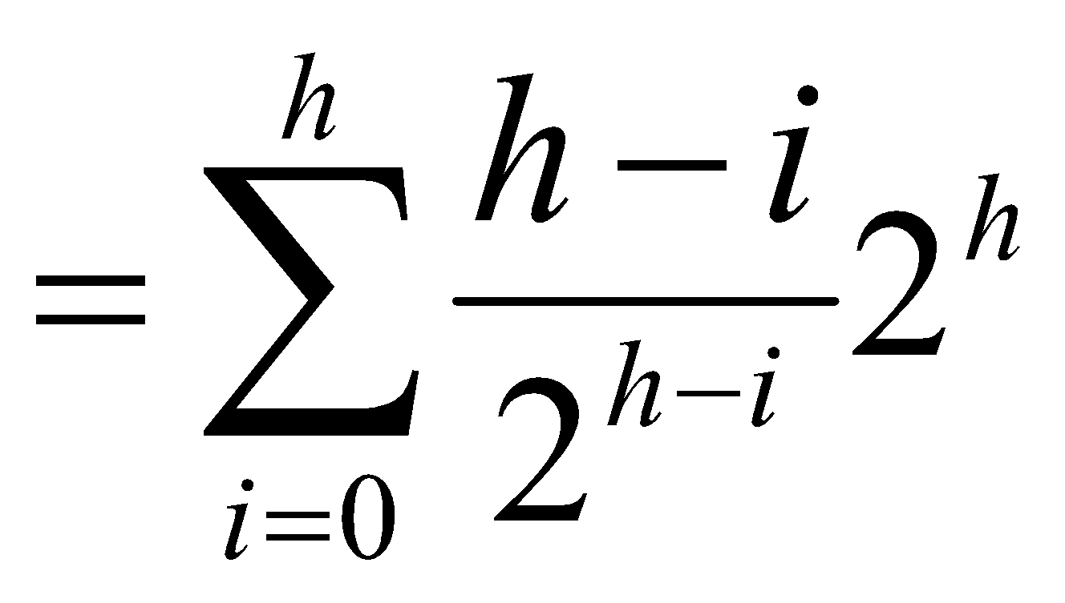
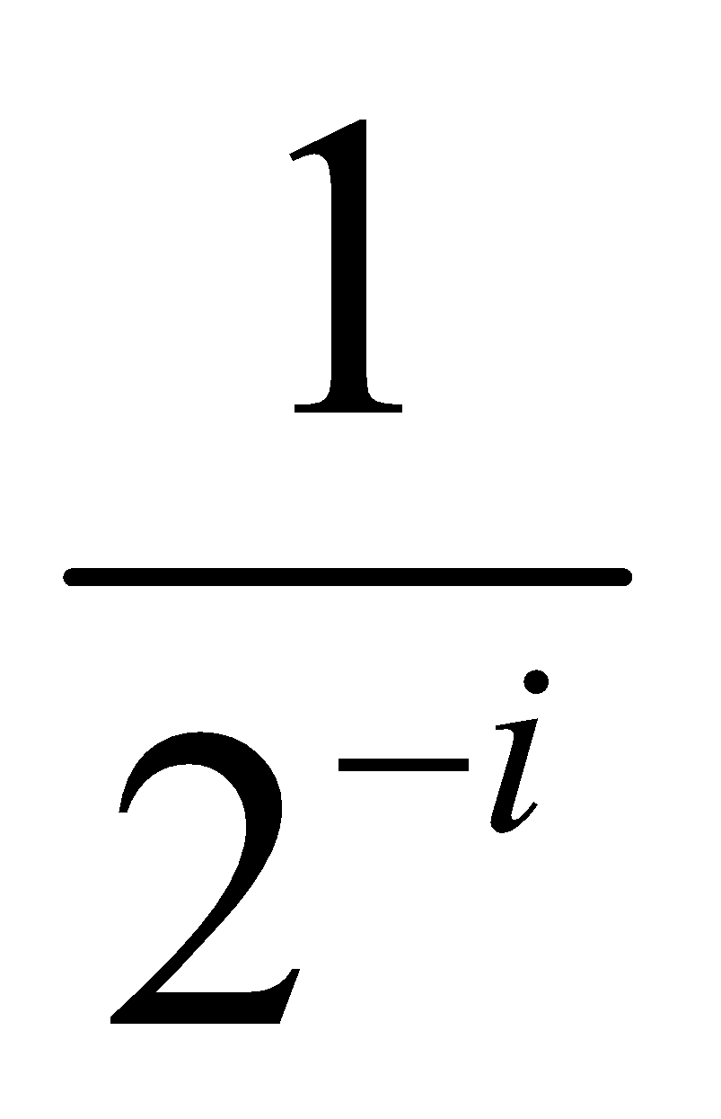
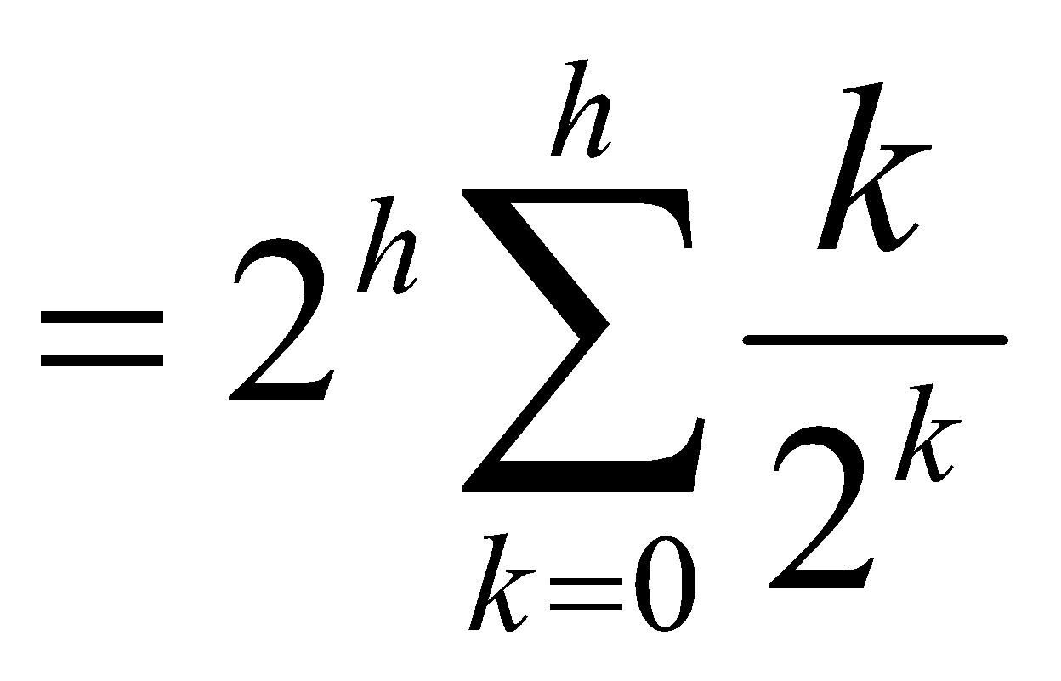
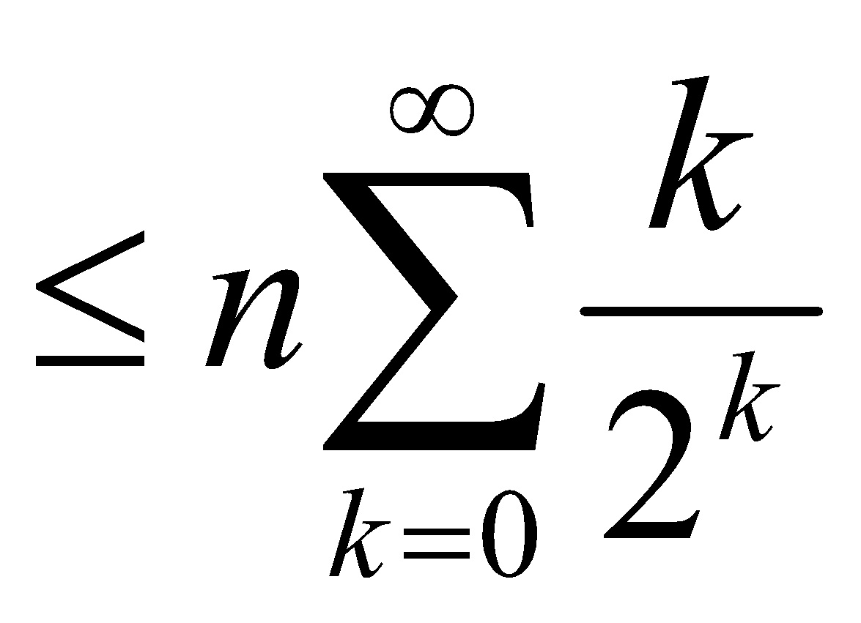
Running Time of BUILD MAX HEAP
Cost of HEAPIFY at level i * number of nodes at that level
Replace the values of n_{i} and h_{i} computed before
Multiply by 2^{h} both at the nominator and denominator and
write 2^{i} as
Change variables: k = h - i
The sum above is smaller than the sum of all elements to ∞
and h = lgn
The sum above is smaller than 2
Running time of BUILD-MAX-HEAP: T(n) = O(n)

Slide 19
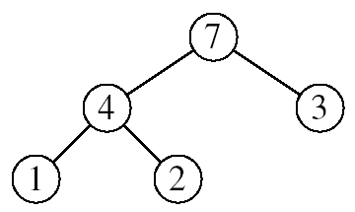
Heapsort
Goal:
Sort an array using heap representations
Idea:
Build a max-heap from the array
Swap the root (the maximum element) with the last element in the array
“Discard” this last node by decreasing the heap size
Call MAX-HEAPIFY on the new root
Repeat this process until only one node remains

Slide 20
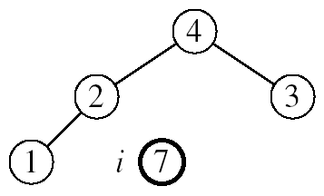
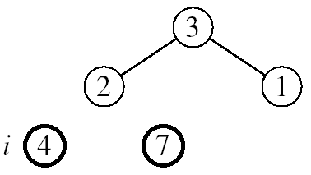
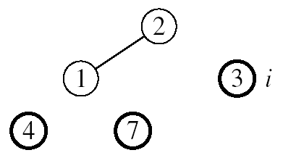
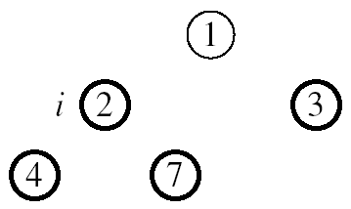

Example: A=[7, 4, 3, 1, 2]
MAX-HEAPIFY(A, 1, 4)
MAX-HEAPIFY(A, 1, 3)
MAX-HEAPIFY(A, 1, 2)
MAX-HEAPIFY(A, 1, 1)

Slide 21
Alg: HEAPSORT(A)
BUILD-MAX-HEAP(A)
for i ← length[A] downto 2
do exchange A[1] ↔ A[i]
MAX-HEAPIFY(A, 1, i - 1)
Running time: O(nlgn) --- Can be shown to be Θ(nlgn)
O(n)
n-1 times
O(lgn)

Slide 22
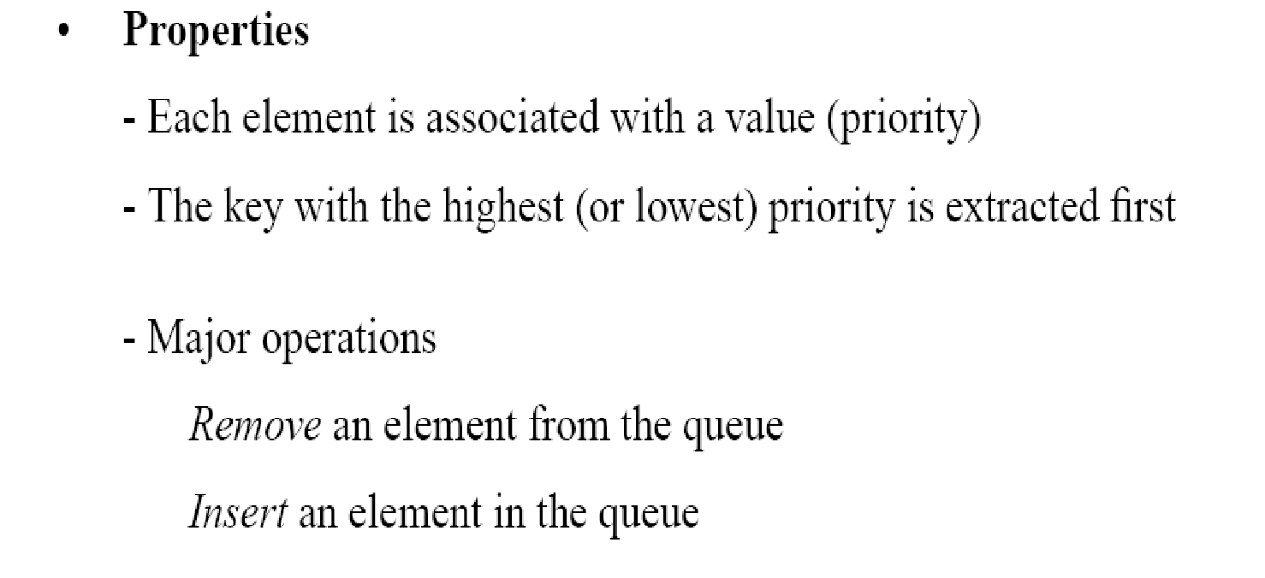
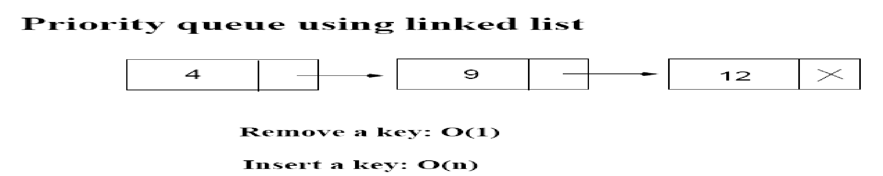
Priority Queues
12
4

Slide 23
Operations on Priority Queues
Max-priority queues support the following operations:
INSERT(S, x): inserts element x into set S
EXTRACT-MAX(S): removes and returns element of S with largest key
MAXIMUM(S): returns element of S with largest key
INCREASE-KEY(S, x, k): increases value of element x’s key to k (Assume k ≥ x’s current key value)

Slide 24
HEAP-MAXIMUM
Goal:
Return the largest element of the heap
Alg: HEAP-MAXIMUM(A)
return A[1]
Running time: O(1)
Heap A:
Heap-Maximum(A) returns 7

Slide 25
HEAP-EXTRACT-MAX
Goal:
Extract the largest element of the heap (i.e., return the max value and also remove that element from the heap
Idea:
Exchange the root element with the last
Decrease the size of the heap by 1 element
Call MAX-HEAPIFY on the new root, on a heap of size n-1
Heap A:
Root is the largest element

Slide 26
Example: HEAP-EXTRACT-MAX
16
1
14
10
max = 16
14
10
8
7
9
3
8
7
9
3
2
4
1
2
4
Heap size decreased with 1
14
Call MAX-HEAPIFY(A, 1, n-1)
8
10
4
7
9
3
2
1

Slide 27
HEAP-EXTRACT-MAX
Alg: HEAP-EXTRACT-MAX(A, n)
if n < 1
then error “heap underflow”
max ← A[1]
A[1] ← A[n]
MAX-HEAPIFY(A, 1, n-1) remakes heap
return max
Running time: O(lgn)

Slide 28
HEAP-INCREASE-KEY
Goal:
Increases the key of an element i in the heap
Idea:
Increment the key of A[i] to its new value
If the max-heap property does not hold anymore: traverse a path toward the root to find the proper place for the newly increased key
16
14
10
8
i
7
9
3
Key [i] ← 15
2
4
1

Slide 29
Example: HEAP-INCREASE-KEY
16
16
14
10
14
10
8
i
7
9
3
8
i
7
9
3
2
4
1
2
15
1
Key [i ] ← 15
16
16
i
14
10
15
10
i
15
7
9
3
14
7
9
3
2
8
1
2
8
1

Slide 30
HEAP-INCREASE-KEY
Alg: HEAP-INCREASE-KEY(A, i, key)
if key < A[i]
then error “new key is smaller than current key”
A[i] ← key
while i > 1 and A[PARENT(i)] < A[i]
do exchange A[i] ↔ A[PARENT(i)]
i ← PARENT(i)
Running time: O(lgn)
16
14
10
8
i
7
9
3
2
4
1
Key [i] ← 15

Slide 31
MAX-HEAP-INSERT
Goal:
Inserts a new element into a max-heap
Idea:
Expand the max-heap with a new element whose key is -∞
Calls HEAP-INCREASE-KEY to set the key of the new node to its correct value and maintain the max-heap property
16
14
10
8
7
9
3
2
4
1
-∞
16
14
10
8
7
9
3
2
4
1
15

Slide 32
Example: MAX-HEAP-INSERT
Insert value 15:
- Start by inserting -∞
Increase the key to 15
Call HEAP-INCREASE-KEY on A[11] = 15
16
16
14
10
14
10
8
7
9
3
8
7
9
3
2
4
1
-∞
2
4
1
15
The restored heap containing
the newly added element
16
16
14
10
15
10
8
15
9
3
8
14
9
3
2
4
1
7
2
4
1
7

Slide 33
MAX-HEAP-INSERT
Alg: MAX-HEAP-INSERT(A, key, n)
heap-size[A] ← n + 1
A[n + 1] ← -∞
HEAP-INCREASE-KEY(A, n + 1, key)
16
14
10
8
7
9
3
2
4
1
-∞
Running time: O(lgn)

Slide 34
Summary
We can perform the following operations on heaps:
MAX-HEAPIFY O(lgn)
BUILD-MAX-HEAP O(n)
HEAP-SORT O(nlgn)
MAX-HEAP-INSERT O(lgn)
HEAP-EXTRACT-MAX O(lgn)
HEAP-INCREASE-KEY O(lgn)
HEAP-MAXIMUM O(1)
Average
O(lgn)

Slide 35
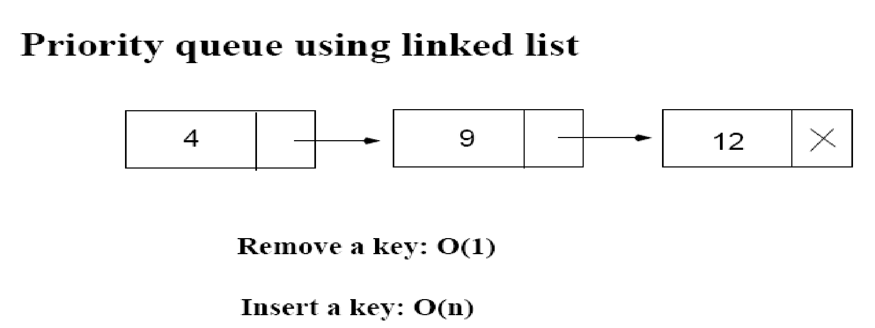
Priority Queue Using Linked List
12
4
Average: O(n)
Increase key: O(n)
Extract max key: O(1)

Slide 36
Problems
Assuming the data in a max-heap are distinct, what are the possible locations of the second-largest element?

Slide 37
Problems
(a) What is the maximum number of nodes in a max heap of height h?
(b) What is the maximum number of leaves?
(c) What is the maximum number of internal nodes?

Slide 38
Problems
Demonstrate, step by step, the operation of Build-Heap on the array
A=[5, 3, 17, 10, 84, 19, 6, 22, 9]

Slide 39
Problems
Let A be a heap of size n. Give the most efficient algorithm for the following tasks:
Find the sum of all elements
Find the sum of the largest lgn elements

