Slide 1
Sorting
Insertion sort
Design approach:
Sorts in place:
Best case:
Worst case:
Bubble Sort
Design approach:
Sorts in place:
Running time:
incremental
Yes
Θ(n)
Θ(n²)
incremental
Yes
Θ(n²)
‹#›
Notes:
‹#›

Slide 2
Sorting
Selection sort
Design approach:
Sorts in place:
Running time:
Merge Sort
Design approach:
Sorts in place:
Running time:
incremental
Yes
Θ(n²)
divide and conquer
No
Let’s see!!
‹#›
Notes:
‹#›

Slide 3
Divide-and-Conquer
Divide the problem into a number of sub-problems
Similar sub-problems of smaller size
Conquer the sub-problems
Solve the sub-problems recursively
Sub-problem size small enough ⇒ solve the problems in straightforward manner
Combine the solutions of the sub-problems
Obtain the solution for the original problem
‹#›
Notes:
‹#›

Slide 4
Merge Sort Approach
To sort an array A[p . . r]:
Divide
Divide the n-element sequence to be sorted into two subsequences of n/2 elements each
Conquer
Sort the subsequences recursively using merge sort
When the size of the sequences is 1 there is nothing more to do
Combine
Merge the two sorted subsequences
‹#›
Notes:
‹#›

Slide 5
Merge Sort
p
q
r
1
2
3
4
5
6
7
8
Alg.: MERGE-SORT(A, p, r)
if p < r Check for base case
then q ← ⎣(p + r)/2⎦ Divide
MERGE-SORT(A, p, q) Conquer
MERGE-SORT(A, q + 1, r) Conquer
MERGE(A, p, q, r) Combine
Initial call: MERGE-SORT(A, 1, n)
5
2
4
7
1
3
2
6
‹#›
Notes:
‹#›

Slide 6
Example – n Power of 2
Divide
1
2
3
4
5
6
7
8
5
2
4
7
1
3
2
6
q = 4
1
2
3
4
5
6
7
8
5
2
4
7
1
3
2
6
1
2
3
4
5
6
7
8
5
2
4
7
1
3
2
6
1
2
3
4
5
6
7
8
5
2
4
7
1
3
2
6
‹#›
Notes:
‹#›

Slide 7
Example – n Power of 2
Conquer
and
Merge
1
2
3
4
5
6
7
8
1
2
2
3
4
5
6
7
1
2
3
4
5
6
7
8
2
4
5
7
1
2
3
6
1
2
3
4
5
6
7
8
2
5
4
7
1
3
2
6
1
2
3
4
5
6
7
8
5
2
4
7
1
3
2
6
‹#›
Notes:
‹#›

Slide 8
Example – n Not a Power of 2
1
2
3
4
5
6
7
8
9
10
11
Divide
4
7
2
6
1
4
7
3
5
2
6
q = 6
1
2
3
4
5
6
7
8
9
10
11
q = 3
4
7
2
6
1
4
7
3
5
2
6
q = 9
1
2
3
4
5
6
7
8
9
10
11
4
7
2
6
1
4
7
3
5
2
6
1
2
3
4
5
6
7
8
9
10
11
4
7
2
6
1
4
7
3
5
2
6
1
2
4
5
7
8
4
7
6
1
7
3
‹#›
Notes:
‹#›

Slide 9
Example – n Not a Power of 2
Conquer
and
Merge
1
2
3
4
5
6
7
8
9
10
11
1
2
2
3
4
4
5
6
6
7
7
1
2
3
4
5
6
7
8
9
10
11
1
2
4
4
6
7
2
3
5
6
7
1
2
3
4
5
6
7
8
9
10
11
2
4
7
1
4
6
3
5
7
2
6
1
2
3
4
5
6
7
8
9
10
11
4
7
2
1
6
4
3
7
5
2
6
1
2
4
5
7
8
4
7
6
1
7
3
‹#›
Notes:
‹#›

Slide 10
Merging
p
q
r
1
2
3
4
5
6
7
8
2
4
5
7
1
2
3
6
Input: Array A and indices p, q, r such that p ≤ q < r
Subarrays A[p . . q] and A[q + 1 . . r] are sorted
Output: One single sorted subarray A[p . . r]
‹#›
Notes:
‹#›

Slide 11
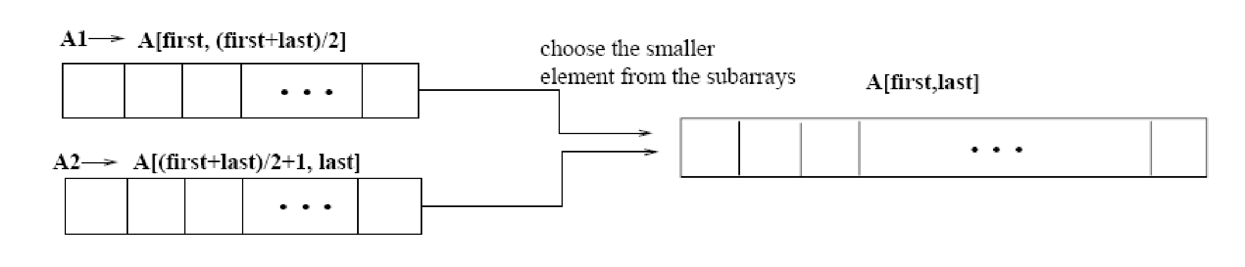
Merging
p
q
r
Idea for merging:
Two piles of sorted cards
Choose the smaller of the two top cards
Remove it and place it in the output pile
Repeat the process until one pile is empty
Take the remaining input pile and place it face-down onto the output pile
1
2
3
4
5
6
7
8
2
4
5
7
1
2
3
6
A1🡨 A[p, q]
A[p, r]
A2🡨 A[q+1, r]
‹#›
Notes:
‹#›

Slide 12
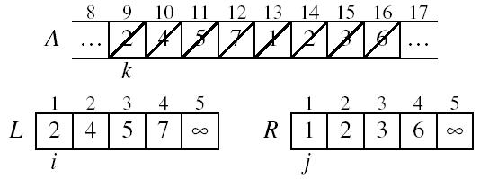
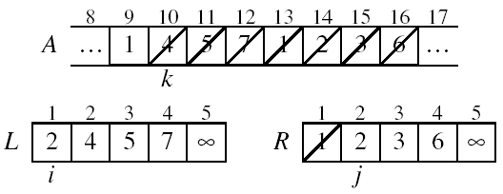
Example: MERGE(A, 9, 12, 16)
p
q
r
‹#›
Notes:
‹#›

Slide 13
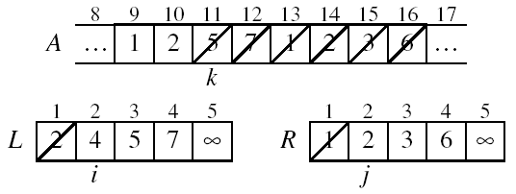
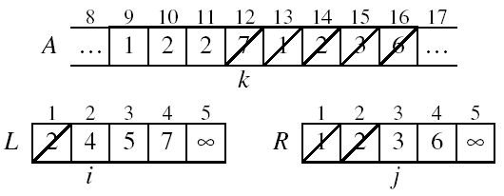
Example: MERGE(A, 9, 12, 16)
‹#›
Notes:
‹#›

Slide 14
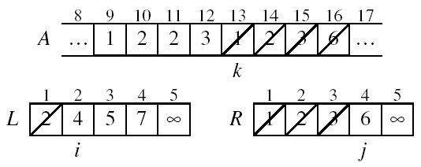
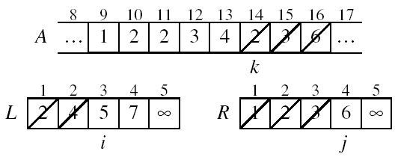
Example (cont.)
‹#›
Notes:
‹#›

Slide 15
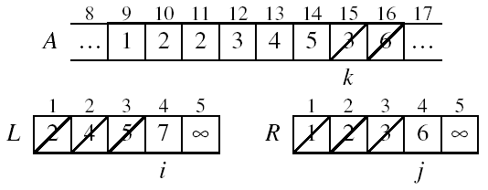
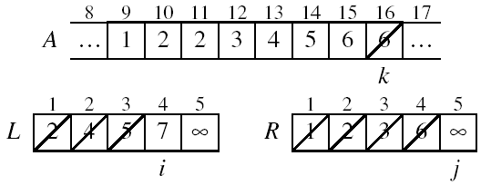
Example (cont.)
‹#›
Notes:
‹#›

Slide 16
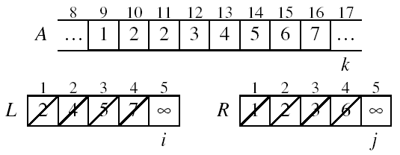
Example (cont.)
Done!
‹#›
Notes:
‹#›

Slide 17
Merge - Pseudocode
p
q
r
Alg.: MERGE(A, p, q, r)
Compute n₁ and n₂
Copy the first n₁ elements into L[1 . . n₁ + 1] and the next n₂ elements into R[1 . . n₂ + 1]
L[n₁ + 1] ← ∞; R[n₂ + 1] ← ∞
i ← 1; j ← 1
for k ← p to r
do if L[ i ] ≤ R[ j ]
then A[k] ← L[ i ]
i ←i + 1
else A[k] ← R[ j ]
j ← j + 1
1
2
3
4
5
6
7
8
2
4
5
7
1
2
3
6
n₁
n₂
p
q
L
2
4
5
7
∞
q + 1
r
R
1
2
3
6
∞
‹#›
Notes:
‹#›

Slide 18
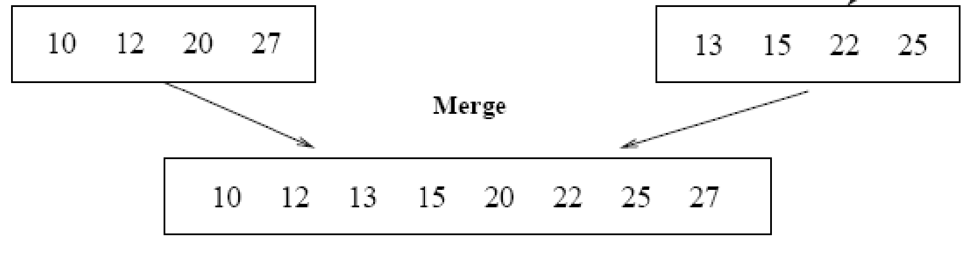
Running Time of Merge (assume last for loop)
Initialization (copying into temporary arrays):
Θ(n₁ + n₂) = Θ(n)
Adding the elements to the final array:
- n iterations, each taking constant time ⇒ Θ(n)
Total time for Merge:
Θ(n)
‹#›
Notes:
‹#›

Slide 19
Analyzing Divide-and Conquer Algorithms
The recurrence is based on the three steps of the paradigm:
T(n) – running time on a problem of size n
Divide the problem into a subproblems, each of size n/b: takes D(n)
Conquer (solve) the subproblems aT(n/b)
Combine the solutions C(n)
Θ(1) if n ≤ c
T(n) = aT(n/b) + D(n) + C(n) otherwise
‹#›
Notes:
‹#›

Slide 20
MERGE-SORT Running Time
Divide:
compute q as the average of p and r: D(n) = Θ(1)
Conquer:
recursively solve 2 subproblems, each of size n/2 ⇒ 2T (n/2)
Combine:
MERGE on an n-element subarray takes Θ(n) time ⇒ C(n) = Θ(n)
Θ(1) if n =1
T(n) = 2T(n/2) + Θ(n) if n > 1
‹#›
Notes:
‹#›

Slide 21
Solve the Recurrence
T(n) = c if n = 1
2T(n/2) + cn if n > 1
Use Master’s Theorem:
Compare n with f(n) = cn
Case 2: T(n) = Θ(nlgn)
‹#›
Notes:
‹#›

Slide 22
Merge Sort - Discussion
Running time insensitive of the input
Advantages:
Guaranteed to run in Θ(nlgn)
Disadvantage
Requires extra space ≈N
‹#›
Notes:
‹#›

Slide 23
Sorting Challenge 1
Problem: Sort a file of huge records with tiny keys
Example application: Reorganize your MP-3 files
Which method to use?
merge sort, guaranteed to run in time ~NlgN
selection sort
bubble sort
a custom algorithm for huge records/tiny keys
insertion sort
‹#›
Notes:
‹#›

Slide 24
Sorting Files with Huge Records and Small Keys
Insertion sort or bubble sort?
NO, too many exchanges
Selection sort?
YES, it takes linear time for exchanges
Merge sort or custom method?
Probably not: selection sort simpler, does less swaps
‹#›
Notes:
‹#›

Slide 25
Sorting Challenge 2
Problem: Sort a huge randomly-ordered file of small records
Application: Process transaction record for a phone company
Which sorting method to use?
Bubble sort
Selection sort
Mergesort guaranteed to run in time ~NlgN
Insertion sort
‹#›
Notes:
‹#›

Slide 26
Sorting Huge, Randomly - Ordered Files
Selection sort?
NO, always takes quadratic time
Bubble sort?
NO, quadratic time for randomly-ordered keys
Insertion sort?
NO, quadratic time for randomly-ordered keys
Mergesort?
YES, it is designed for this problem
‹#›
Notes:
‹#›

Slide 27
Sorting Challenge 3
Problem: sort a file that is already almost in order
Applications:
Re-sort a huge database after a few changes
Doublecheck that someone else sorted a file
Which sorting method to use?
Mergesort, guaranteed to run in time ~NlgN
Selection sort
Bubble sort
A custom algorithm for almost in-order files
Insertion sort
‹#›
Notes:
‹#›

Slide 28
Sorting Files That are Almost in Order
Selection sort?
NO, always takes quadratic time
Bubble sort?
NO, bad for some definitions of “almost in order”
Ex: B C D E F G H I J K L M N O P Q R S T U V W X Y Z A
Insertion sort?
YES, takes linear time for most definitions of “almost in order”
Mergesort or custom method?
Probably not: insertion sort simpler and faster
‹#›
Notes:
‹#›

Slide 29
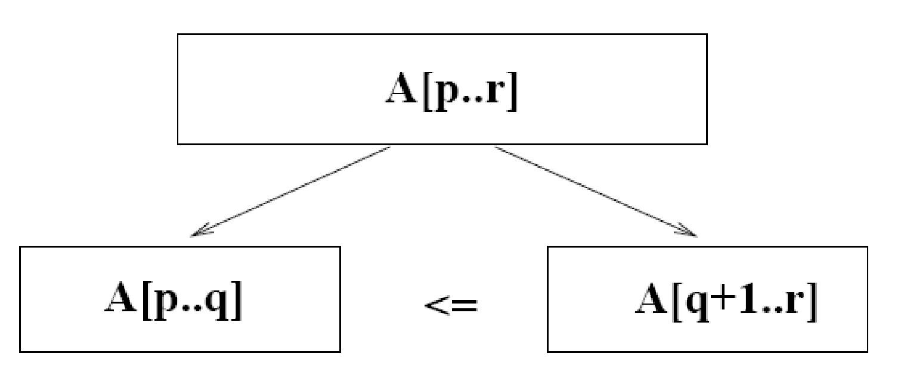
Quicksort
A[p…q]
≤
A[q+1…r]
Sort an array A[p…r]
Divide
Partition the array A into 2 subarrays A[p..q] and A[q+1..r], such that each element of A[p..q] is smaller than or equal to each element in A[q+1..r]
Need to find index q to partition the array
‹#›
Notes:
‹#›

Slide 30
Quicksort
A[p…q]
≤
A[q+1…r]
Conquer
Recursively sort A[p..q] and A[q+1..r] using Quicksort
Combine
Trivial: the arrays are sorted in place
No additional work is required to combine them
The entire array is now sorted
‹#›
Notes:
‹#›

Slide 31
QUICKSORT
Alg.: QUICKSORT(A, p, r)
if p < r
then q ← PARTITION(A, p, r)
QUICKSORT (A, p, q)
QUICKSORT (A, q+1, r)
Initially: p=1, r=n
Recurrence:
T(n) = T(q) + T(n – q) + f(n)
PARTITION())
‹#›
Notes:
‹#›

Slide 32
Partitioning the Array
Choosing PARTITION()
There are different ways to do this
Each has its own advantages/disadvantages
Hoare partition (see prob. 7-1, page 159)
Select a pivot element x around which to partition
Grows two regions
A[p…i] ≤ x
x ≤ A[j…r]
A[p…i] ≤ x
x ≤ A[j…r]
i
j
‹#›
Notes:
‹#›

Slide 33
Example
A[p…r]
pivot x=5
5
3
2
6
4
1
3
7
5
3
2
6
4
1
3
7
i
j
i
j
3
3
2
6
4
1
5
7
3
3
2
6
4
1
5
7
i
j
i
j
A[p…q]
A[q+1…r]
3
3
2
1
4
6
5
7
3
3
2
1
4
6
5
7
i
j
j
i
‹#›
Notes:
‹#›

Slide 34
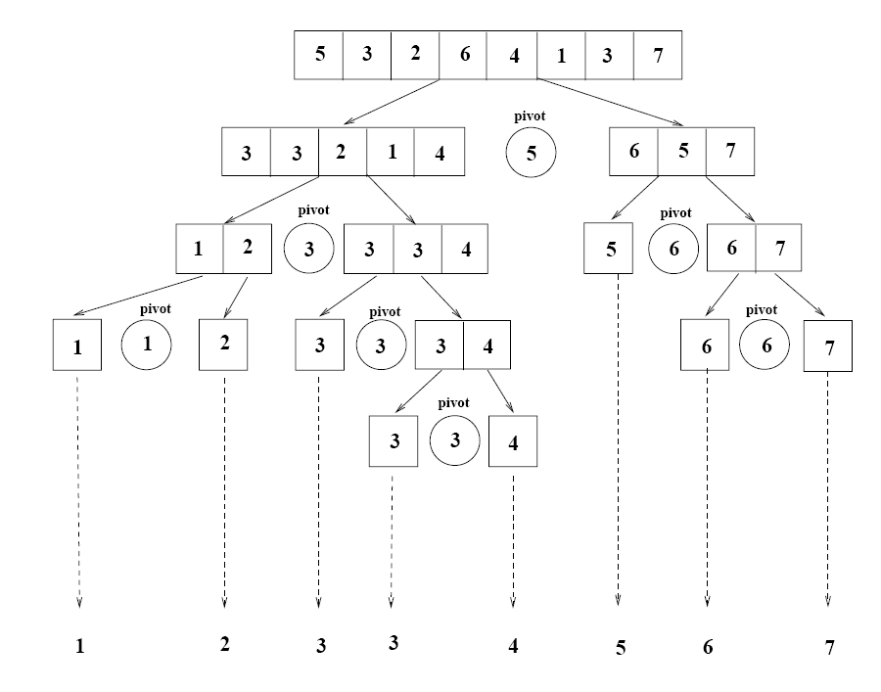
Example
‹#›
Notes:
‹#›

Slide 35
Partitioning the Array
Alg. PARTITION (A, p, r)
x ← A[p]
i ← p – 1
j ← r + 1
while TRUE
do repeat j ← j – 1
until A[j] ≤ x
do repeat i ← i + 1
until A[i] ≥ x
if i < j
then exchange A[i] ↔ A[j]
else return j
p
r
A:
5
3
2
6
4
1
3
7
i
j
A[p…q]
≤
A[q+1…r]
A:
a_{p}
a_{r}
j=q
i
Each element is
visited once!
Running time: Θ(n)
n = r – p + 1
‹#›
Notes:
‹#›

Slide 36
Recurrence
Alg.: QUICKSORT(A, p, r)
if p < r
then q ← PARTITION(A, p, r)
QUICKSORT (A, p, q)
QUICKSORT (A, q+1, r)
Initially: p=1, r=n
Recurrence:
T(n) = T(q) + T(n – q) + n
‹#›
Notes:
‹#›

Slide 37
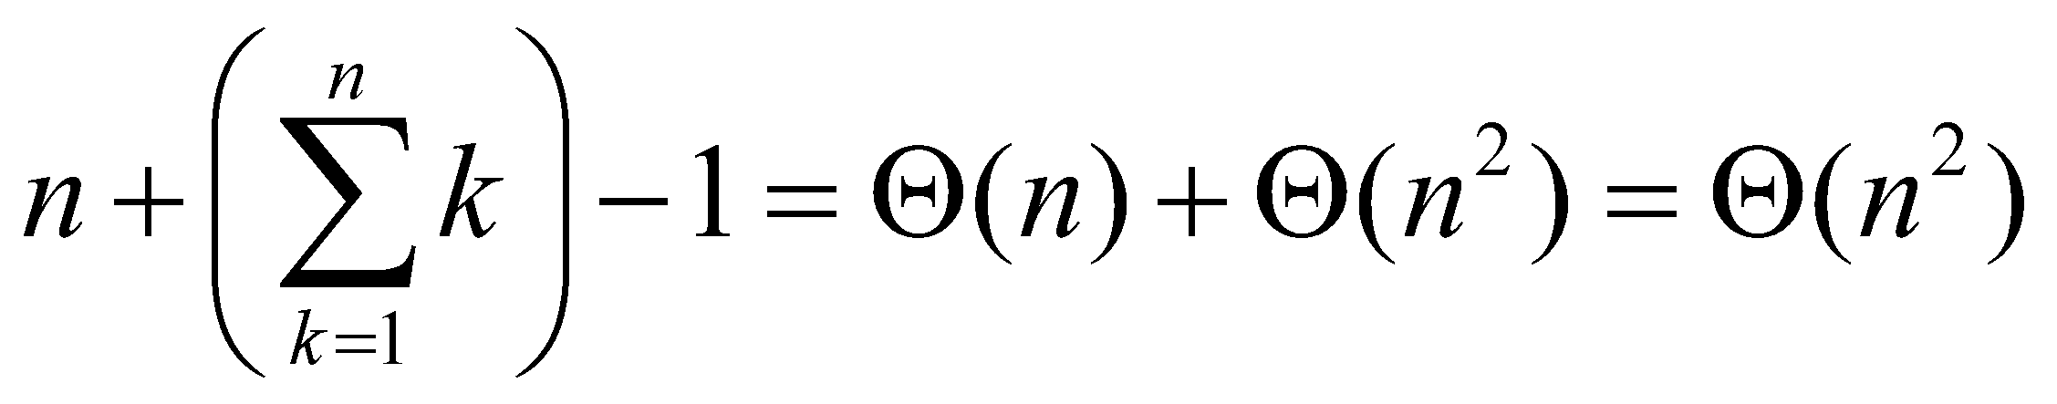
Worst Case Partitioning
Worst-case partitioning
One region has one element and the other has n – 1 elements
Maximally unbalanced
Recurrence: q=1
T(n) = T(1) + T(n – 1) + n,
T(1) = Θ(1)
T(n) = T(n – 1) + n
=
n
n
1
n - 1
n
1
n - 2
n - 1
n
1
n - 3
n - 2
1
2
3
1
1
2
Θ(n²)
When does the worst case happen?
‹#›
Notes:
‹#›

Slide 38
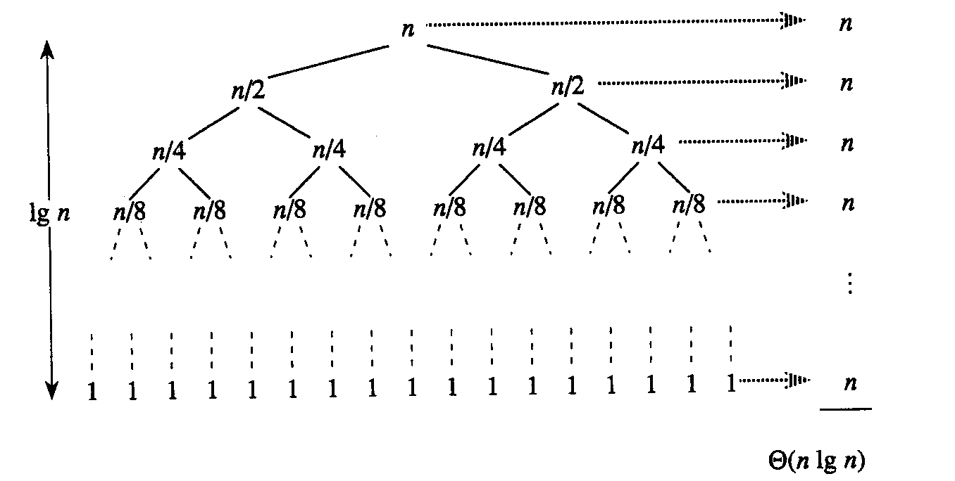
Best Case Partitioning
Best-case partitioning
Partitioning produces two regions of size n/2
Recurrence: q=n/2
T(n) = 2T(n/2) + Θ(n)
T(n) = Θ(nlgn) (Master theorem)
‹#›
Notes:
‹#›

Slide 39
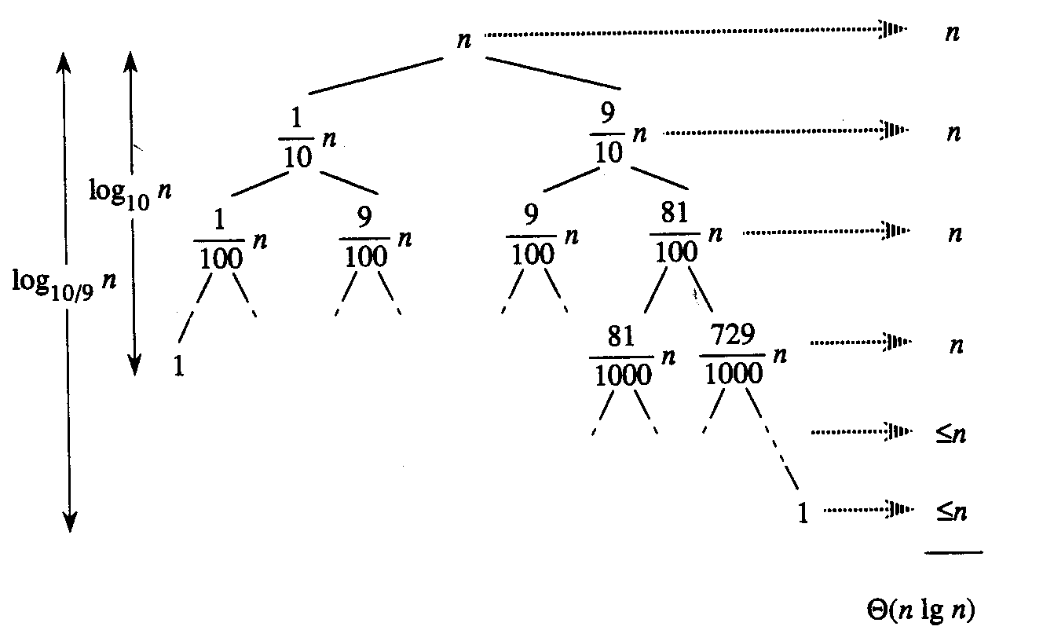
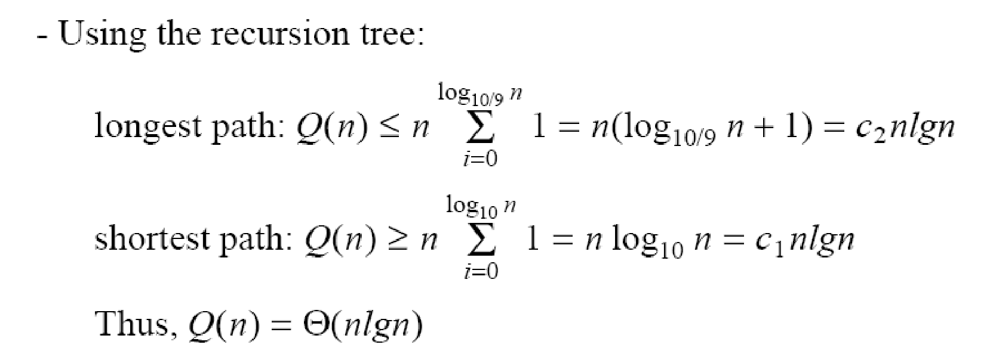
Case Between Worst and Best
9-to-1 proportional split
Q(n) = Q(9n/10) + Q(n/10) + n
‹#›
Notes:
‹#›

Slide 40
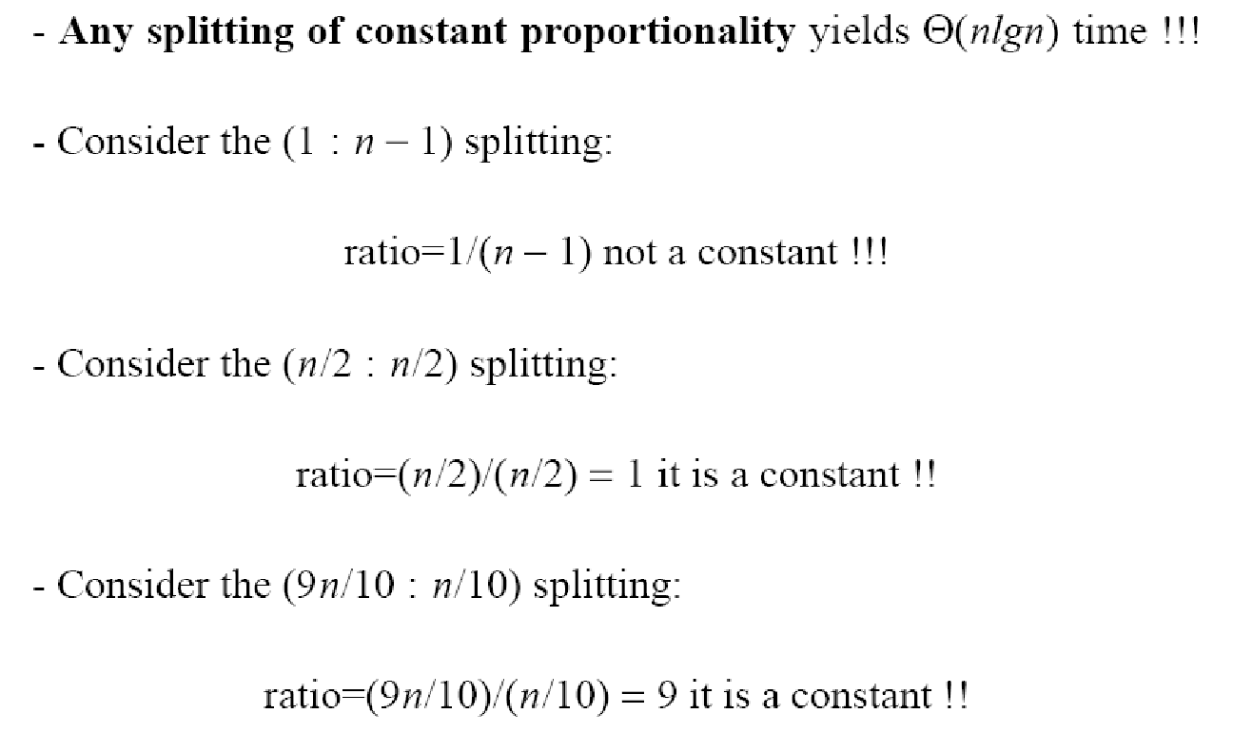
How does partition affect performance?
‹#›
Notes:
‹#›

Slide 41
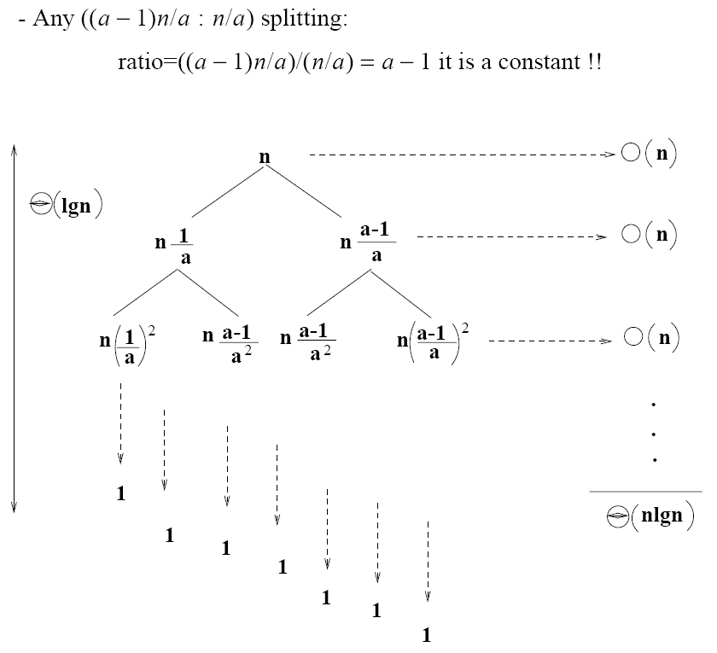
How does partition affect performance?
‹#›
Notes:
‹#›

Slide 42
Performance of Quicksort
Average case
All permutations of the input numbers are equally likely
On a random input array, we will have a mix of well balanced and unbalanced splits
Good and bad splits are randomly distributed across throughout the tree
partitioning cost:
n = Θ(n)
n
combined partitioning cost:
2n-1 = Θ(n)
n
1
n - 1
(n – 1)/2 + 1
(n – 1)/2
(n – 1)/2
(n – 1)/2
Alternate of a good
and a bad split
Nearly well
balanced split
Running time of Quicksort when levels alternate between good and bad splits is O(nlgn)
‹#›
Notes:
‹#›

