Slide 1
Fluid Simulation
Aviral Gupta 170101014
Devansh Gupta 170101022

Slide 2
Introduction
Fluid simulation refers to computer graphics techniques for generating realistic animations of fluids such as water and smoke.
Physics Model
Jos Stam introduced fast and stable methods to graphics [Stam 1999]
Many Applications

Slide 3
Physics
Need scalar and vector fields
Scalar fields: amount of smoke or dye
Vector fields: fluid velocity
Naviers-Stokes Equation

Slide 4
Physics of Velocity
Navier-Stokes Equations
u_{t} = k∇²u –(u⋅∇)u + f
Diffusion
Advection
Forces
Change in Velocity

Slide 5
Physics of Density
Navier-Stokes Equations
p_{t} = k∇² p –(p⋅∇)p + S
Diffusion
Advection
Added Densities
Change in Density

Slide 6
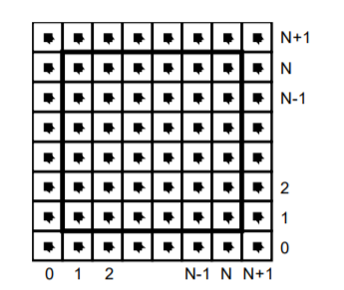
Fluid in a box
Represented by square grid
Values constant over each grid cell
Values displayed at cell center.

Slide 7
Density Field
(r,b,g)
(r,b,g)
…
(r,b,g)
(r,b,g)
…
…
…
…

Slide 8
Velocity Fields
u_{ij} = (u^{x},u^{y})

Slide 9
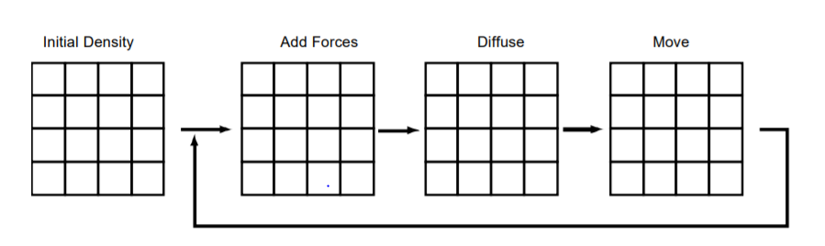
Moving Densities/Velocities
Start with initial states.
User will apply force or add densities.
Added forces will set the motion.
Added densities will be injected
For Velocity Field

Slide 10
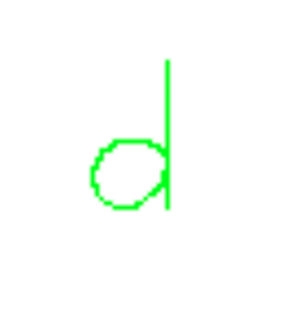


Diffusion
Original
Some Diffusion
More Diffusion

Slide 11
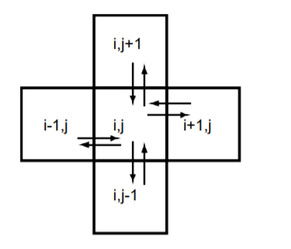
Diffusion
Cell exchanges densities only with its four direct neighbors as shown above.
Simple diffusion method unfortunately doesn’t work.
Find densities which when diffuse backward in time yield the densities we started with.
We use a Gauss-Seidel relaxation algorithm as recommended in Jos Stam’s fluid dynamics paper.

Slide 12
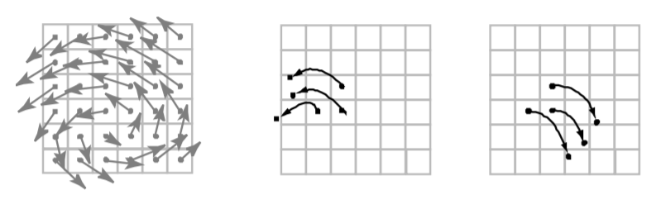
Advection
Moving densities/velocities would be easy to solve if they were modeled as a set of particles
Grid cell center is a particle.
Back trace the particle from the next state grid to the current state grid.
The back tracing step is done using a fourth order Runge Kutta method, suggested by Kenneth I. Joy’s in “Numerical Methods for Particle Tracing in Vector Fields.

Slide 13
Advection

Slide 14
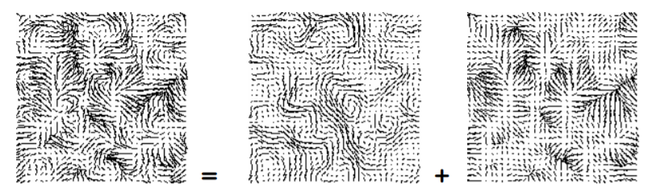
Project Routine
Unique to velocity fields.
The add forces, diffuse, and advection steps tend to produce non-conservative vector fields.
This step by uses Hodge decomposition.
Every velocity field is the sum of mass conserving field and a gradient field.
We want mass conserving fields.
The project routine is called after both the advent and diffusion routine in velocity step.

Slide 15
Boundary Conditions
Fluid is contained in a box with solid walls.
No flow should exit the walls.
Horizontal component of the velocity should be zero on the vertical walls and vice versa.
Continuity for density fields.

Slide 16
Demo

