Slide 1
SMART INDIA HACKATHON · TRACK 2
SkillSwap AI
AI-powered marketplace where students & young creators
showcase proof of skill, get matched intelligently, and deliver securely.
Not a Fiverr clone · Trust-weighted matching · Milestone-safe workflows
Live: skillswap-ai-ecru.vercel.app

Slide 2
Problem
Why traditional freelancing fails students
Experience gatekeeping
Race to the bottom
Marketplaces rank by years of work — students with strong projects get buried.
Lowest-price ranking pushes underbidding, weak quality, and distrust.
Weak portfolios
Unsafe delivery
Raw college projects don't look client-ready without heavy rewrite effort.
Flat pay-after-delivery models expose young creators to scope creep and unpaid work.

Slide 3
Solution
SkillSwap AI — proof-of-skill marketplace
• AI Portfolio Builder turns uploads + notes into client-ready cards
• Trust-weighted Talent Match (skills, portfolio, trust — never cheapest first)
• Gig marketplace for creators + browse/save for clients
• Milestone booking workflow: Pending → Accepted → In Progress → Submitted → Completed
• Verified reviews only after completed projects
• Realtime chat, notifications, analytics for both roles

Slide 4
User Journey
Creator and Client flows
Creator
Client
• Register as Creator
• Build AI portfolio cards
• Publish gigs
• Accept bookings + milestones
• Submit delivery → earn trust
• Track earnings & analytics
• Register as Client
• Post a job brief
• Get AI talent matches + reasons
• Browse / save creators
• Book with milestones
• Complete → leave verified review

Slide 5
Architecture
Production deployment topology
Vercel
Frontend
React + Vite
Railway
Backend
FastAPI + JWT
Supabase
PostgreSQL
Schema + Seed
Cloudinary
Media
Uploads
HTTPS → JWT Auth / REST / WebSocket → SQLAlchemy + Alembic → OpenAI-compatible AI layer

Slide 6
AI Features
Provider-abstracted OpenAI-compatible service
generate_portfolio()
Title, description, skills, tools, portfolio card from uploads + notes
match_creators()
Compatibility score + human reasons using skills, tags, portfolio, trust
suggest_pricing()
Category + experience aware gig pricing guidance
chat_assistant()
Brief writing help for creators and clients

Slide 7
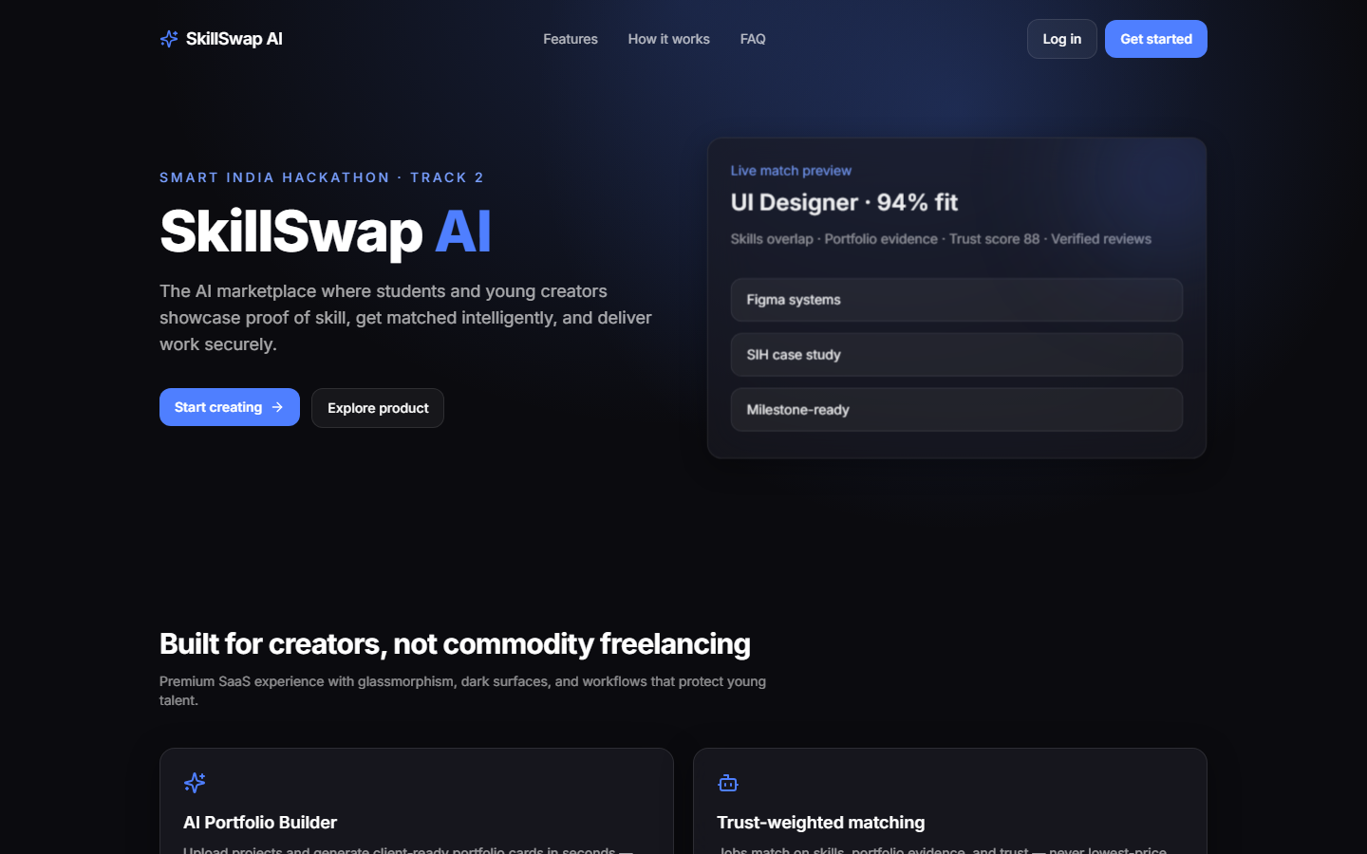
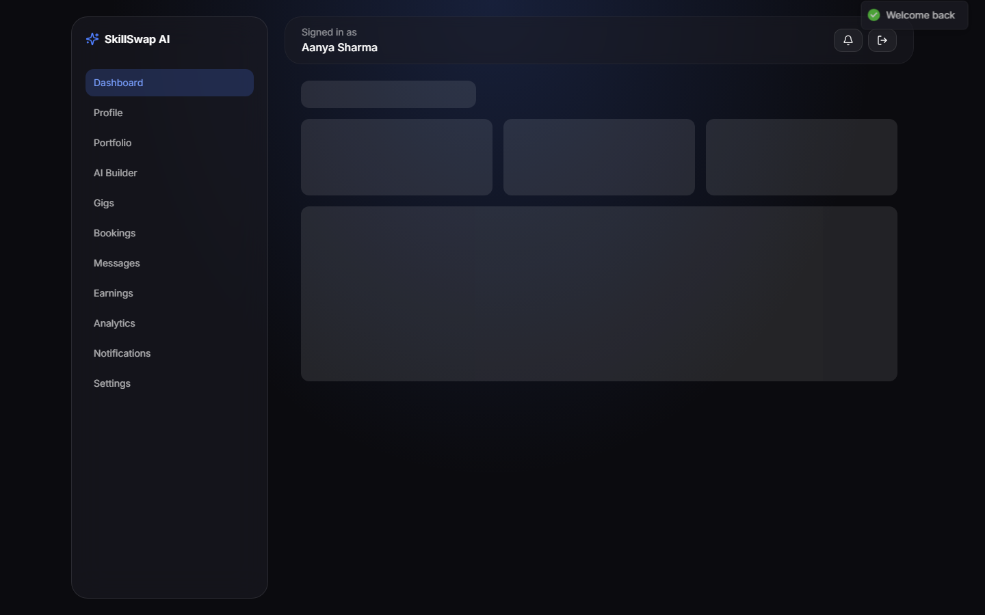
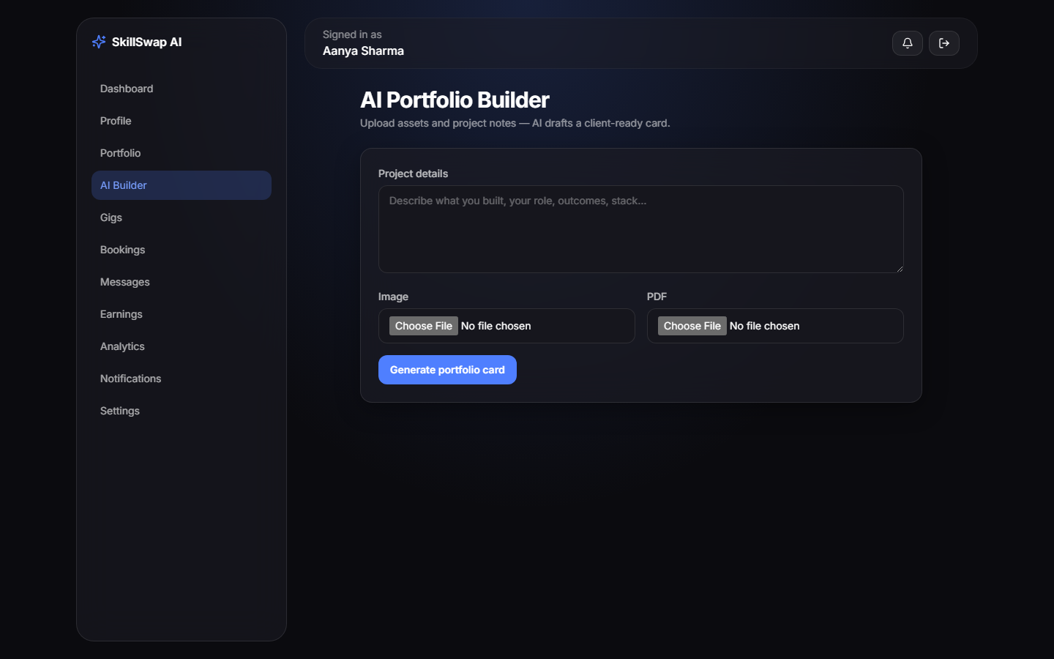
UI Screens
Premium dark SaaS — Apple × Linear × Stripe inspired
Landing
Creator Dashboard
AI Portfolio Builder

Slide 8
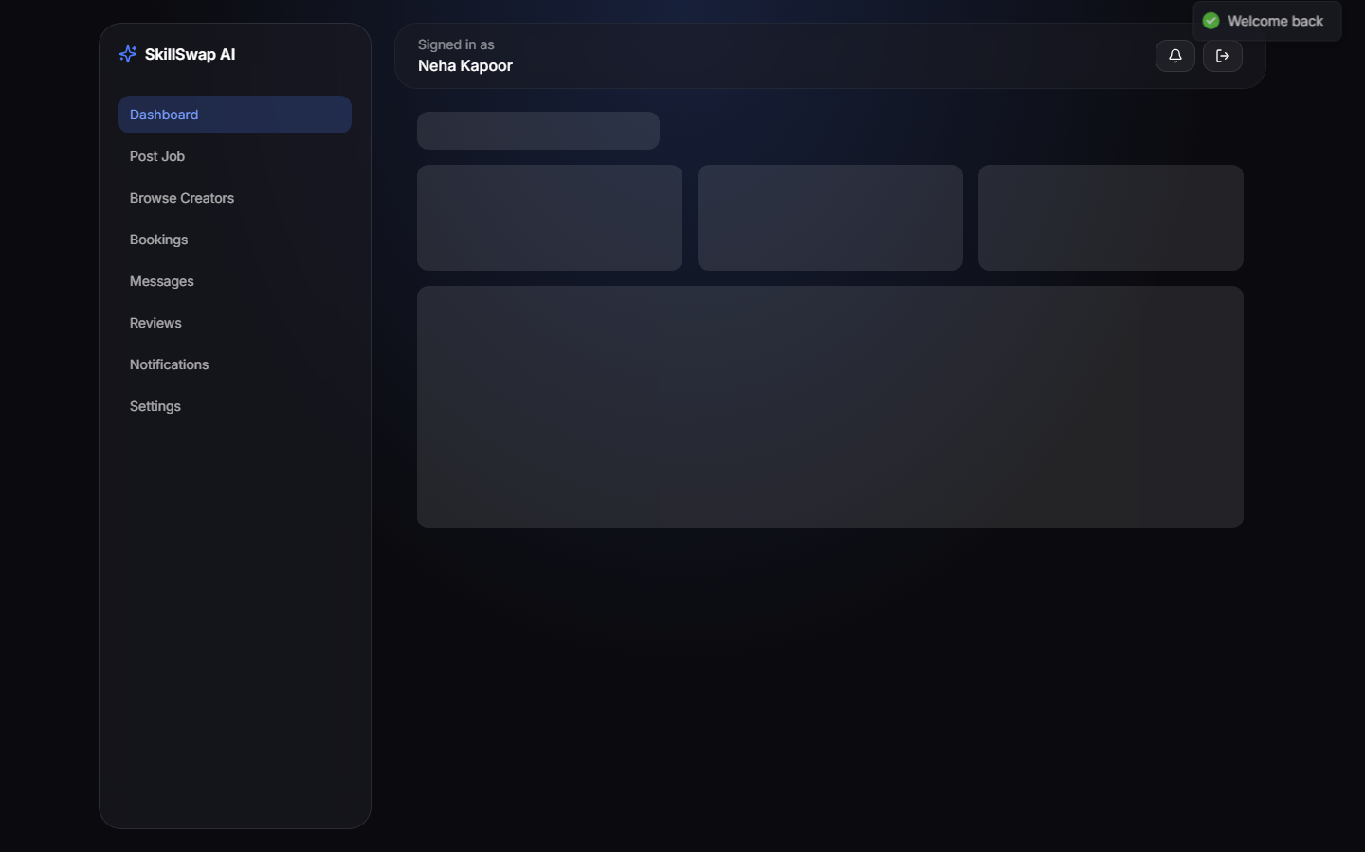
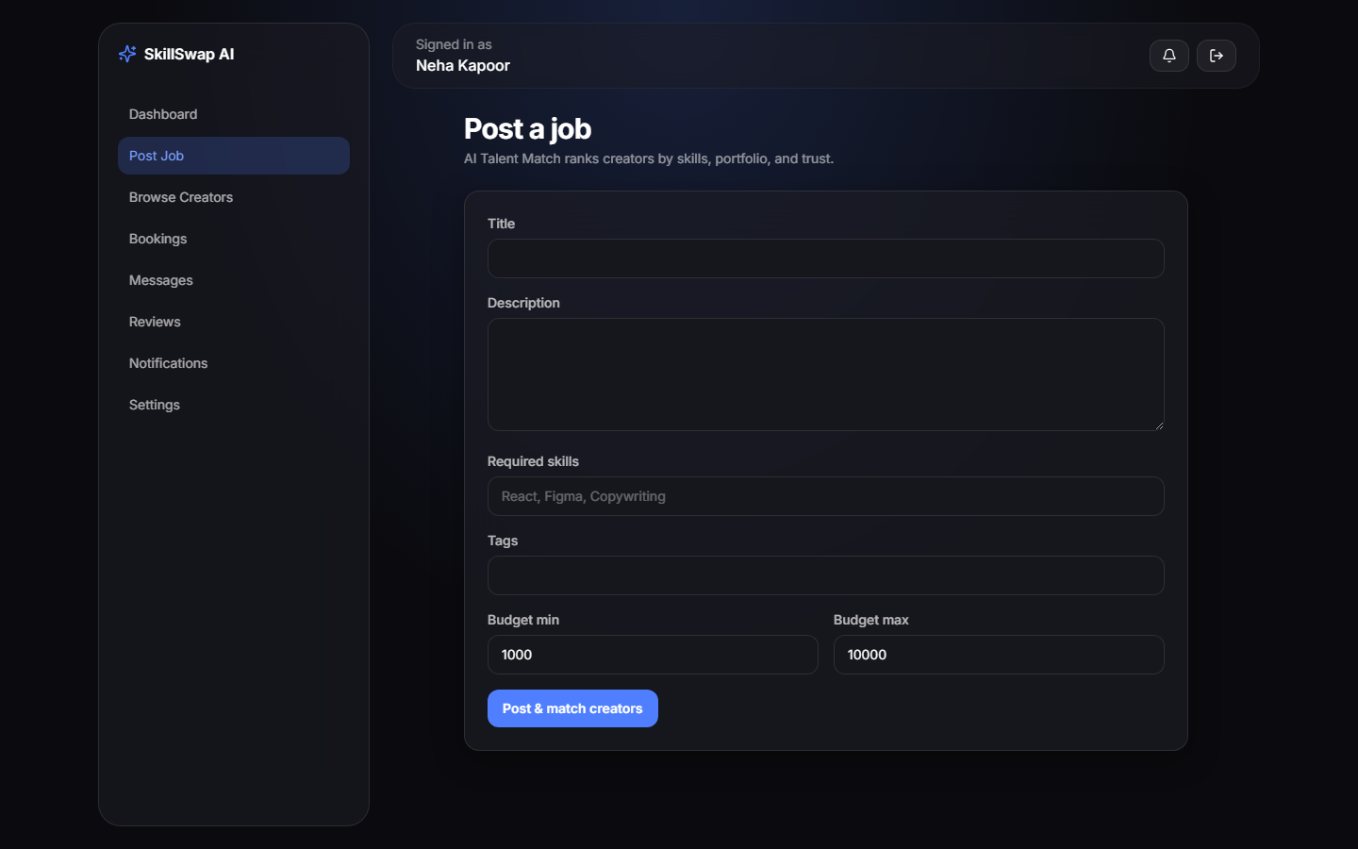
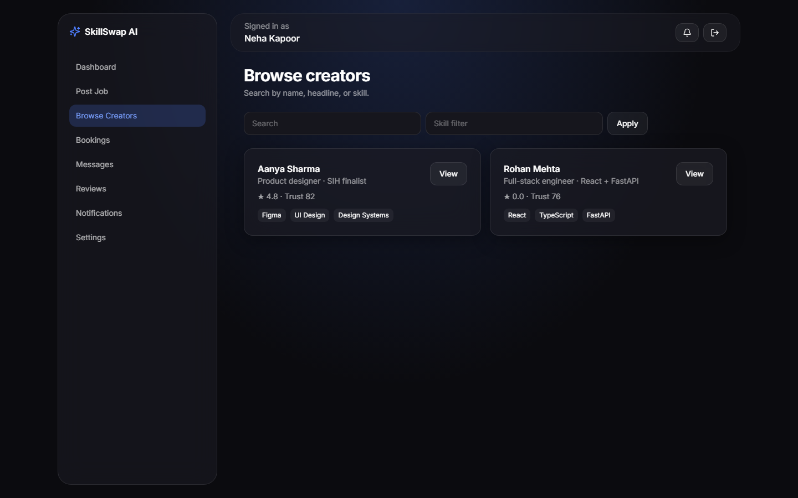
UI Screens
Client experience
Client Dashboard
Post Job + Match
Browse Creators

Slide 9
Database
PostgreSQL on Supabase · SQLAlchemy models + Alembic
Users
CreatorProfiles
ClientProfiles
PortfolioProjects
Gigs
Jobs
Bookings
Milestones
Reviews
Messages
Conversations
Notifications
SavedGigs
SavedJobs
SavedCreators

Slide 10
Tech Stack
Modular · scalable · production-ready
Frontend
Backend
Platform
• React 18
• Vite + TypeScript
• Tailwind CSS
• React Router
• Framer Motion
• React Query
• Axios
• Python 3.11
• FastAPI + Uvicorn
• SQLAlchemy
• Alembic
• JWT + Refresh
• Pydantic
• SlowAPI
• PostgreSQL (Supabase)
• Cloudinary
• Vercel
• Railway
• WebSockets
• OpenAI-compatible AI

Slide 11
Business Model
Sustainable marketplace for student talent
Marketplace fee
Small commission on completed milestone bookings
Creator Pro
Boosted visibility, advanced analytics, AI credits
Client teams
Multi-seat hiring workspaces for campuses & startups
Verified badges
Optional identity / institute verification partnerships

Slide 12
Future Scope
Roadmap beyond SIH MVP
• Payment gateway + escrow for milestone releases
• Vector embeddings for deeper portfolio similarity matching
• Mobile apps (React Native) for creators on the go
• Institute SSO / campus talent hubs
• AI contract assistant + dispute mediation support
• Multi-language support for Bharat-scale reach

Slide 13
Thank You
SkillSwap AI · Smart India Hackathon Track 2
Demo https://skillswap-ai-ecru.vercel.app
GitHub https://github.com/devanshgupta2610/SkillSwap-AI
API https://skillswap-ai-api-production.up.railway.app/docs
Questions?

