Slide 1
SVNIT Summer Research Fellowship Project 2013 SVNIT UPDATES
PRESENTED BY
Pallavi Khandelwal
Devanshi Patel
Kshama Jain
UNDER THE GUIDANCE OF
Rupa G. Mehta Mam
COED

Slide 2
Overview
Application
server
Tablet
Android
phone
Tablet
Android
phone

Slide 3
SVNIT UPDATES – Android application
This application provides the user recent happenings and news of the college.
There are easily accessible contacts of heads of various student chapters and student council members.
It allows users to send any piece of news they want to share.
Users can send feedback for any change or improvement of the application.
It provides user direct link to the college website by clicking on the college logo placed on the main page.

Slide 4
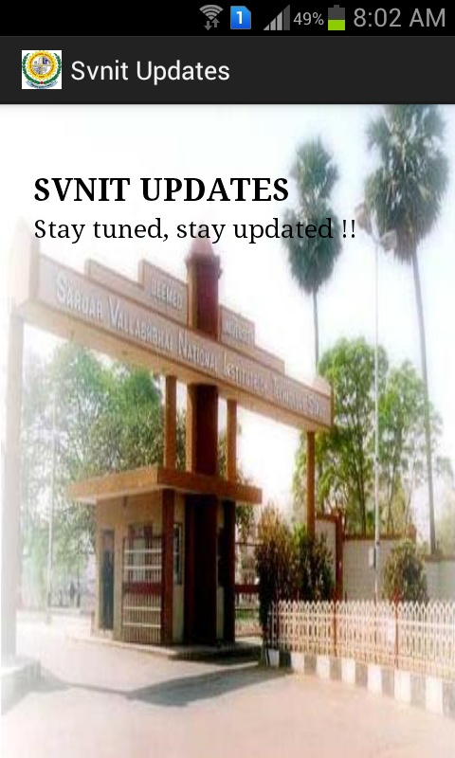
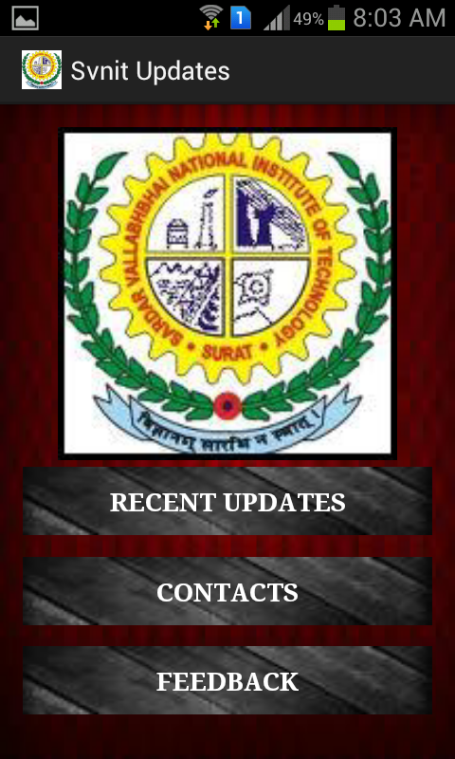
Screenshots of Android Application
Start Screen
Menu Page

Slide 5
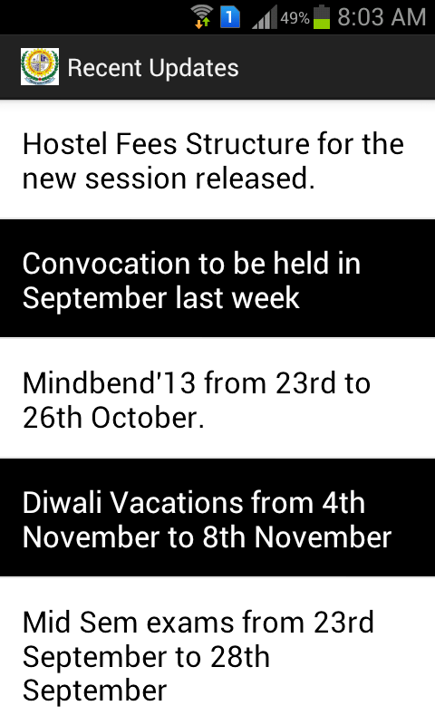
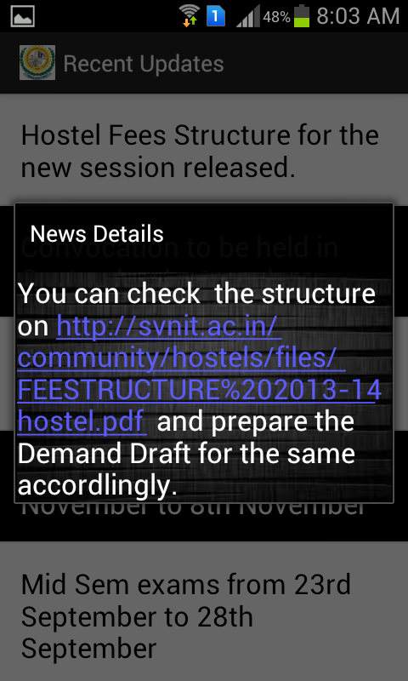
Updates Page
Detailed Updates Page

Slide 6
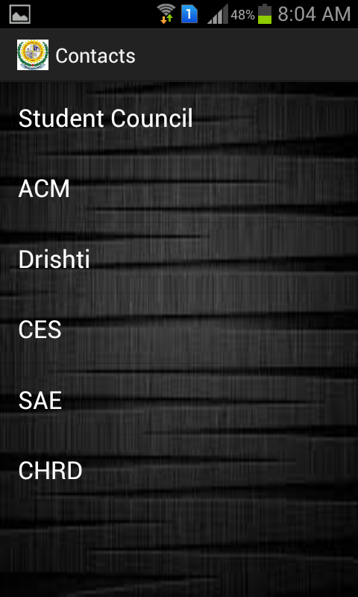
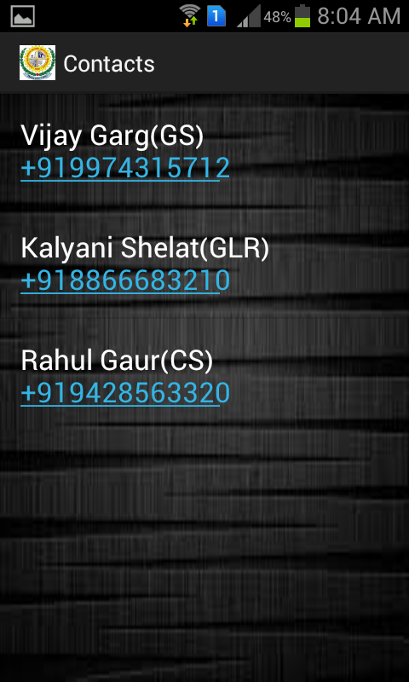
Contacts Page
Detailed Contacts Page

Slide 7

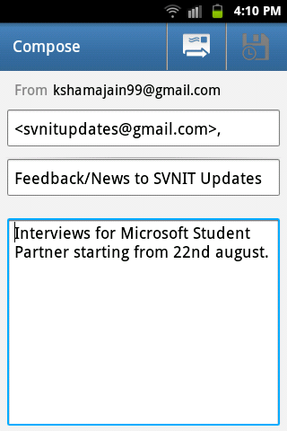
Feedback Page

Slide 8
SVNIT UPDATES Applet – Java Applet
Java applet is used to update the android application by changing the web page.
It is used to communicate with the database and the XML data file.
It helps us to insert, delete and modify any update in the data file which is then reflected in our application.

Slide 9
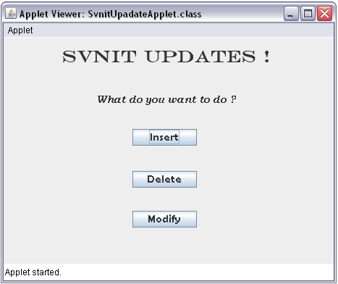
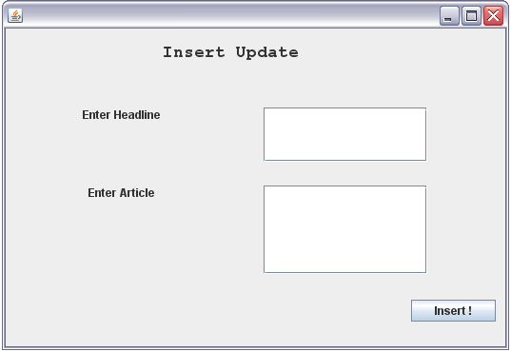
Screenshots of the server side Java Applet
Menu Frame
Insert Update Frame

Slide 10
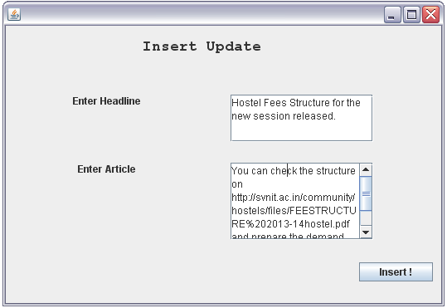
Server Side
Application
Java Applet
Android Application

Slide 11
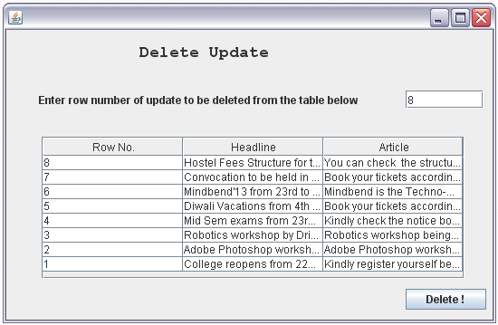
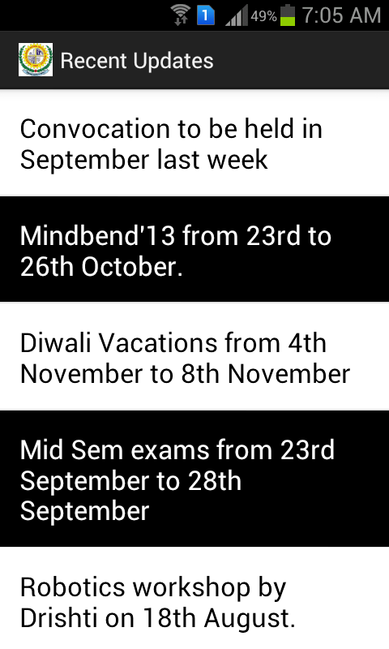
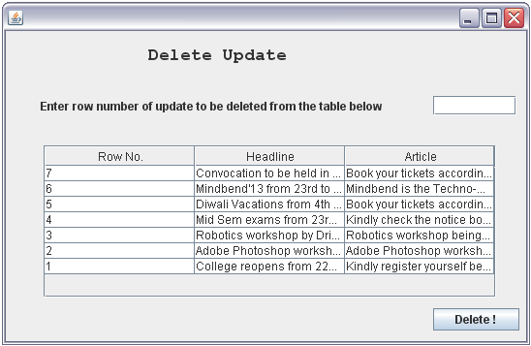
Server Side
Application

Slide 12
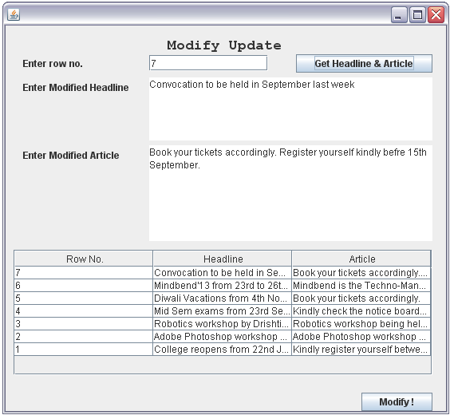
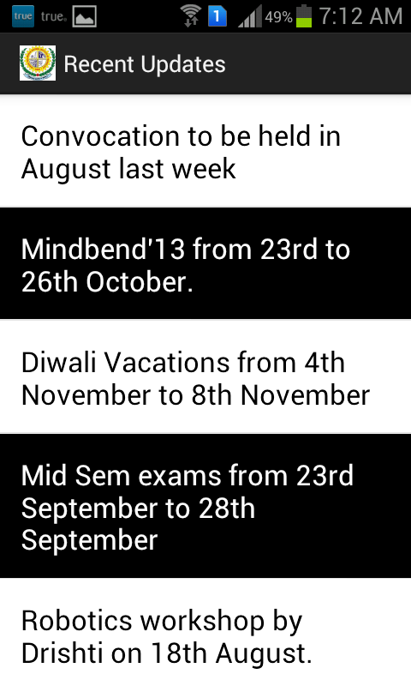
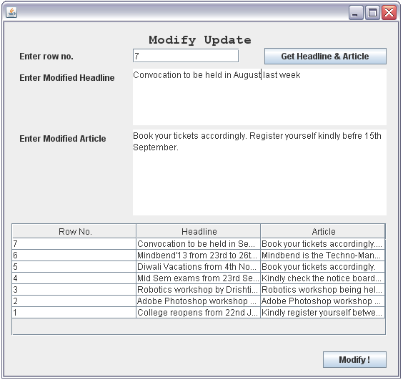
Server Side
Application

Slide 13
Implementation of project

Slide 14
Flowchart Of SVNIT Updates
Android Application
Xml File
SQL Table
Java Code
Hibernate
Java
XML Parsing

Slide 15
Installations learnt for the project
Eclipse | Version: 4.2 Juno Build: v22.0.0-675183 | It is a common platform to communicate between Android, SQL, Java, Hibernate and XML.
Android | Version: JellyBean Build : 4.2.2 | It is a Linux-based OS on which open source applications for various devices such as touchscreen gadgets are developed.
Java | Version: 1.7.25 | It is a concurrent, class-based, object-oriented computer programming language.
Hibernate | Version: ORM 4.2.3 | It is used for mapping an object oriented domain model to relational database

Slide 16
XML | Version: 1.0 | Extensible Markup Language (XML) is a markup language that defines a set of rules for encoding documents in a format that is both human-readable and machine-readable.
MySQL | Oracle 5.2.47CE Revision 10398 | MySQL is an open source relational database management system (RDBMS) that runs as a server providing multi-user access to a number of databases.
WindowsBuilder | WindowBuilder Core 1.6.0.r42x201305211944 | WindowBuilder is a powerful and easy to use bi-directional Java GUI designer.
WampServer | Version: 2.2 | This is a common platform for web application development and deployment.

Slide 17
Conclusion
We started with the aim to bridge the gap of spread of rapid information among the institute and we have got the results well by making this application.
The users can easily install this application in their android devices by just installing the .apk file and take the benefit.
Thereby concluding the presentation, and the hard work we did for the last 2.5 months of vacation, we have learned as many as 8-10 software varying from beginner to advanced levels during the term and have come out with this finishing product in the end which can definitely help.

Slide 18
Future Vision
Providing year-wise / department-wise filters in the application and hence helping student quickly scroll through the suitable news.
Any new link added on the college website will be notified to the user via this application.

