Slide 1
Summer Training
Devanshi Bhavsar
12002040701028

Slide 2
Content
Company profile
Technology learned
Mini project
IOT devices and sensors used
Circuit Diagram
Working principle
Result
Applications
Conclusion

Slide 3
Company profile
Tech Elecon is the IT division of the Elecon group of companies and has an experience of more than 25 years in the field of hardware, software and networking solutions. Situated in the heart of Vitthal Udyognagar an Industrial Estate and in the proximity of the educational town of Vallabh Vidyanagar, Tech Elecon is all set to reach new heights in the field of IT solutions.
It provides all sorts of solutions and deliver any application that is web based and further solutions are designed to adapt business.
Their solutions are 100% fruitful and empower you to take control of business online and in real time.
It provides OEM level products, packaged products, and ready to install systems for wireless Data and Voice for industrial, and military, and government clients. Also serve a variety of customers ranging from radio integrators to multibillion-dollar defense contractors.

Slide 4
Technology Learned
One of the most prominent technological revolutions of recent times is the Internet of Things (IoT). IoT refers to the network of interconnected devices that exchange data and enable automation and seamless communication between the physical and digital realms.
Learned about different sensors like
Vibration sensor
Noise sensor
Environmental sensor

Slide 5
Mini project
Project title: Air Quality Monitoring Device
The Air Quality Monitoring System is designed to measure and monitor the air quality in a specific environment using the MQ-135 gas sensor.
This project aims to provide real-time information about the concentration of various harmful gases present in the air, allowing users to take necessary actions to ensure a healthier living or working space.
The MQ-135 gas sensor can detect various gases like carbon dioxide, ammonia, benzene, alcohol, smoke.

Slide 6
IOT devices and sensors used
Various IOT devices and sensors used are as follow:
MQ135: The MQ-135 gas sensor can detect various gases, including carbon dioxide (CO2).
NodeMCU: The NodeMCU is a popular development board based on the ESP8266 microcontroller with built-in Wi-Fi capabilities.
LCD display: An LCD (Liquid Crystal Display) is a visual output device that can be used to display information in text or graphical format.

Slide 7
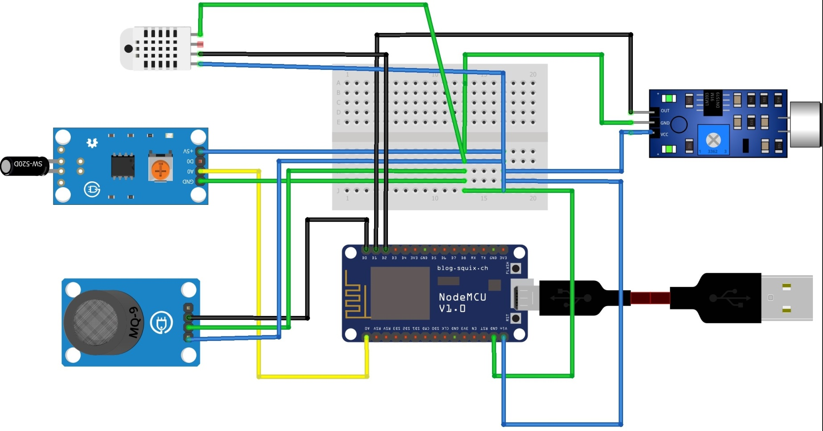
Circuit Daigram

Slide 8
Working principle
The MQ-135 sensor has a sensitive element that interacts with the target gas, in this case, carbon dioxide (CO2). The gas molecules come in contact with the sensor, causing a change in the electrical conductivity of the sensitive material.
Connect the MQ-135 sensor to a microcontroller, such as NodeMCU, to interface with it. The microcontroller reads the analog output of the MQ-135 sensor, which represents the concentration of carbon dioxide. The microcontroller converts this analog value into a digital format.
Use the Blynk application to create a user interface for monitoring and controlling the MQ-135 sensor remotely.
Connect the LCD display to the NodeMCU board. Most LCD displays utilize the I2C or parallel interface.

Slide 9
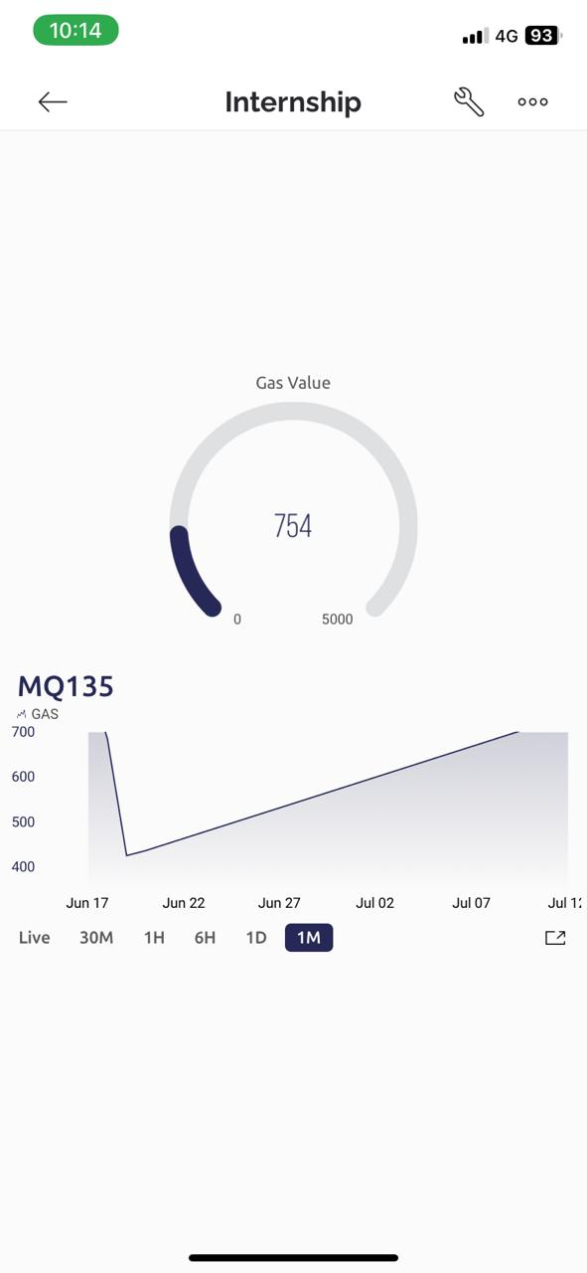
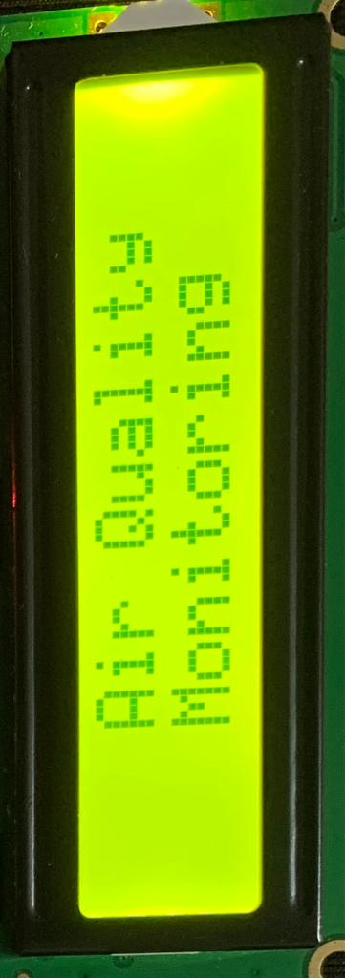
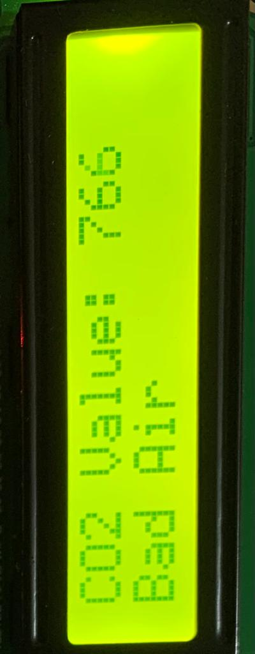
Result

Slide 10
Application
Indoor Air Quality Monitoring: It is used to monitor and assess the air quality in homes, offices, schools, and other indoor environments.
Gas Leakage Detection: The sensor can be utilized in gas detection systems to identify and alert against gas leaks in industrial settings or household gas supply systems.
Environmental Monitoring: It enables the measurement of air pollution levels in outdoor environments, contributing to environmental studies and research.
Safety Systems: The MQ-135 sensor can be integrated into safety systems to detect the presence of hazardous gases and trigger appropriate actions or alarms.

Slide 11
Conclusion
In conclusion, the developed system offers a cost-effective and reliable solution for monitoring air quality using readily available components. The combination of NodeMCU, MQ135 sensor, LCD display.
Blynk platform creates a comprehensive and user-friendly solution that can be scaled and adapted to suit various applications and environments.
The addition of an LCD display provided a convenient local interface, allowing users to view the real-time air quality information directly.
Users could conveniently monitor the air pollutant levels from anywhere, ensuring continuous awareness of the air quality situation in their surroundings.

Slide 12
References
Liu, J., Li, X., & Cheng, X. (2020). "Design of air quality monitoring system based on NodeMCU and Blynk." 2020 International Conference on Information Technology and Internet of Things (ITIO). IEEE.
Kumar, A., & Bhardwaj, A. (2018). "A review on air quality monitoring system using IoT-based sensors." International Journal of Scientific Research in Computer Science, Engineering, and Information Technology, 4(3), 383-388.
Chhaya, V., & Patel, H. (2017). "IoT-based air quality index monitoring using MQ135 sensor and ESP8266 for indoor environment." 2017 International Conference on Trends in Electronics and Informatics (ICEI). IEEE.

