Slide 1

VoLTE
Presented By : Swarnil Shinde , Sachin Shinde

Slide 2
1
INTRODUCTION
Voice over LTE (VoLTE) is a technology that allows voice calls to be made over LTE networks, offering better call quality and faster call setup times compared to traditional methods. It enables users to make voice calls while using data services simultaneously, enhancing the overall communication experience on mobile devices.
Larana University | 2024

Slide 3
2
How VoLTE Works
Leverages IP Multimedia Subsystem (IMS): An advanced framework for managing voice and multimedia services over LTE networks.
Packet-switched technology: Breaks down voice calls into data packets for efficient transmission over the LTE network.
Seamless integration with existing networks: VoLTE works seamlessly with traditional phone networks to ensure call completion even in areas without VoLTE coverage.
UCoE | 2024

Slide 4
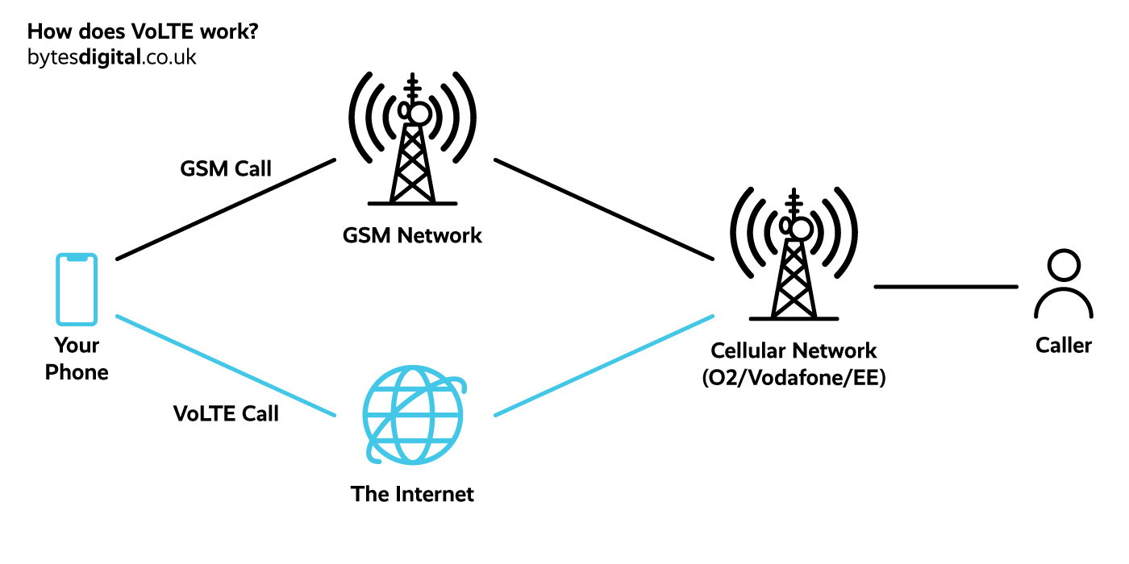





2
How VoLTE Works
UCoE | 2024

Slide 5
3
Benefits of VoLTE
Crystal-clear call quality : VoLTE supports high-definition (HD) voice calls, providing clearer and more natural-sounding conversations compared to traditional voice calls.
Faster call connection times: No more waiting for calls to connect – VoLTE delivers near-instantaneous call setup.
Simultaneous voice and data: Browse the web, use apps, or download files while on a call, all without interruption.
Improved Coverage and Reliability: VoLTE networks typically offer better signal strength and coverage, resulting in fewer dropped calls and improved call quality even in areas with weak signal reception.
UCoE | 2024

Slide 6
The Future of Mobile Communication
4
VoLTE paves the way for innovative features: Expect exciting new features like video calling, group calling, and enhanced multimedia messaging.
Improved network efficiency: VoLTE allows operators to handle more calls on their networks, improving overall network performance.
A cornerstone of 5G technology: VoLTE serves as the foundation for next-generation 5G networks, promising even faster call speeds and superior quality.
UCoE| 2024

Slide 7
5
Conclusion
VoLTE represents a significant advancement in mobile communication technology, offering enhanced voice communication experiences to users. As mobile operators continue to deploy VoLTE networks and expand coverage, users can expect further improvements in voice call quality, reliability, and advanced communication features.
UCoE| 2024

Slide 8
THANK YOU

