Slide 1
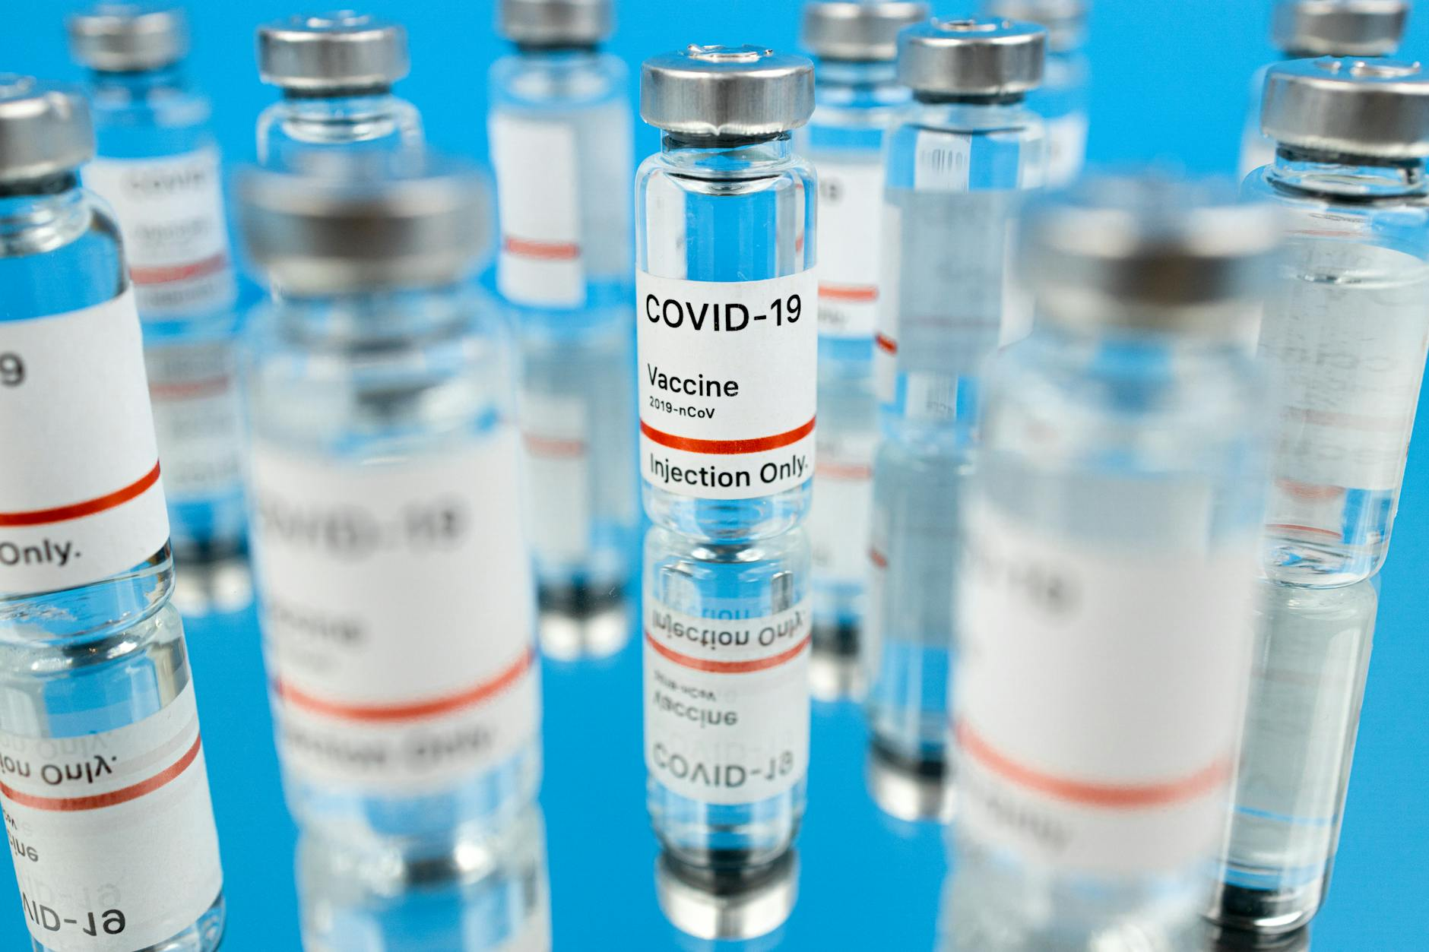
COVID-19: A Global Overview
Introduction to the SARS-CoV-2 virus and its origins.
Initial spread and identification of the disease in Wuhan, China.
Declaration of a pandemic by the World Health Organization (WHO).

Slide 2

Understanding the Virus: Structure and Transmission
Structure of the SARS-CoV-2 virus: spike protein, RNA, and envelope.
Primary modes of transmission: respiratory droplets and aerosols.
Importance of hand hygiene, mask-wearing, and social distancing.

Slide 3
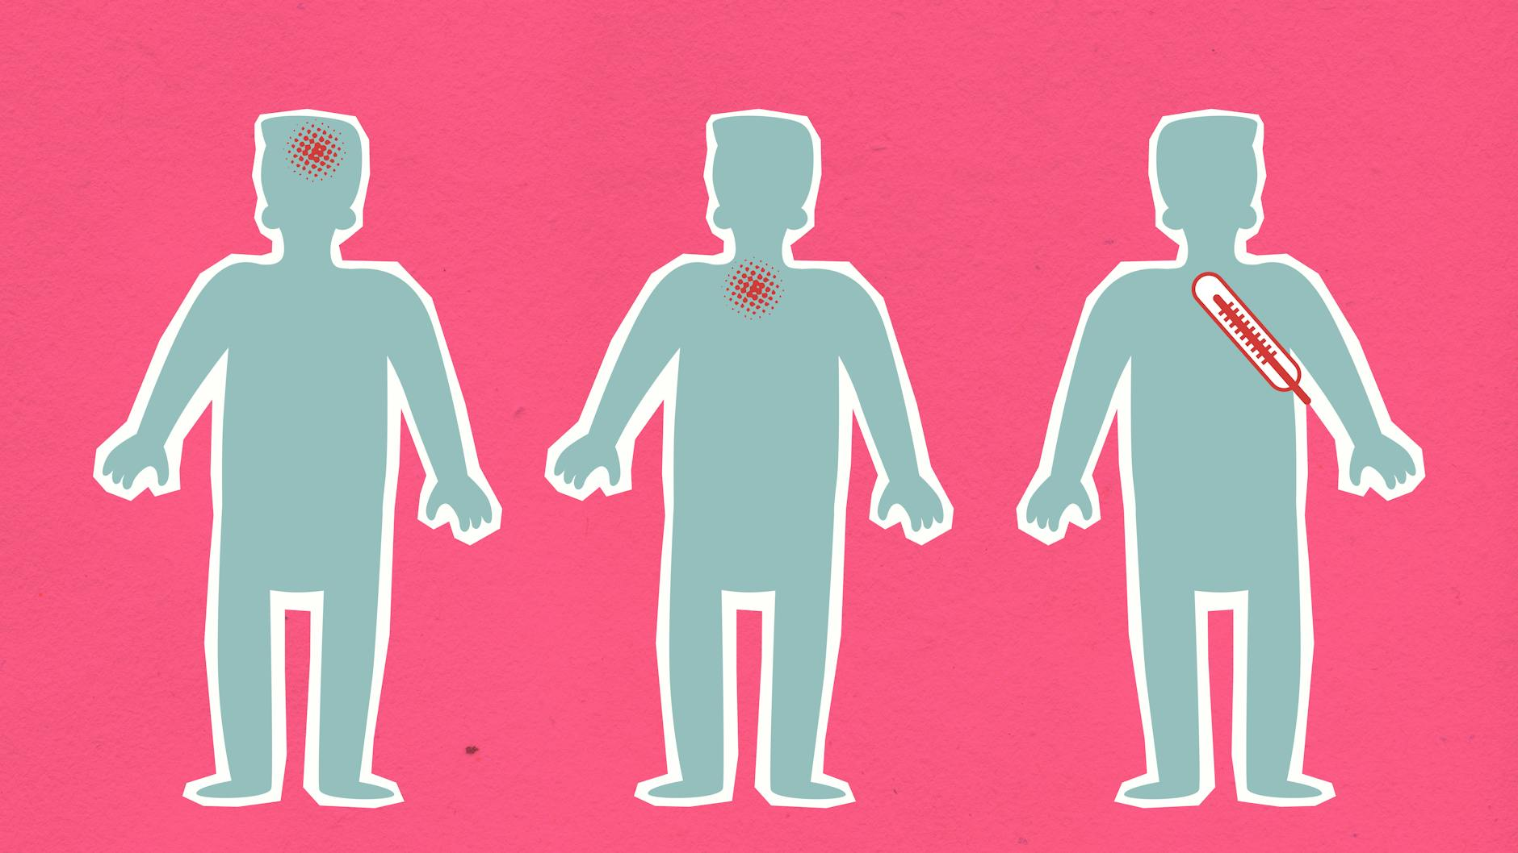
Symptoms and Diagnosis of COVID-19
Common symptoms: fever, cough, fatigue, loss of taste or smell.
Diagnostic methods: PCR testing, rapid antigen tests, antibody tests.
Importance of early detection and isolation to prevent further spread.

Slide 4

Global Impact: Mortality and Morbidity
Statistics on global cases, deaths, and recovery rates.
Impact on healthcare systems and infrastructure.
Socioeconomic consequences: unemployment, poverty, and inequality.

Slide 5
Vaccine Development and Deployment
Overview of different vaccine technologies: mRNA, viral vector, inactivated.
Efficacy and safety data from clinical trials.
Global vaccination efforts and challenges: distribution, access, hesitancy.

Slide 6
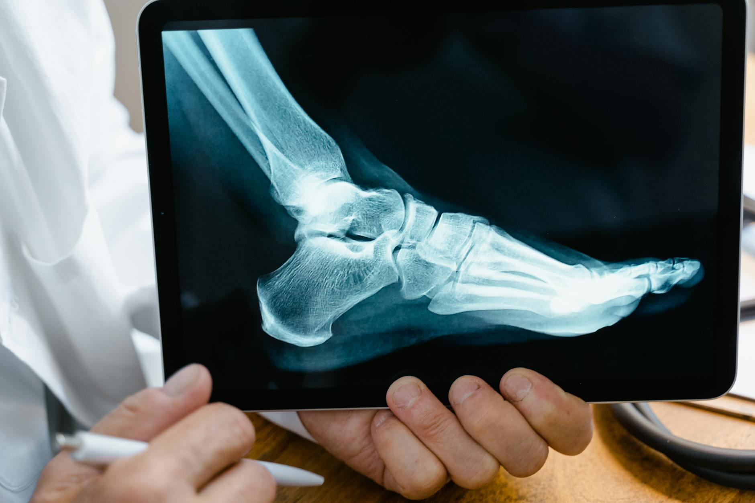
Treatment Options: Current and Emerging Therapies
Overview of available treatments: antiviral drugs, corticosteroids.
Supportive care: oxygen therapy, ventilation.
Emerging therapies: monoclonal antibodies, convalescent plasma.

Slide 7

Long COVID: The Persistent Impact
Definition and symptoms of Long COVID (post-COVID conditions).
Prevalence and risk factors for developing Long COVID.
Research and management strategies for Long COVID patients.

Slide 8
Variants of Concern: Mutations and Spread
Introduction to viral mutations and variants of concern (e.g., Delta, Omicron).
Impact of variants on transmissibility, severity, and vaccine effectiveness.
Ongoing monitoring and surveillance of emerging variants.

Slide 9

Public Health Measures: Prevention and Control
Importance of non-pharmaceutical interventions: masks, social distancing.
Effective contact tracing and isolation strategies.
Role of public health communication and community engagement.

Slide 10

The Future of COVID-19: Lessons Learned and Preparedness
Key lessons learned from the pandemic response.
Strategies for improving future pandemic preparedness.
The ongoing need for global collaboration and investment in public health.

