Slide 1
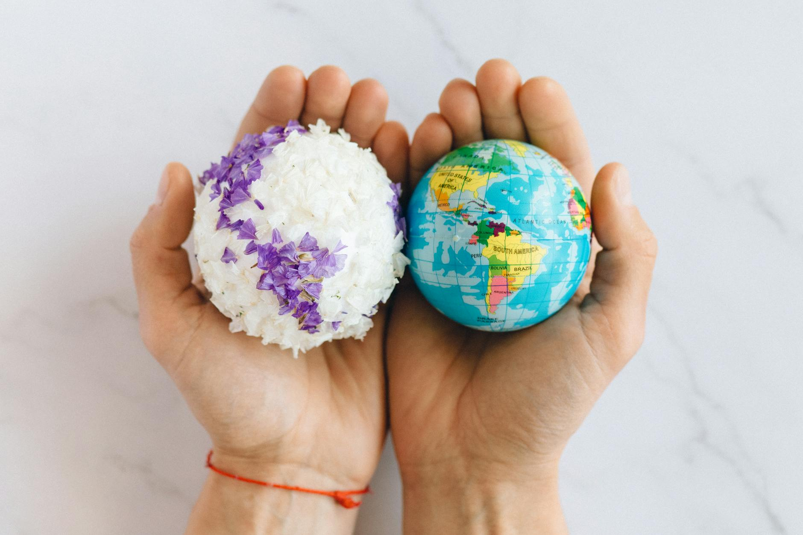
Understanding Pollution: A Global Crisis
Pollution defined: Contamination of the environment by harmful substances.
Types of Pollution: Air, water, soil, noise, light, and thermal.
Impact on Human Health: Respiratory problems, cancer, and developmental issues.

Slide 2
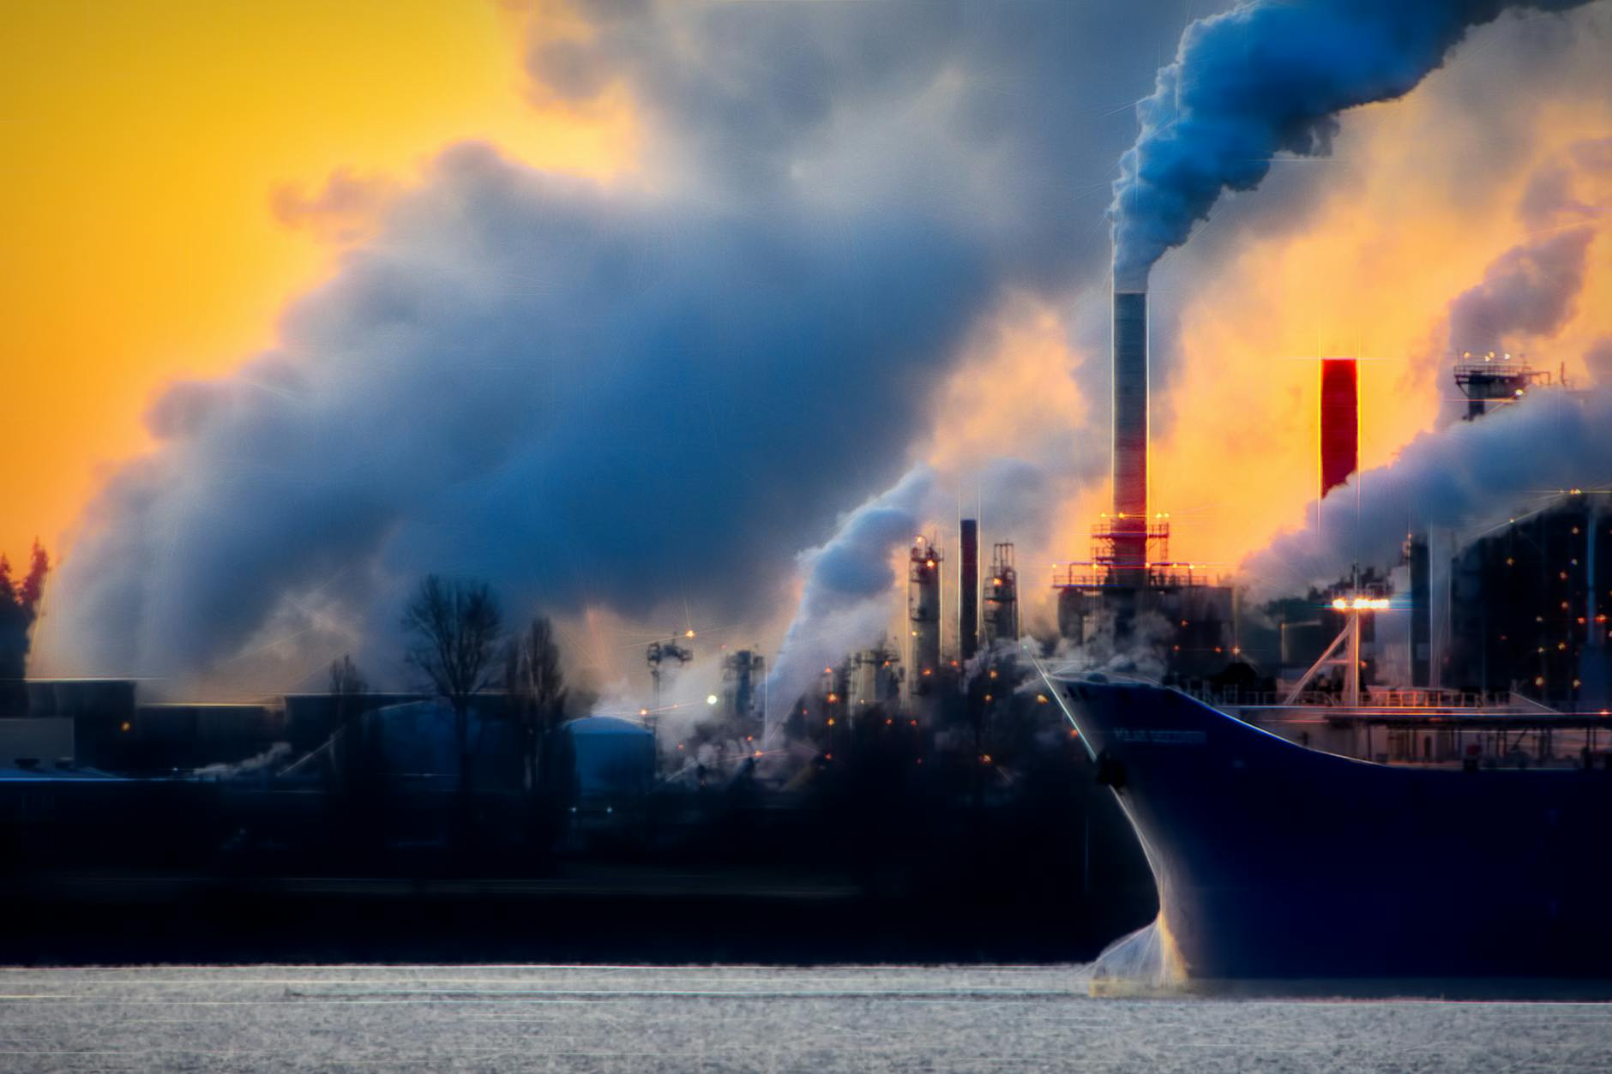
Air Pollution: The Silent Killer
Sources of Air Pollution: Vehicle emissions, industrial processes, and burning fossil fuels.
Major Pollutants: Particulate matter (PM2.5 & PM10), ozone, nitrogen dioxide, and sulfur dioxide.
Health Effects: Asthma, heart disease, lung cancer, and premature death.

Slide 3
Water Pollution: Threat to Aquatic Life
Sources of Water Pollution: Industrial discharge, agricultural runoff, sewage, and oil spills.
Types of Water Pollutants: Chemicals, heavy metals, pathogens, and plastics.
Impact on Ecosystems: Disruption of food chains, dead zones, and loss of biodiversity.

Slide 4
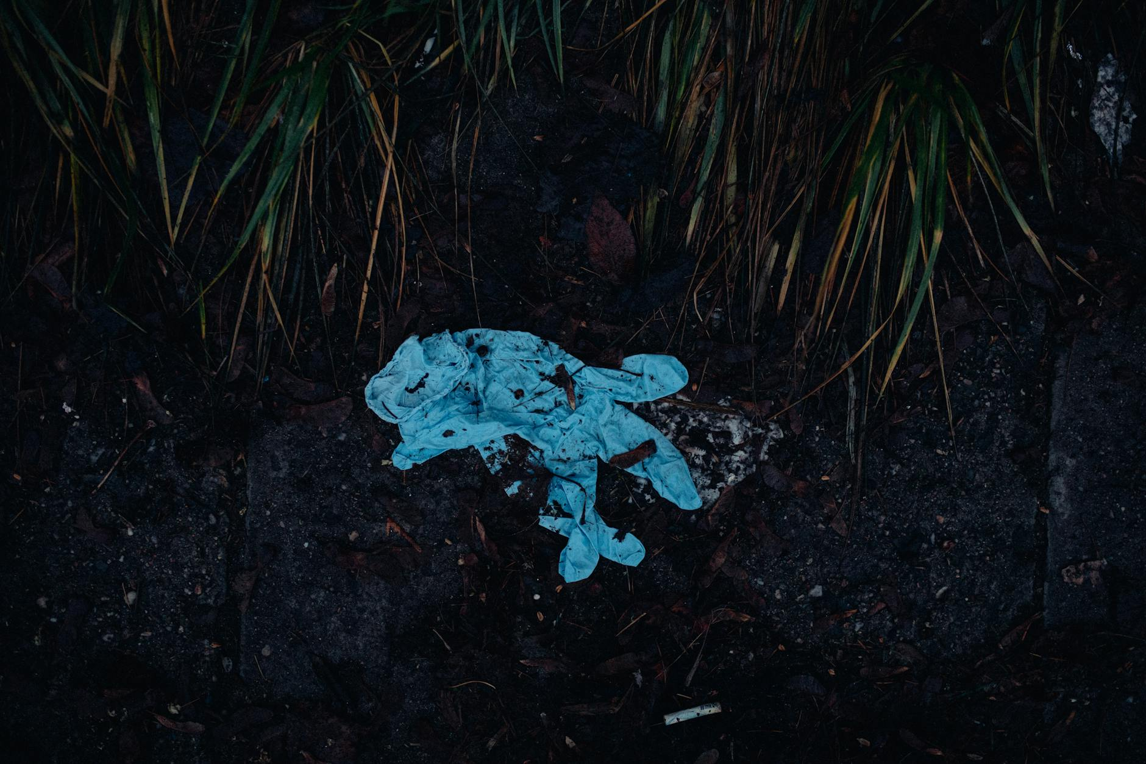
Soil Pollution: Degradation of Land
Sources of Soil Pollution: Industrial waste, pesticides, fertilizers, and mining activities.
Soil Pollutants: Heavy metals, persistent organic pollutants (POPs), and radioactive materials.
Impact on Agriculture: Reduced crop yields, contamination of food, and soil erosion.

Slide 5
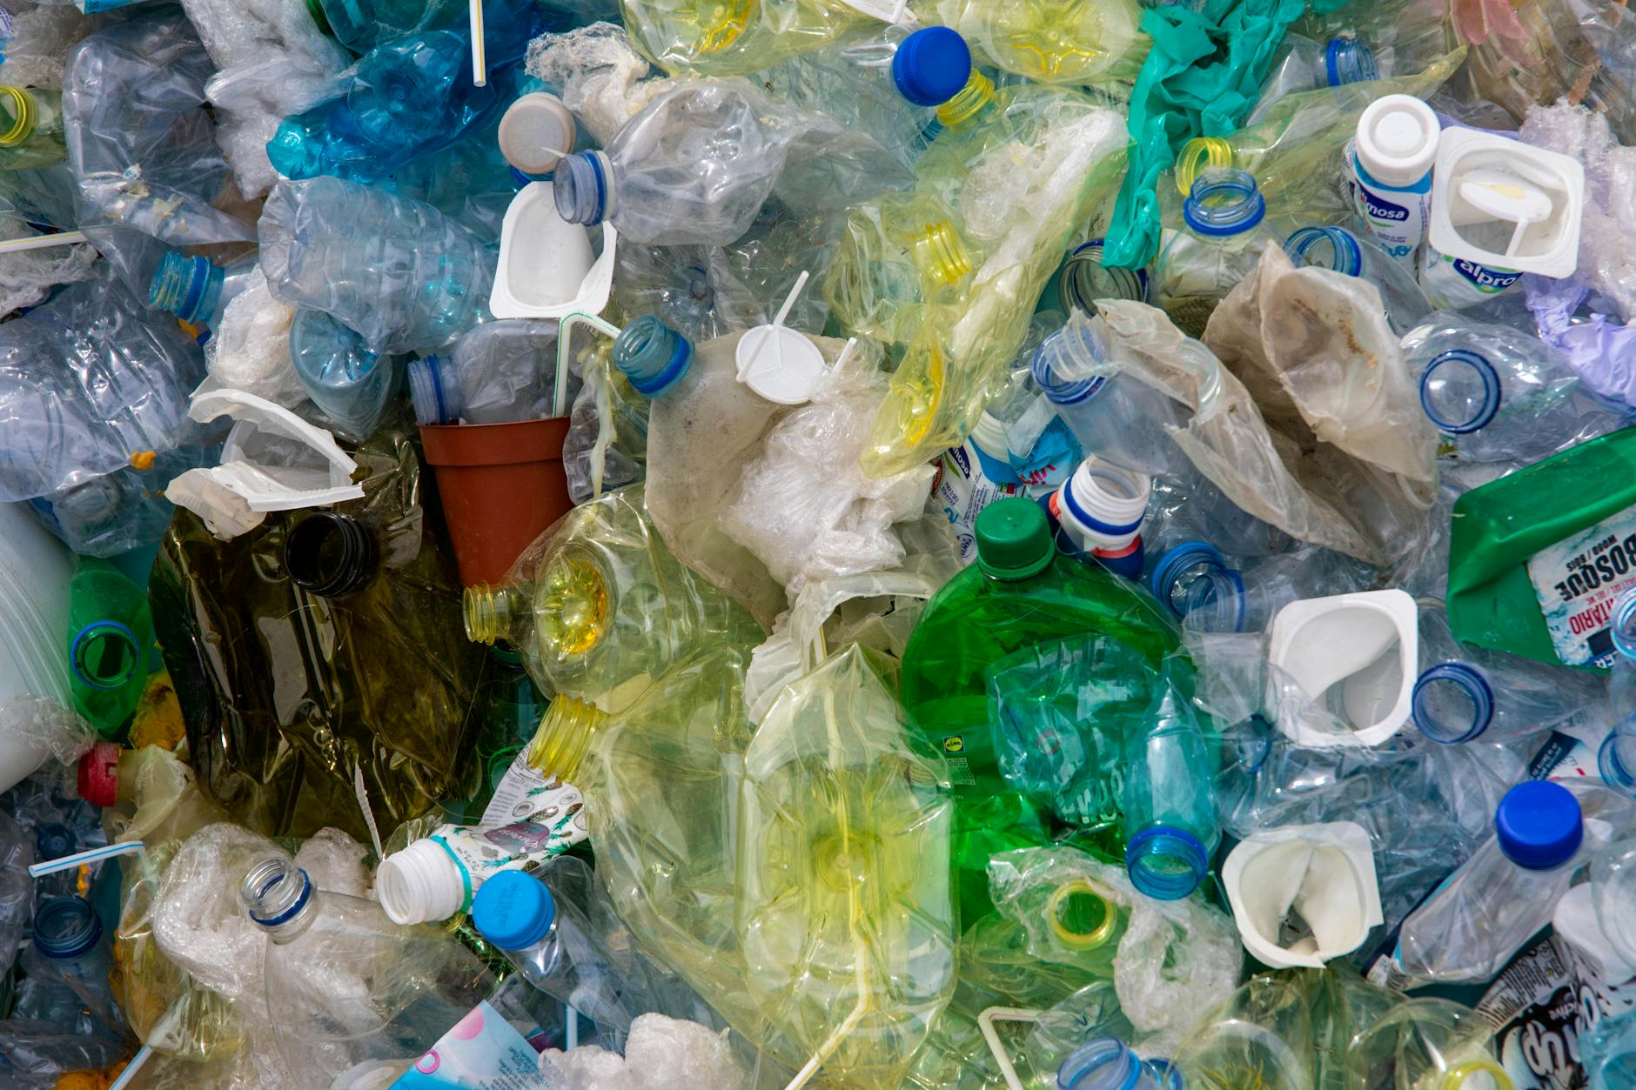
The Role of Plastics in Pollution
Plastic Production and Waste: Exponential growth of plastic production and improper disposal.
Microplastics: Small plastic particles that contaminate oceans and food chains.
Environmental Impact: Entanglement of wildlife, ingestion by animals, and release of toxins.

Slide 6
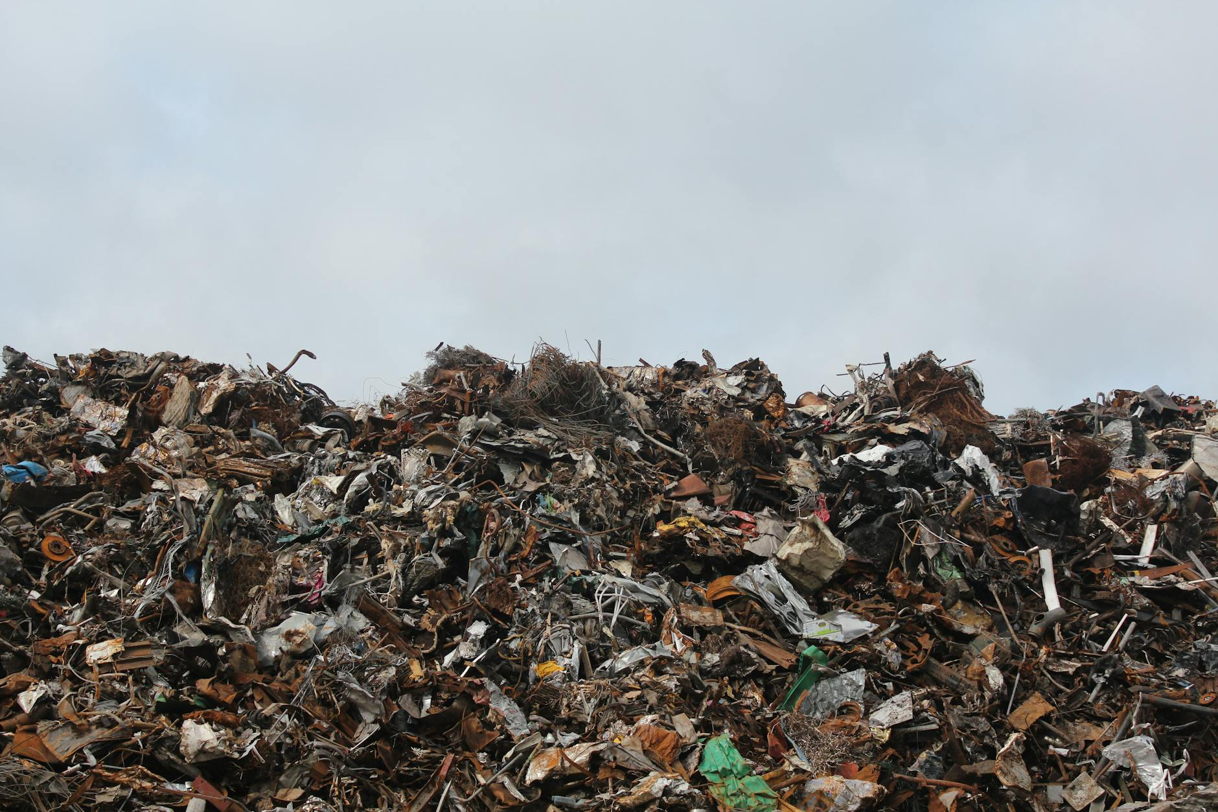
Sources of Pollution: A Quick Glance
Industrial activities release harmful pollutants into the air and water.
Agricultural practices such as pesticides and fertilizers contaminate soil and water.
Transportation sector contributes to air pollution through vehicle emissions.

Slide 7
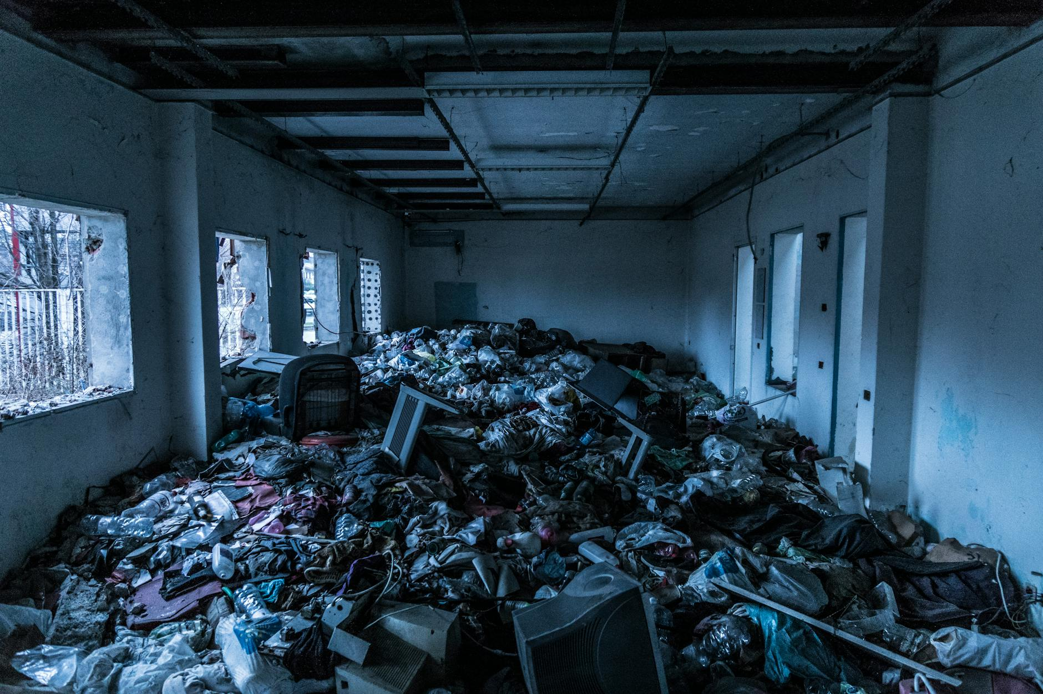
The Economic Costs of Pollution
Healthcare Expenses: Treating pollution-related illnesses places a burden on healthcare systems.
Reduced Productivity: Pollution can decrease worker productivity and economic output.
Environmental Damage: Costs associated with cleaning up polluted areas and restoring ecosystems.

Slide 8

Solutions: Towards a Cleaner Future
Reduce, Reuse, Recycle: Minimizing waste and maximizing resource utilization.
Renewable Energy: Transitioning to solar, wind, and other clean energy sources.
Sustainable Transportation: Promoting public transit, cycling, and electric vehicles.

Slide 9
Policy and Regulations: Government's Role
Environmental Regulations: Setting emission standards and pollution control measures.
International Agreements: Collaborative efforts to address global pollution challenges.
Incentives and Subsidies: Encouraging businesses and individuals to adopt eco-friendly practices.

Slide 10
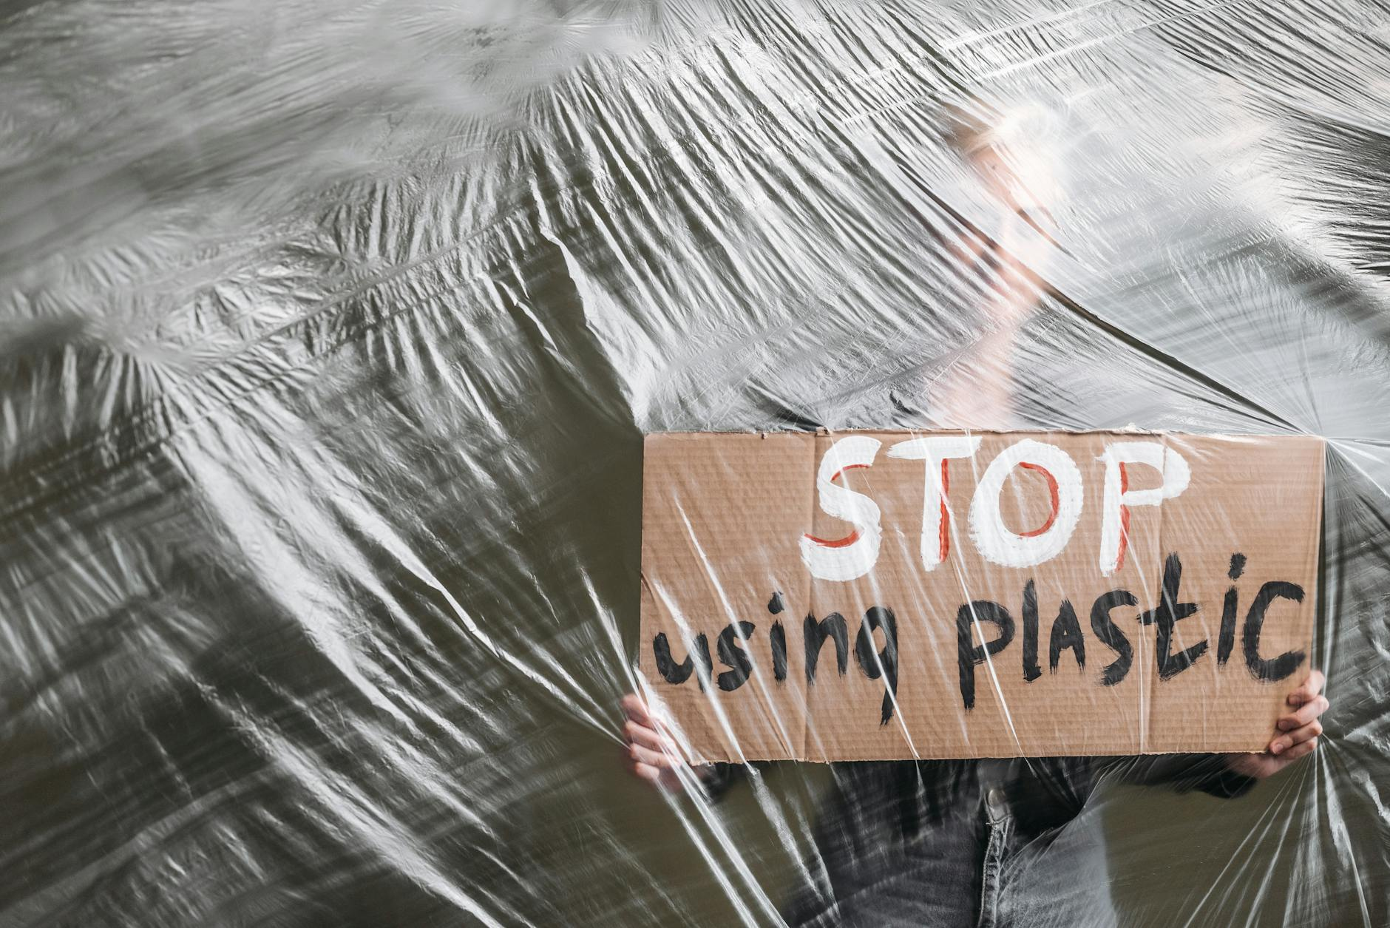
Taking Action: Your Contribution Matters
Reduce Your Carbon Footprint: Conserve energy, reduce waste, and choose sustainable products.
Support Environmental Organizations: Donate or volunteer to support pollution reduction efforts.
Educate Others: Raise awareness about pollution and inspire positive change in your community.

