Slide 1

Understanding Pollution: A Global Threat
Pollution encompasses contamination of air, water, and land.
It poses significant risks to human health and ecosystems.
Understanding the sources and impacts is crucial for effective solutions.

Slide 2
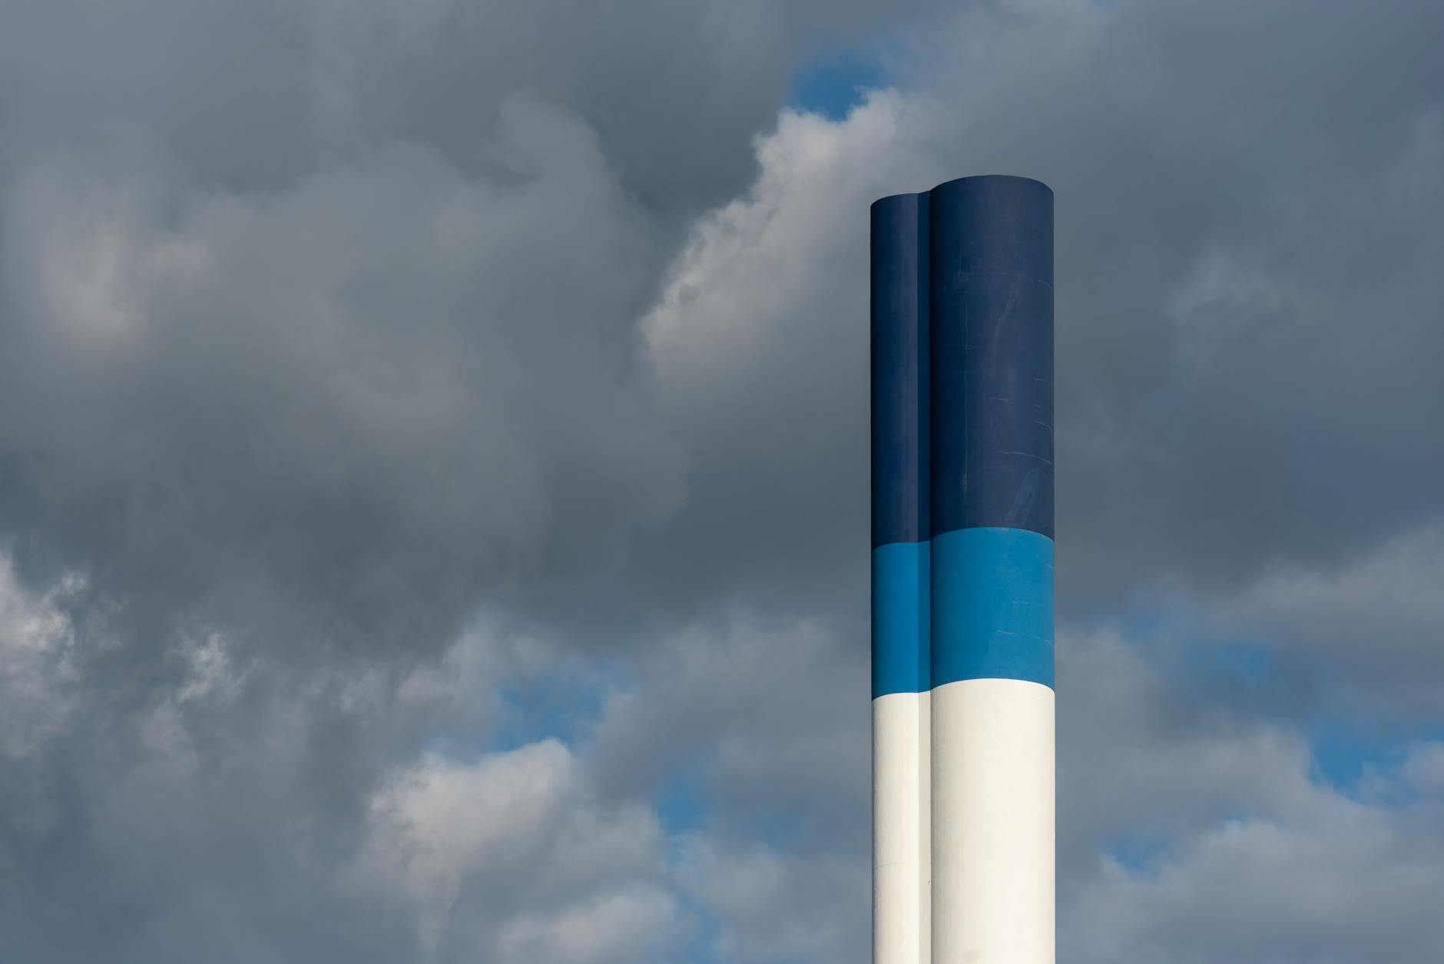
Types of Pollution and Their Sources
Air pollution: industrial emissions, vehicle exhaust, burning fossil fuels.
Water pollution: agricultural runoff, sewage, industrial waste discharge.
Land pollution: improper waste disposal, mining activities, chemical spills.

Slide 3

The Devastating Impacts of Pollution
Health Effects: Respiratory illnesses, cancer, cardiovascular diseases.
Environmental Degradation: Loss of biodiversity, climate change, acid rain.
Economic Costs: Healthcare expenses, decreased agricultural productivity, resource depletion.

Slide 4
Combating Pollution: Collective Action
Government Regulations: Emission standards, waste management policies, environmental protection laws.
Technological Innovations: Renewable energy, wastewater treatment, carbon capture.
Individual Responsibility: Reducing consumption, recycling, using public transportation.

Slide 5
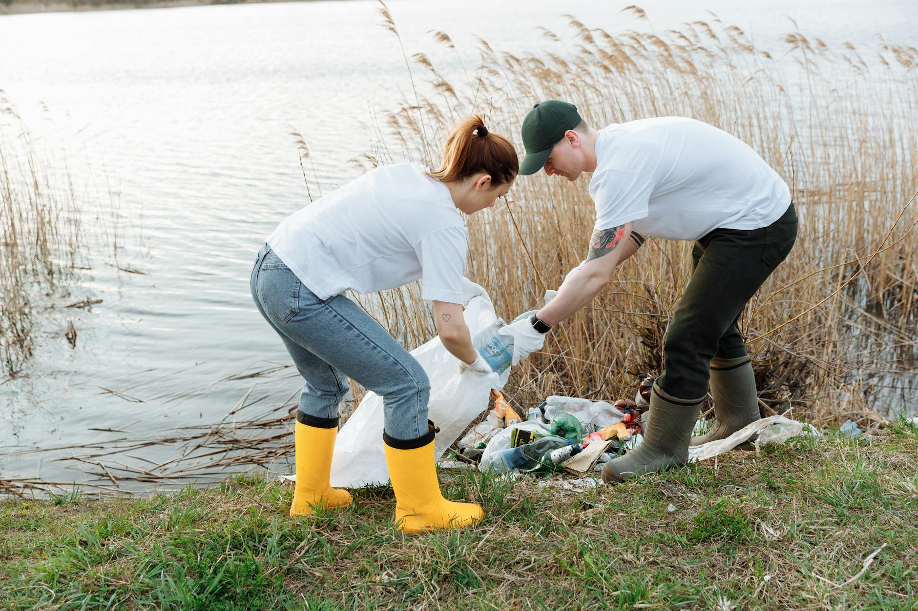
A Cleaner Future: Our Shared Responsibility
Sustainable practices are essential for a healthy planet.
Education and awareness are key to driving change.
Let's work together to create a pollution-free future.

