Slide 1
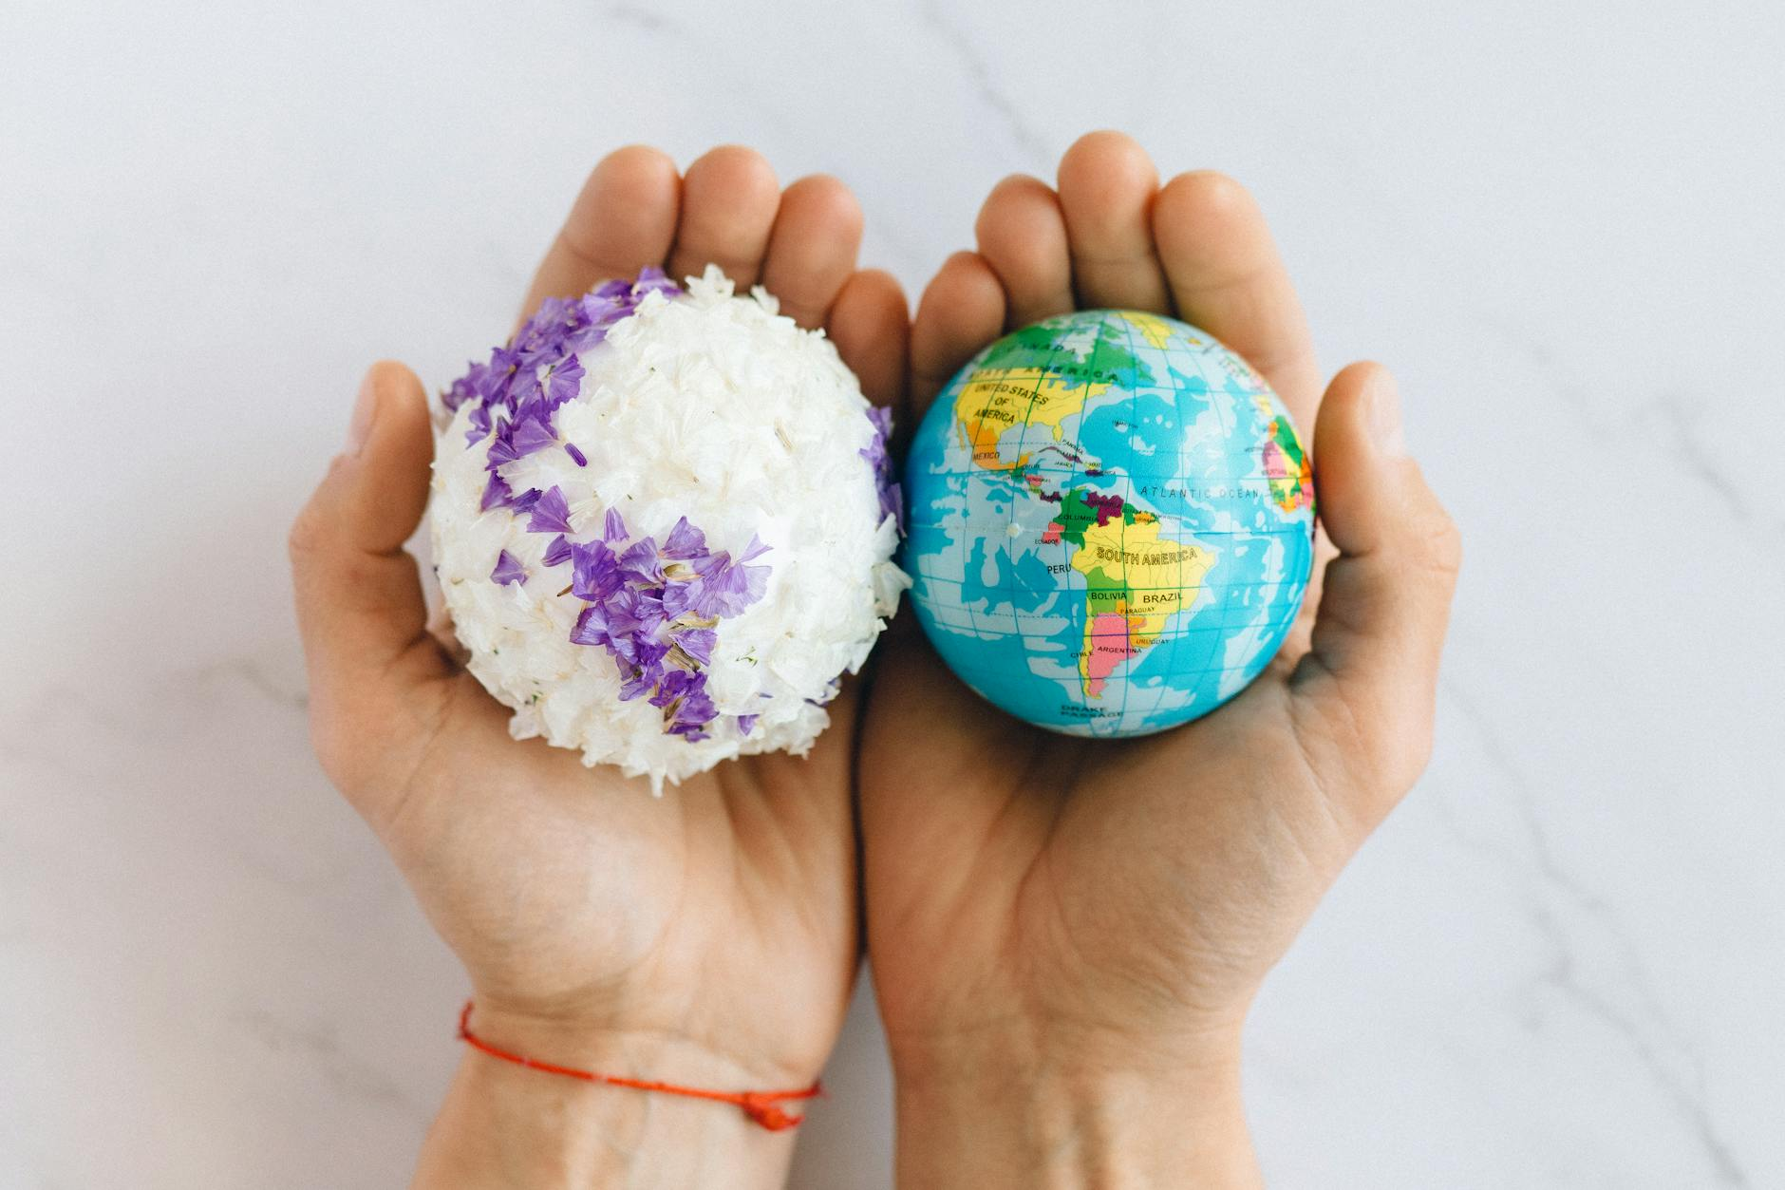
Understanding Pollution: A Global Challenge
Pollution encompasses contaminants entering natural environments, disrupting ecosystems and human health.
Key sources include industrial emissions, agricultural runoff, and improper waste disposal.
Different forms of pollution (air, water, land, noise) require tailored solutions and preventative measures.

Slide 2
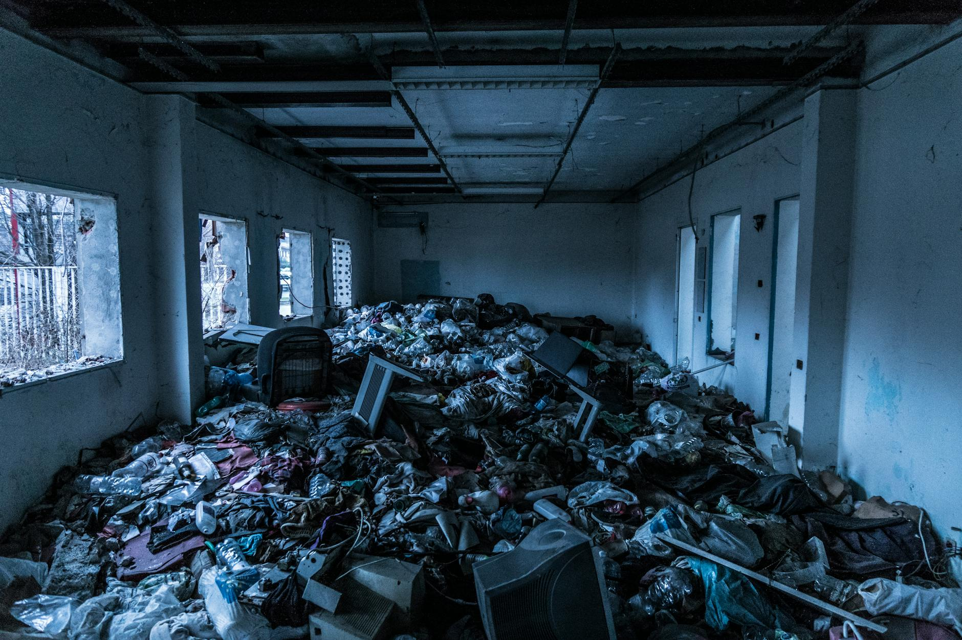
Mitigating Pollution: Solutions and Actions
Technological advancements, such as carbon capture and water filtration, offer promising pollution control methods.
Policy and regulations play a crucial role in enforcing environmental standards and promoting sustainable practices.
Individual actions – reducing consumption, recycling, and advocating for change – collectively contribute to a cleaner future.

