Slide 1
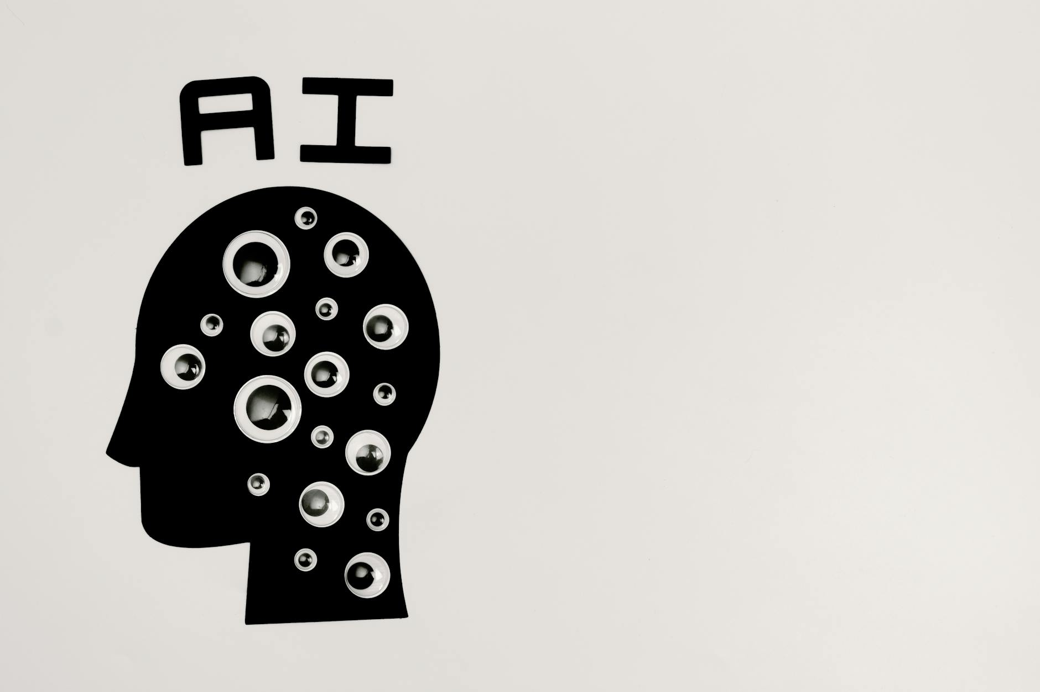
Understanding Artificial Intelligence
AI: Mimicking human intelligence in machines.
Key Capabilities: Learning, Reasoning, Problem-solving.
Distinction: AI, Machine Learning, Deep Learning.

Slide 2
AI Applications Across Industries
Healthcare: Diagnosis, drug discovery, personalized medicine.
Finance: Fraud detection, algorithmic trading, risk assessment.
Manufacturing: Automation, predictive maintenance, quality control.

Slide 3
The Future of AI: Opportunities and Challenges
Opportunities: Innovation, efficiency, solving complex problems.
Challenges: Ethical considerations, bias, job displacement.
Key Takeaway: AI requires responsible development and deployment.

