Slide 1

The Future of Robotics: An Overview
Robotics is rapidly transforming industries and daily life.
Key drivers include advancements in AI, materials, and sensors.
This presentation explores emerging trends and potential impacts.

Slide 2

Advancements in Artificial Intelligence
AI powers increasingly sophisticated robotic capabilities.
Machine learning enables robots to learn and adapt autonomously.
Deep learning enhances perception and decision-making abilities.

Slide 3
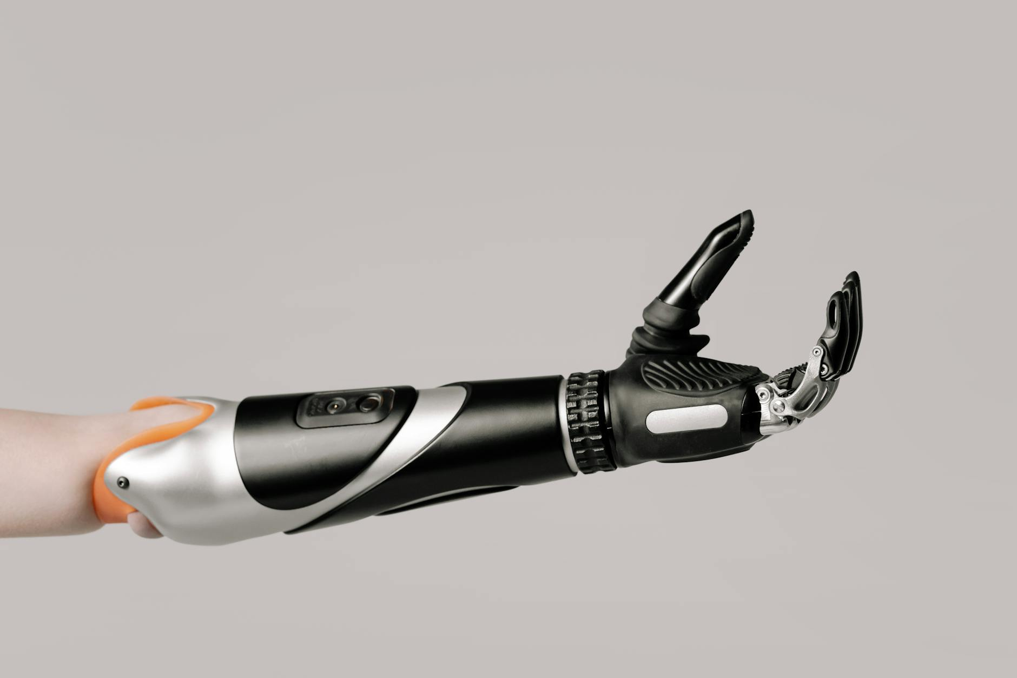
Robotics in Healthcare: A Revolution
Robotic surgery offers greater precision and minimally invasive options.
Assistive robots improve patient care and rehabilitation.
Drug delivery and lab automation enhance efficiency and accuracy.

Slide 4
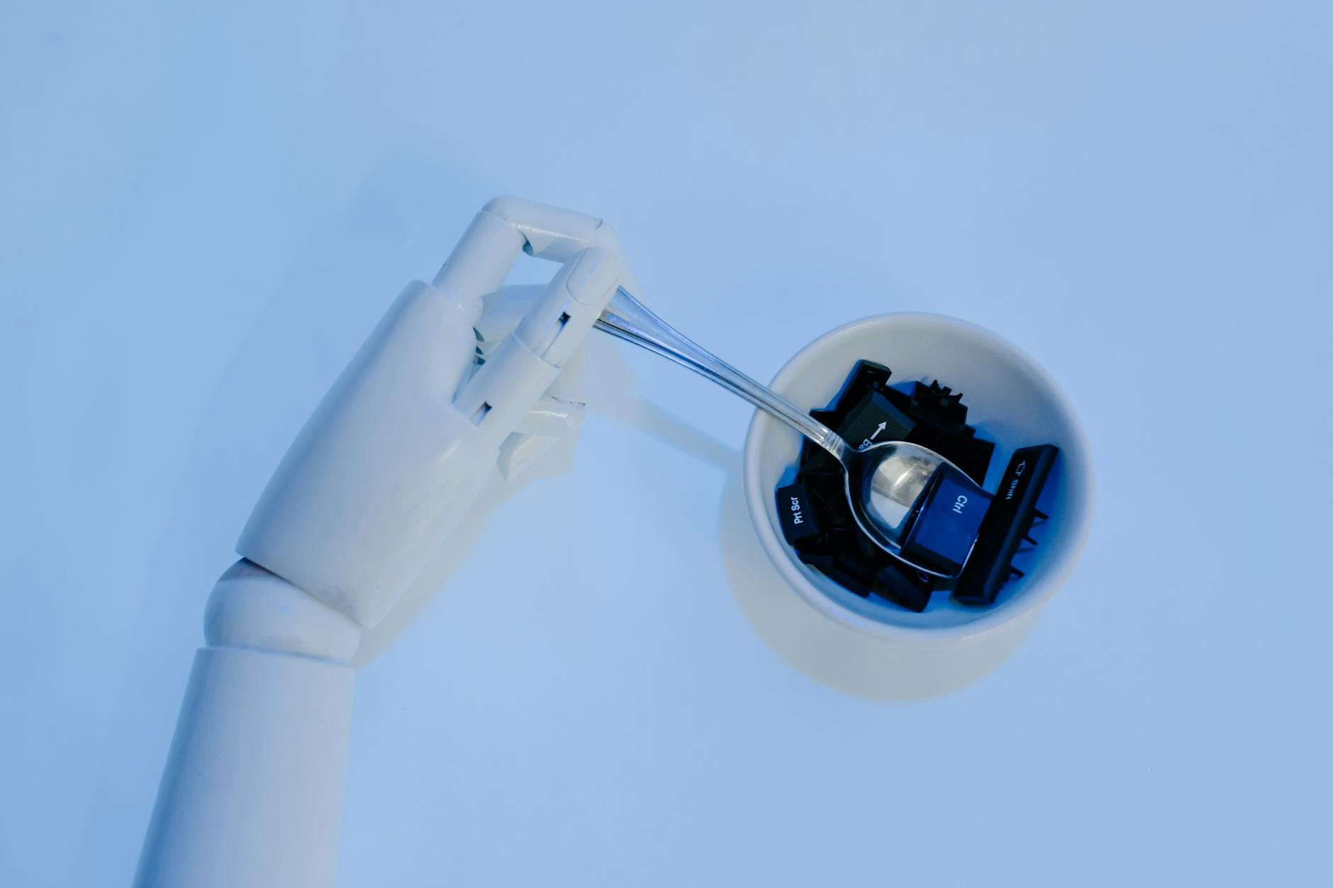
Manufacturing and Logistics: Automation Unleashed
Robots increase efficiency and precision in manufacturing processes.
Autonomous mobile robots (AMRs) optimize warehouse logistics.
Cobots collaborate with human workers for improved productivity.

Slide 5
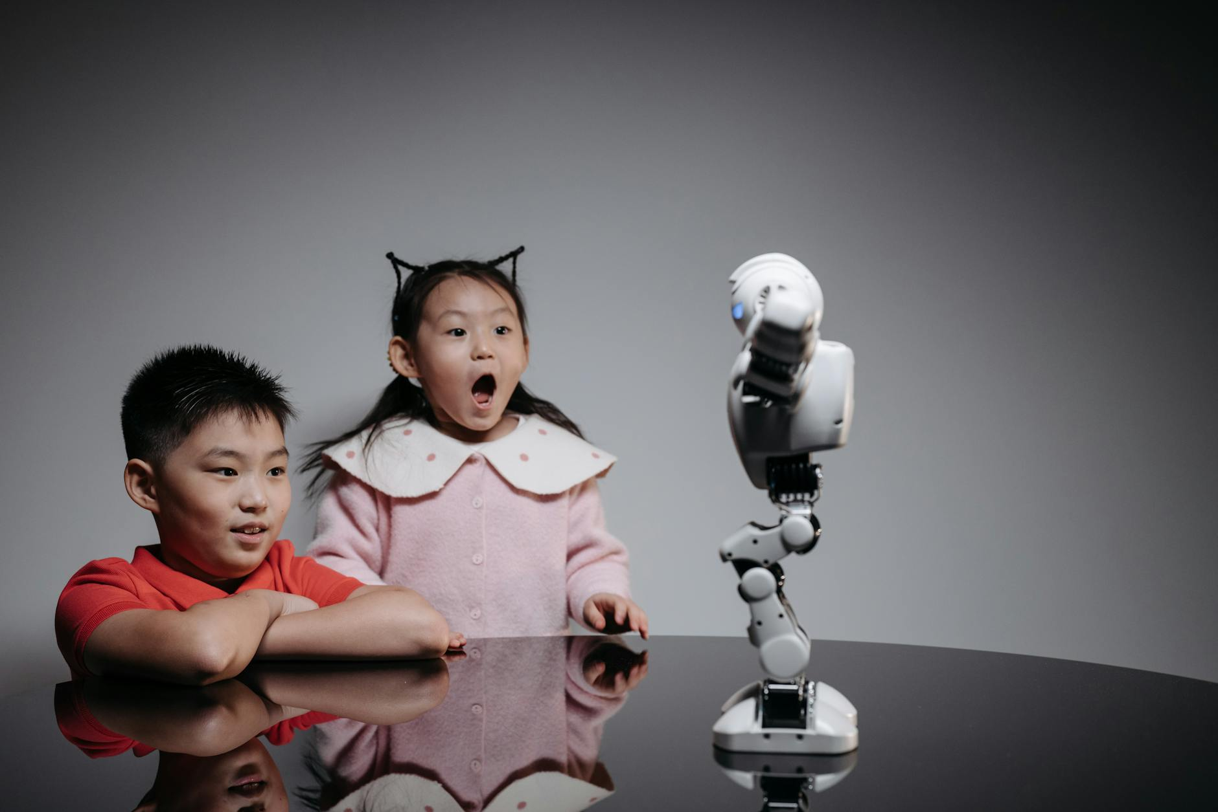
Robotics in Exploration and Research
Robots explore extreme environments like space and deep sea.
They gather data and perform tasks too dangerous for humans.
Drones provide aerial surveillance and mapping capabilities.

Slide 6

The Rise of Social Robots
Social robots interact with humans in a natural and intuitive way.
They provide companionship, education, and assistance.
Applications include elderly care, education, and customer service.

Slide 7
Ethical Considerations and Challenges
Job displacement due to automation is a major concern.
Ethical guidelines are needed for AI and robot development.
Data privacy and security are crucial considerations.

Slide 8
The Impact on the Workforce
Robotics will change the nature of work, not necessarily eliminate it.
New job roles will emerge in robotics maintenance, programming and design.
Focus on reskilling initiatives and lifelong learning.

Slide 9

Future Trends and Predictions
Increased collaboration between humans and robots (cobots).
Development of more versatile and adaptable robots.
Greater integration of robots into everyday life (smart homes, personal assistants).

Slide 10
Conclusion: Embracing the Robotic Revolution
Robotics offers immense potential for progress and innovation.
Addressing ethical concerns and societal impacts is crucial.
Collaboration between stakeholders is essential for responsible development.

