Slide 1

Understanding Pollution: A Global Crisis
Pollution degrades our environment, impacting human health and ecosystems.
Various forms exist: air, water, land, noise, and light pollution.
Addressing pollution requires global collaboration and sustainable practices.

Slide 2
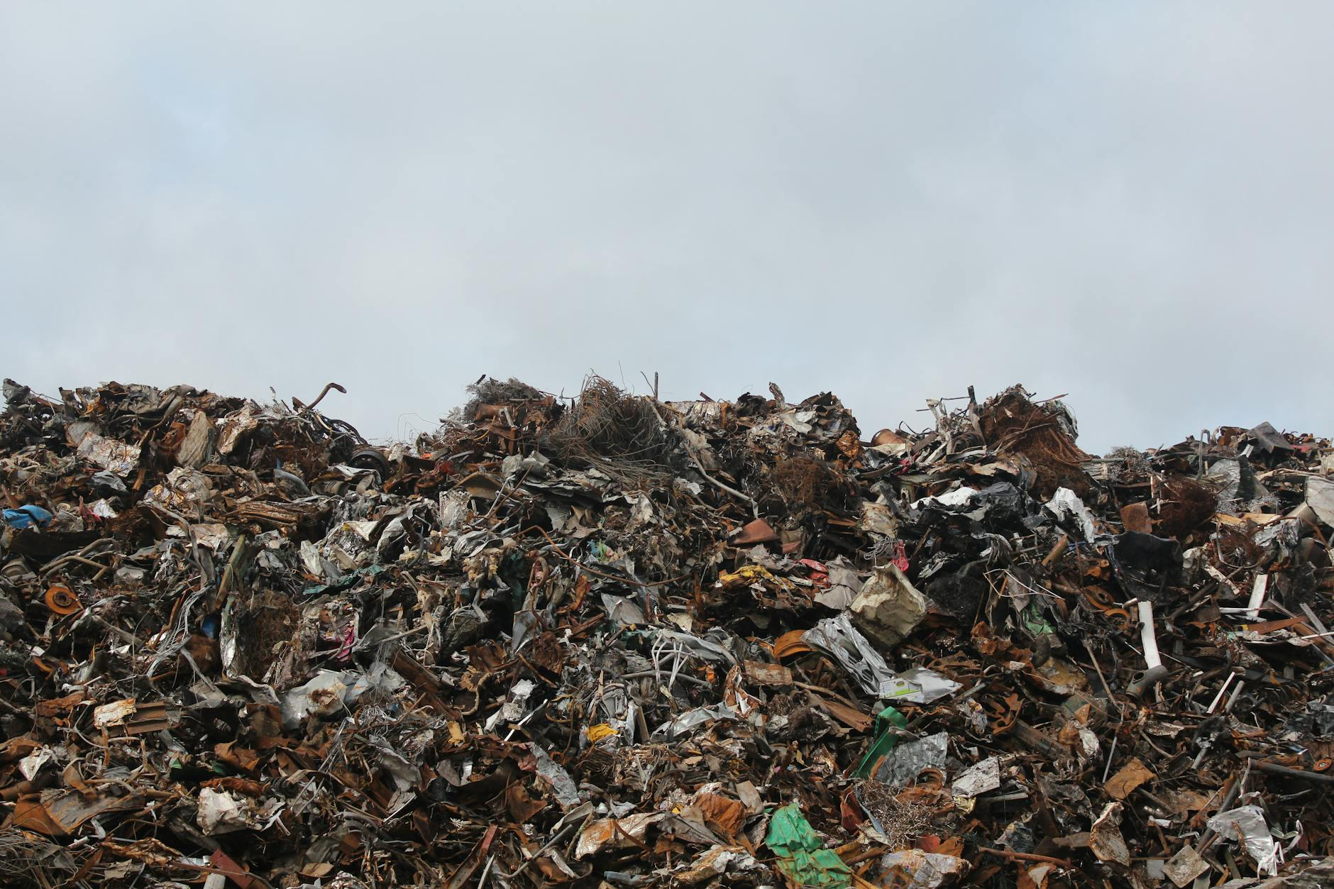
Sources and Types of Pollution
Industrial activities release harmful chemicals and greenhouse gases.
Agricultural runoff contaminates water sources with pesticides and fertilizers.
Improper waste disposal leads to land and water pollution, harming wildlife.

Slide 3

The Impact of Pollution on Human Health
Air pollution causes respiratory illnesses, cardiovascular diseases, and cancer.
Water pollution leads to waterborne diseases and exposure to toxins.
Noise pollution contributes to stress, hearing loss, and sleep disturbances.

Slide 4
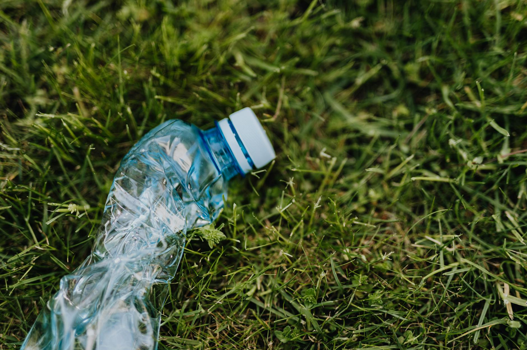
Environmental Consequences of Pollution
Pollution disrupts ecosystems, leading to biodiversity loss and habitat destruction.
Climate change is accelerated by greenhouse gas emissions from pollution sources.
Acid rain damages forests, lakes, and soil, affecting plant and animal life.

Slide 5
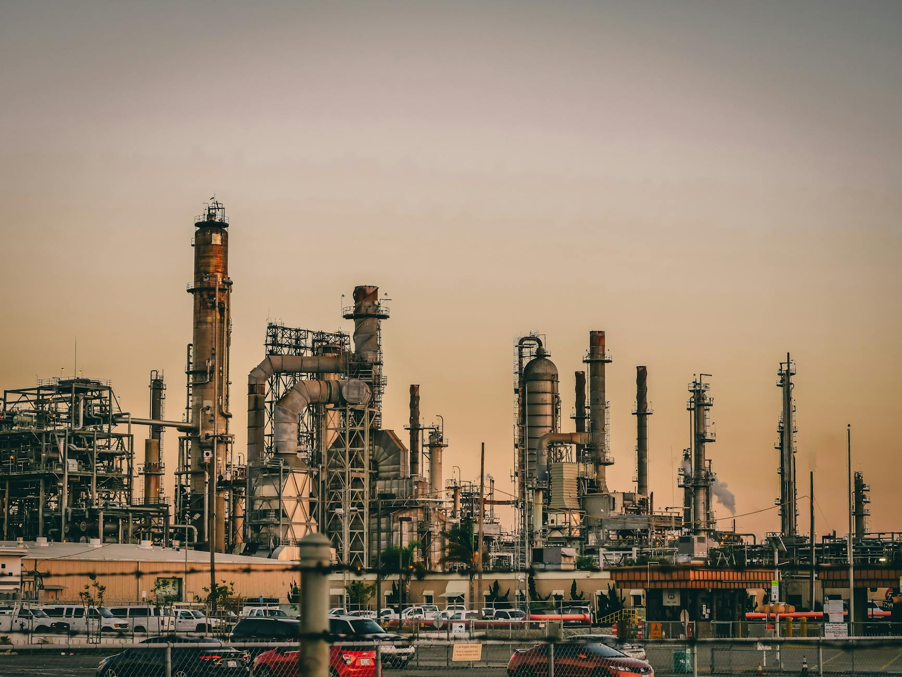
Solutions for a Cleaner Future
Promote renewable energy sources to reduce reliance on fossil fuels.
Implement stricter environmental regulations and enforce pollution control measures.
Encourage sustainable consumption and waste reduction practices.
Invest in research and development of innovative pollution-reduction technologies.

