Slide 1
Pollution: A Global Crisis
Pollution is a significant threat to human health and the environment.
It contaminates air, water, and soil, affecting ecosystems and biodiversity.
Addressing pollution requires global cooperation and sustainable practices.

Slide 2
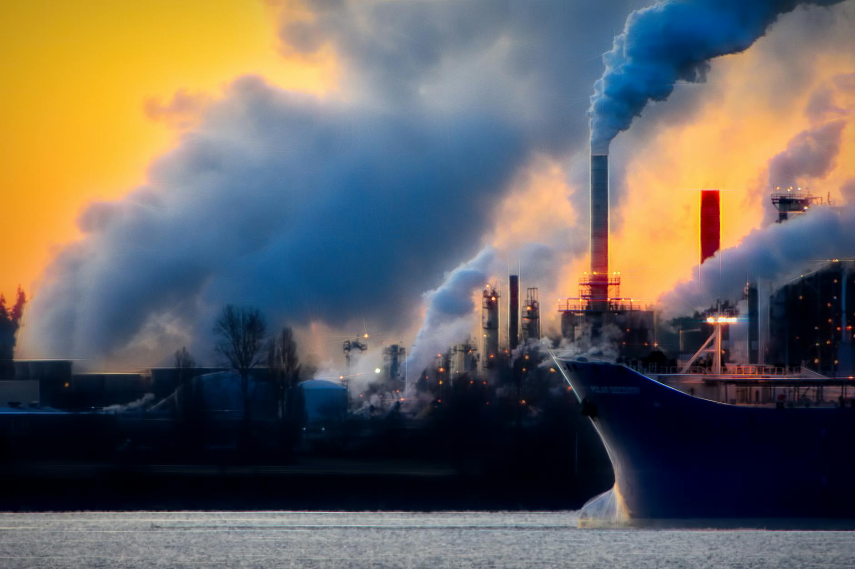
Air Pollution: A Silent Killer
Air pollution is caused by emissions from vehicles, industries, and burning of fossil fuels.
It leads to respiratory illnesses, cardiovascular diseases, and cancer.
Reducing air pollution requires cleaner energy sources and stricter emission controls.

Slide 3
Water Pollution: Threat to Aquatic Life
Water pollution is caused by industrial discharge, agricultural runoff, and sewage.
It contaminates drinking water sources and harms aquatic ecosystems.
Effective wastewater treatment and responsible agricultural practices are crucial.

Slide 4

Soil Pollution: Impact on Agriculture
Soil pollution results from pesticides, heavy metals, and improper waste disposal.
It reduces soil fertility, contaminates food crops, and harms soil organisms.
Promoting organic farming and safe waste management is essential.

Slide 5
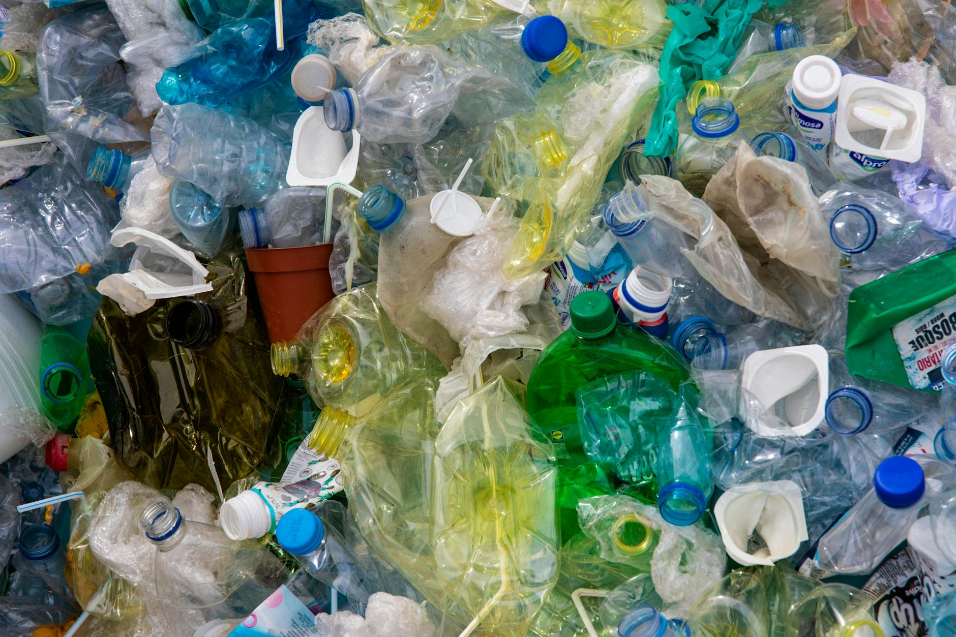
Plastic Pollution: A Growing Problem
Plastic pollution is caused by excessive plastic production and improper disposal.
It accumulates in oceans, harming marine life and ecosystems.
Reducing plastic consumption, promoting recycling, and developing biodegradable alternatives are key.

Slide 6
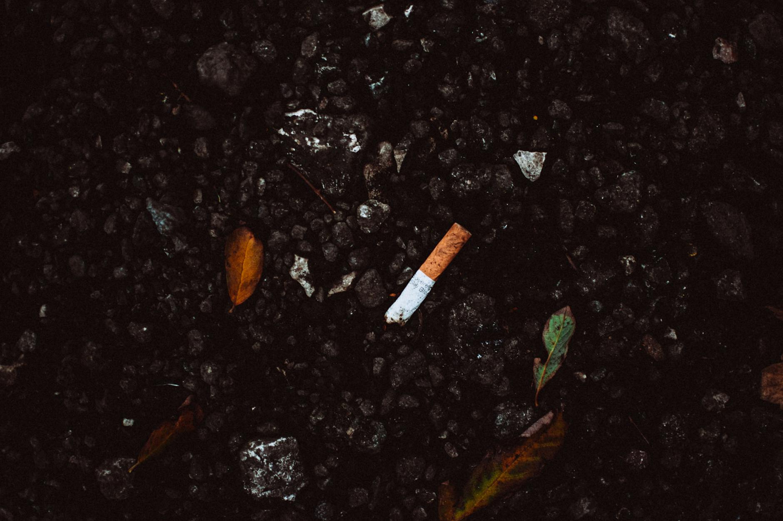
Impact on Human Health
Pollution exposure can lead to a variety of health problems, from respiratory issues to cancer.
Children, the elderly, and those with pre-existing conditions are most vulnerable.
Reducing pollution is critical for protecting public health.

Slide 7
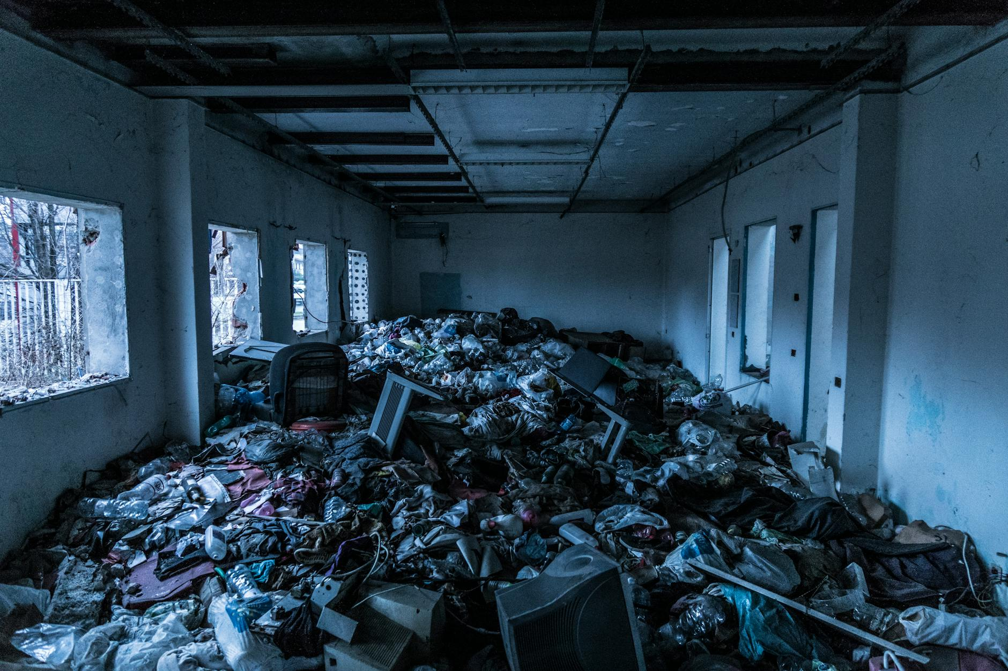
Economic Costs of Pollution
Pollution leads to increased healthcare costs, reduced agricultural productivity, and damage to ecosystems.
Clean-up efforts and remediation are expensive and time-consuming.
Investing in pollution prevention is economically sound in the long run.

Slide 8
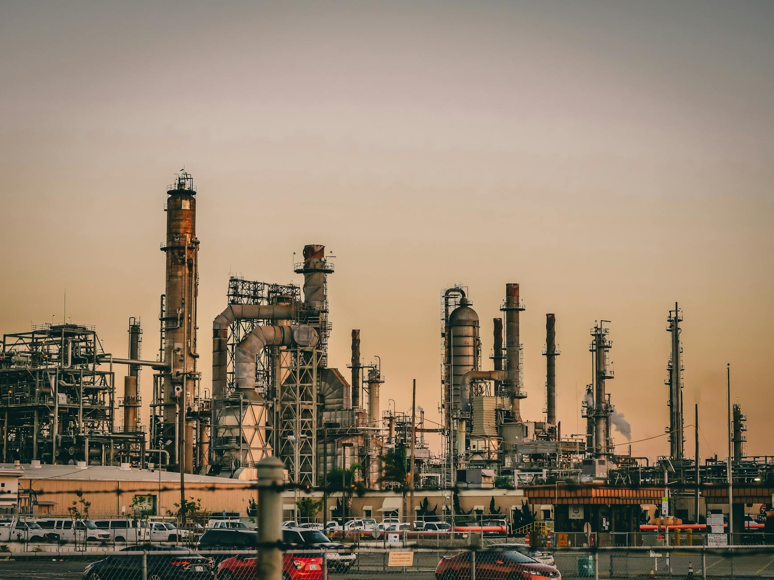
Solutions: Cleaner Energy
Transitioning to renewable energy sources like solar, wind, and hydro power.
Improving energy efficiency in buildings and transportation.
Investing in research and development of cleaner technologies.

Slide 9
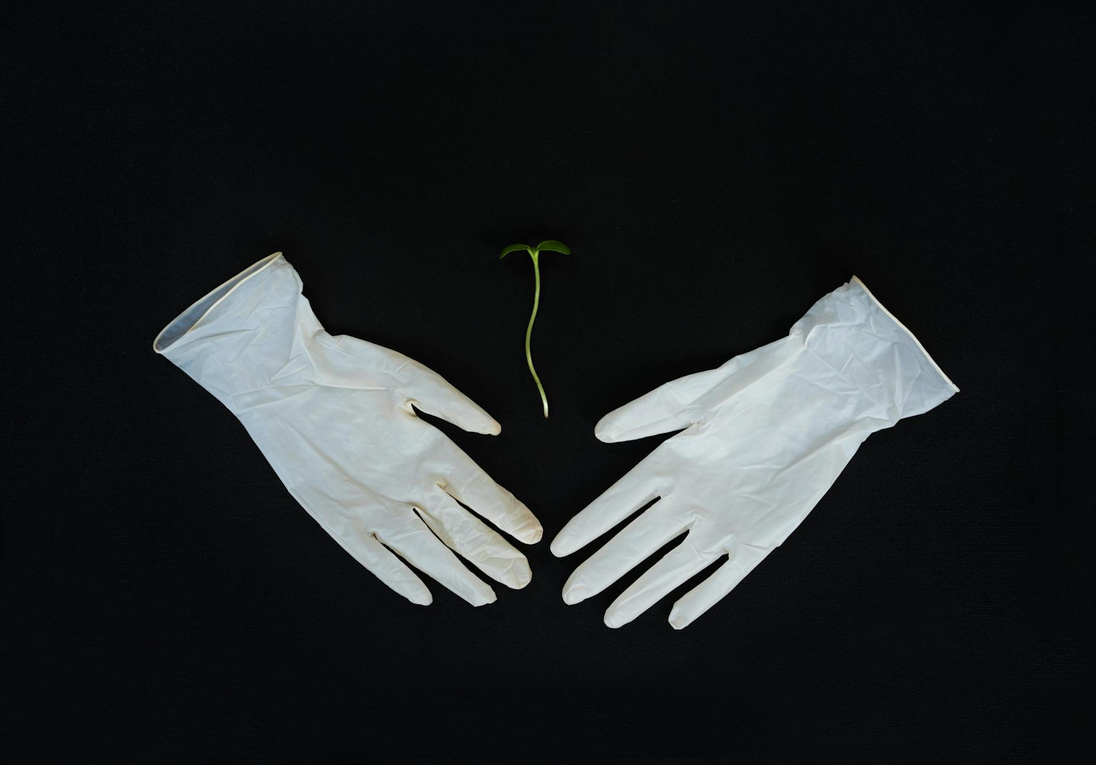
Solutions: Sustainable Practices
Adopting sustainable agricultural practices to reduce fertilizer and pesticide use.
Promoting recycling and waste reduction programs.
Encouraging responsible consumption and production patterns.

Slide 10
Call to Action: Protect Our Planet
We all have a role to play in reducing pollution and protecting the environment.
Support policies that promote clean energy and sustainable practices.
Make conscious choices to reduce your environmental footprint and inspire others.

