Slide 1

The Cybersecurity Landscape: An Introduction
Cybersecurity is the practice of protecting systems, networks, and data from digital attacks.
Threats are constantly evolving, requiring continuous adaptation and vigilance.
Importance spans individual privacy to national infrastructure security.

Slide 2

Common Cyber Threats: A Taxonomy
Malware: Viruses, worms, trojans designed to harm systems.
Phishing: Deceptive emails to steal credentials and information.
Ransomware: Encrypts data, demanding payment for its release.

Slide 3

Understanding Vulnerabilities and Exploits
Vulnerabilities are weaknesses in software or hardware.
Exploits are methods to take advantage of vulnerabilities.
Regular patching and updates are crucial for mitigation.

Slide 4

Defense in Depth: A Layered Approach
Multiple layers of security measures to protect assets.
Includes firewalls, intrusion detection systems, and endpoint protection.
Even if one layer fails, others provide continued protection.

Slide 5
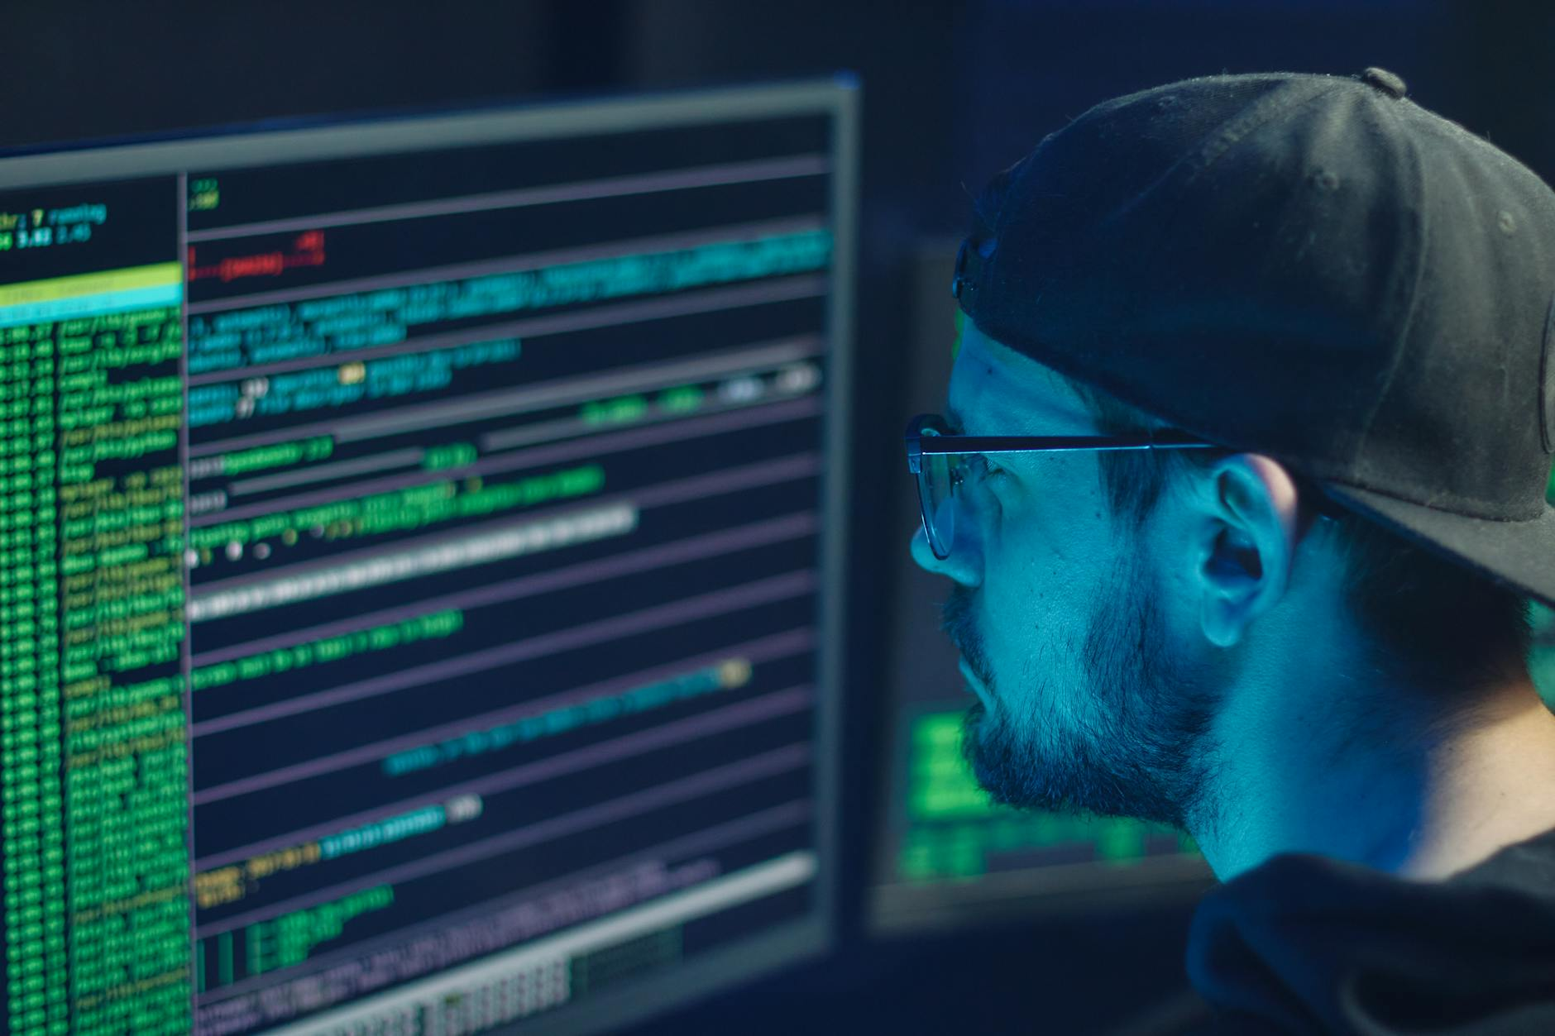
The Importance of Strong Passwords and Authentication
Strong, unique passwords are the first line of defense.
Multi-factor authentication (MFA) adds an extra layer of security.
Password managers can help generate and store strong passwords.

Slide 6
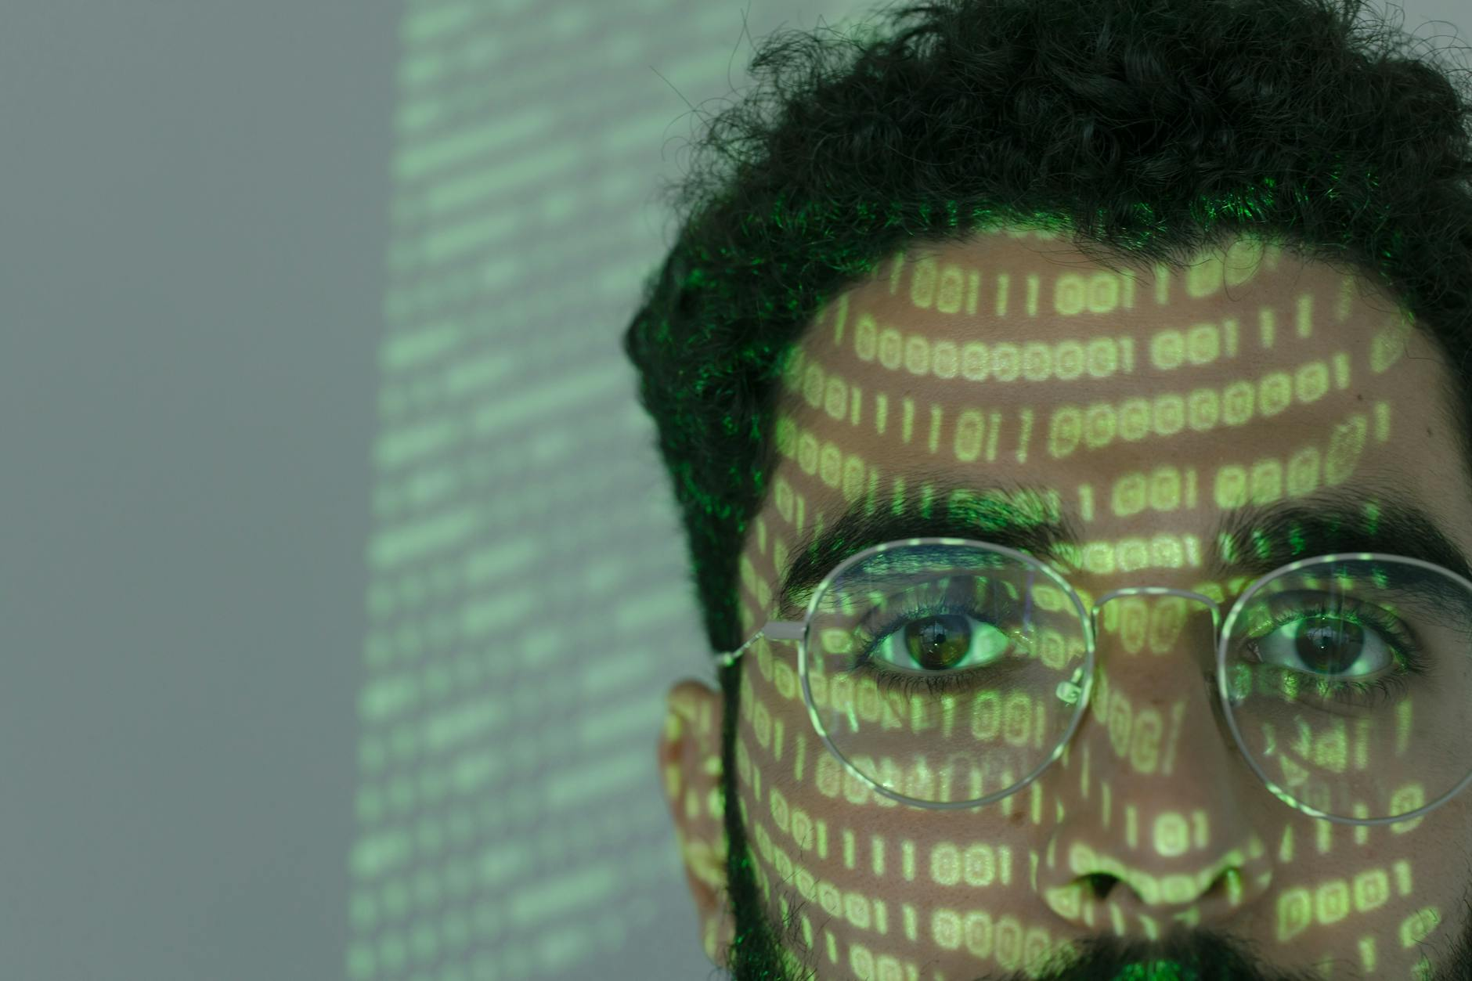
Data Encryption: Protecting Data at Rest and in Transit
Encryption transforms data into an unreadable format.
Protects data from unauthorized access even if compromised.
Essential for both data at rest (stored) and in transit (being sent).

Slide 7

Network Security: Firewalls and Intrusion Detection
Firewalls control network traffic based on predefined rules.
Intrusion detection systems (IDS) monitor for suspicious activity.
Together, they provide a strong defense against network-based attacks.

Slide 8

Incident Response: Planning and Execution
A well-defined incident response plan is crucial.
Includes identification, containment, eradication, and recovery.
Regularly test and update the plan to ensure effectiveness.

Slide 9

Security Awareness Training: Empowering Employees
Educate employees about cybersecurity threats and best practices.
Covers topics like phishing, social engineering, and password security.
Reduces the risk of human error and strengthens overall security posture.

Slide 10
Staying Ahead: The Future of Cybersecurity
Cybersecurity threats are constantly evolving.
Emerging technologies like AI and blockchain offer new security solutions.
Continuous learning and adaptation are essential for staying ahead.

