Slide 1
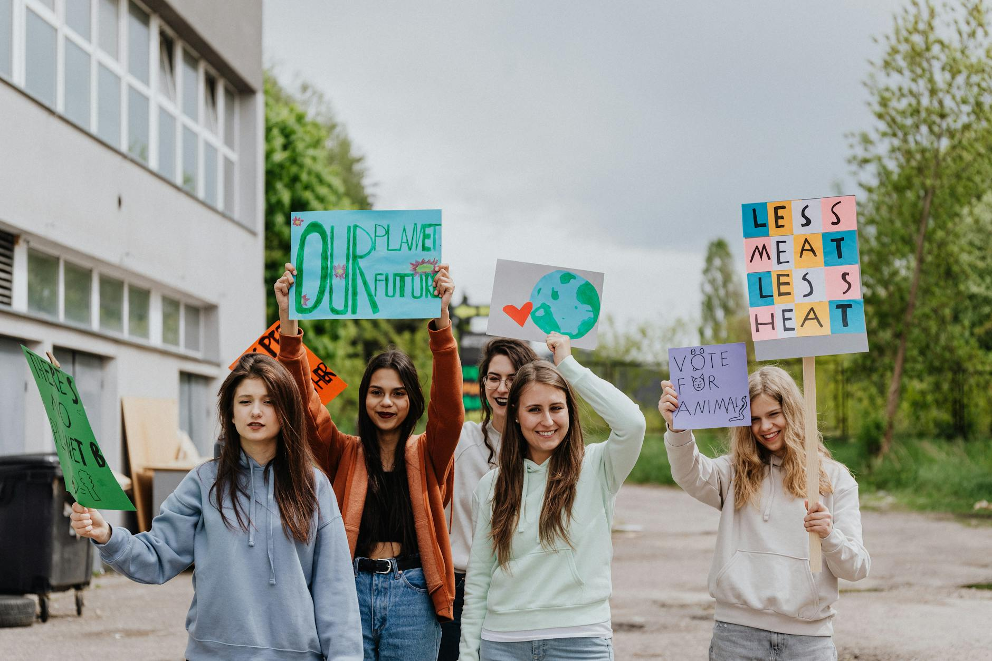
Global Warming: Understanding the Basics
Rising Global Temperatures: Earth's average surface temperature has increased significantly.
Greenhouse Gas Effect: Gases trap heat, leading to a warmer planet.
Human Activities: Burning fossil fuels and deforestation are major contributors.
Impact on Weather: Leads to more frequent and intense heatwaves, droughts, and floods.

Slide 2
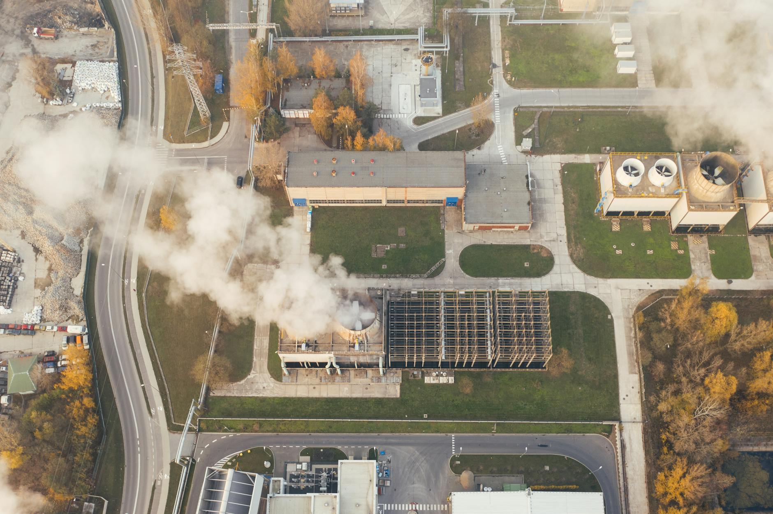
Observable Effects and Environmental Consequences
Melting Ice and Rising Sea Levels: Polar ice caps and glaciers are melting at an alarming rate.
Ocean Acidification: Increased CO2 absorption harms marine life.
Ecosystem Disruption: Changing climates affect species distribution and survival.
Extreme Weather Events: More hurricanes, wildfires, and severe storms are occurring.

Slide 3
Mitigation and Solutions: Taking Action Now
Reduce Greenhouse Gas Emissions: Transition to renewable energy sources (solar, wind).
Energy Efficiency: Improve building insulation and transportation systems.
Carbon Capture and Storage: Develop technologies to remove CO2 from the atmosphere.
Sustainable Practices: Promote sustainable agriculture and responsible consumption.

