Slide 1

The Future of AI: A Glimpse into Tomorrow
Artificial Intelligence is rapidly transforming every aspect of our lives.
This presentation explores key trends, challenges, and opportunities.
Prepare to explore the innovative landscape that AI is creating.

Slide 2
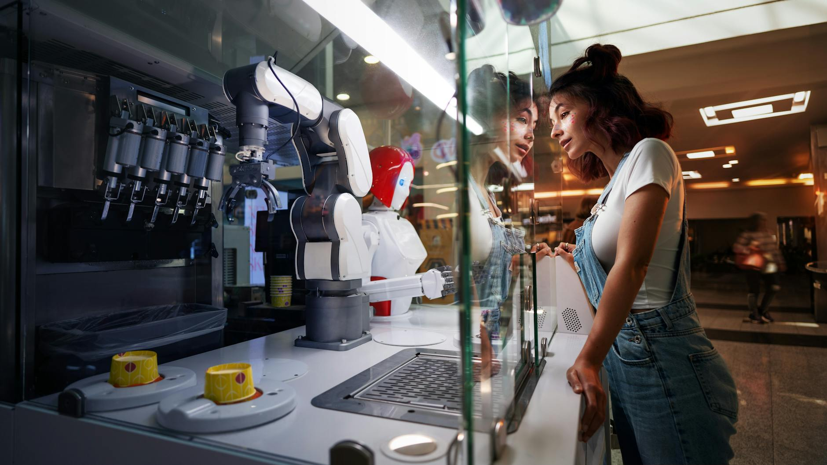
AI-Driven Automation: Redefining Work
Automation is extending beyond routine tasks to complex decision-making.
Impact on job markets requires proactive workforce adaptation and reskilling.
AI is enabling new forms of human-machine collaboration and augmentation.

Slide 3
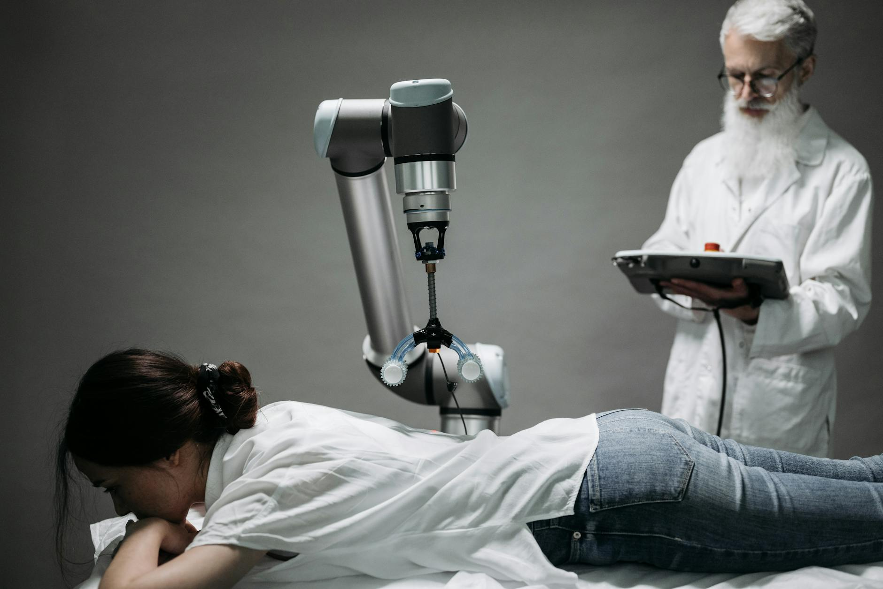
Healthcare Revolution: AI in Medicine
AI is improving diagnostics, treatment planning, and drug discovery.
Personalized medicine powered by AI is becoming increasingly prevalent.
Ethical considerations surrounding data privacy and algorithmic bias are crucial.

Slide 4
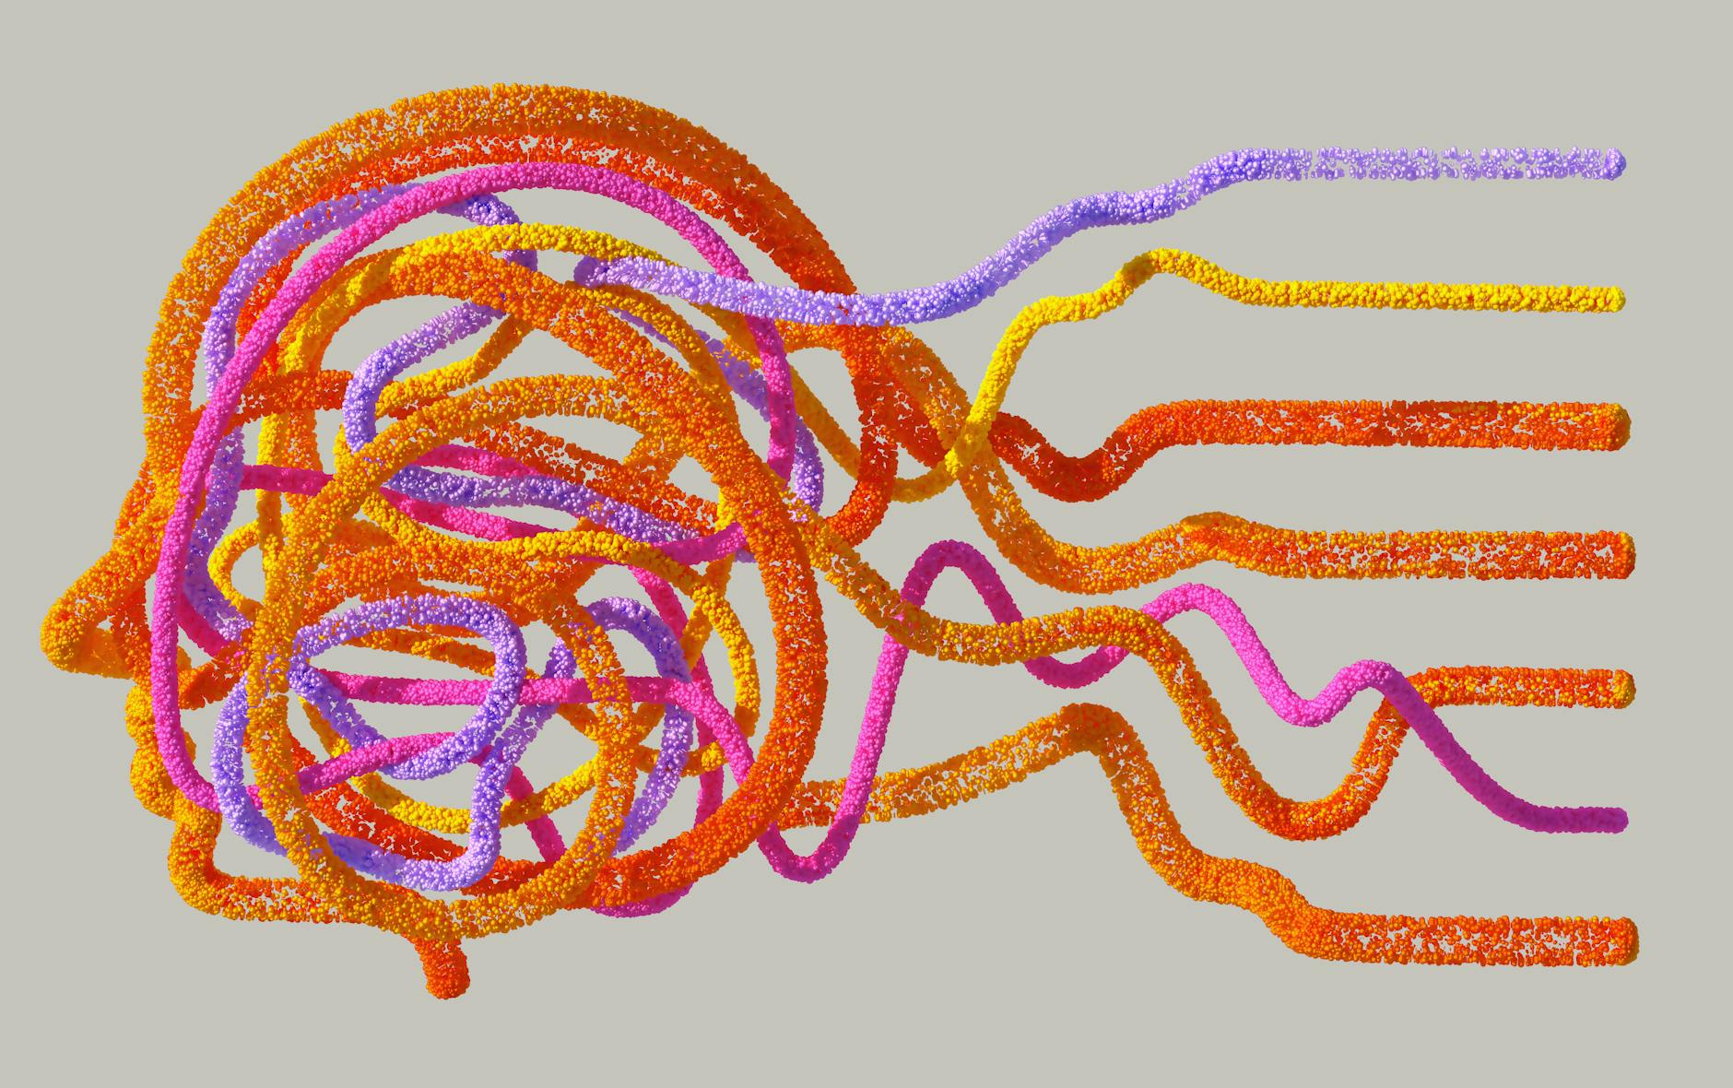
AI and the Creative Arts: A New Era
AI tools are assisting artists in music, painting, and writing.
Generative AI models are creating novel and unique artistic expressions.
Debate continues on the role of AI as a collaborator versus a replacement.

Slide 5

The Rise of Edge AI: Decentralized Intelligence
Edge AI brings processing closer to the data source, improving speed and efficiency.
Enables real-time applications in autonomous vehicles, IoT devices, and robotics.
Reduces reliance on cloud infrastructure and enhances data privacy.

Slide 6
Ethical Considerations: Navigating the AI Landscape
Addressing biases in AI algorithms is critical for fairness and equity.
Ensuring transparency and explainability in AI decision-making processes.
Establishing robust regulatory frameworks to govern AI development and deployment.

Slide 7

AI and Cybersecurity: A Dual-Edged Sword
AI is enhancing threat detection and prevention in cybersecurity.
AI is also being used by attackers to create sophisticated cyber weapons.
The cybersecurity landscape is becoming an AI-driven arms race.

Slide 8
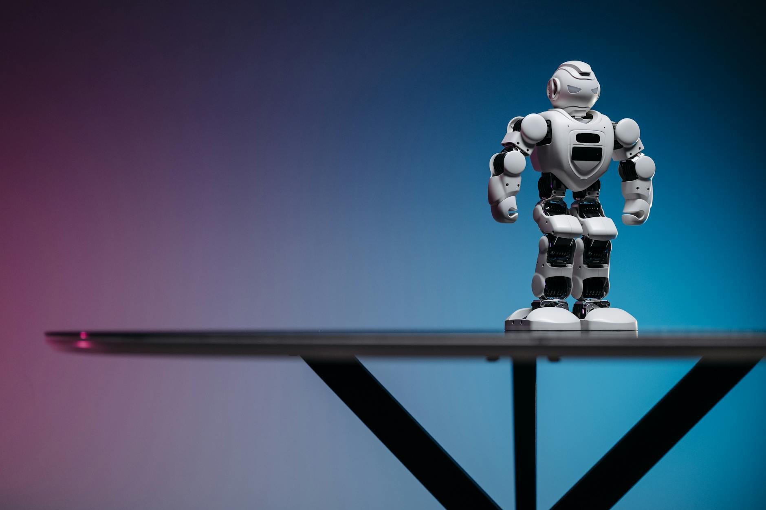
AI in Education: Transforming Learning
AI-powered personalized learning platforms are adapting to individual student needs.
AI tutors provide customized support and feedback.
Automation of administrative tasks frees up teachers' time for student interaction.

Slide 9

The Future of AI: Challenges and Opportunities
Addressing the skills gap in AI and related fields is crucial.
Promoting international collaboration and standardization in AI development.
Investing in research and development to unlock AI's full potential.

Slide 10

Thank You & Q&A
AI is rapidly evolving; staying informed is key.
We're excited to see what the future holds.
Open for questions and discussion.

