Slide 1

The Future of Robotics: A Glimpse into Tomorrow
Robotics is rapidly evolving, impacting all aspects of life.
From automation to healthcare, robots are transforming industries.
Understanding these trends is crucial for preparing for the future.

Slide 2
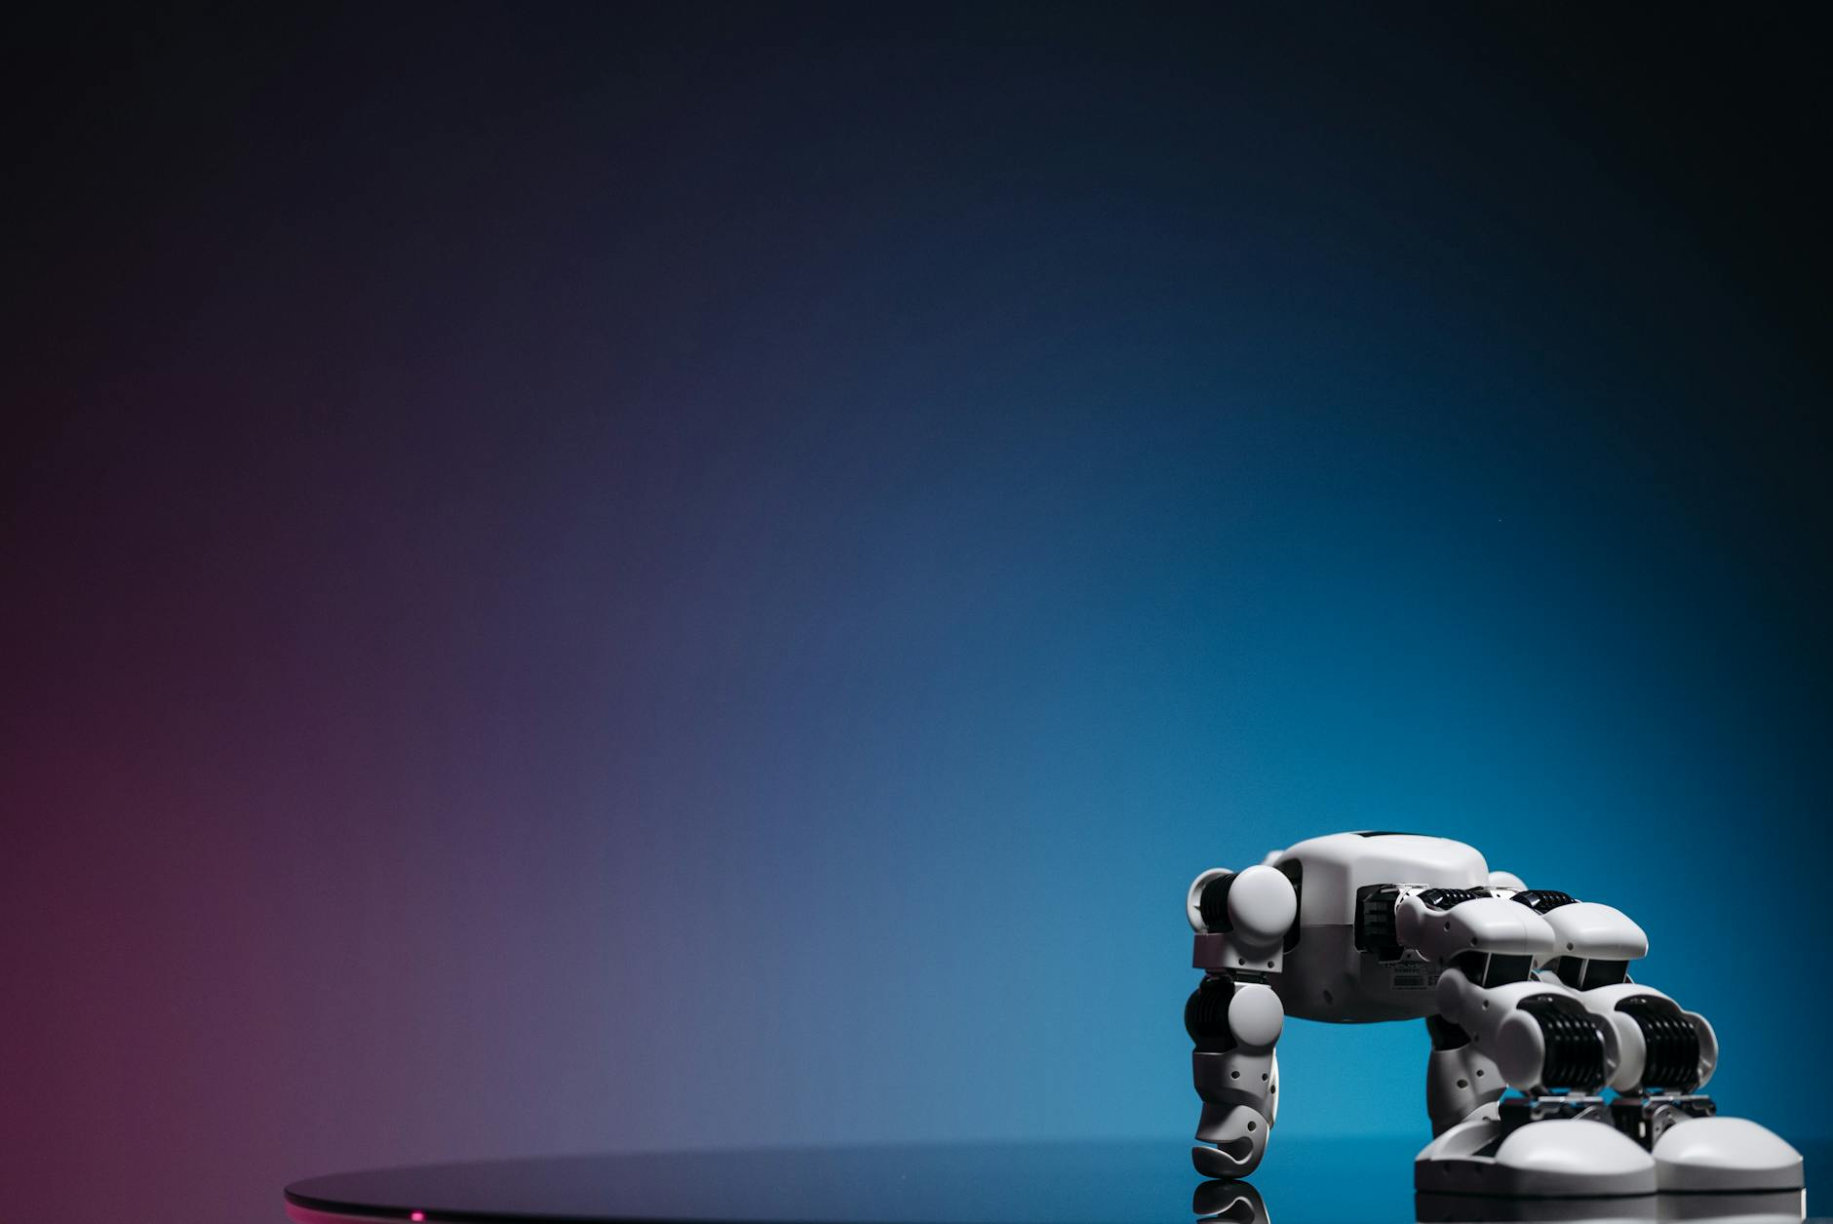
Advancements in AI and Machine Learning
AI is enabling robots to learn, adapt, and solve complex problems.
Machine learning algorithms improve robot performance over time.
This leads to more autonomous and efficient robotic systems.

Slide 3
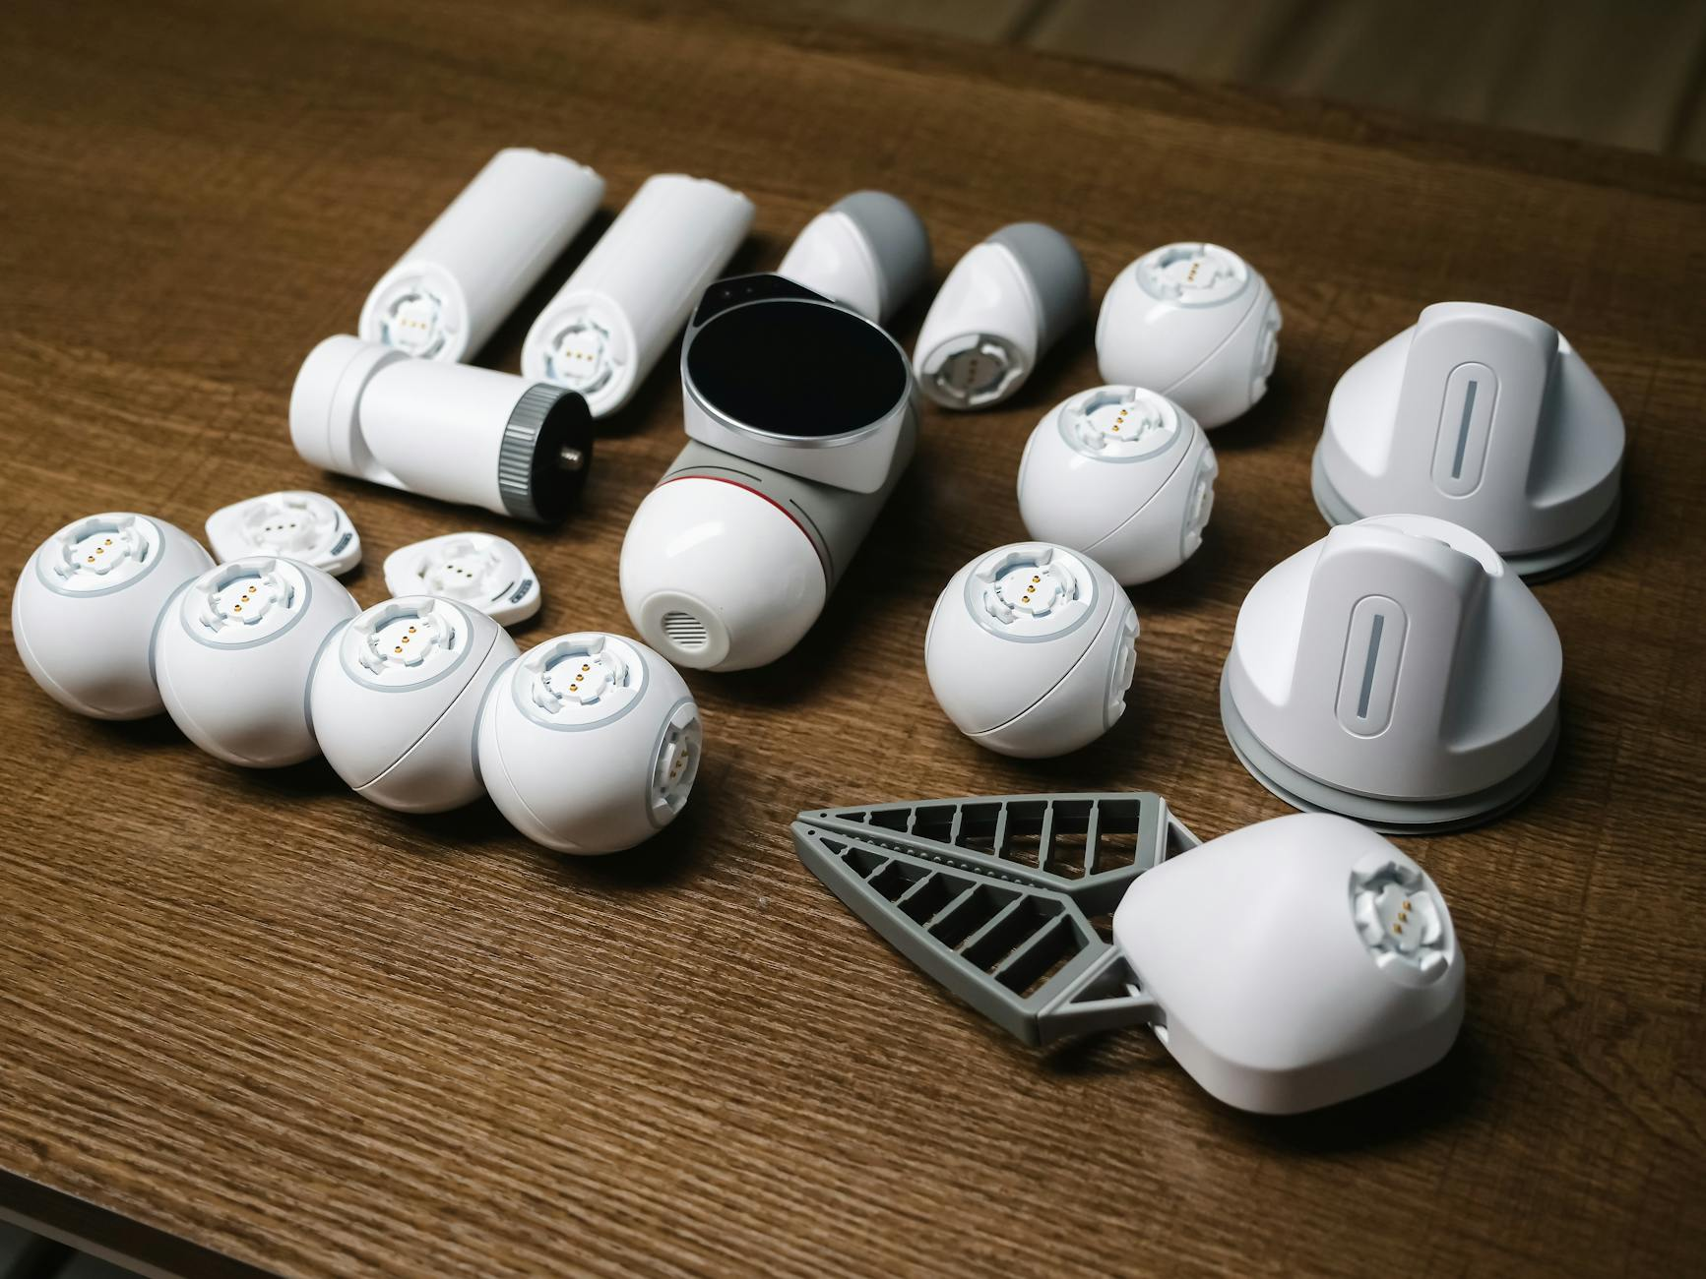
Robotics in Manufacturing: Automation Revolution
Robots are automating tasks, increasing efficiency and reducing costs.
Collaborative robots (cobots) work alongside humans safely.
The future of manufacturing is highly automated with advanced robotics.

Slide 4
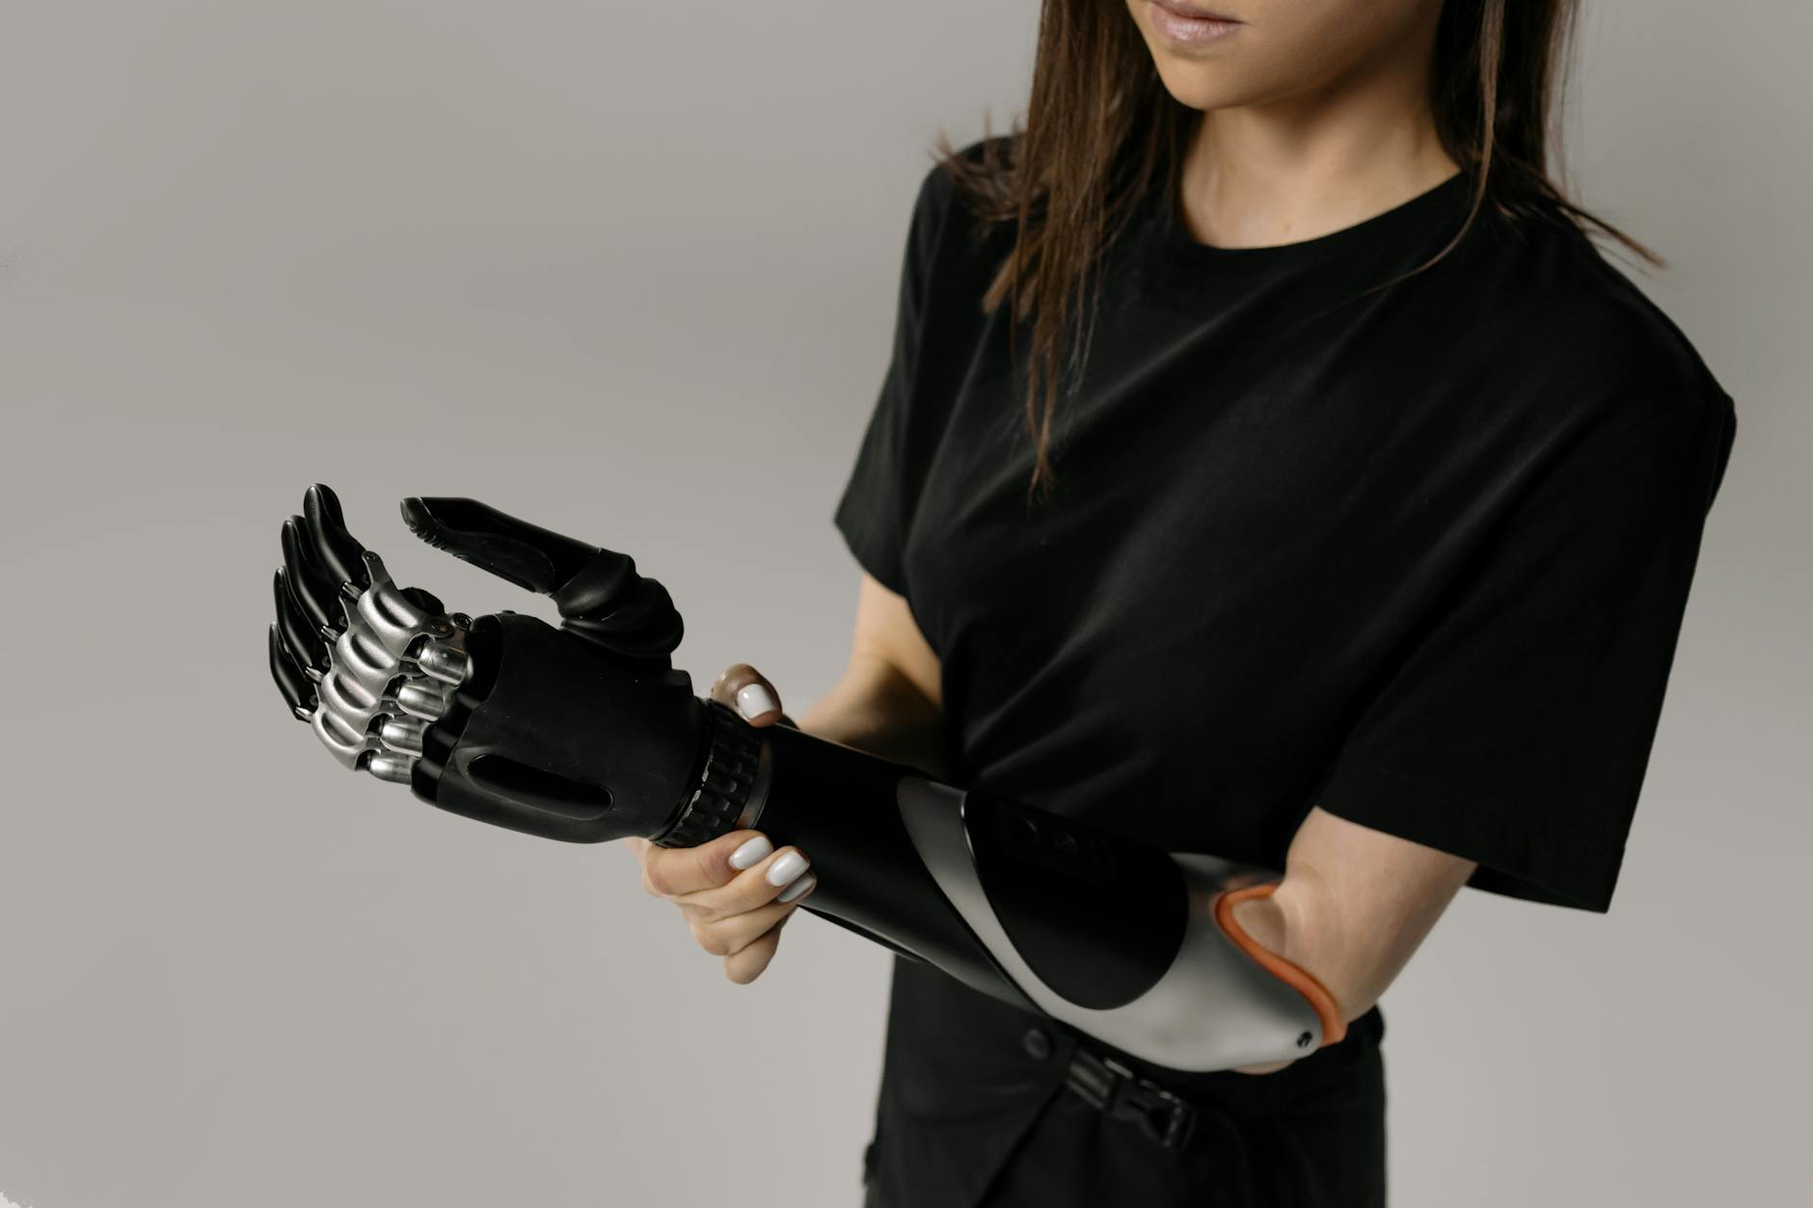
Robotics in Healthcare: Precision and Care
Robotic surgery improves precision and reduces recovery times.
Robots assist with patient care, medication delivery, and sanitation.
AI-powered diagnostic robots provide faster and more accurate results.

Slide 5
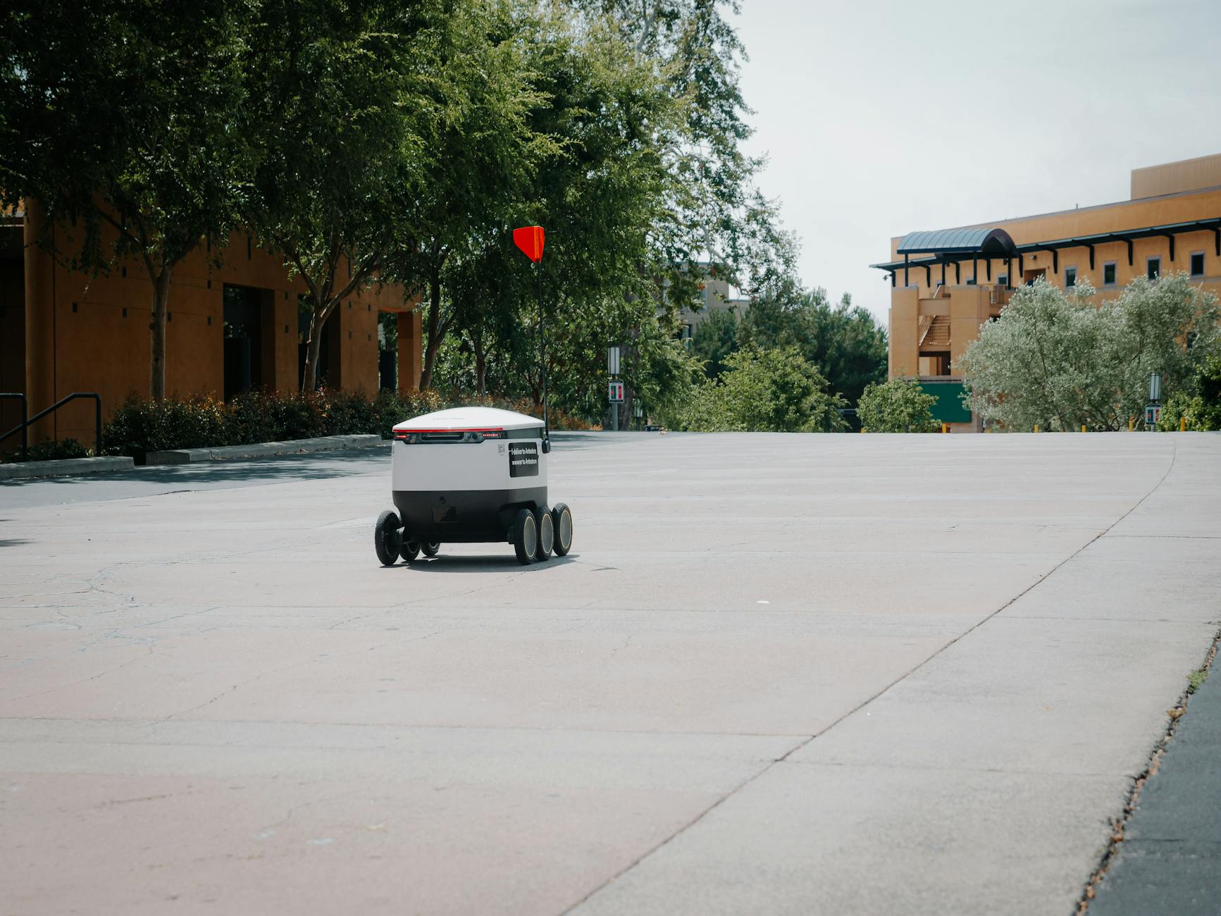
Robotics in Logistics and Delivery: Efficiency and Speed
Robots automate warehouse operations, speeding up order fulfillment.
Autonomous delivery robots are transforming last-mile delivery.
Drones are being used for package delivery and inventory management.

Slide 6
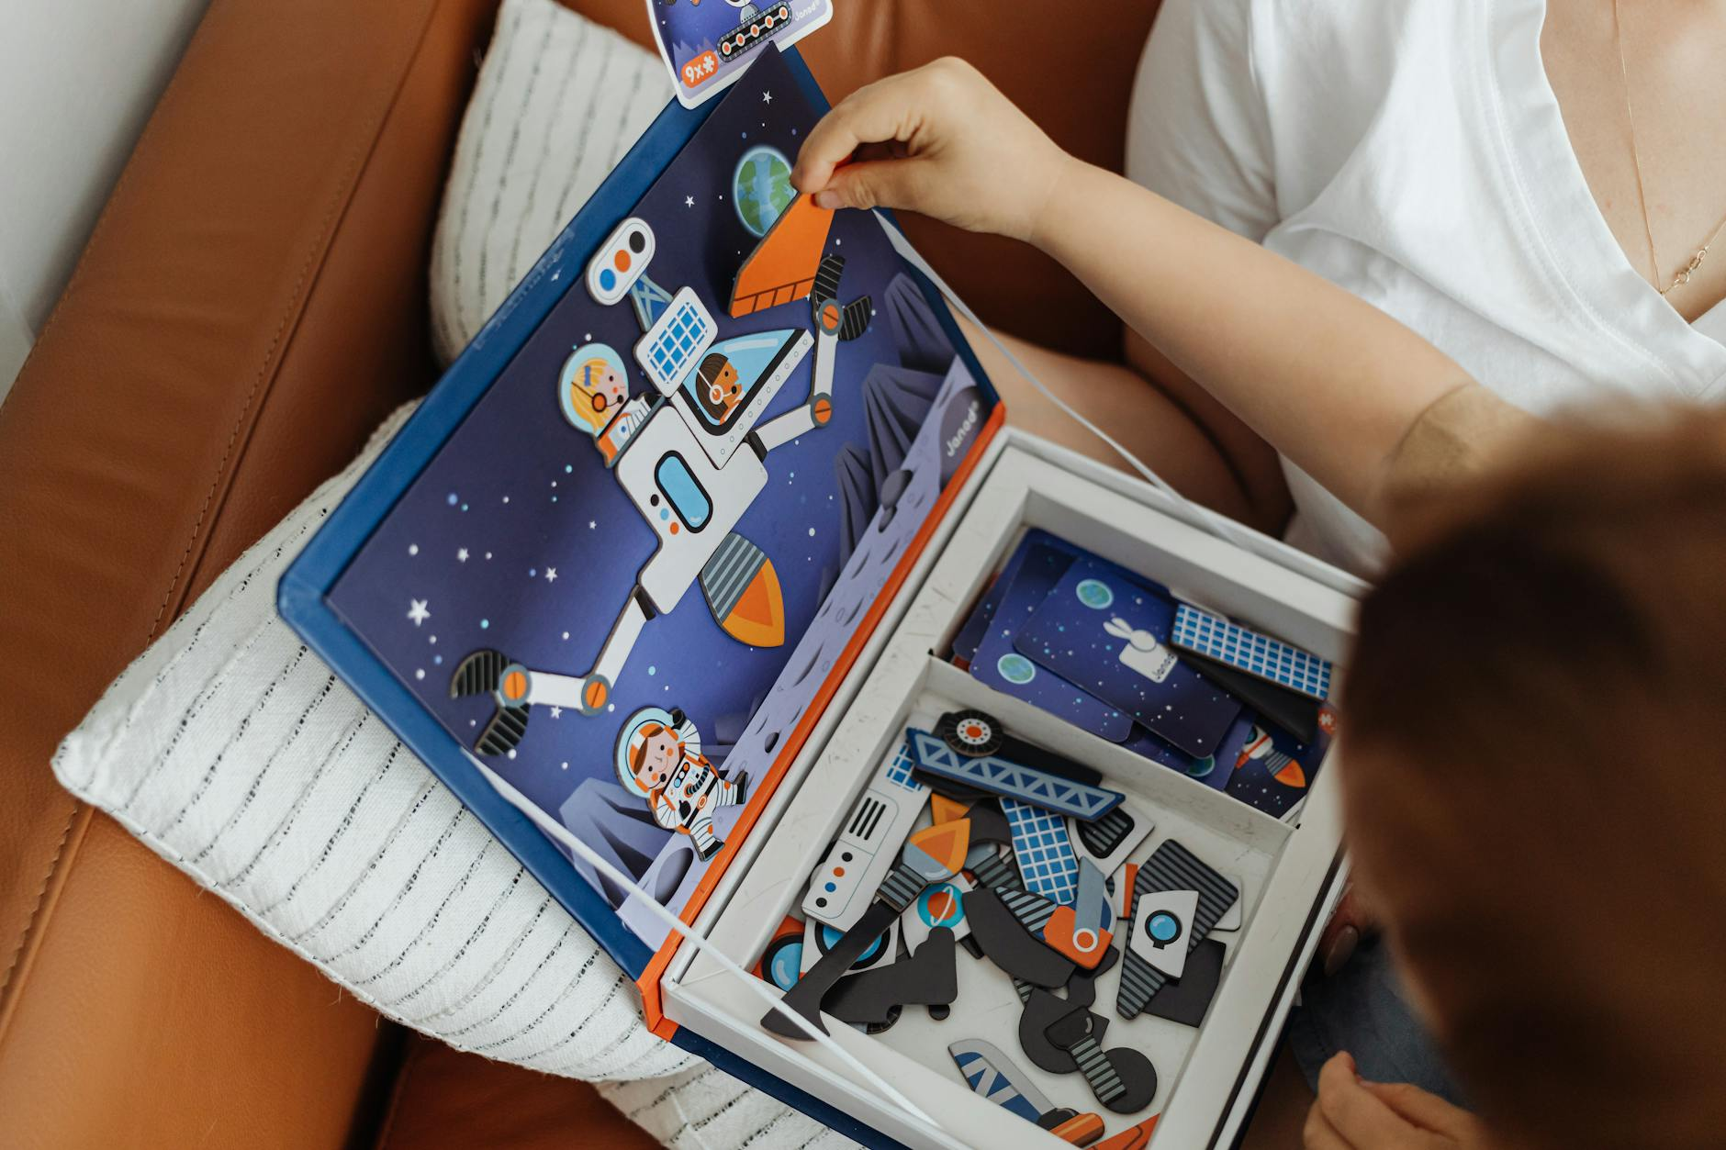
Robotics in Exploration: Reaching New Frontiers
Robots explore space, underwater, and other hazardous environments.
They collect data, perform experiments, and build infrastructure.
Robotics enables us to explore places that are inaccessible to humans.

Slide 7
Ethical Considerations and Challenges
Job displacement due to automation raises ethical concerns.
Ensuring safety and security in robotic systems is paramount.
Addressing bias in AI algorithms is crucial for fairness.

Slide 8
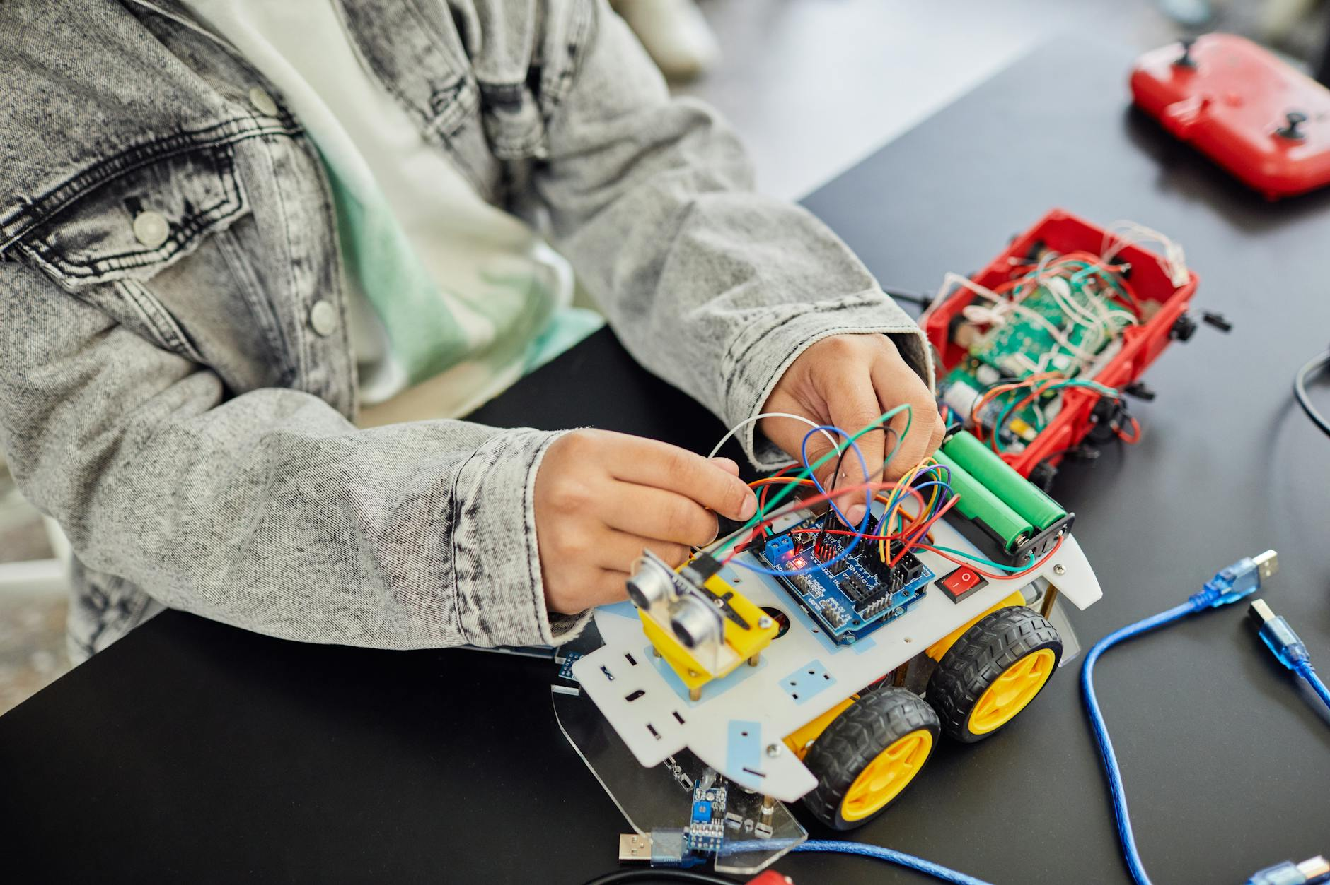
The Role of Education and Training
Developing skills in robotics, AI, and related fields is essential.
Educational programs need to adapt to the changing demands.
Lifelong learning is crucial for navigating the future of work.

Slide 9

Key Trends Shaping the Future
Human-robot collaboration will become more common.
Robots will be more personalized and adaptable to individual needs.
Cloud robotics will enable greater connectivity and intelligence.

Slide 10
Embracing the Robotic Revolution
Robotics offers immense potential to improve our lives.
By addressing ethical concerns and investing in education, we can harness this potential.
The future of robotics is bright, full of innovation and opportunity.

