Slide 1

Understanding Pollution: A Global Crisis
Pollution harms human health, ecosystems, and economies worldwide.
Various forms exist: air, water, land, noise, and light pollution.
Urgent action is needed to mitigate its devastating impacts.

Slide 2
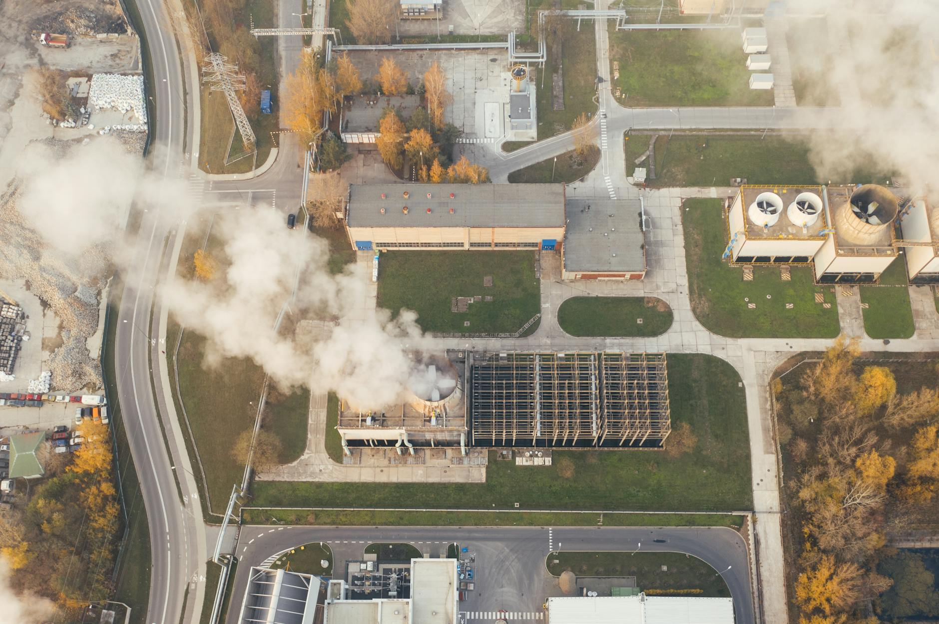
Air Pollution: A Breath of Fresh Air?
Sources include vehicle emissions, industrial activities, and burning fossil fuels.
Contributes to respiratory illnesses, cardiovascular diseases, and cancer.
Solutions involve cleaner energy, public transport, and emission controls.

Slide 3
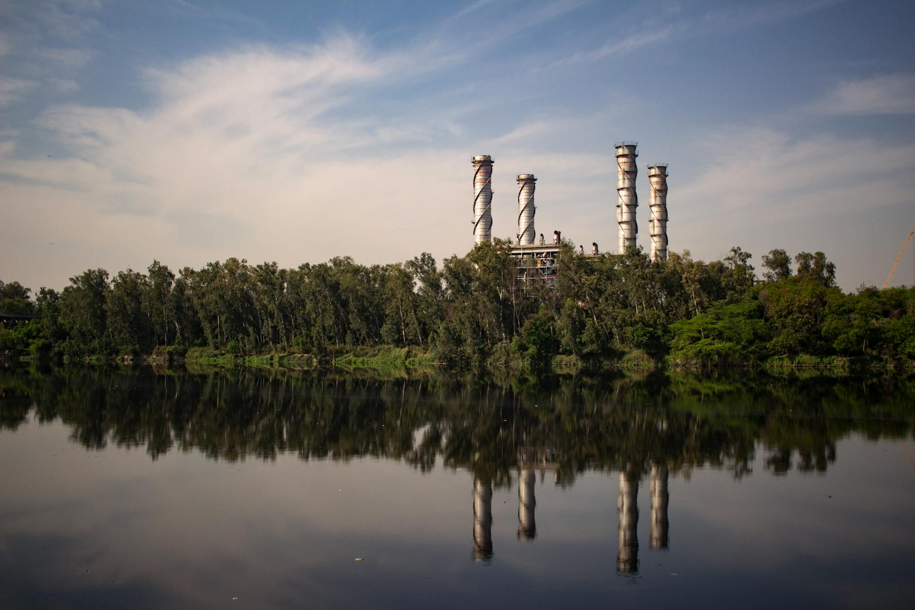
Water Pollution: A Dying Resource
Industrial waste, agricultural runoff, and sewage contaminate water sources.
Harms aquatic life, pollutes drinking water, and disrupts ecosystems.
Effective wastewater treatment, responsible farming, and regulations are essential.

Slide 4
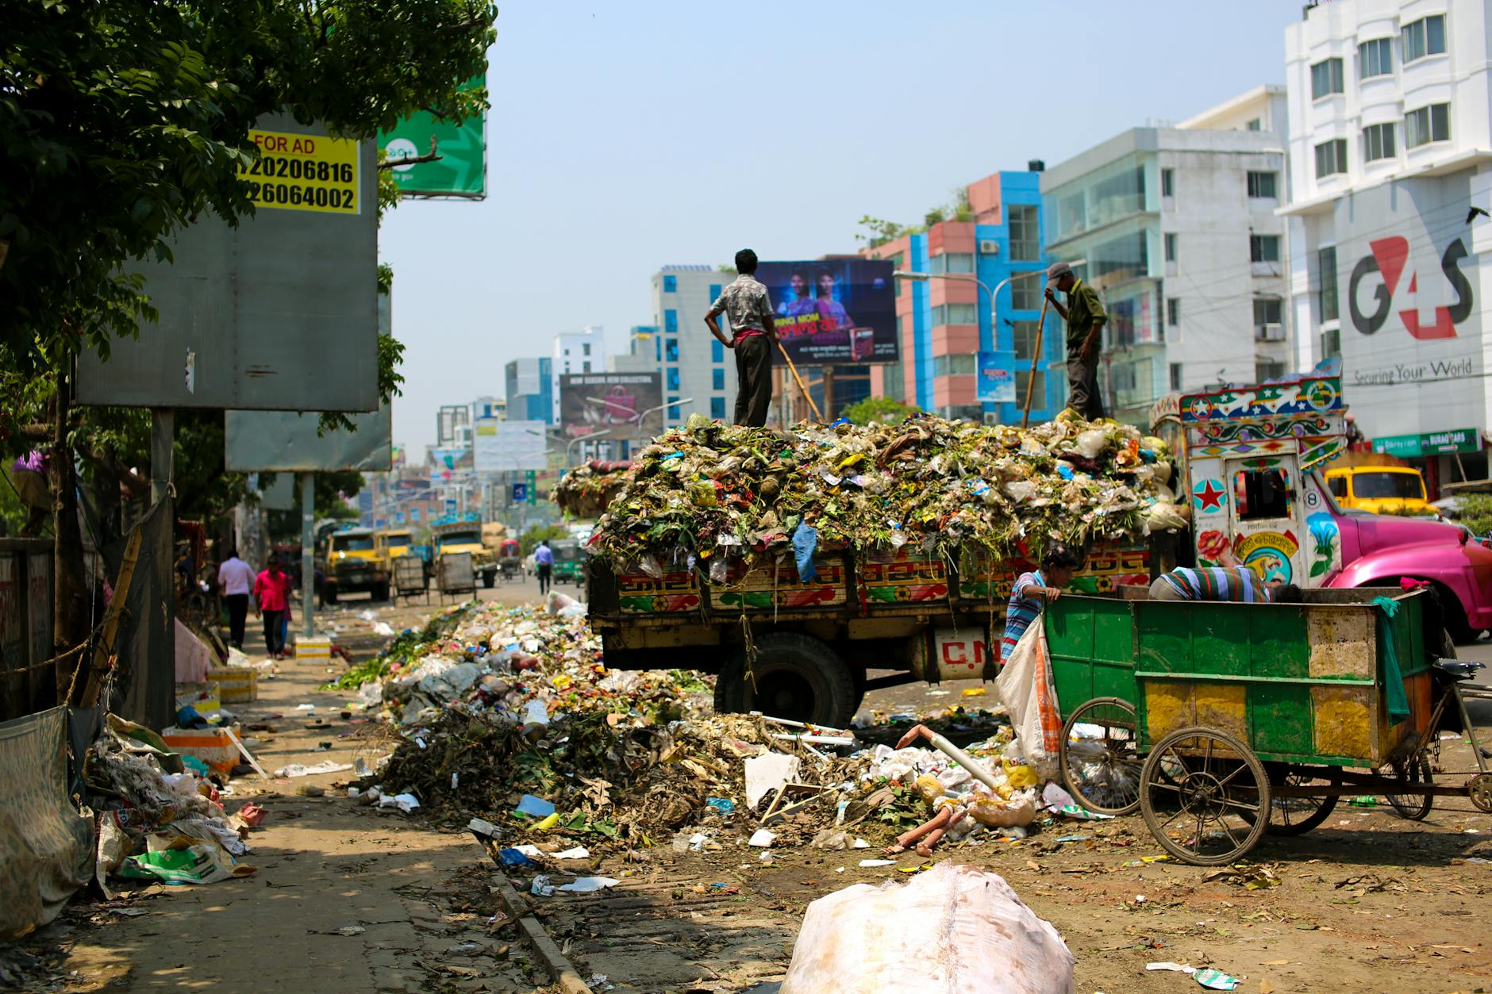
Land Pollution: A Buried Problem
Causes include improper waste disposal, mining activities, and chemical spills.
Contaminates soil, pollutes groundwater, and harms plant and animal life.
Promote reduce, reuse, recycle, responsible waste management, and remediation efforts.

Slide 5

Taking Action: Towards a Cleaner Future
Support policies that promote sustainability and environmental protection.
Reduce your environmental footprint through conscious choices.
Educate others and advocate for change in your community.

