Slide 1
Pollution: A Global Crisis
Pollution degrades our environment and threatens all life.
Multiple forms, each with unique sources and impacts.
Urgent action is needed to mitigate its devastating effects.

Slide 2
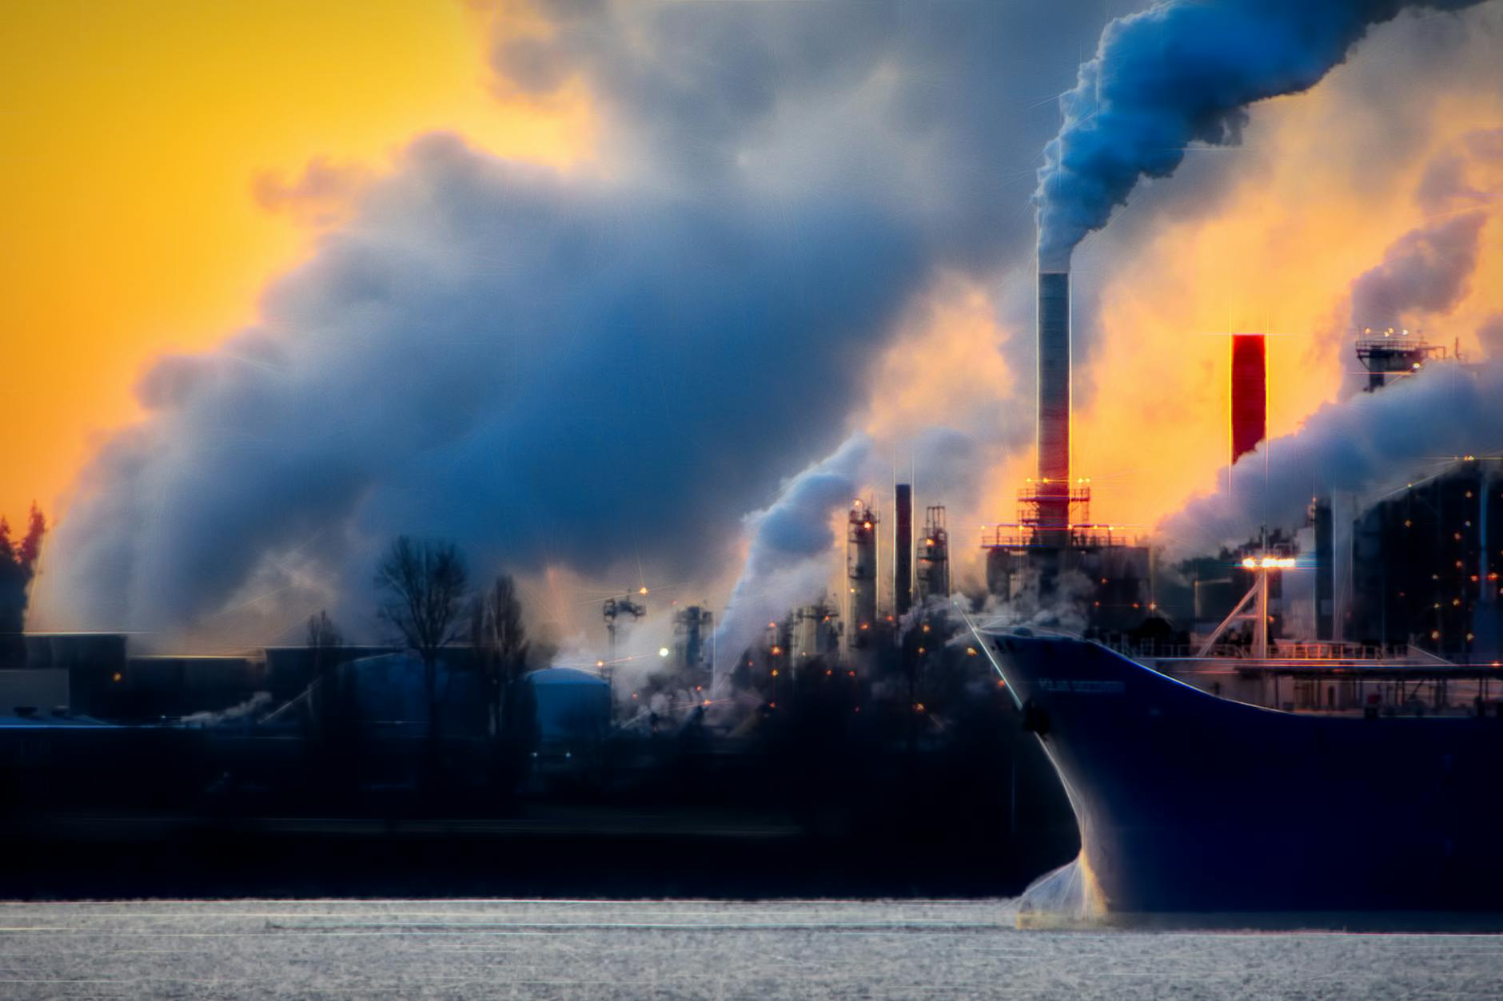
Air Pollution: A Breath of Poison
Sources include vehicles, factories, and power plants.
Harmful to respiratory health, cardiovascular system and causes cancer.
Contributes to acid rain, smog, and climate change.

Slide 3
Water Pollution: Tainted Waters
Agricultural runoff, industrial waste, and sewage contaminate water sources.
Threatens aquatic life and human health via drinking water.
Plastic pollution in oceans is a growing crisis.

Slide 4
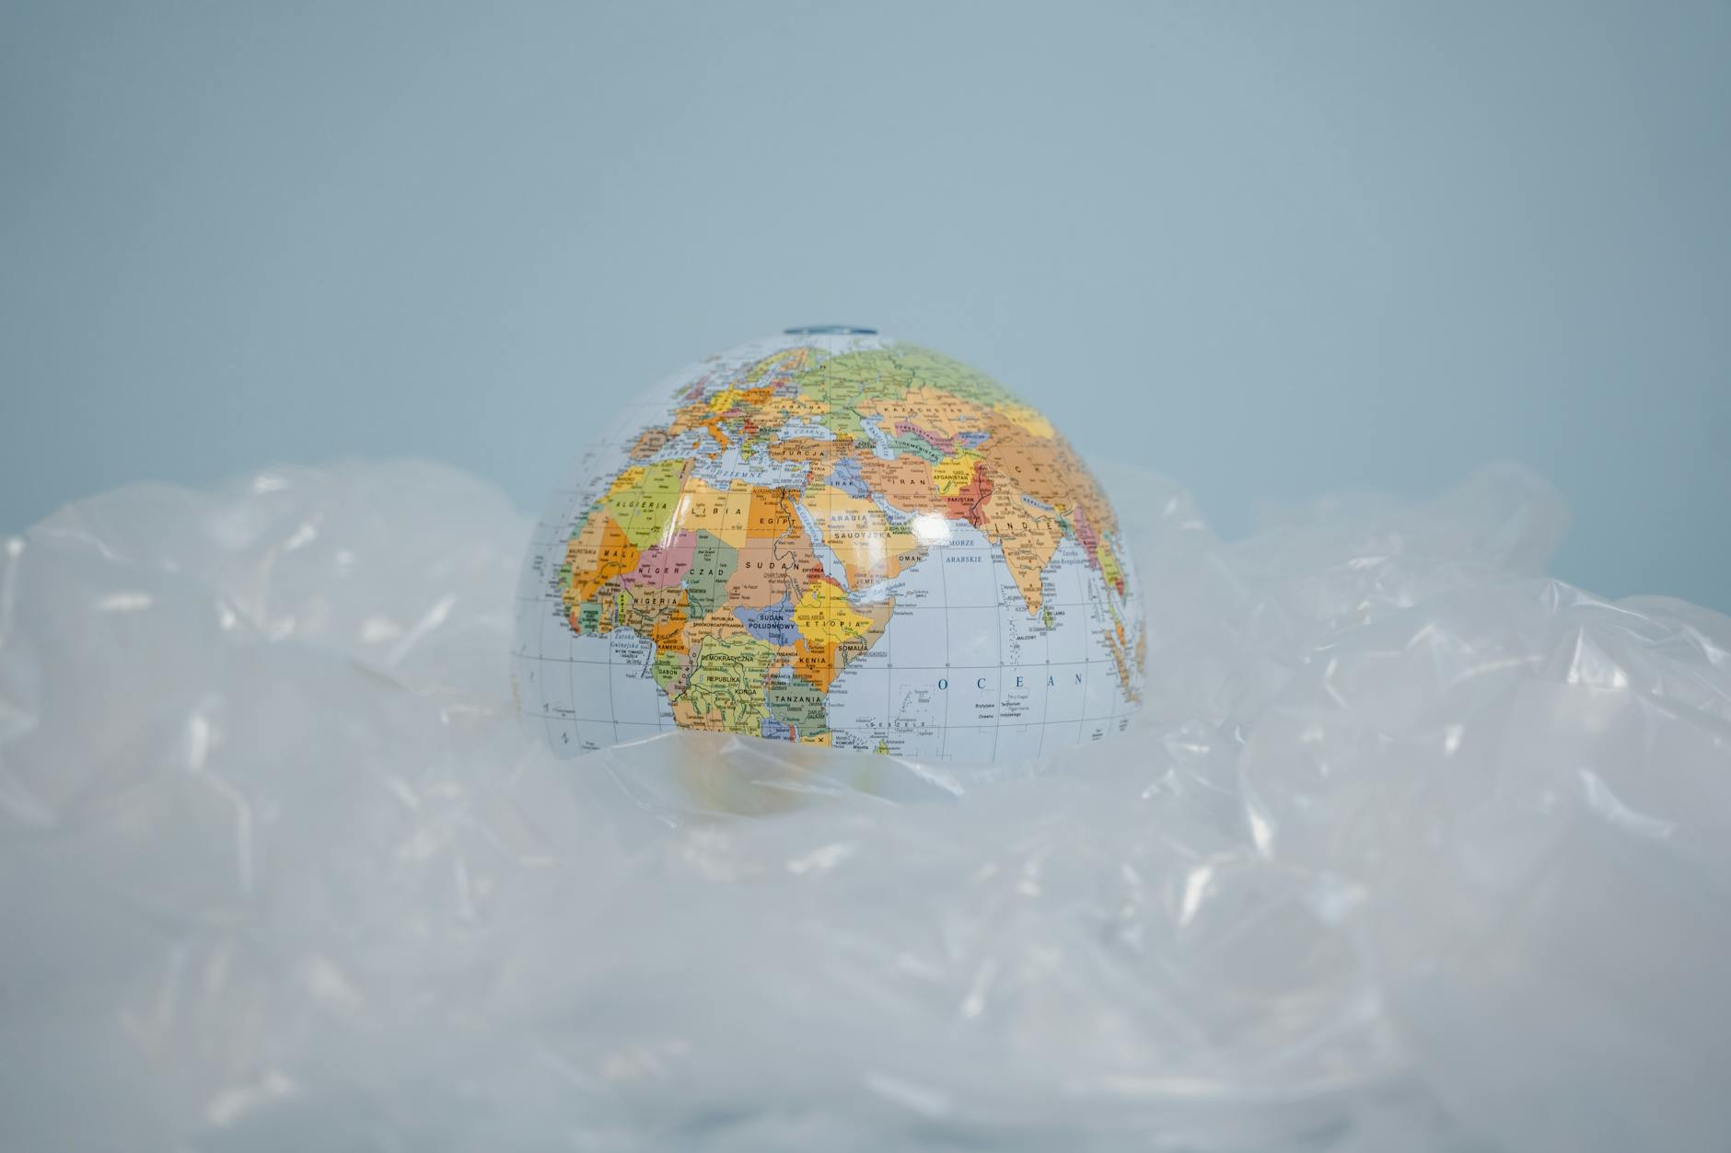
Land Pollution: A Growing Waste Problem
Improper waste disposal leads to soil contamination and groundwater pollution.
Deforestation, mining, and construction contribute to land degradation.
Harmful to ecosystems and agriculture.

Slide 5
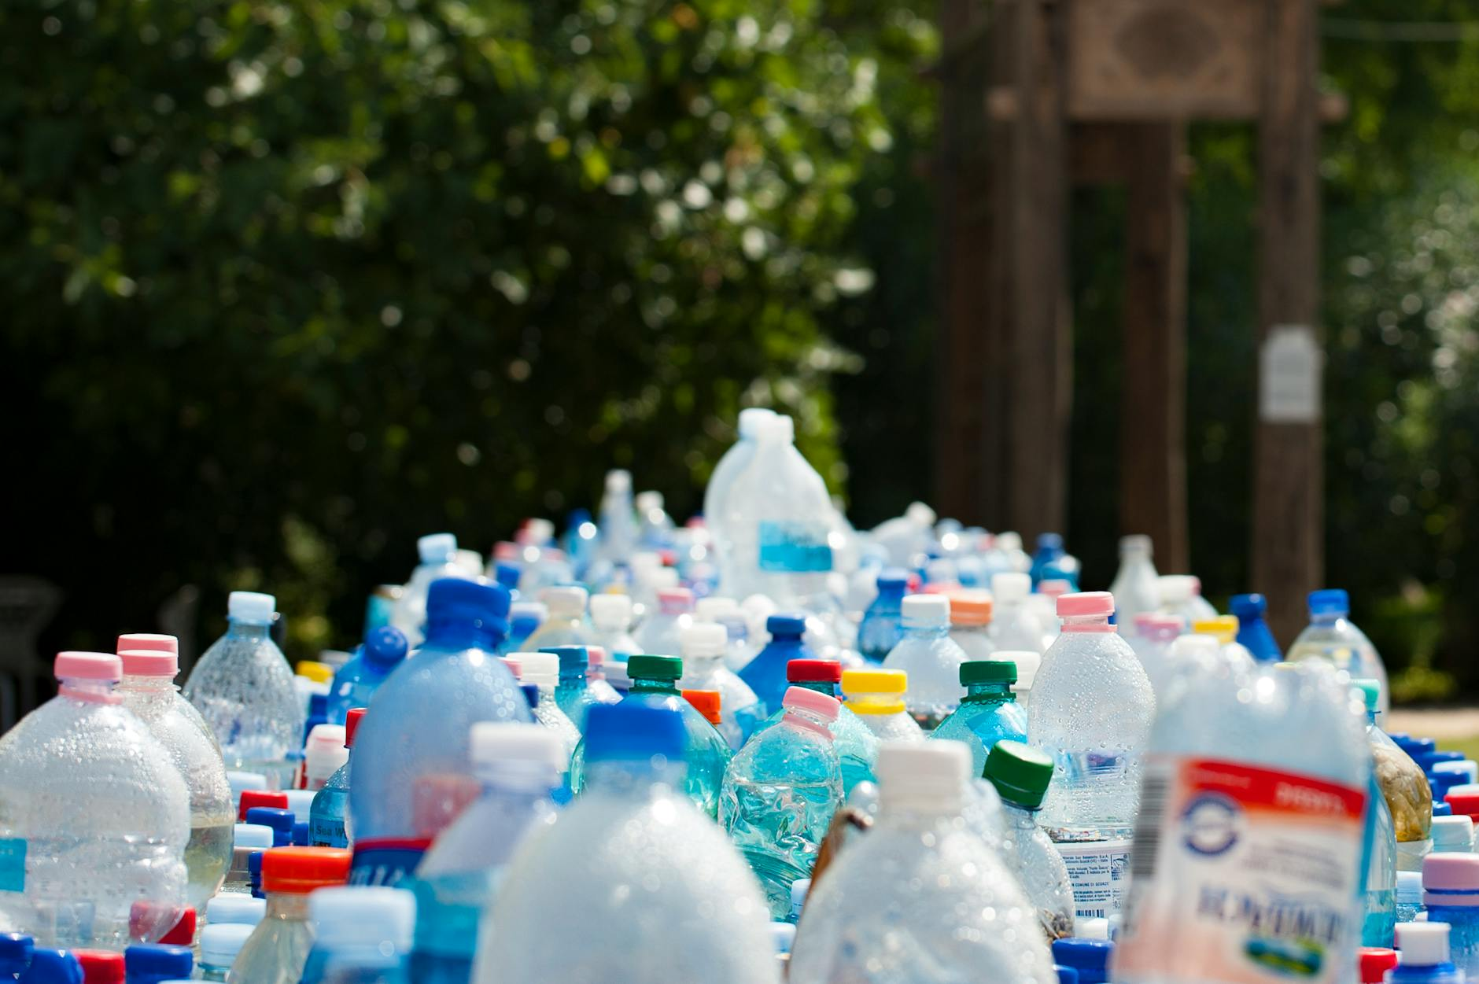
Noise Pollution: The Silent Killer
Traffic, construction, and industrial activities generate excessive noise.
Can cause hearing loss, stress, and sleep disturbances.
Affects wildlife by disrupting communication and behavior.

Slide 6
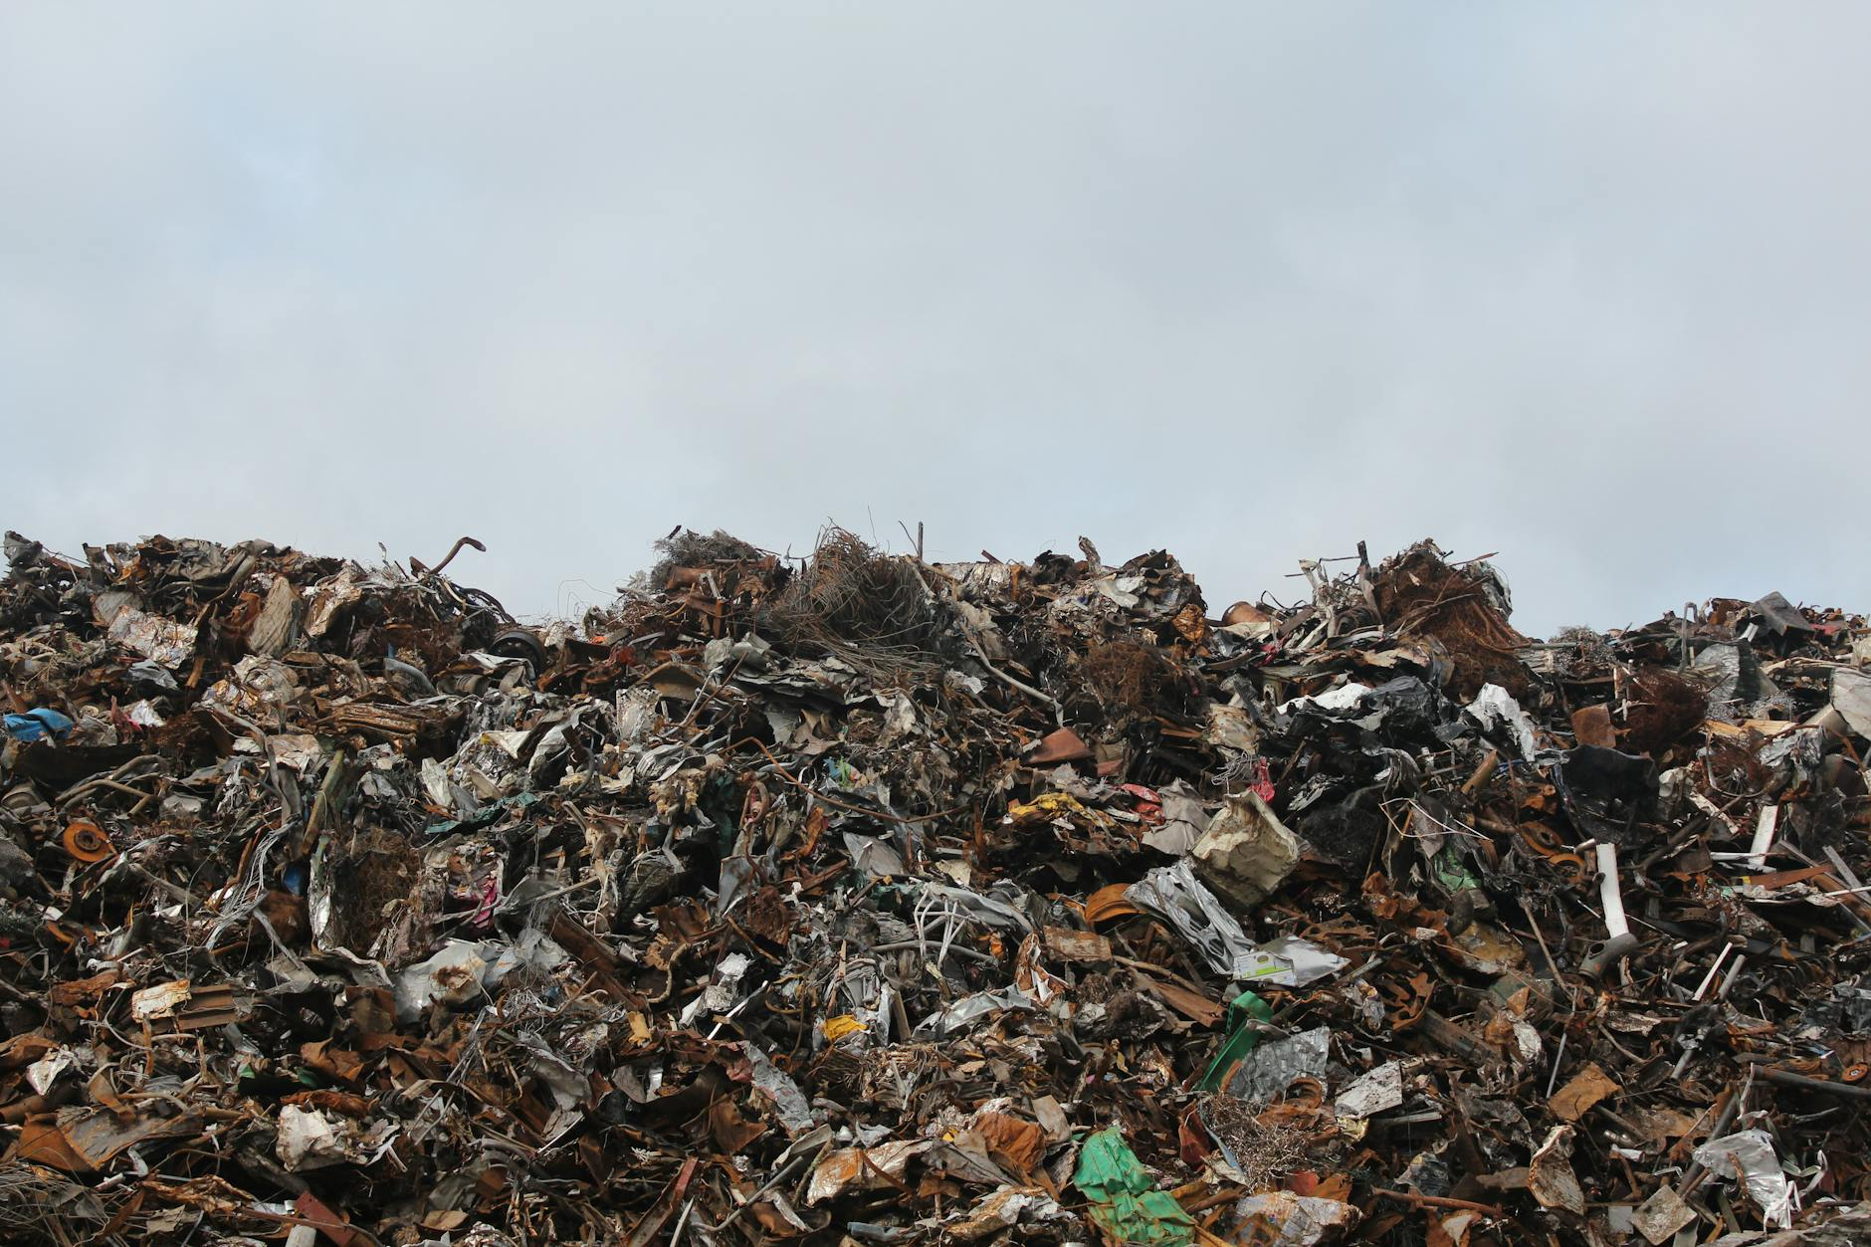
Sources of Pollution: Pinpointing the Culprits
Industry: Manufacturing, mining, and energy production.
Agriculture: Fertilizers, pesticides, and animal waste.
Transportation: Vehicles, ships, and airplanes.

Slide 7
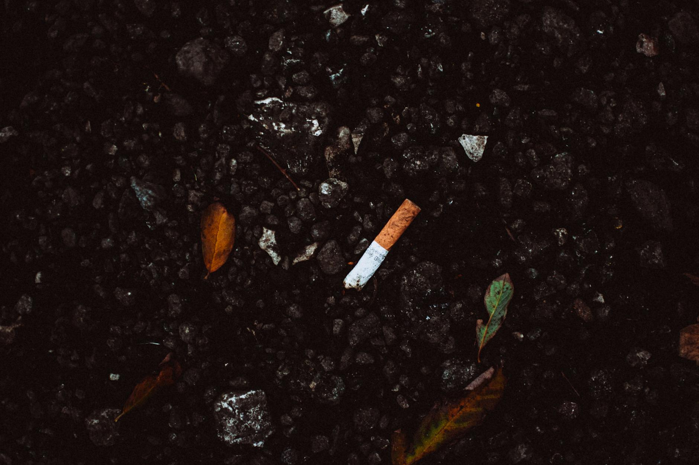
Impacts on Human Health: A Grave Threat
Respiratory diseases, cancer, and cardiovascular problems.
Neurological damage, developmental issues, and reproductive problems.
Disproportionately affects vulnerable populations.

Slide 8
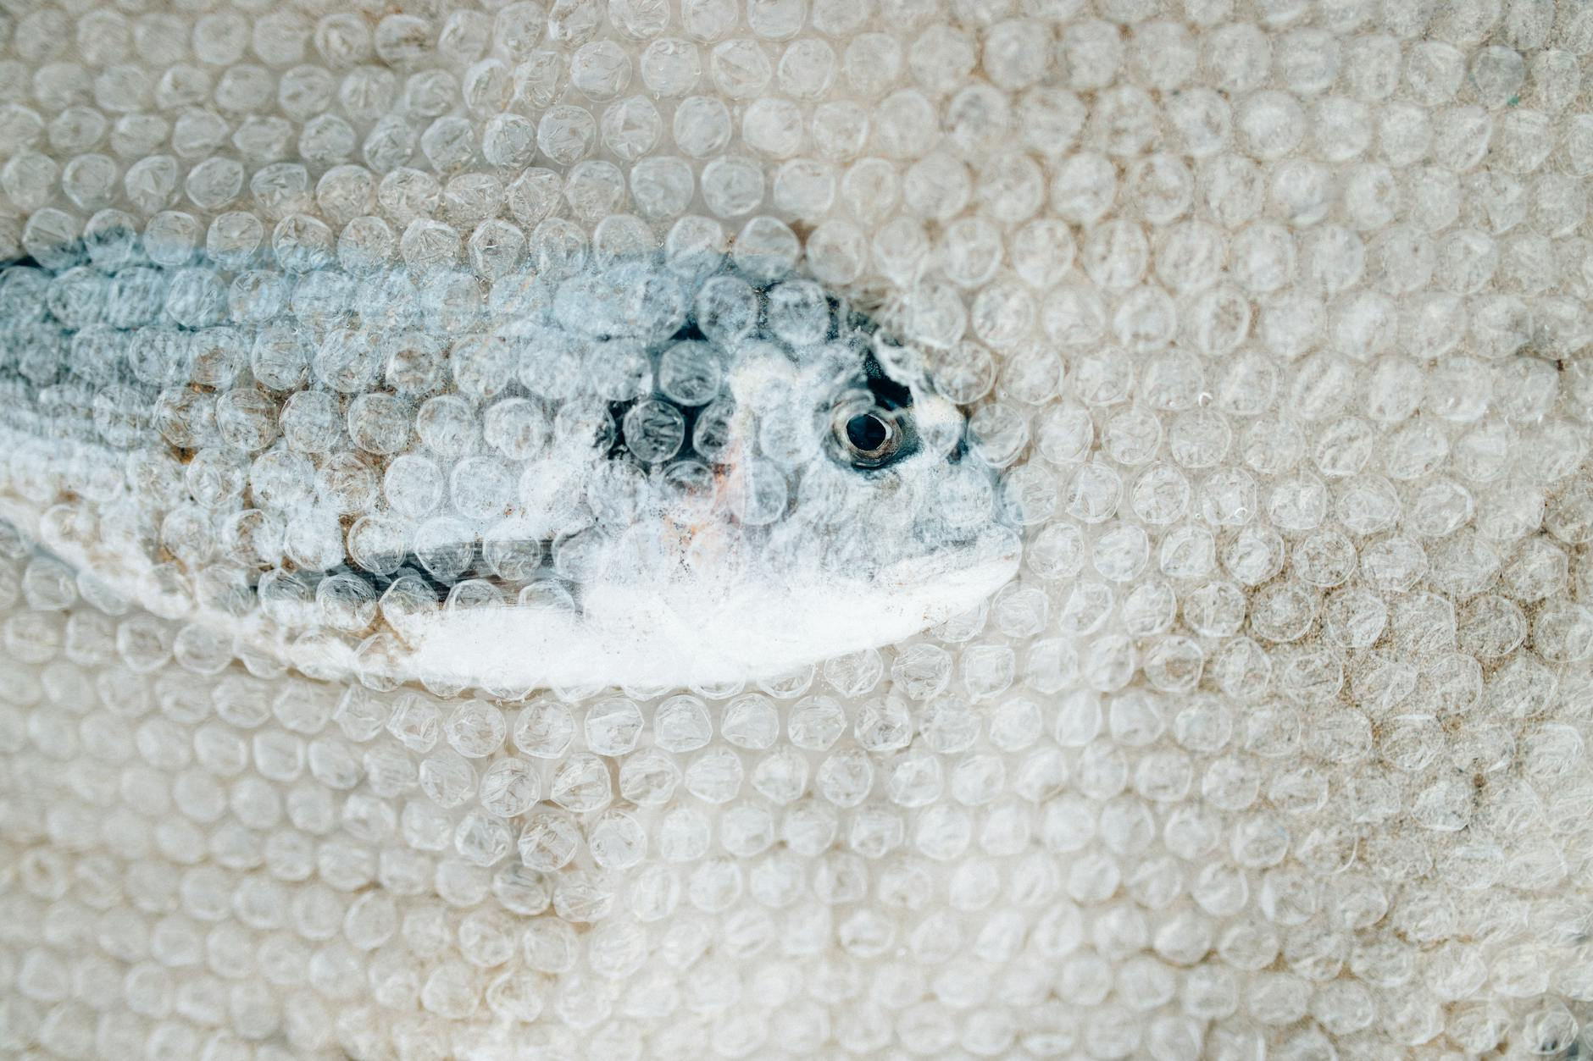
Environmental Consequences: Devastating Loss
Loss of biodiversity and ecosystem disruption.
Climate change acceleration and extreme weather events.
Water scarcity, soil degradation, and deforestation.

Slide 9
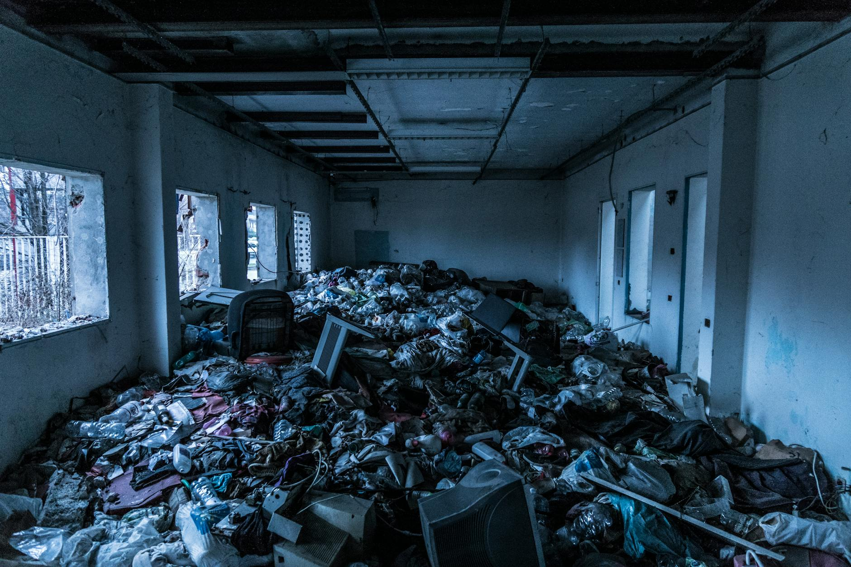
Solutions: A Path to a Cleaner Future
Reduce, reuse, and recycle to minimize waste generation.
Transition to renewable energy sources to combat air pollution.
Implement stricter environmental regulations and enforce them effectively.

Slide 10
Call to Action: Protecting Our Planet
Educate yourself and others about pollution issues.
Support policies that promote environmental sustainability.
Make conscious choices to reduce your environmental footprint.

