Slide 1
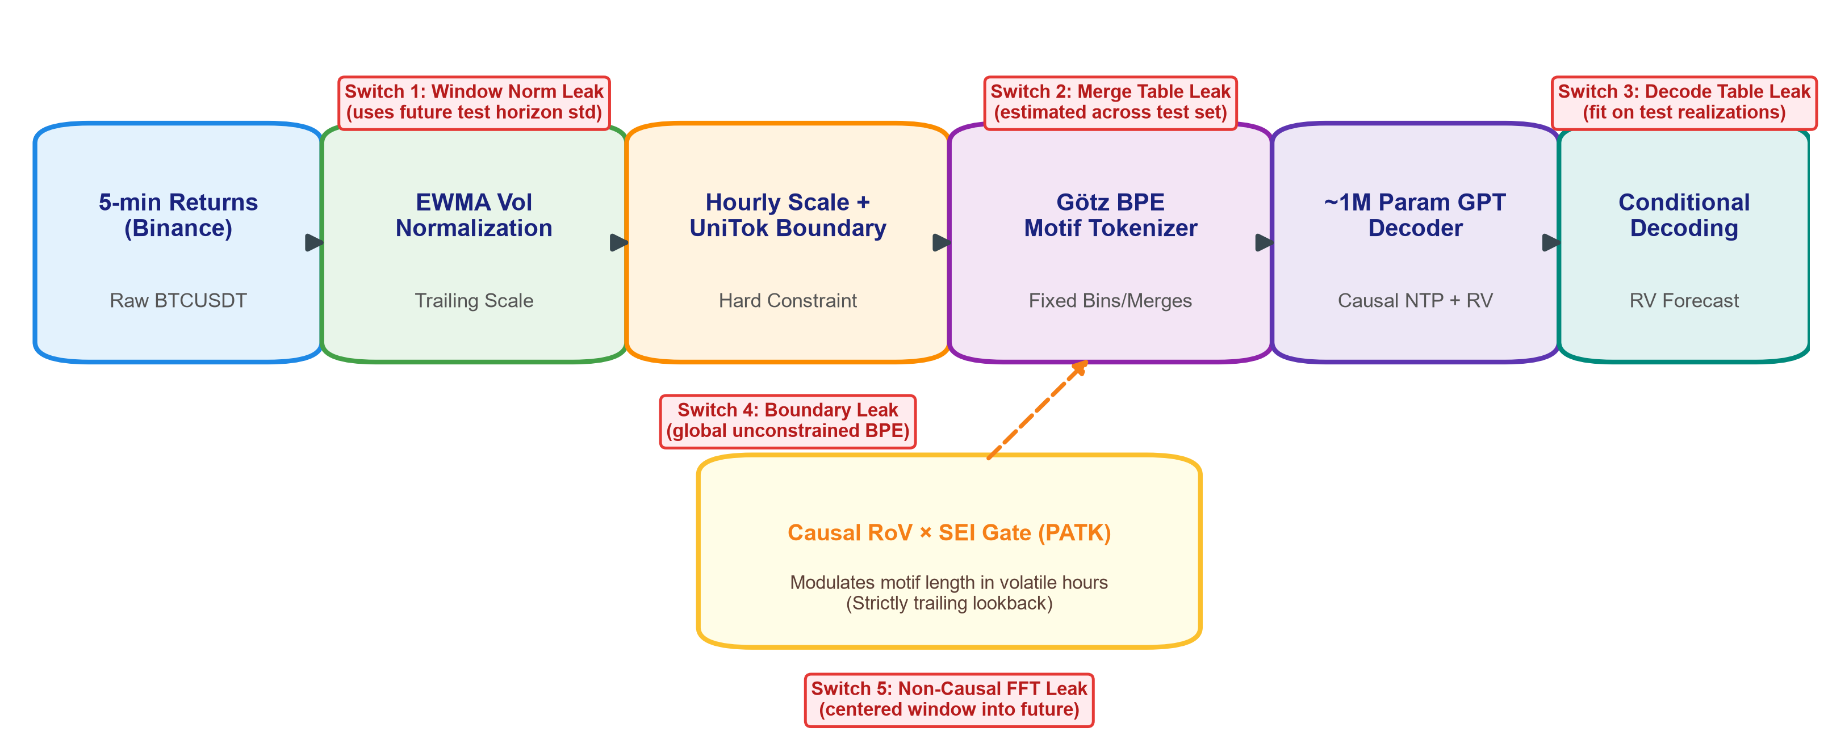
Quantifying Look-Ahead Bias via Causal, Volatility-Aware Motif Tokenization in Financial Time Series
DA4022 Course Project Midterm Progress Report | Team of 5 | Oct 15, 2026 Submission | Scope: Sept 22 – Oct 14 Sprint & Beyond
CORE RESEARCH QUESTION
How much does each look-ahead leakage channel (windowing, merge/decode tables, non-incremental token boundaries, FFT) artificially inflate walk-forward realized volatility forecasts in BPE-based foundation models?
PROGRESS SO FAR: WORKING EMPIRICAL EVIDENCE
All experiments implemented end-to-end on real Binance BTCUSDT 5-min klines & GARCH(1,1) simulator.
ROADMAP TO NOV 26 & TEAM EXECUTION
6-Week Rigorous Execution Schedule to Final Deliverable
1. First Leak Evidence: Token Boundary Mismatch (No Model Needed)
• Tested over 300 walk-forward origins on BTCUSDT:
- UniTok Hard Boundaries (Our Causal Ref): 0.00% mismatch rate (strictly incremental)
- Unconstrained Götz BPE (Channel 4): 84.00% mismatch & straddling rate!
• Finding: Naive BPE leaks post-origin information backward into context in 84% of origins.
Timeline Strip (Oct 16 - Nov 26 Final):
• Oct 16–22: Harness & Causality Audit — Complete 6-fold test on all baselines; perturbation pass.
• Oct 23–29: RoV×SEI Gate & GPT — Ablation of causal PATK gate; multi-horizon 1h & 1d RV.
• Oct 30–Nov 5: 5 Leak Sweeps — Evaluate all 5 channels across 6 folds; verify negative control.
• Nov 6–12: Seeds & Statistics — 3-seed runs, Holm-corrected superiority & TOST equivalence.
• Nov 13–18: Code Freeze & Holdout — Nov 14 code freeze; score sealed 2025 holdout exactly once.
• Nov 19–26: Final Deliverables — Report synthesis, 5-min video presentation, clean repo.
SYSTEM ARCHITECTURE & THE 5 LEAK SWITCHES
2. Negative Control: GARCH(1,1) Oracle QLIKE Floor Test
• Theoretical Property: Analytic E_t[RV_{t+1:t+H}] is strictly optimal under QLIKE loss.
- Oracle Floor (Analytical Truth): QLIKE = 0.15096 (95% CI: [0.1364, 0.1635])
- GARCH(1,1) Estimated (Causal): QLIKE = 0.15110 (Diff: +0.00014, stays >= floor)
- HAR-RV Estimated (Causal): QLIKE = 0.34887 (Diff: +0.19791)
- Gross Leak (Positive Control): QLIKE = 0.00505 (Breaks floor by -0.14591, DM p < 1e-10)
• Validates that the test reliably catches look-ahead bias with extreme statistical significance.
3. Preliminary Fold 1 Next-Hour RV Results (2021 Train -> 2022-Q1 Test)
Team Roles & Division of Labor (Team of 5):
Member A (Data & Baselines): Binance 5-min archive ingestion, EWMA normalization, RV targets, HAR-RV & GARCH baselines.
Member B (Tokenizer & Causality): Götz BPE, UniTok hour-boundary constraint, future-perturbation & mismatch rate audit.
Member C (GPT & Decoding): ~1M-param causal GPT decoder, conditional decoding table, training & rollout harness.
Member D (Simulator & Leaks): GARCH(1,1) simulator, analytic oracle QLIKE floor, 5 leakage channel switches.
Member E (Stats & Deliverables): Block bootstrap CIs, Holm-Bonferroni, TOST tests, Diebold-Mariano, slide & report.
• Causal Reference (Leak-Free):
Trailing EWMA vol normalization + UniTok hourly scale tokens (hard boundaries) + Götz BPE within-hour + Trailing RoV×SEI gate.
• 5 Audited Leakage Channels (switched 1-at-a-time):
1. Per-window normalization using future horizon std
2. Merge table fit on full data (test overlap)
3. Conditional decoding table fit on test data
4. Unconstrained BPE token boundary straddling
5. Non-causal centered FFT spectral energy
• Positive Control:
Deliberately gross normalization leak (target RV injection).
Model / Variant | QLIKE | Inflation | DM p-val | TOST
HAR-RV Baseline | 0.5428 | Baseline | --- | ---
Causal Ref (~1M GPT) | 0.6383 | 0.00% | --- | REF
Ch 1: Norm Leak | 0.5930 | +7.1% | 0.416 | Reject
Ch 2: Merge Leak | 0.6384 | -0.0% | 0.993 | Equiv
Ch 4: Boundary Leak | 0.5326 | +16.6% | 0.004 | Reject
Positive Control (Gross) | 0.1963 | +69.2% | < 0.001 | Reject

