Slide 1

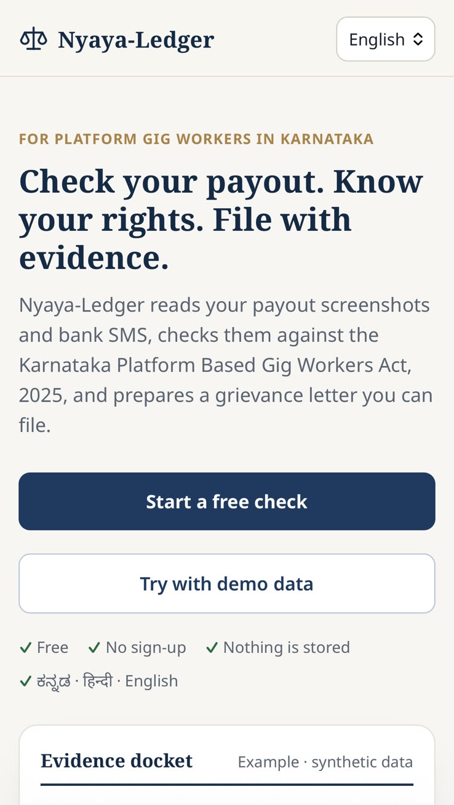
Built with
CLINE AI BUILDER HACKATHON · ROUND 2
Nyaya-Ledger
Nyaya (न्याय / ನ್ಯಾಯ) means justice.
Helps India's gig workers turn the payout screenshots and bank SMS on their phone into a checked, law-grounded grievance they can file.
Cline SDK agent inside
Built to scale state by state
Kannada · Hindi · English
Devansh Jangid · Debasis Patnaik
Live nyaya-ledger.onrender.com
Code github.com/devanshjangid2005/nyaya-ledger
Notes:
Hi, we're Devansh and Debasis. Nyaya-Ledger helps gig workers in India, delivery riders and cab drivers, turn what is already on their phone, payout screenshots and bank SMS, into a checked grievance docket they can file under gig-worker law. We start in Karnataka, where the law and a grievance portal are already working, and the app is built so each new state is mostly a new law file and a new language. It is live, so you can open it on your phone right now. Cline was our coding partner for the whole build, and the Cline SDK runs inside the product as the agent that does the audit.

Slide 2
02 THE PROBLEM
Built with
Paid, penalised and blocked by systems they can't inspect
7.7M → 23.5M
~7 lakh
83% · 87%
gig workers in India, 2020-21 → projected 2029-30 (NITI Aayog)
active gig workers reported by platforms in Karnataka, April 2026
of cab drivers · delivery workers say ID blocking or deactivation hurt them (PAIGAM 2024)
WHAT A WORKER ACTUALLY SEES
Adjustment −₹180
A deduction with no reason given
App ₹6,105 · Bank ₹6,005
Less money arrives than the app shows
"Your ID has been blocked"
No reason, effective the same day
The platform holds the data. The worker holds a pile of screenshots.
Sources: NITI Aayog (2022); The Hindu (2026); PAIGAM, Prisoners on Wheels? (2024). Links in the README.
Nyaya-Ledger · Cline AI Builder Hackathon
2 / 11
Notes:
India has millions of gig workers, close to 7 lakh in Karnataka alone. They are paid, penalised and deactivated by apps they cannot inspect: a deduction just called 'Adjustment', a bank credit smaller than the app showed, an ID block with no reason. In PAIGAM's survey more than 80% said blocking hurt them. The platform has all the data; the worker has screenshots in the gallery and SMS in the inbox.

Slide 3
03 VOICE FROM THE GROUND
Built with
We asked a delivery partner
Q
Aap delivery payments ya platform ke related kuch problems face karte hai kya?
Do you face any problems with delivery payments or the platform?
“
A
"Han, kaafi dikkatein horhi hai recently, abhi kuch din pehle protest bhi hua tha iski wajah se."
Yes, there have been a lot of problems recently. A few days ago there was even a protest because of it.
Prabal Sharma
Delivery partner, Blinkit
Interviewed by our team during the hackathon
WHY IT MATTERS
Workers already feel the problem. What they lack is evidence in a form a grievance committee can act on.
Nyaya-Ledger · Cline AI Builder Hackathon
3 / 11
Notes:
During the hackathon we spoke to Prabal Sharma, a Blinkit delivery partner. We asked whether he faces problems with delivery payments or the platform. In his words: "Han, kaafi dikkatein horhi hai recently", meaning yes, there have been a lot of problems recently, and a few days earlier there had even been a protest about it. Workers already feel the problem. What they lack is evidence in a form a grievance committee can act on, and that is what Nyaya-Ledger produces.

Slide 4
04 WHY KARNATAKA FIRST
Built with
The rights and the filing channel exist. The evidence doesn't.
KARNATAKA PLATFORM BASED GIG WORKERS ACT, 2025
TIMELINE
s.15(1)
Reasons for every deduction, stated in the invoice; pay as per contract
30 May 2025
Act in force
s.15(2)
Pay at least weekly, with no delay
1 May 2026
Grievances filed via IPGRS, routed to the IDRC
s.14(2)
No deactivation without written reasons and 14 days' notice
3 Jul 2026
High Court declines to stay the Act; case pending
s.13(1)
Right to ask how automated systems affect earnings
s.22(2)
Grievance on payouts, deductions or termination to the platform's IDRC
Missing: the evidence
It sits in the worker's gallery and SMS inbox, and nobody reconciles it by hand.
Nyaya-Ledger · Cline AI Builder Hackathon
4 / 11
Notes:
Karnataka now has a law that speaks to exactly these problems: reasons for every deduction, weekly pay, 14 days' written notice before deactivation, and a right to ask how the algorithm works. Since May 2026 workers can file grievances through the state's IPGRS portal, which makes Karnataka the best place to prove the idea. Other states are moving the same way: Rajasthan, Telangana and Bihar have gig-worker laws, and the central Code on Social Security covers gig workers. In every state, what is missing is the evidence in a form a committee can act on. That is the gap we fill.

Slide 5
05 THE SOLUTION
Built with
From a pile of screenshots to a docket a committee can act on
Upload payout screenshots, paste bank SMS, add hours and fuel cost. Nyaya-Ledger does the rest:
1
2
3
4
5
6
Read
Vision model reads each screenshot. SMS parsed by plain code, no AI
Confirm
Worker checks and corrects every number
Check
Deterministic, unit-tested audit checks
Quote
Exact clause text from a bundled copy of the Act
Draft
Grievance letter + s.13 request in Kannada, Hindi or English
Docket
PDF evidence docket, ready for IPGRS
AI model
Plain code
Worker
WHAT IT DOES NOT CLAIM
Not a verdict
Findings say "possible issue for review", with the arithmetic shown
Not legal advice
Every docket says so, and notes the pending High Court case
No platform login
No partner API exists; scraping could get the worker blocked
Nyaya-Ledger · Cline AI Builder Hackathon
5 / 11
Notes:
The worker uploads screenshots, pastes bank SMS and adds two numbers. A vision model reads the screenshots; the SMS are parsed by plain code and never go to an AI. Then the key step: the worker sees every extracted number and confirms or fixes it, so a misread number never becomes an accusation. Deterministic checks run on the confirmed data, the exact clause text is quoted, and the agent drafts the letter in the worker's language. Output is a PDF docket for the IPGRS portal. Equally important is what we do not claim: no verdicts, not legal advice, and no logging into the platform.

Slide 6
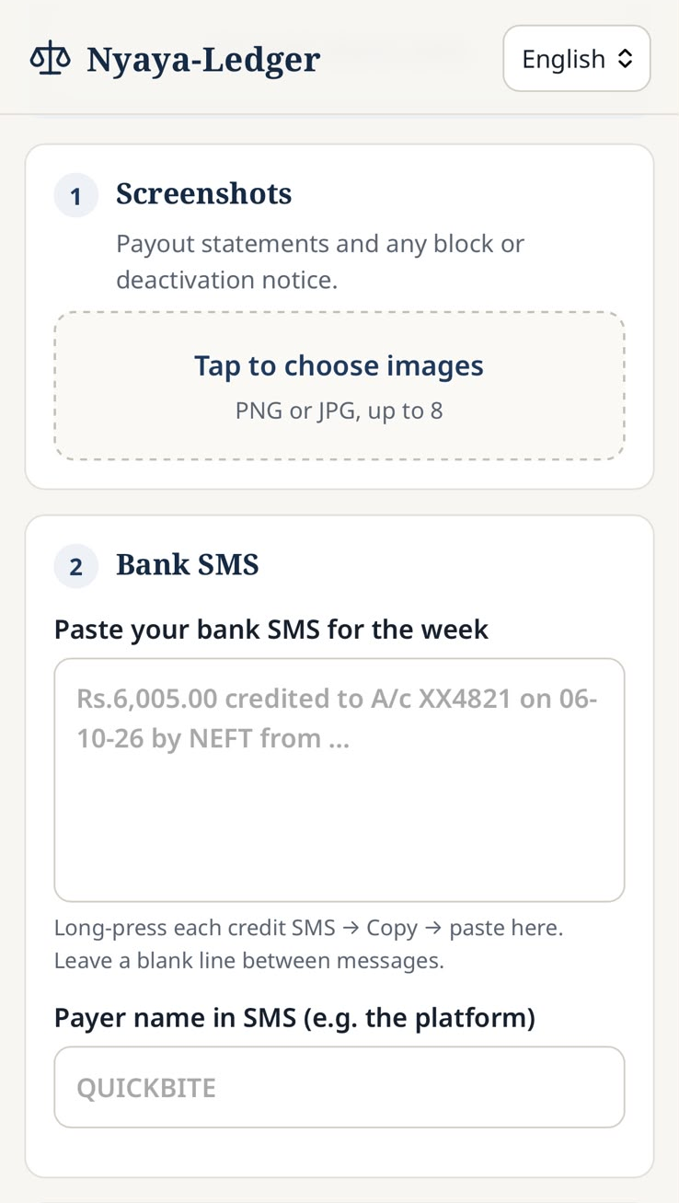
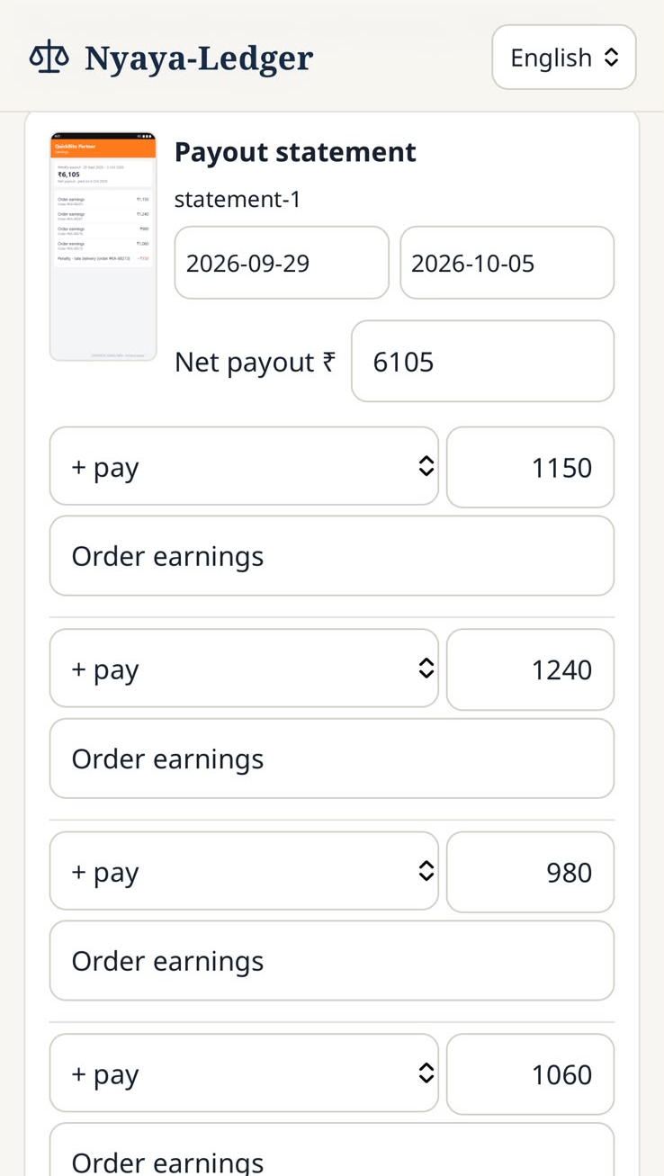
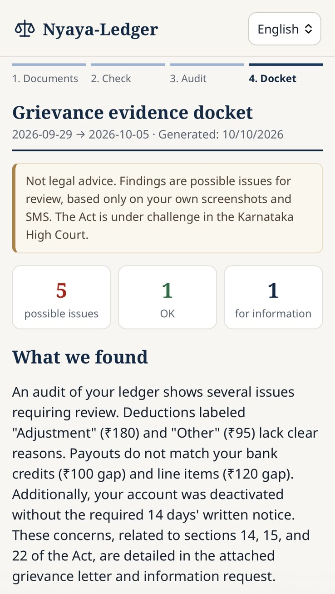
06 DEMO · RAVI'S WEEK
Built with
One week of evidence, audited in about 30 seconds
WHAT IT FOUND (SYNTHETIC DATA)
C1
₹275 of deductions with only a vague label
C2
₹120 gap: ₹6,650 − ₹425 ≠ ₹6,105 shown
C3
0 days notice and no reason for an ID block
C7
₹100 less reached the bank than the app showed
C5
₹90/h real earnings after fuel, against ₹128/h gross
C4 OK weekly payouts. OTP and fuel-debit SMS skipped automatically.
Output: 5 possible issues, grievance letter, s.13 request, PDF docket.
1 Collect
2 Confirm
3 Docket
Nyaya-Ledger · Cline AI Builder Hackathon
6 / 11
Notes:
Meet Ravi, a synthetic two-wheeler delivery partner in Bengaluru. He uploads three screenshots, two overlapping weekly statements and an ID-block notice, and pastes five SMS. On the Confirm screen he fixes one misread number. About 30 seconds later the docket shows five possible issues: ₹275 of deductions with only vague labels, a ₹120 arithmetic gap, a block with zero days' notice and no reason, ₹100 less in the bank than the app showed, and his real hourly earnings after fuel: ₹90, not ₹128. All numbers come from code, not from the AI.

Slide 7
07 ARCHITECTURE
Built with
AI reads and writes. Code decides the numbers.
Worker
Phone browser, React + Vite. Kannada, Hindi or English
Vision model
1 call per screenshot → zod-checked JSON
Confirm
The worker checks and fixes every number. Only confirmed data goes on
Docket
Findings, letter, s.13 request, quoted clauses. Browser "Save as PDF" with Noto fonts
SMS parser · no AI
Keeps bank credits, skips OTPs and debits
Fallback
No model, an error or 120 s → English template docket. Same checks, same guard
Cline SDK Agent
Picks the checks that apply, asks the worker if something is missing, explains the findings and writes the letter. Only 5 custom tools: no shell, file or web.
submit_docket
Citation + verdict guard
Unknown clause or "violation" → rejected
run_checks
Audit checks C1-C5, C7
Pure functions, unit-tested
get_ledger_summary
ask_worker
lookup_clause
Legal corpus
Verbatim text of the Act
STACK
TypeScript · Node 22
Express + multer
React + Vite
@cline/sdk
Gemini 3.1 Flash-Lite
zod
vitest · 42 tests
Render free tier
Nyaya-Ledger · Cline AI Builder Hackathon
7 / 11
Notes:
One Node process serves the API and the web app on Render's free tier. The vision model reads each screenshot into JSON that is validated with zod; bank SMS are parsed by plain code. After the worker confirms, the Cline SDK agent takes over. It has only five custom tools: run_checks calls our deterministic audit library, lookup_clause reads the bundled Act, and submit_docket ends the run, but only if every cited clause exists and the letter contains no verdict words. If there is no model, an error, or the run passes 120 seconds, a template fallback uses the same checks and guard, so the worker always gets a docket.

Slide 8
08 AI MODELS AND TOOLS
Built with
AI where language is hard. Code where numbers must be right.
AI DOES
CODE DOES (NO AI)
Read screenshots
Gemini 3.1 Flash-Lite (vision) → strict JSON, validated with zod, 1 retry. Every value keeps its source image ID
Parse bank SMS
Regex parser for SBI, HDFC and Axis-style credits. SMS never reach a model
Run the audit
Cline SDK Agent on the same model: decides which checks apply, asks the worker for missing inputs
Every number
Checks C1-C5 and C7 are pure TypeScript functions with vitest tests
Explain and draft
Plain-language summary, grievance letter and s.13 request in Kannada, Hindi or English
Every citation
Clause text comes from a bundled copy of the Act, never from the model
THE AGENT'S ONLY 5 TOOLS
get_ledger_summary
what's in the ledger
run_checks
deterministic checks
lookup_clause
verbatim Act text
ask_worker
one question, live
submit_docket
guarded, ends the run
Nyaya-Ledger · Cline AI Builder Hackathon
8 / 11
Notes:
We split the work carefully. AI does what is hard for code: reading messy screenshots, deciding what to check, and writing in Kannada or Hindi. Code does everything that must be exactly right: parsing SMS, every number in every finding, and every quoted clause. The agent runs on Gemini 3.1 Flash-Lite through the Cline SDK's built-in provider, and any other provider works by changing an environment variable. It has exactly five typed tools. The rule we built around: the agent decides what to do and how to explain it, never what the numbers are.

Slide 9
09 HOW CLINE WAS USED
Built with
Cline built it. The Cline SDK runs inside it.
IN THE BUILD
INSIDE THE PRODUCT · BONUS CRITERION
Cline in the build
A3 clip frame: Cline panel with the failing SMS test → the fix in sms.ts → tests green
shots/cline-build.png
const agent = createAgent(source, {
systemPrompt: systemPrompt(ledger),
tools: [getLedgerSummary, runChecks,
lookup, ask, submit],
maxIterations: 12,
});
createTool({ name: "submit_docket",
lifecycle: { completesRun: true }, ... })
Test-first Failing vitest test first, then Cline writes the check until it passes
server/agent.ts
Agent + createTool 5 zod-typed custom tools, no built-in shell, file or web tools
Built with Cline Scaffold, zod schemas, citation guard, React screens, e2e test
ask_worker Pauses the run and asks the worker a question over SSE
42 tests checks, SMS parser, guards, agent loop with a stub model, API
completesRun submit_docket ends the run, only after the guards pass
Nyaya-Ledger · Cline AI Builder Hackathon
9 / 11
Notes:
Cline was used in two ways. In the build, Cline was our coding partner from the first commit: we wrote a failing test, and Cline wrote the code until it passed. The clip in our video shows Cline adding new bank SMS formats exactly this way. Inside the product, the Cline SDK Agent runs every audit. We give it only our five custom tools, typed with zod. ask_worker can pause the run to ask the worker a question, and submit_docket uses completesRun, so the run ends only when a docket passes our citation and verdict guards.

Slide 10
10 CHALLENGES
Built with
What could go wrong, and what we built for it
CHALLENGE
WHAT WE DID
Vision misreads a number
→
The worker confirms every value before any check runs
Bank SMS formats vary
→
Test-first parser; unknown formats are skipped with a reason, credits can be added by hand
Prompt injection in screenshots
→
Agent has only 5 typed tools. Ledger text is treated as data, never as instructions
Model invents a law or a verdict
→
Citation guard + verdict-word guard (EN · ಕನ್ನಡ · हिन्दी) reject the docket; agent must rewrite
Kannada PDF on a 512 MB free host
→
No server Chromium: print stylesheet + Noto fonts, the phone's browser saves the PDF
Free-tier quota and timeouts
→
Template fallback after 120 s, same checks and guard, labelled "generated without AI"
The Act is challenged in court
→
No position taken; every docket carries the pending-case note
Real example: in testing, Gemini wrote ಉಲ್ಲಂಘನೆ (violation) in a Kannada letter. The verdict guard caught it and the agent rewrote it.
Nyaya-Ledger · Cline AI Builder Hackathon
10 / 11
Notes:
Every one of these happened or nearly happened during the build. Vision models misread numbers, so the worker confirms them. Bank SMS formats vary, so the parser is test-first and skips what it can't read. Screenshot text could contain instructions, so the agent has no general tools. Models invent things, so citations and verdict words are checked in code. In testing Gemini wrote the Kannada word for 'violation', and the guard sent it back. Kannada PDFs needed proper shaping, so the phone's browser makes the PDF. And because free quotas run out, there is always a template fallback.

Slide 11

11 LIMITS · FUTURE · TRY IT
Built with
Karnataka today. Every state with a gig-worker law next.
LIMITATIONS
FUTURE SCOPE
Try it on your phone
One state's law so far: Karnataka
Accuracy depends on screenshot quality
Can't see platform-side data: incentive rules, welfare-fee deposits
Not legal advice; the Act's validity is pending in the High Court
More states Rajasthan, Telangana, Bihar, and the central Code on Social Security
Less typing Voice input in Kannada and Hindi; screen-recording and bank-statement import
Android companion Reads bank SMS directly (Play Store money-management exception)
Union dashboard Anonymised, aggregated findings across workers
Platform data DPDP access requests from May 2027; direct IPGRS filing if an API opens
Tap "Try with demo data"
nyaya-ledger.onrender.com
github.com/devanshjangid2005/nyaya-ledger
First load may take a minute (free server wakes up)
Nyaya-Ledger · Cline AI Builder Hackathon
11 / 11
Notes:
Our limits: today it covers one state's law, Karnataka's. Accuracy depends on screenshot quality, and we cannot see platform-side data. It is not legal advice, and the Act is still before the High Court. Our goal is every gig worker in India. The checks are plain code and the law is a data file, so the next step is Rajasthan, Telangana, Bihar and the central Code on Social Security, each mostly a new law file and a new language. After that: voice input, an Android companion that reads bank SMS directly, and a union dashboard of anonymised findings. Please scan the code and try it on your phone: tap 'Try with demo data'. Thank you.

