Slide 1
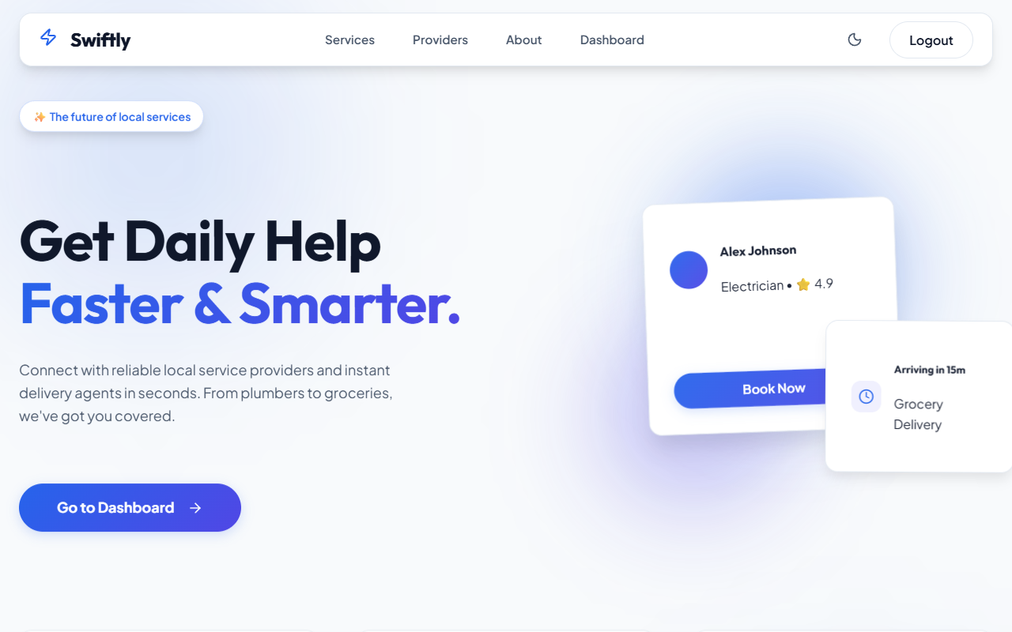
⚡ Swiftly App
MERN Full-Stack Real-Time Service Marketplace

Slide 2
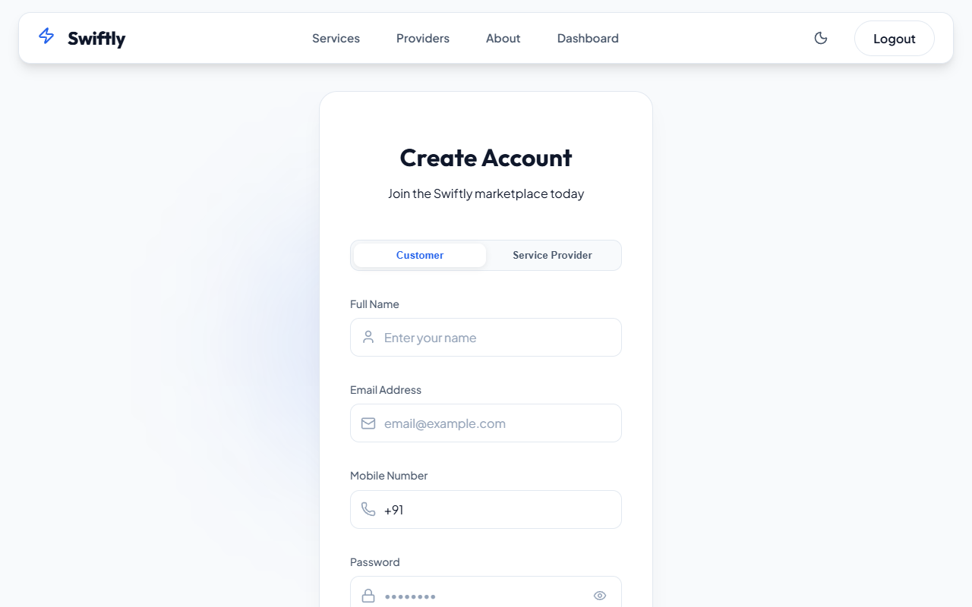
AUTHENTICATION
Secure, Role-Aware Auth
• JWT Token standard
• bcryptjs hashed passwords
• Auto-routing based on Customer vs Provider roles

Slide 3
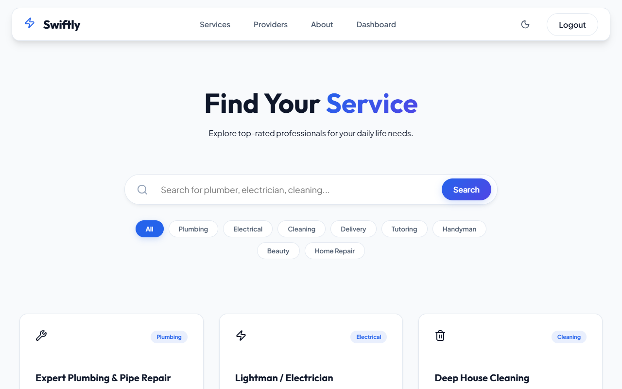
MARKETPLACE
Infinite Service Discovery
Customers can browse categories and dynamically find approved providers ready to accept bookings instantly.

Slide 4
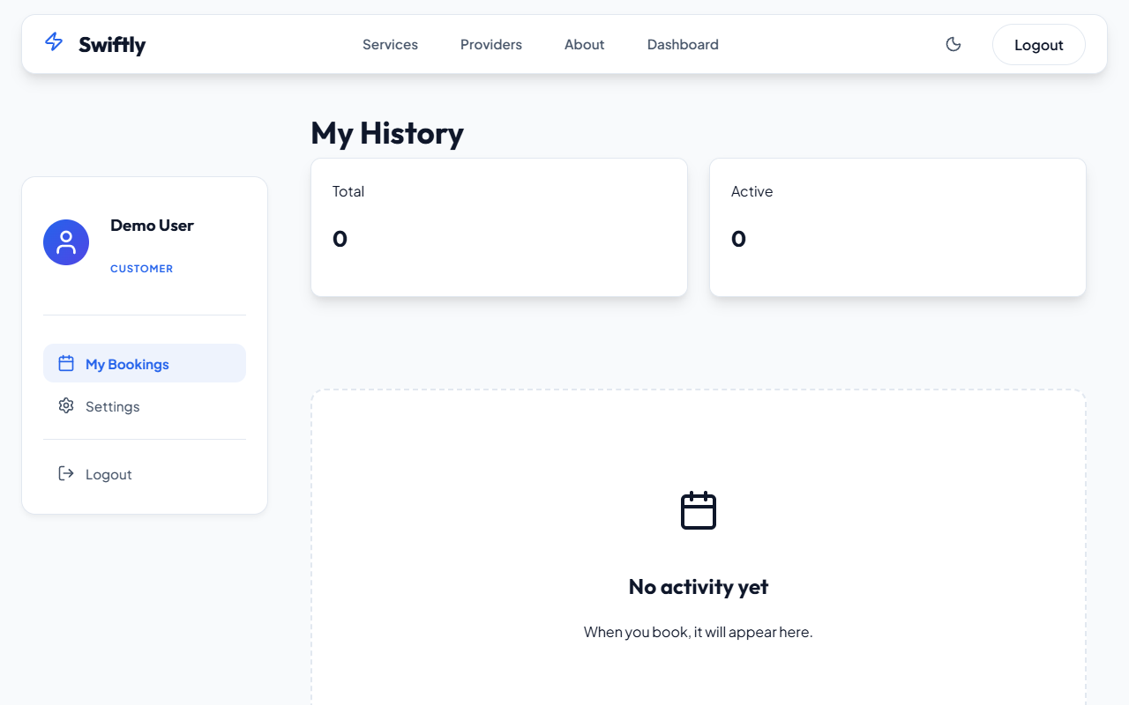
USER DASHBOARD
Real-Time Booking Status
• Live Socket.IO Updates
• Chat integration for active bookings
• Instant state changes (Pending -> Accepted)

Slide 5
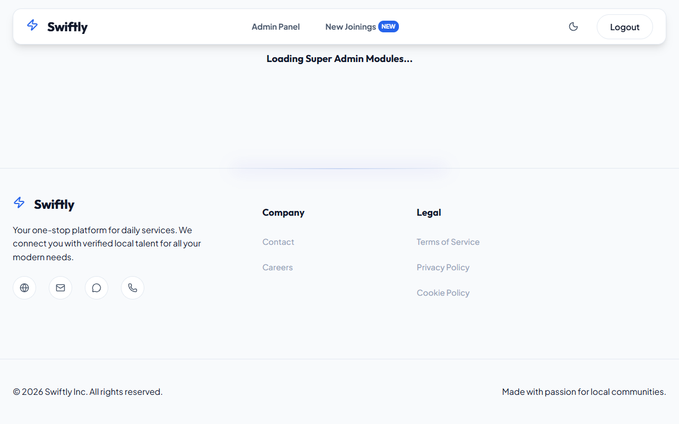
SUPER ADMIN
Bird's-Eye Platform Control
The admin sees live stats (Recharts), manages registered users, and strictly controls provider approvals via the /admin portal.

Slide 6
SYSTEM ARCHITECTURE
Tech Stack & Workflow
Stack: MongoDB, Express, React 19, Node, Socket.IO, Recharts
Workflow: Search -> Book -> Accept -> Chat -> Complete

Slide 7
Designed and created by
Deepak: 2204850100069
Devansh Mishra: 2204850100072
Dheeraj Prajapati: 2204850100069
Manish Kumar Vishwkarma: 22048501000

