Slide 2
Alphabet Encoding
MENTOR : Mrs. Anushree Sah
NAME ENROLL. NO.
ABHISHEK Joshi R610218003
Devansh Raghuvanshi R610218013
GARVIT R610218015
Vaibhav Gandhi R610218027

Slide 3
ABSTRACT
Currently, data security and privacy policy has been regarded as one of the biggest concerns in the era computing. In our project user will securely input data followed by the symmetric-key for the encryption and decryption of data. Cryptography enables the user to encrypt or decrypt the plaintext in a cipher text(or vice versa) to maintain the confidentiality of the data so that the data(plaintext) cannot be compromise. So, this scheme can make users assure about the security of data stored.

Slide 4
INTRODUCTION
To secure the data most of the systems use the combination of techniques, including:
• Encryption- It is used to encode the data in such a way that third party will not be able to
hack that data.
• Decryption- Decryption is the process of transforming data that has been rendered unreadable through encryption back to its unencrypted form.
This we are implementing using three algorithms
Play fair cipher
Rail fence cipher
Caesar cipher

Slide 5
PROBLEM STATEMENT
Currently, data security and privacy policy has been regarded as one of the biggest concerns. The plain text can be easily compromise and it is easily readable. So the confidentiality of data cannot be maintain. Moreover, authentication of users is also an important concern to think about

Slide 6
OBJECTIVE
The primary goal of this project is to provide and simulate an effective solution to face the challenges and solve security issues.
To Design and Implement Symmetric encryption and decryption with four algorithms(Play-Fair cipher, Rail fence cipher, Caesar cipher) through Java language.

Slide 7
Methodology
START
UNDERSTANDING KEY ENCRYPTION AND DECRYPTION
UNDERSTANDING THE FOLLOWING ALGORITHM:
PLAY-FAIR CIPHER
RAIL FENCE CIPHER
CEASAR CIPHER
IMPLEMENT ENCRYPTION TECHNIQUE
IMPLEMENT DECRYPTION TECHNIQUE
END

Slide 8
DFD(LEVEL-0)
Cipher text
Encryption
Decryption
Plaintext
Cipher text
Plain text
key
key

Slide 9
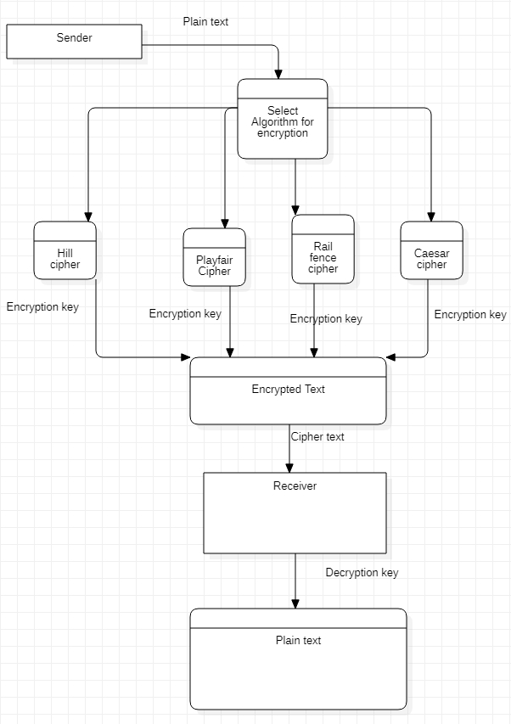
DFD (level-1)

Slide 10
ALGORITHM
Rail Fence cipher
The rail fence cipher is also known as zig-zag. It is a transposition cipher that follows a simple rule for mixing up the characters in the plaintext to form the ciphertext. The rail fence cipher offers essentially no communication security. Although it is weak on its own, but it can be combined with other ciphers, such as a substitution cipher, the combination of which is more difficult to break than either cipher on it's own.
To encrypt a message using the Rail Fence Cipher, we have to write the message in zigzag lines across the page, and then read off each row.
The decryption process for the Rail Fence Cipher involves reconstructing the diagonal grid used to encrypt the message

Slide 11
For Encryption Read row wise
For decryption Read column wise
D |  |  |  | R
 | H |  | E |  | A
 |  | E |  |  |  | J
PLAIN TEXT= DHEERAJ
KEY=3
CIPHER TEXT=DRHEAEJ

Slide 12
Flowchart of Rail fence
START
STOP
(Encryption)
ENTER THE PLAINTEXT
Plaintext=Replace
(plaintext,” “,””)
Output ciphertext
Cipher text=””
Ciphertext=ciphertext + plaintext[i]
LOOP from i=0 to len(plaintext)-1
LOOP from i=1 to len(plaintext)-1
Ciphertext=ciphertext + plaintext[i]

Slide 13
ALGORITHM
Play fair cipher
The Playfair cipher is a symmetric encryption and decryption technique . This technique works upon the pairs of characters instead of single character. It contains base structure of 5 × 5 matrix which consists of 25 cells, with which its uniqueness should be maintained . Although alphabets consists of 26 letters but one of the letters from alphabets (i.e. i/j) will be adjusted in one cell so that all letters in alphabets will cover the cells. 4 rules are used to encrypt the data . And to decrypt the data we use 3 rules to implement this technique which are reverse of encryption. It is used to pass the secret information. Hence with pairing of the words we can convert plain text to cipher text.

Slide 14
R | O | M | A | N
B | C | D | E | F
G | H | I | K | L
P | Q | S | T | U
V | W | X | Y | Z
KEY: ROMAN
PLAINTEXT: INSTRUMENT
Matrix,
PLAINTEXT: INSTRUMENT
AFTER SPLIT: “IN” “ST” “RU” “ME” “NT”
AFTER REPLACING, IN=LM ST=TU RU=NP ME=AD NT=AU
ENCRYPTED MESSAGE: LMTUNPADAU
DECRYPTING, LM=IN TU=ST NP=RU AD=ME AU=NT
DECRYPTED MESSAGE: INSTRUMENT

Slide 15
START
Generate the key Square(5×5) matrix=25 cells
Flowchart of Playfair cipher
Add key in it and fill remaining cells by remaining Alphabhabetic letters.
Input the plain text
If characters of text is even then make pairs of two.
If no then,
If yes then,
Else add a character ‘X’ with the remaing odd.
Use the rules of algorithm to encrypt the data.
Text is converted to cipher text.
END

Slide 16
ALGORITHM
Caesar Cipher
The Caesar Cipher strategy is one of the oldest and least complex strategy for encryption method. It's essentially a sort of replacement figure, i.e., each letter of a given book is supplanted by a letter some fixed number of positions down the letters in order. For instance with a move of 1, A would be supplanted by B, B would become C, etc. The technique is obviously named after Julius Caesar, who clearly utilized it to speak with his authorities.

Slide 17
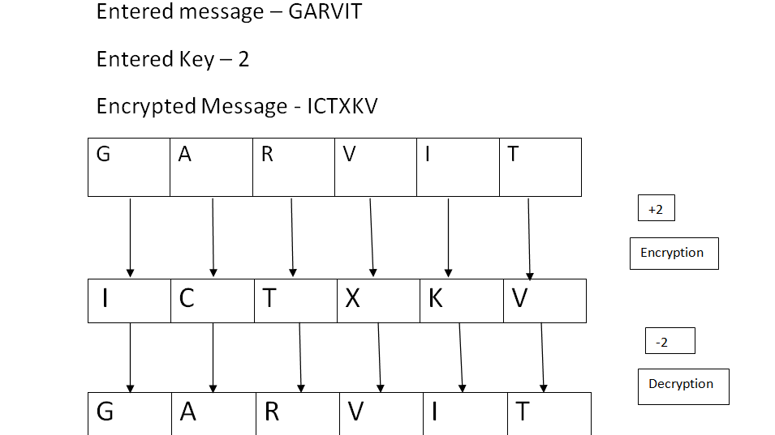

Slide 18
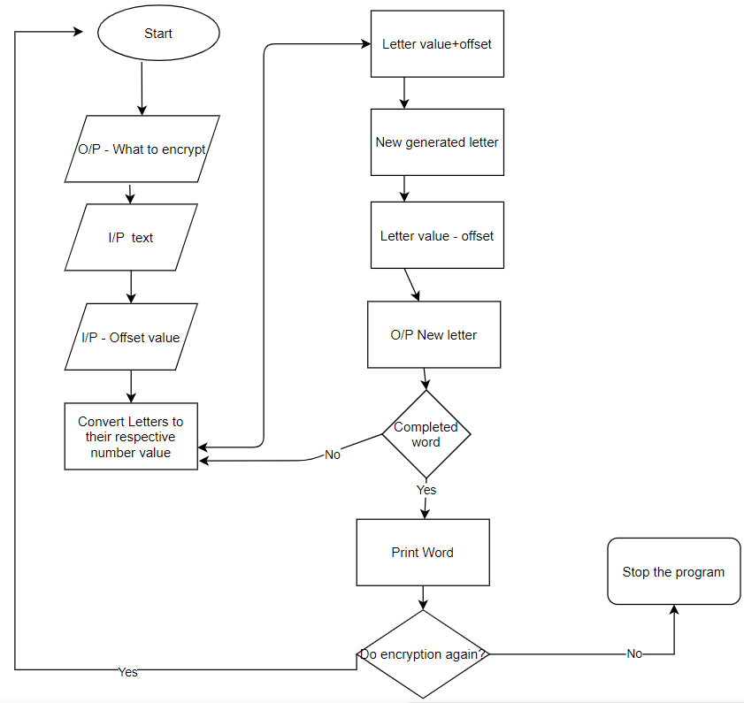
Flowchart of Caesar cipher

Slide 19
FUTURE ENHANCEMENTS
Other algorithms can be taken for encryption and decryption purpose instead of , play fair, rail fence, Caesar cipher.
Different algorithms combinedly used to make a more secured setup.
Different types of keys can be generated to provide more security of data.

Slide 20
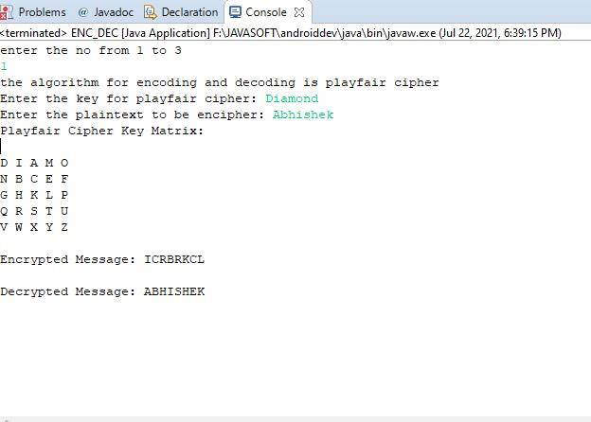
Output

Slide 21
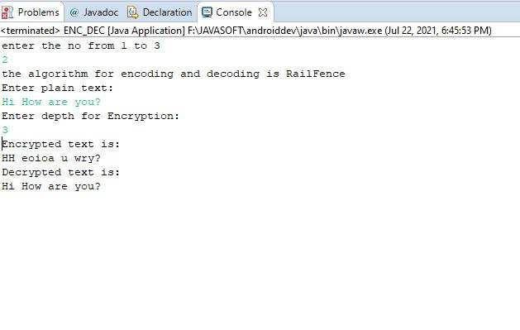

Slide 22
Conclusion
PERFORMACE OR EXECUTION TIME OF ALGORITHMS
CAESAR CIPHER < RAIL FENCE CIPHER < PLAY FAIR CIPHER
Execution Time of Play fair is more .Hence it is harder to break.

Slide 23
References
1. Head First Java 2nd Edition by Kathy Sierra & Bert Bates
2. Cryptography and Nеtwork Sеcurity: Principlеs and Practicе Book by William Stallings

