Slide 1
Presentation on
Identifying Cardiovascular Disorders Through ECG Image Analysis ICC-ROBINS 2024
Authors: Mr. Devansh Rautela Mr. Mohit Bajeli Mr. Anmol Kumar Ms. Himadri Vaidya
Paper ID: ROBIN113

Slide 2
PUBLICATION
D. Rautela, M. Bajeli, A. Kumar and H. Vaidya, "Identifying Cardiovascular Disorders Through ECG Image Analysis," 2024 International Conference on Cognitive Robotics and Intelligent Systems (ICC - ROBINS), Coimbatore, India, 2024, pp. 607-612, doi: 10.1109/ICC-ROBINS60238.2024.10533939.

Slide 3
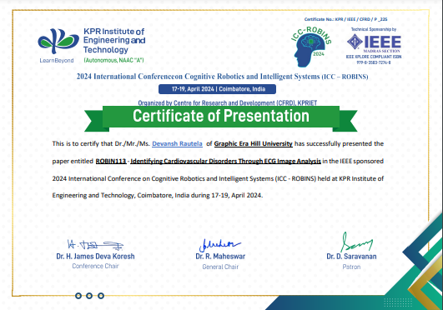
CERTIFICATION

Slide 4


Slide 5
Abstract Introduction Challenges Objective Methodology Result and Impact Conclusion Reference
Outline

Slide 6



ABSTRACT
This research focuses on digitizing paper-based electrocardiogram (ECG) charts to train machine learning models for detecting cardiovascular diseases (CVD), particularly abnormal heartbeat, myocardial infarction, history of myocardial infarction, and normal cases, due to dataset limitations. The digitization involves converting ECG charts into digital formats, allowing advanced data processing and machine learning techniques. Preprocessing steps include Gaussian filtering for noise reduction, thresholding to highlight relevant signals, grayscale conversion for simplicity, and resizing ECG images into a standardized format of 13 leads, subsequently converted into one-dimensional signals for analysis. The study utilizes Support Vector Machine (SVM), K-nearest neighbors (KNN), and Logistic Regression, and proposes an ensemble technique using a Voting-Based Classifier to combine individual predictions, achieving an accuracy of 92.5%, recall of 91%, precision of 92%, and an F1-score of 92%. This approach outperforms existing methods, automating cardiac abnormality detection, reducing manual examination, and leading to faster and more accurate diagnoses, ultimately improving patient outcomes. Despite promising results, limitations include the need for more comprehensive datasets and refining preprocessing and machine learning techniques. In conclusion, digitizing ECG records and applying machine learning can revolutionize CVD detection, providing a valuable tool for early diagnosis and enhanced healthcare.
Index Terms—Electrocardiogram (ECG), Cardiovascular diseases (CVD), Support Vector Machine, Voting Based Classifier.

Slide 7
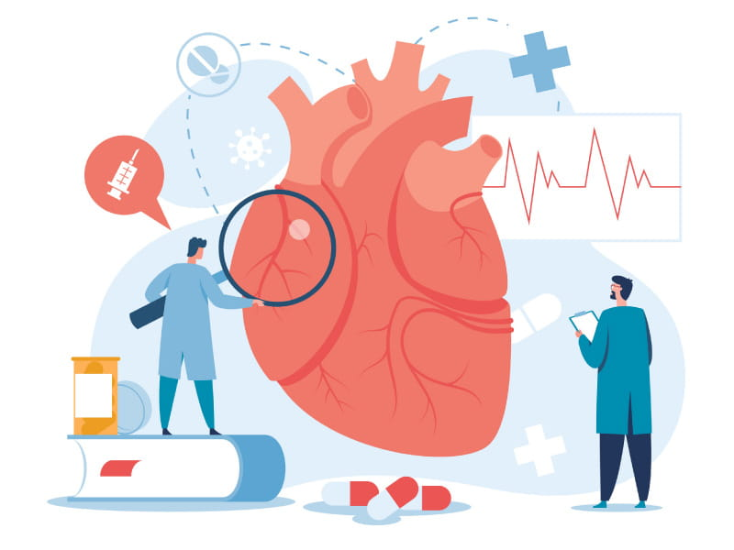
Cardiovascular Diseases(CVDs)
Cardiovascular diseases (CVDs) encompass conditions affecting the heart and blood vessels, classified as non-communicable disorders.
CVDs contribute significantly to global mortality, with an estimated 17.9 million deaths attributed to them, comprising 31% of all global deaths(WHO 2020).
Approximately 85% of CVD-related deaths are attributable to heart attacks and strokes.
Individuals at a heightened risk of CVDs often exhibit elevated blood pressure, glucose levels, and abnormalities in electrocardiogram (ECG or EKG) readings.

Slide 8
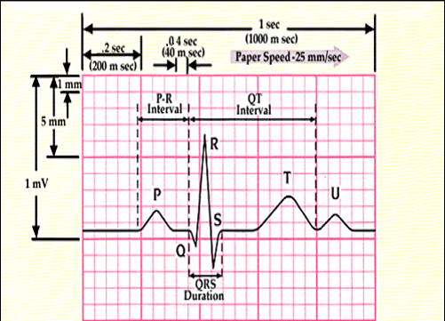
Electrocardiogram(ECG)
An electrocardiogram (ECG) is a diagnostic test that detects the heart's electrical activity by placing sensors on the chest.
Typically, an ECG involves the application of 10 electrode points on the skin.
These electrodes are strategically positioned to create a 12-lead ECG, providing a comprehensive assessment of the heart's electrical conduction.
ECG is quick, painless, and capable of detecting various heart problems.
Early detection of CVDs through ECG enables timely intervention and guided treatment, leading to a reduction in CVD events.

Slide 9

Challenges
Data Collection Challenges: Acquiring diverse ECG datasets with expert-annotated labels poses a significant challenge due to limited availability and the need for specialized knowledge. Imbalanced datasets, where certain conditions are more prevalent, exacerbate the issue, potentially biasing model performance. Techniques such as data augmentation may be necessary to address this imbalance and ensure adequate representation of all classes.
Model Preparation Challenges: Model preparation for ECG analysis involves various hurdles. Preprocessing raw ECG signals is crucial to remove noise and artifacts, enhancing model accuracy. Selecting appropriate machine learning algorithms and optimizing hyperparameters require careful consideration to ensure optimal performance and interpretability. Extracting informative features from ECG signals demands expertise to capture relevant patterns effectively. Balancing model complexity with interpretability and computational efficiency is vital, particularly when handling multiple classes, which may require complex models or ensemble techniques for effective analysis.

Slide 10

Objective
Our project focuses on digitizing electrocardiogram (ECG) records to enhance cardiovascular disease (CVD) detection using machine learning. We aim to develop a system capable of accurately classifying digitized ECG images into various CVD categories. Key emphasis lies on leveraging machine learning techniques to optimize the process. Challenges such as acquiring diverse datasets with expert annotations and addressing data imbalance will be addressed through advanced machine learning algorithms. Preprocessing methods will be applied to refine ECG signals, while feature extraction techniques will capture crucial patterns associated with CVDs. Model selection and optimization will prioritize achieving both high accuracy and interpretability, ensuring clinical acceptance. Ultimately, our goal is to create a reliable system capable of early and precise CVD detection through digitized ECG records, thereby facilitating timely intervention and improving patient outcomes.

Slide 11
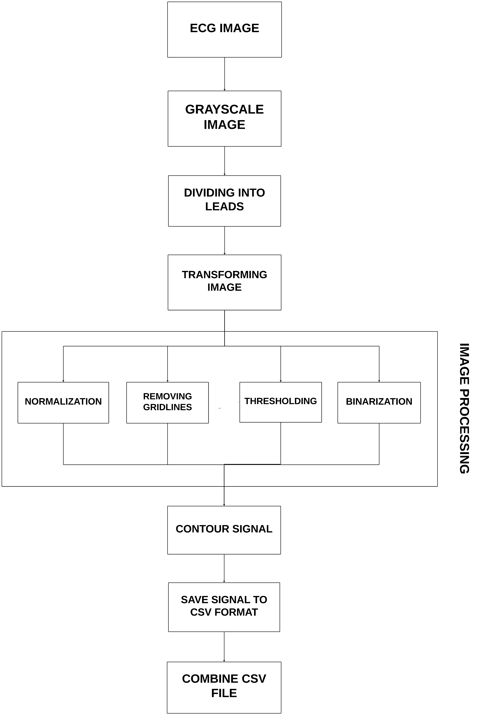
Methodology
Methodology Overview:
The methodology aims to interpret ECG images for cardiovascular disease detection through dataset preparation, preprocessing, and machine learning.
Dataset Description:
A comprehensive dataset sourced from reputable institutions includes annotated ECG images categorized into four classes : Myocardial Infarction, Abnormal Heartbeat, Normal, History of MI.
Image Preprocessing Techniques:
Grayscale conversion, image validation, Gaussian filtering, and thresholding enhance ECG image quality.
Lead Extraction:
The ECG image is divided into 13 leads for comprehensive cardiac information capture.

Slide 12
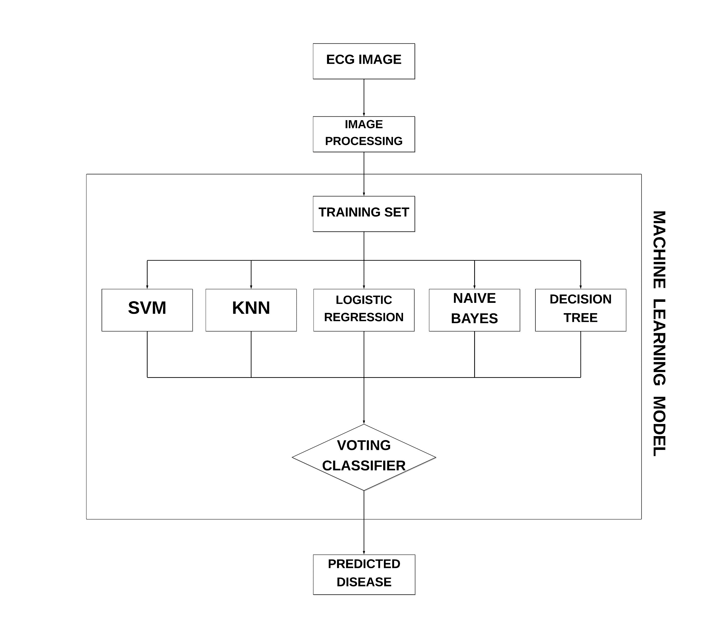
5. Model Selection:
Ensemble technique utilized to enhance accuracy of cardiovascular disorder classification from ECG images.
Models incorporated into the ensemble: SVM, KNN, RF, Bayes, Logistic Regression.
6. Ensemble Technique: Voting Classifier:
Voting classifier combines predictions of individual models, considering probability of each class.
Ensemble method leverages strengths of multiple algorithms to mitigate weaknesses of individual models.
Demonstrated efficacy with 92.47% accuracy, showcasing precise identification of cardiovascular disorders.
7. Evaluation Process:
Used an extracted dataset containing disorder classifications.
Tested model's ability to predict correct disorder classifications in ECG images.
Evaluation involved comparing model's predictions with ground truth labels.
Model's performance determined by prediction error; lower error indicates higher accuracy.
Accuracy calculated as probability of correctly predicting disorder classification.

Slide 13
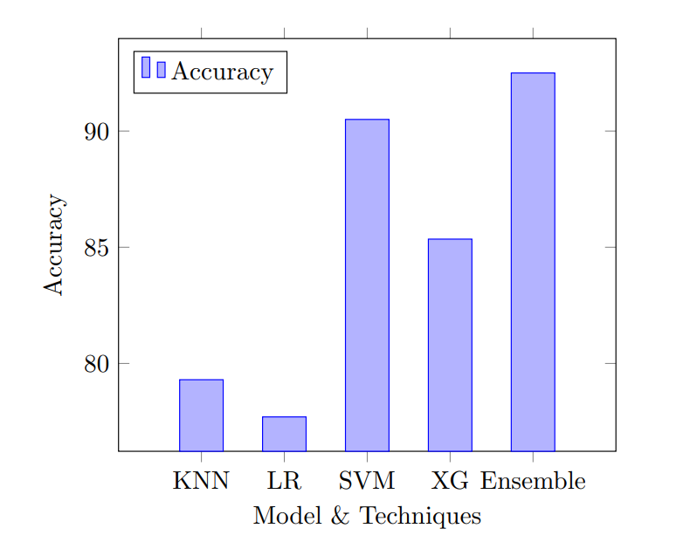
Result and Impact
Performance Comparison:
Combined 12-lead data yields superior accuracy compared to single lead data alone.
Voting-based ensemble classification achieves an impressive accuracy of 92.5%.
Three machine learning models (KNN, SVM, Random Forest) combined and voted for highest accuracy.
Significant improvement over individual models' accuracies: SVM (90.5%), KNN (79.3%), Logistic Regression (77.7%), XGBoost (85.3%).
Ensemble Approach:
Illustrates how ensemble models balance weaknesses and enhance detection of cardiovascular disorders in ECG data.
Makes detection more reliable and accurate.

Slide 14
Conclusion
In conclusion, our study highlights the consistently robust performance of SVM, especially with the combined 12-leads dataset, showcasing improved prediction capabilities. Integration of ensemble models via Voting Classifier further enhances performance by balancing individual weaknesses and strengths. Utilizing pre-processed ECG data, SVM and XGBoost achieve commendable accuracy. Refined datasets can aid in further development, potentially leveraging deep learning models. Ethical considerations, including data privacy and bias mitigation, are crucial in interpreting and deploying these models for cardiovascular disease detection. Real-time validation underscores their practical efficacy in clinical scenarios, offering promising prospects for application in cardiovascular disorder identification through ECG image analysis.

Slide 15
Reference
ECG Images dataset of Cardiac and COVID-19 Patients by Ali Haider Khan et al.
Source: https://doi.org/10.1016/j.dib.2021.106762
Comparative Study on Heart Disease Prediction Using Feature Selection Techniques on Classification Algorithms by Kaushalya Dissanayake et al.
Source: https://doi.org/10.1155/2021/5581806
Prediction of Heart Disease Using a Combination of Machine Learning and Deep Learning by Rohit Bharti et al.
Source: https://doi.org/10.1155/2021/8387680
Cardiovascular Diseases by World Health Organization (WHO)
Source: https://www.who.int/health-topics/cardiovascular-diseases/#tab=tab_1}

