Slide 1
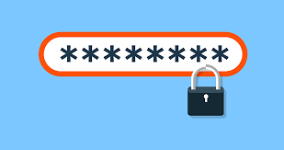
RANDOM PASSWORD GENERATOR
USING PYTHON

Slide 2

WHY IS PASSWORD NEEDED?

Slide 3
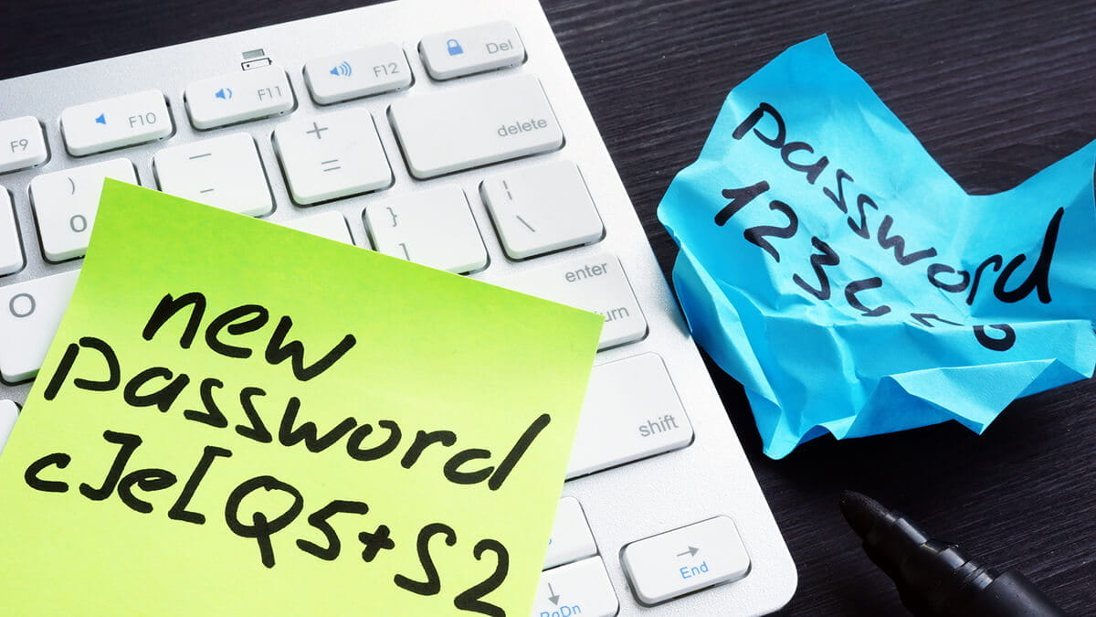
PASSWORD
Password provides the first line of defence against unauthorized access to your computer and personal information. The stronger your password, the more protected your computer will be from hackers and malicious software. You should maintain strong password for all accounts on your computer.

Slide 4
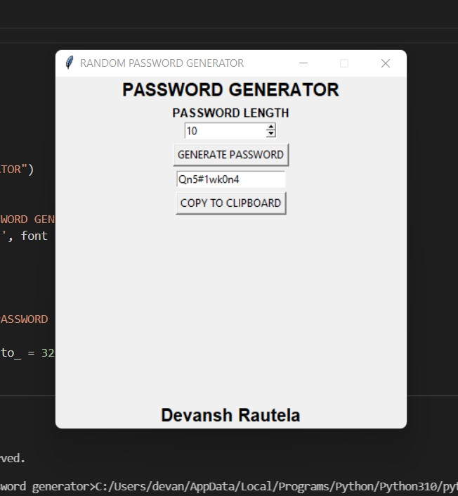
RANDOM PASSWORD GENERTOR

Slide 5

RANDOM PASSWORD GENERATOR
It is a tool that generates passwords based on the given guidelines that you set to create an unpredictable strong password for your accounts.
The Password generator tool creates a random and customized password for users that helps them to create a strong password which provides greater security.

Slide 6

PYTHON LIBRARIES USED
TKINTER
PYPERCLIP
RANDOM
STRING

Slide 7
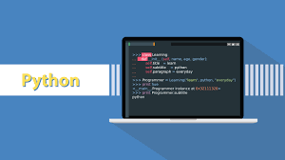
PYTHON LIBRARIES
TKINTER
It is a standard GUI library and is one of the easiest ways to build a GUI application.
PYPERCLIP
This module allows us to copy and paste text to and from the clipboard to you computer.
RANDOM
This module can generate random numbers.
STRING
This module contains a number of functions to process the standard python string.

Slide 8
PROJECT STRUCTURE
IMPORT MODULES
INITIALIZED WINDOW
SELECT PASSWORD LENGTH
DEFINE FUNCTION

