Slide 1

Web Development
Devansh Rautela
Univ. Roll no. 2018314
Roll no. 20
Section – C
Course – B-Tech CSE

Slide 2

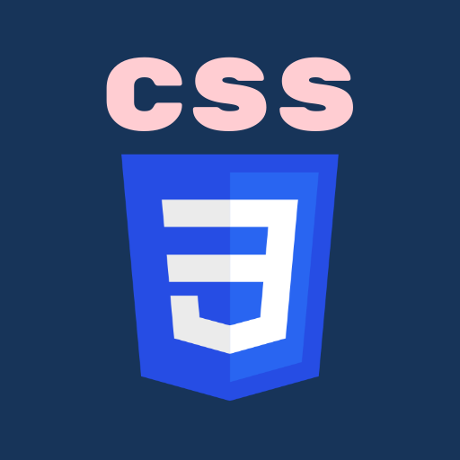

Web Development
Web development refers to the building, creating, and maintaining of websites. It includes aspects such as web design, web publishing, web programming, and database management. It is the creation of an application that works over the internet i.e. websites.

Slide 3
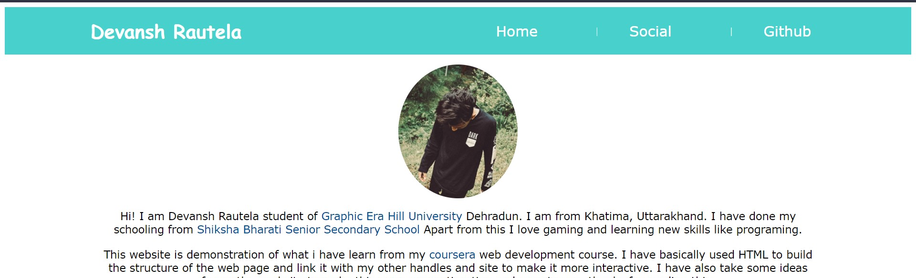
PROJECT
This is a trial project to show what I am learn till now from this web development course. I will further improve this project with the progress in my web development course.

Slide 4
WHAT IS HTML?
The HyperText Markup Language or HTML is the standard markup language for documents designed to be displayed in a web browser. It can be assisted by technologies such as Cascading Style Sheets (CSS) and scripting languages such as Javascript.
Web browsers receive HTML documents from a web server or from local storage and render the documents into multimedia web pages. HTML describes the structure of a web page semantically and originally included cues for the appearance of the document.
HTML elements are the building blocks of HTML pages. With HTML constructs, images and other objects such as interactive forms may be embedded into the rendered page. HTML provides a means to create structured documents by denoting structural semantics for text such as headings, paragraphs, lists, links, quotes and other items

Slide 5
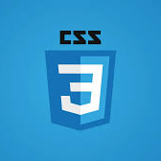
CSS
Cascading Style Sheets (CSS) is a stylesheet language used to describe the presentation of a document written in HTML or XML (including XML dialects such as SVG, MathML or XHTML). CSS describes how elements should be rendered on screen, on paper, in speech, or on other media.
CSS is among the core languages of the open web and is standardized across Web browsers according to W3C specifications. Previously, development of various parts of CSS specification was done synchronously, which allowed versioning of the latest recommendations. You might have heard about CSS1, CSS2.1, CSS3. However, CSS4 has never become an official version.

Slide 6

JAVASCRIT
JavaScript is a text-based programming language used both on the client-side and server-side that allows you to make web pages interactive. Where HTML and CSS are languages that give structure and style to web pages, JavaScript gives web pages interactive elements that engage a user. Common examples of JavaScript that you might use every day include the search box on Amazon, a news recap video embedded on The New York Times, or refreshing your Twitter feed.

Slide 7
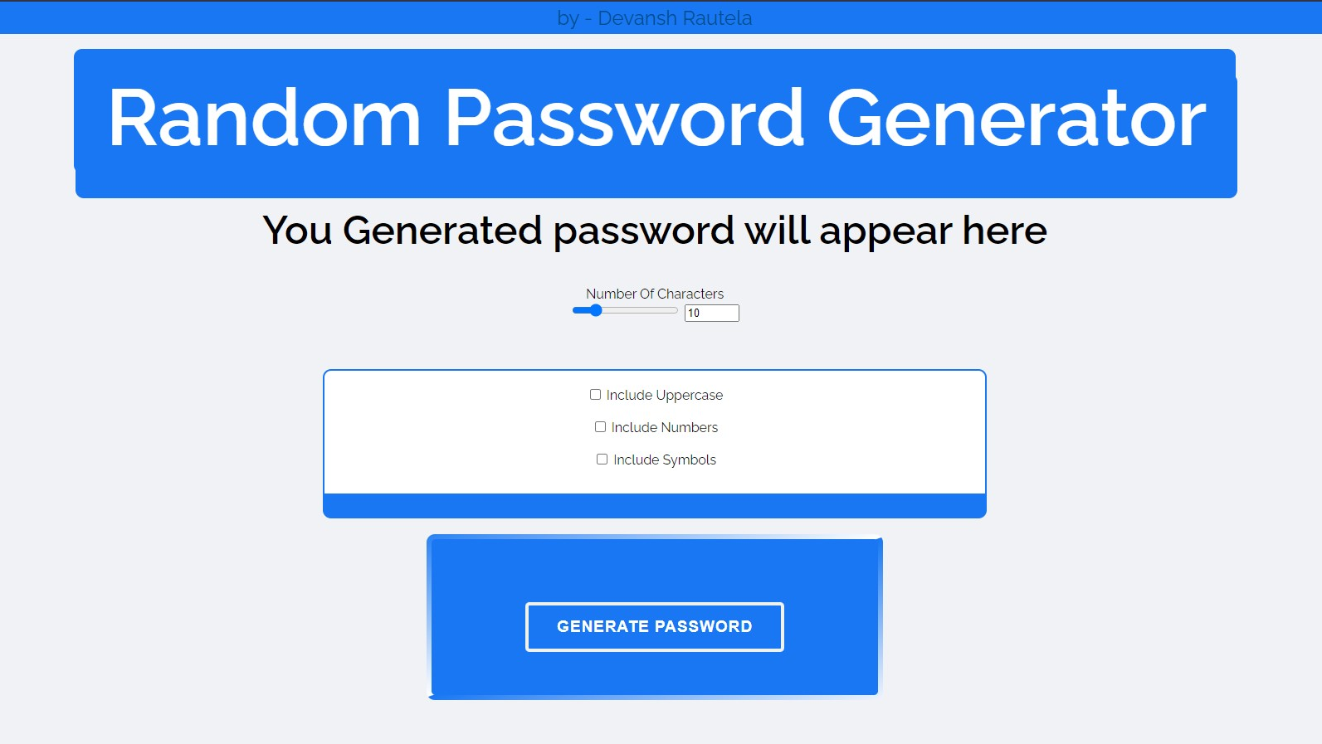
Random Password Generator
This is a basic MOOC seminar project which is a random password generator which use HTML, CSS and JavaScript.
And Math.random() libraries for the algo of generating randomize characters.
And other CSS function to make it more interactive and functionable.
Github link : https://github.com/devanshrautela/web-development

Slide 8


Thank You
DEVANSH RAUTELA
SECTION – C
ROLL NO. – 20
UNIV. ROLLNO. – 2018314
STUDENT ID - 200111158

