Slide 1

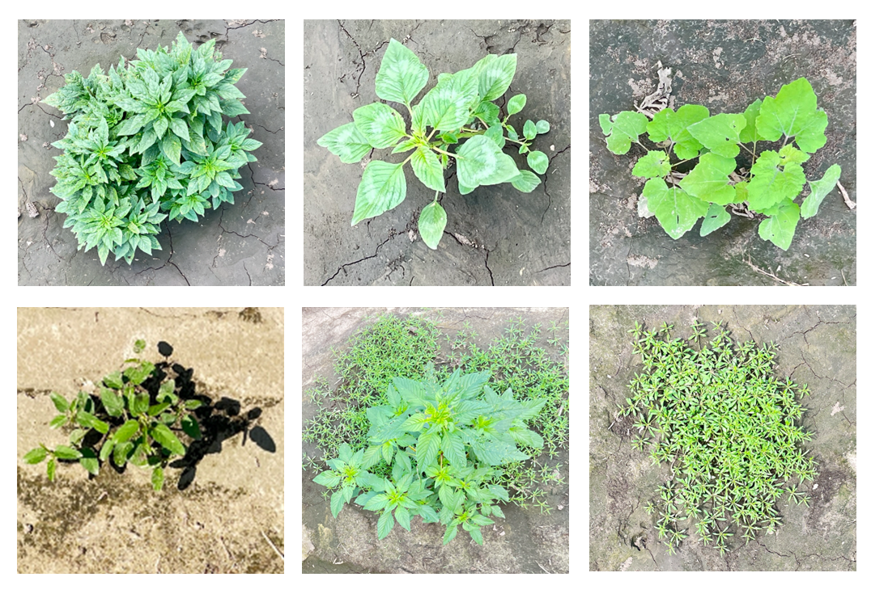
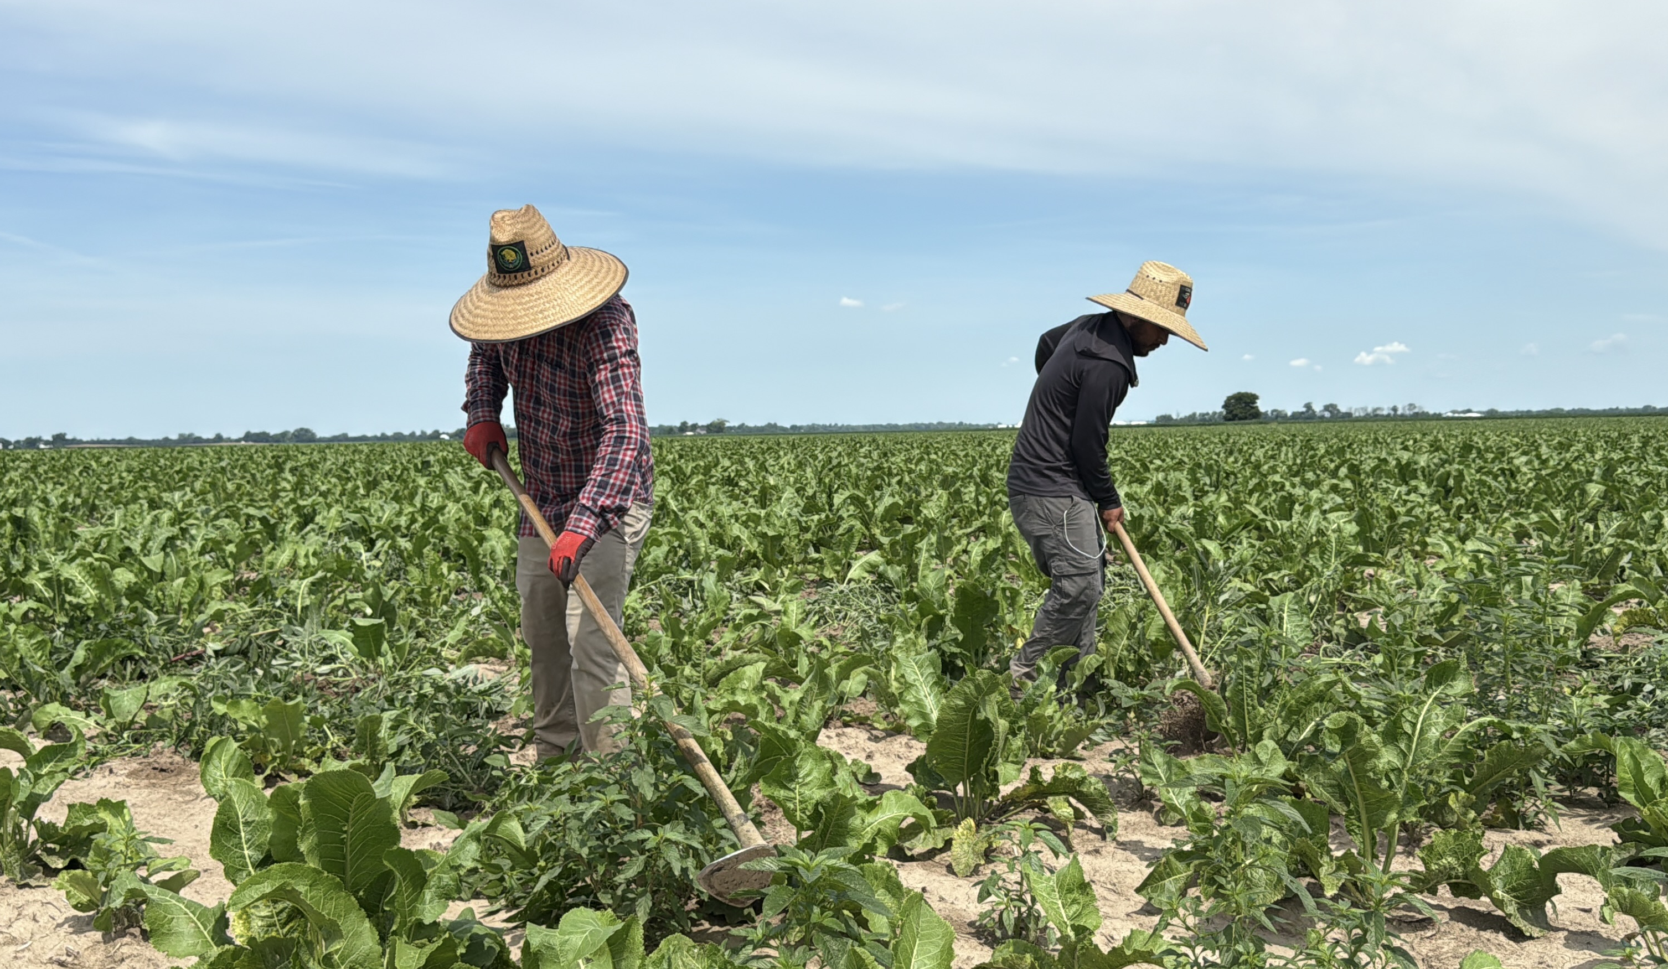
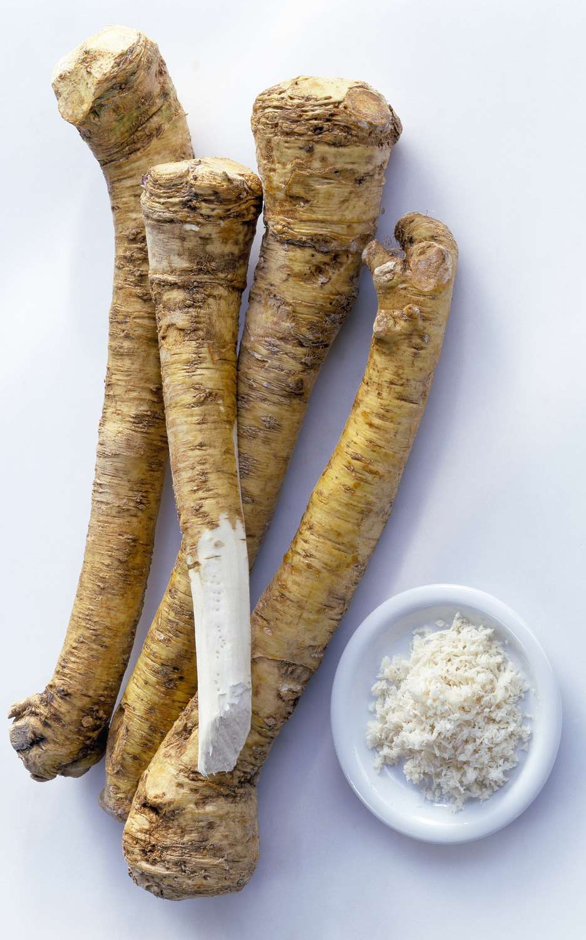
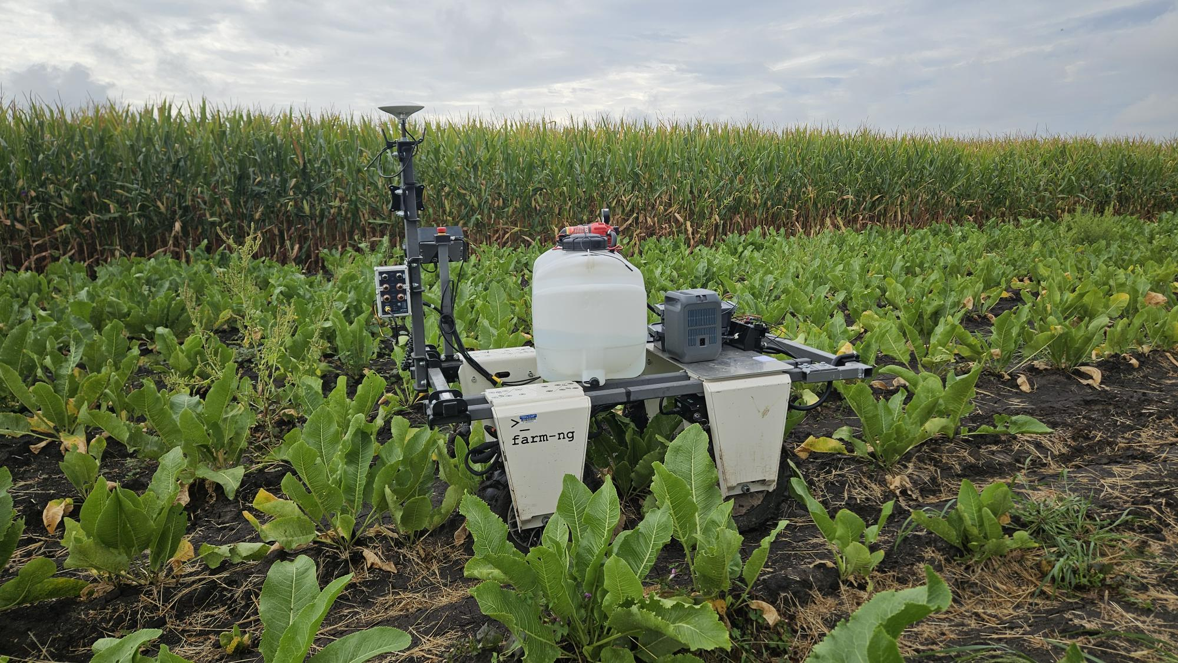
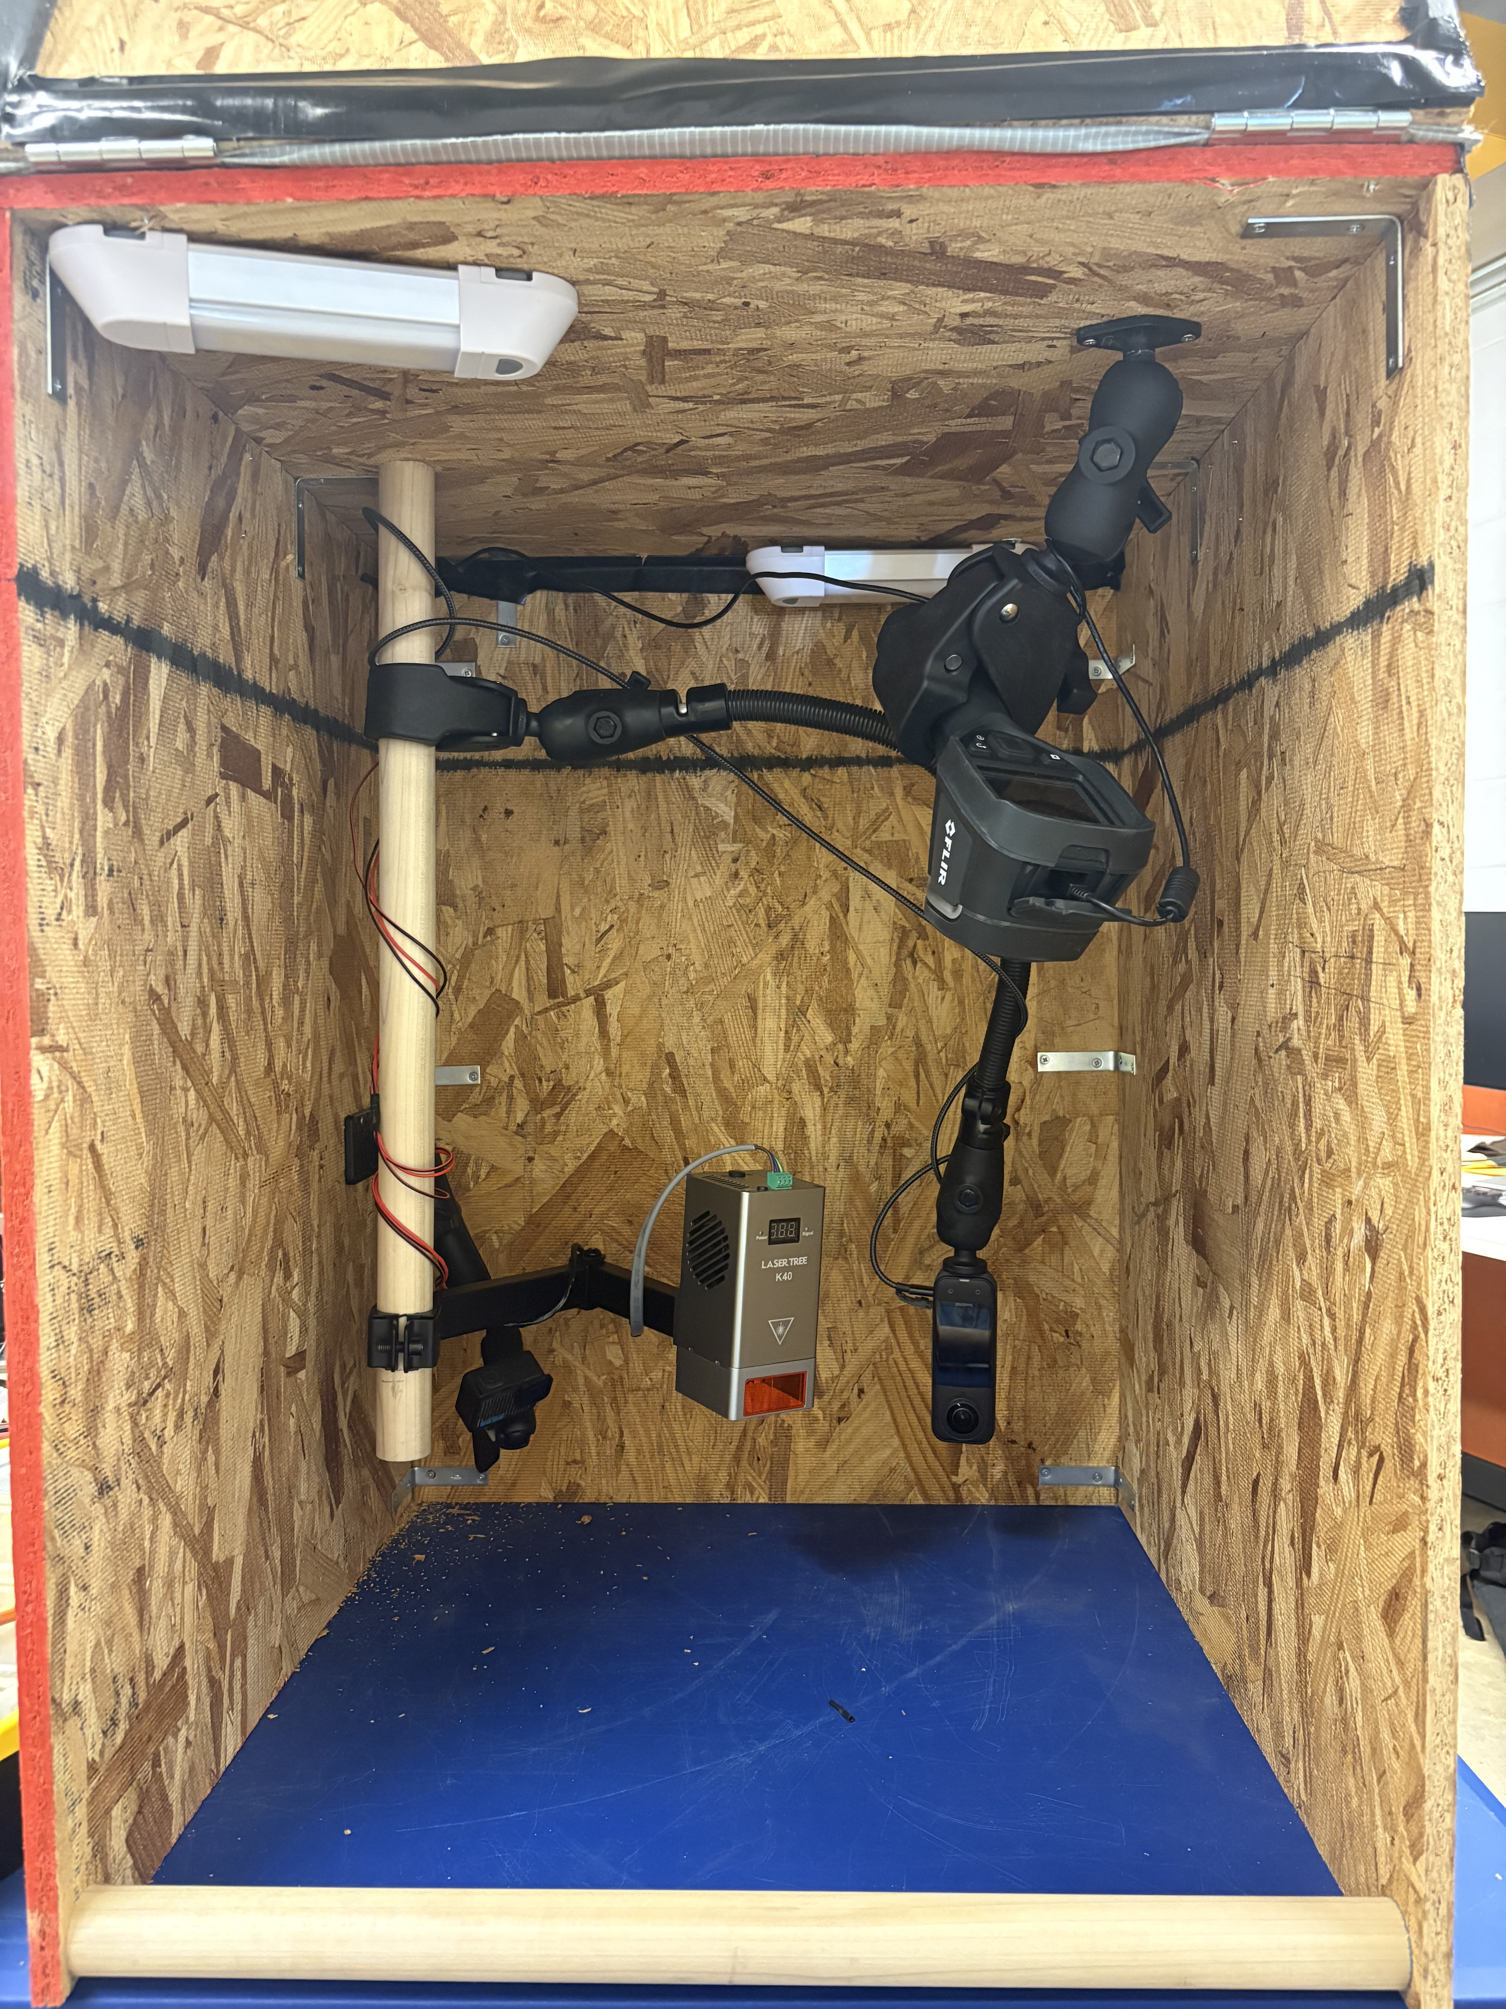
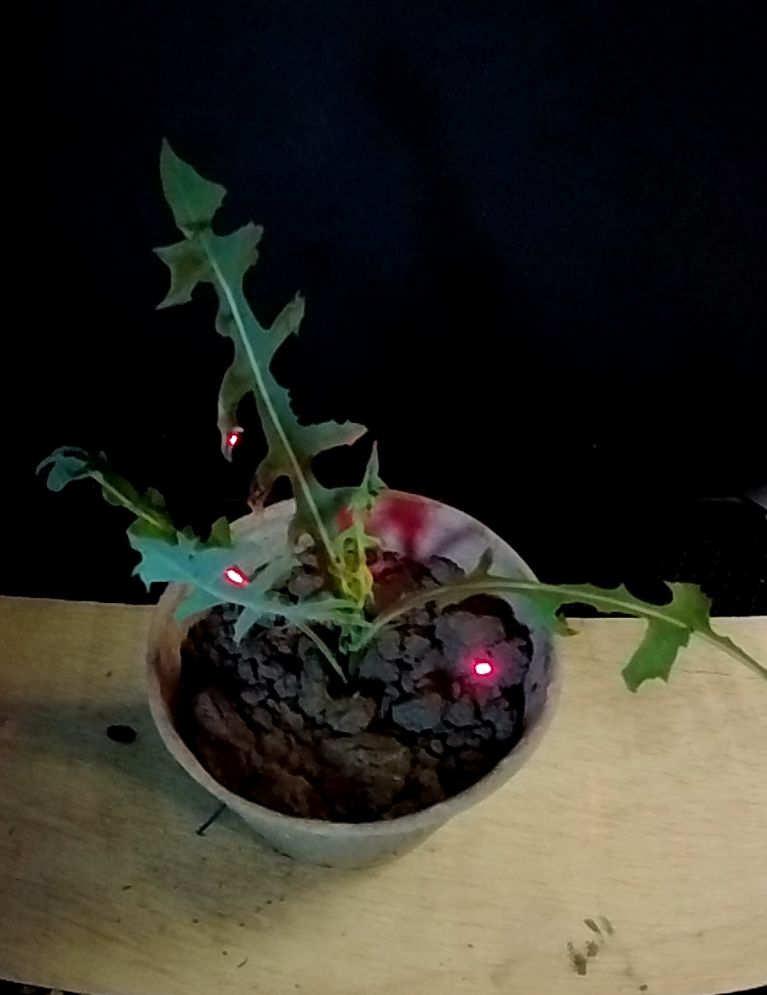
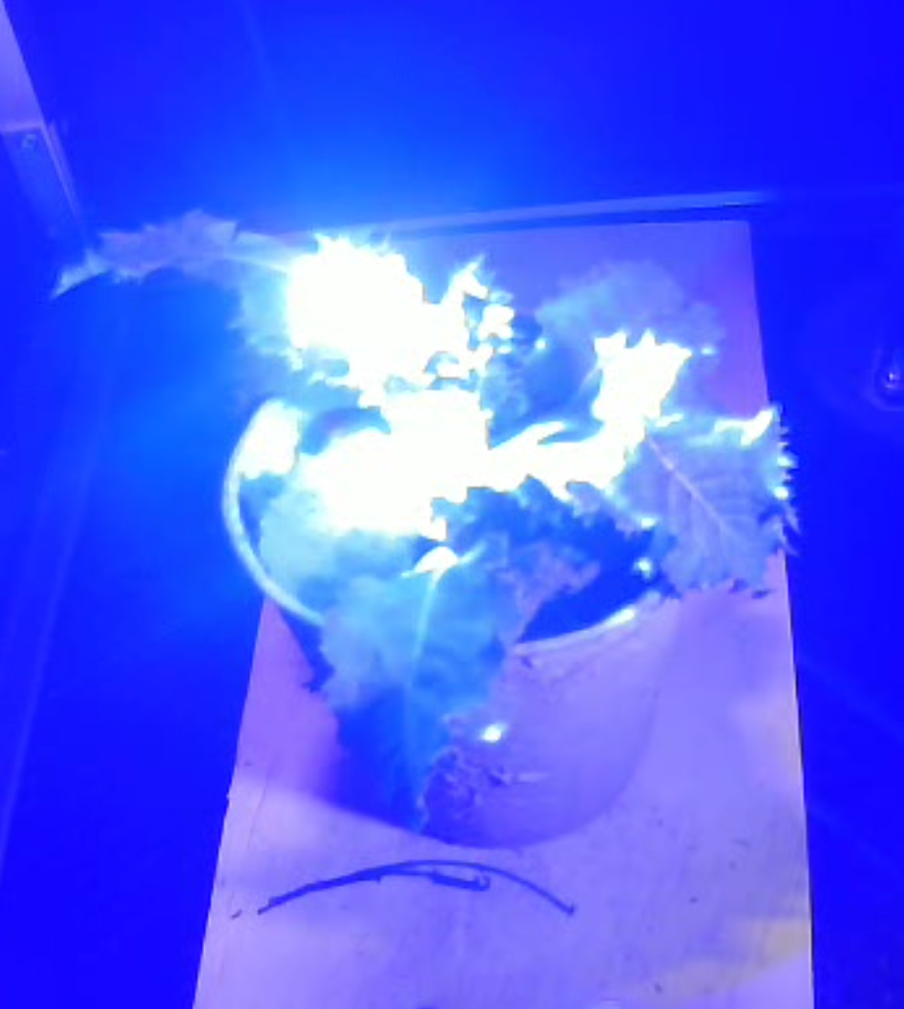
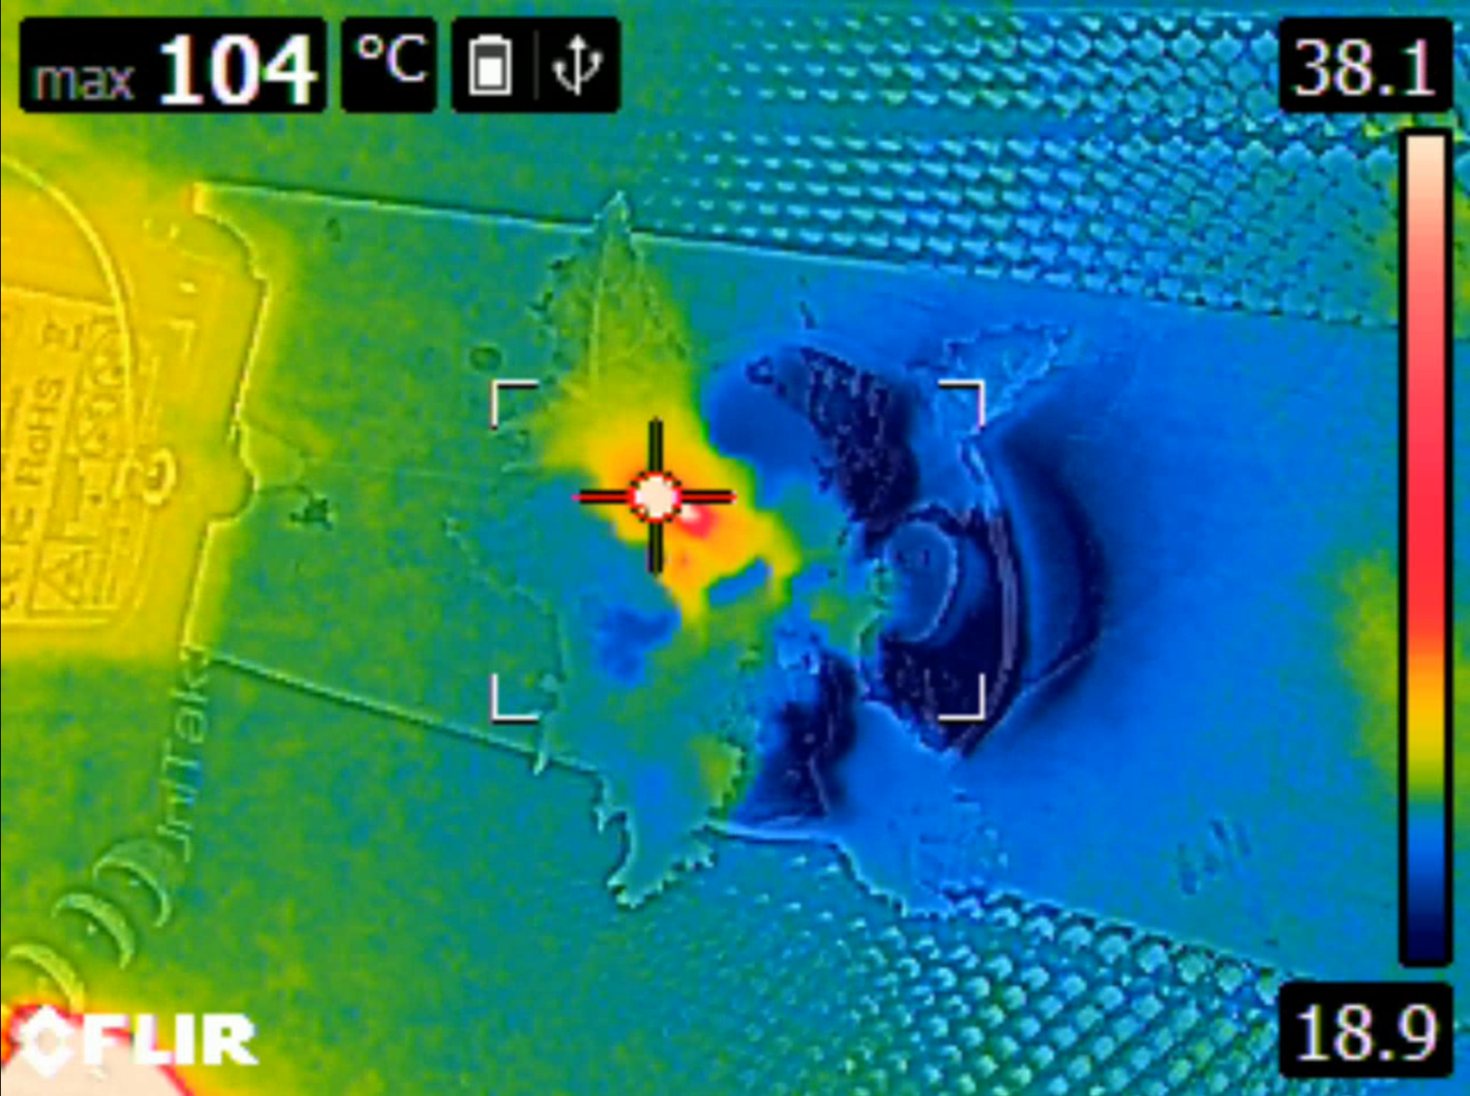
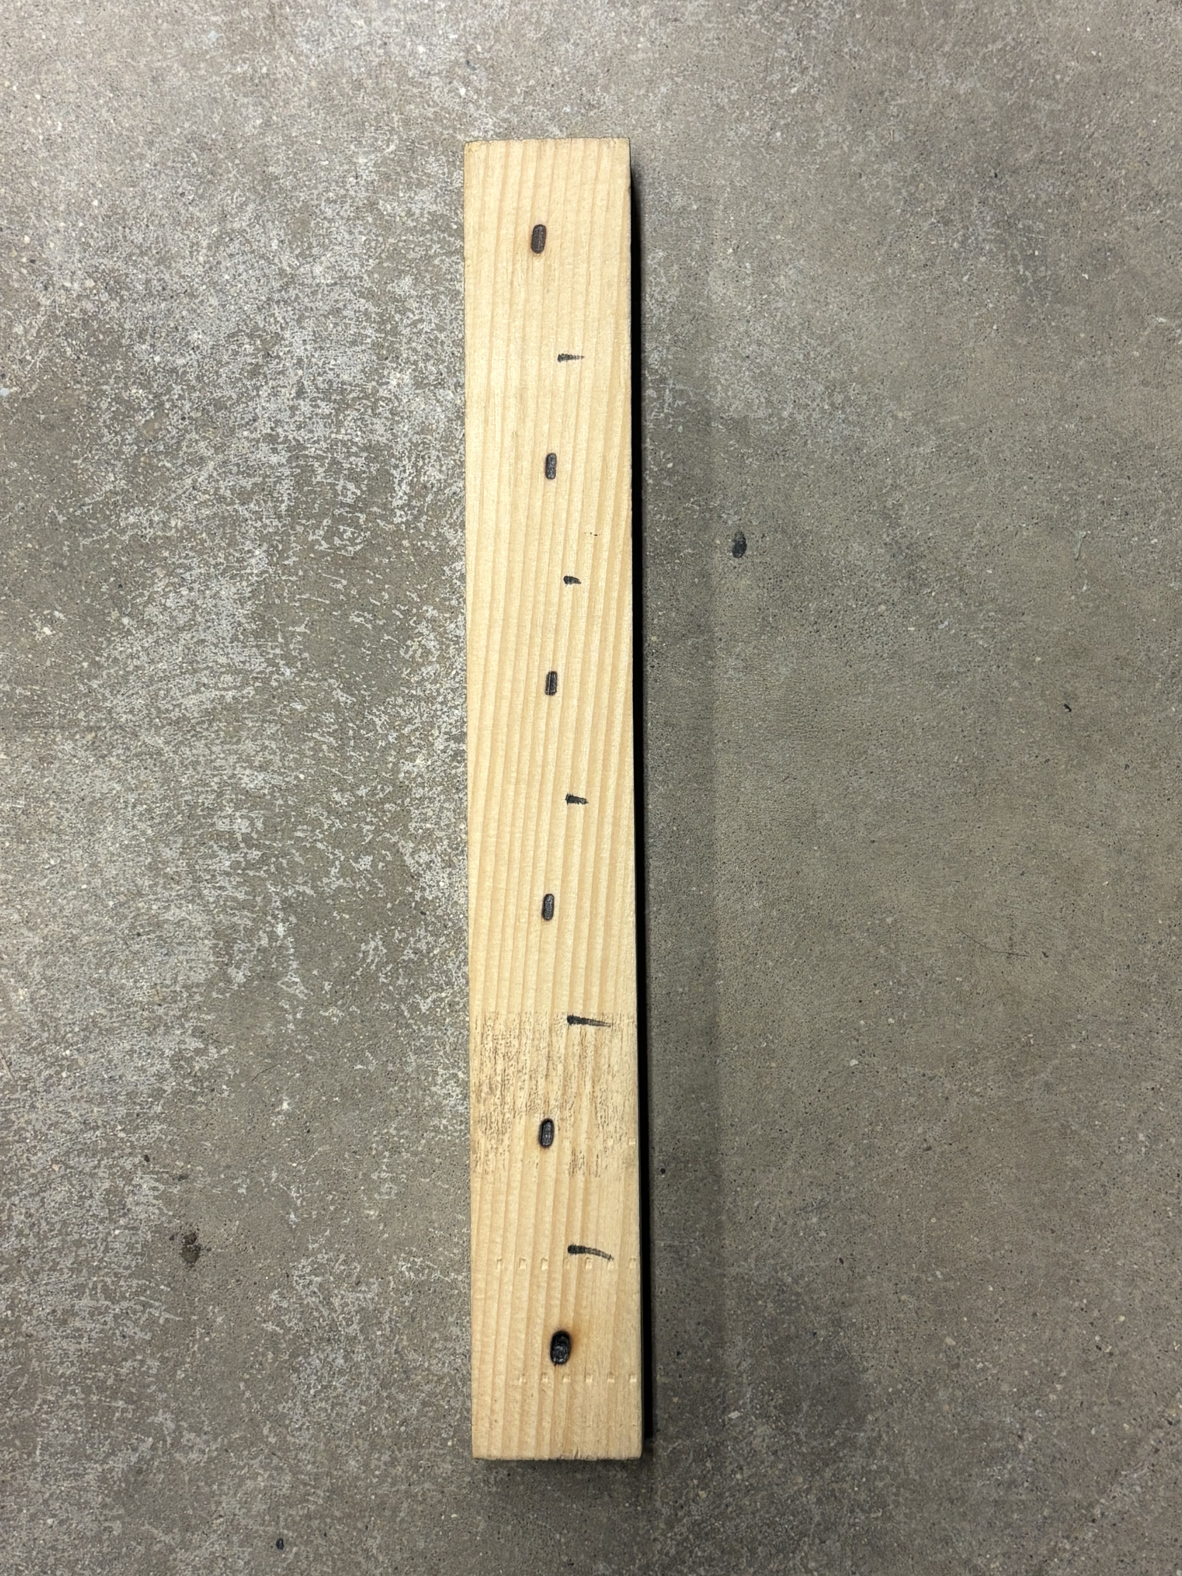
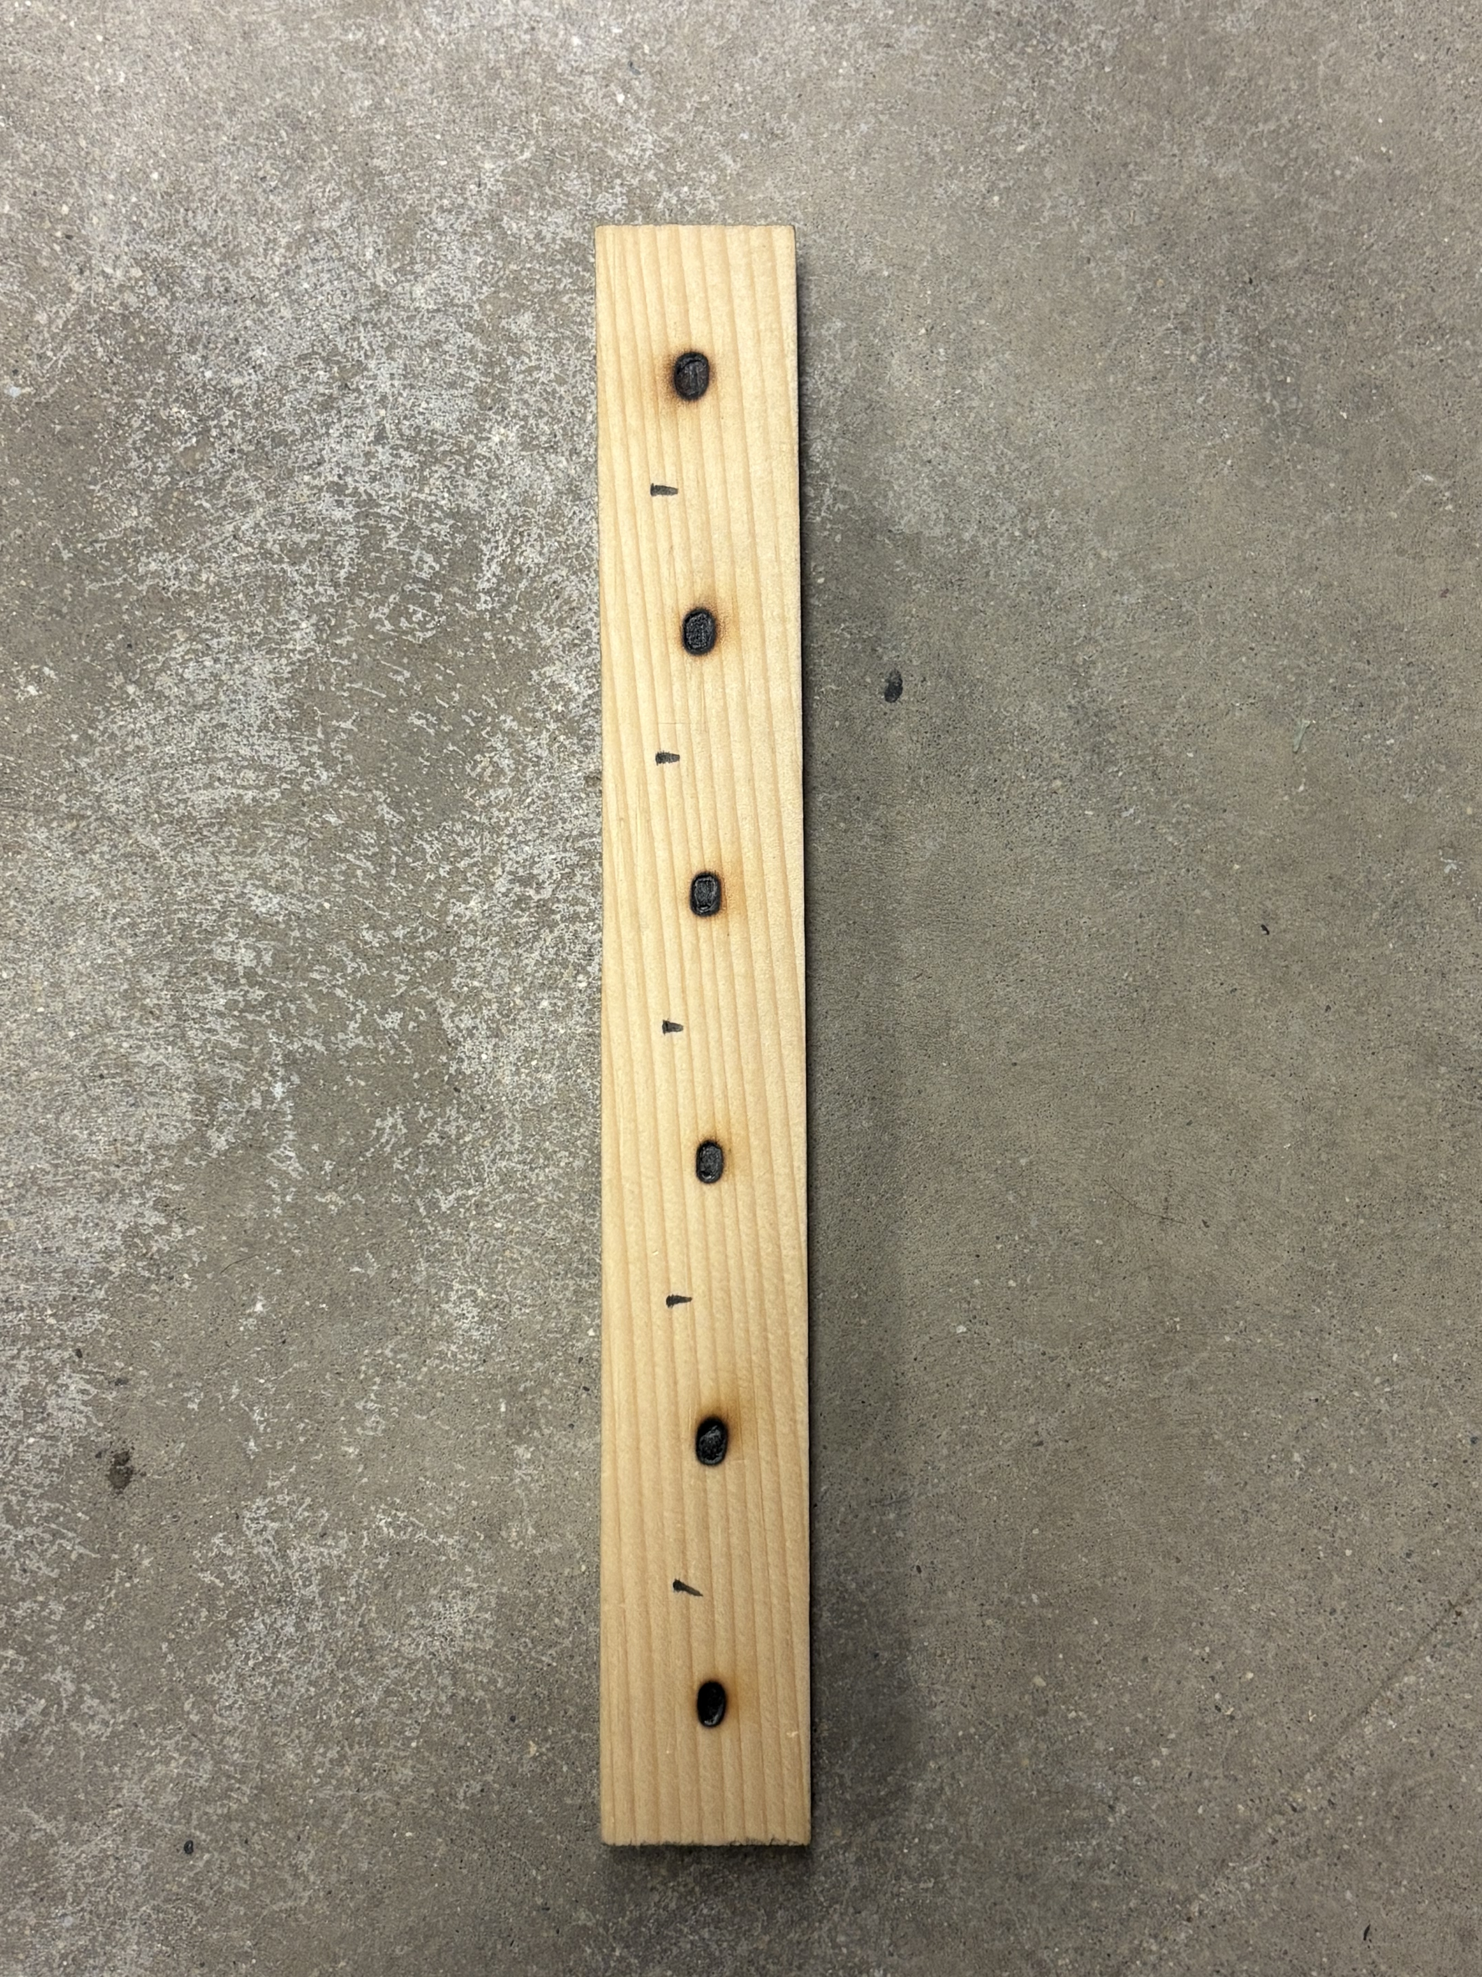

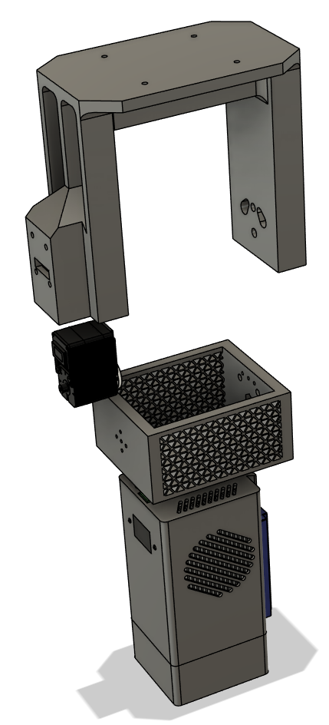
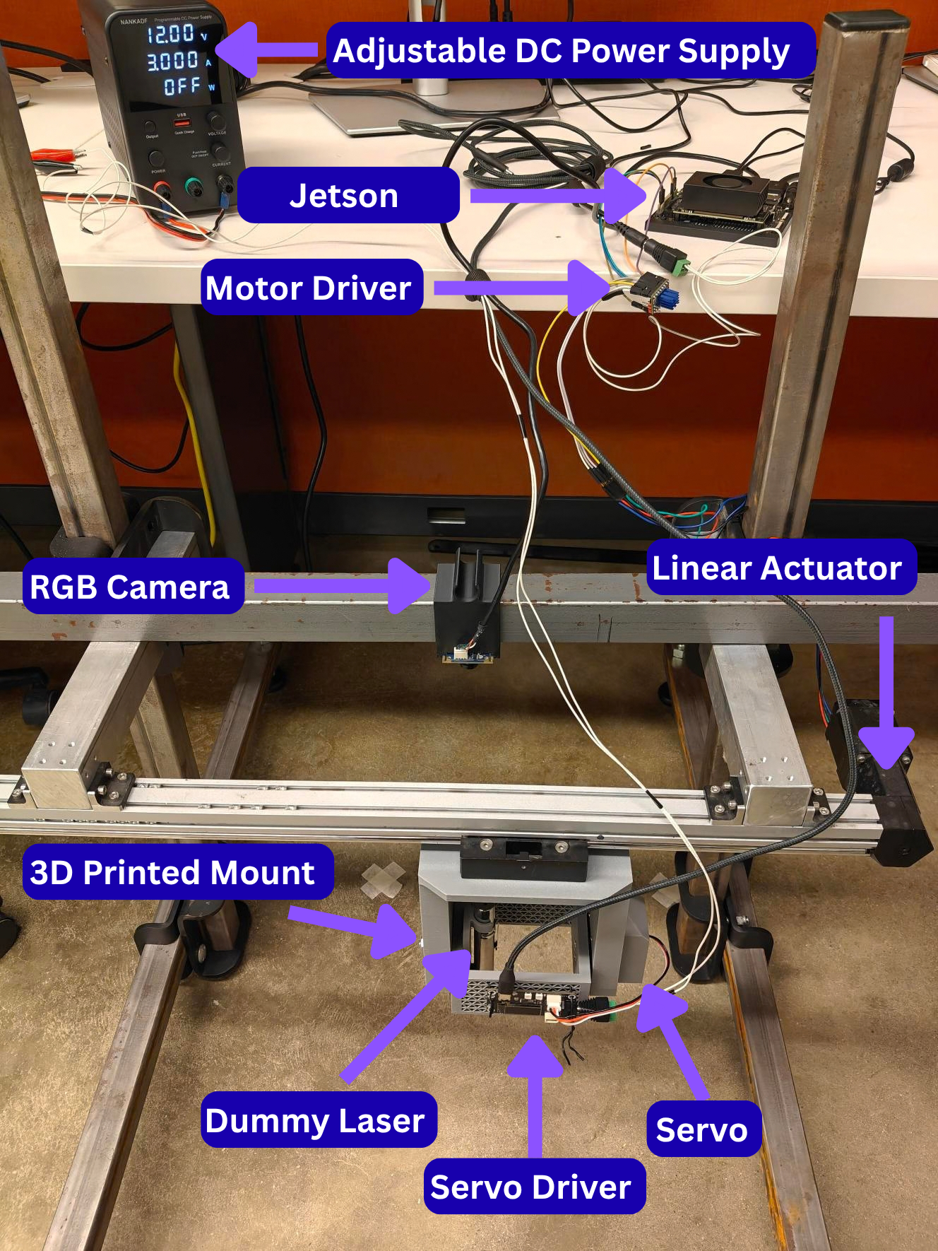
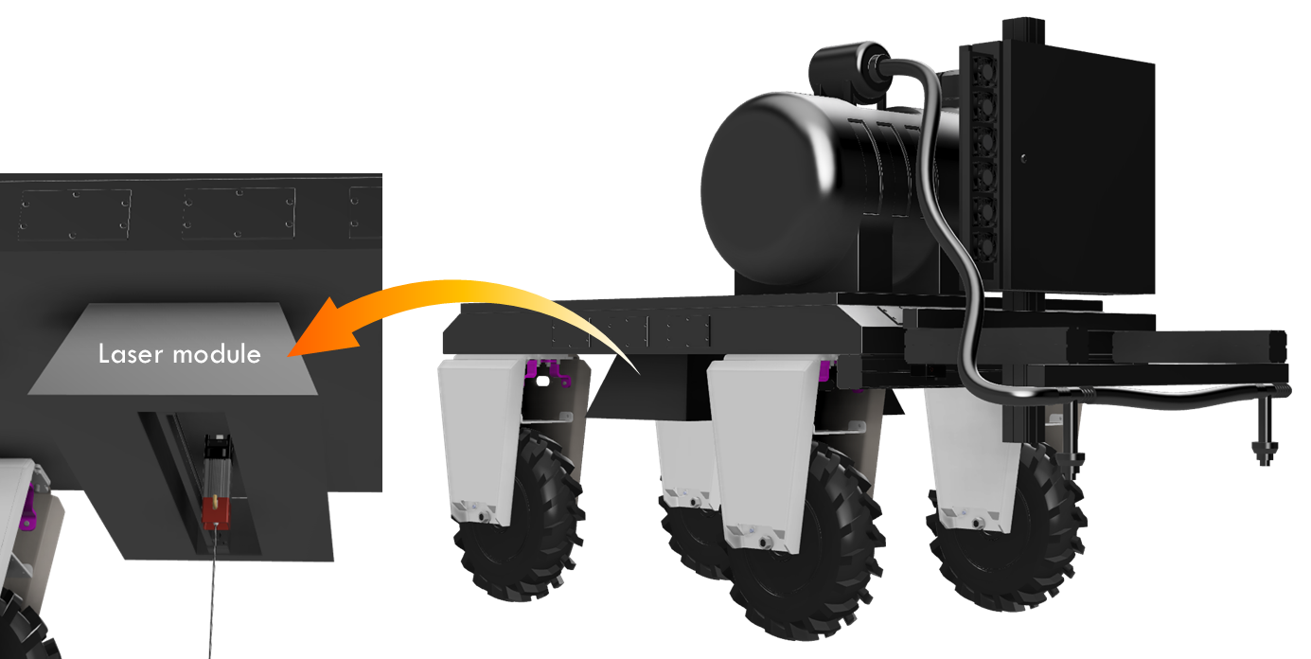






SYMPOSIUM OF DIGITAL AGRICULTURE - 2026
Development of a low-cost modular laser weed management for specialty crops
Devansh Rungta ^{1,2}, Seth Van Hoveln ², Sunoj Shajahan²
¹ Agricultural & Food Engineering Department, Indian Institute of Technology, Kharagpur, India
² Agricultural and Biological Engineering, University of Illinois Urbana-Champaign, Illinois
Abstract
Background & Motivation
Challenge: Weed control in specialty crops (e.g., horseradish) is constrained by limited labor and crop sensitivity.
System design: Low-cost, modular laser setup combining real-time computer vision with precision actuation.
Hardware: Embedded computing platform driving a servo and linear actuator for targeted laser positioning.
Testing and Integration: Validating motion control on a confined testbed prior to mounting on a Farm-ng Amiga platform.
Key benefit: Reduces chemical use, minimizes soil disturbance, and easily adapts across different crops.
Horseradish – root vegetable
Weed management is a challenge.
Almost all weed species are present.
Manual weeding is labor-intensive, costly, and limited by labor availability.
System Overview
Benchtop laser testing
Safety enclosure - 40 W laser housed in a wooden safety box for controlled experimentation.
Visual monitoring - RGB and thermal cameras track the target area and thermal response in real time.
Real-time positioning - Precise weed positioning for consistent laser alignment.
Pre-deployment safety - Validates vision-to-actuation pipeline in lab before field tests.
Farm-ng Amiga-NG platform in a horseradish field, serving as the target mobile platform for future integration of the modular laser weed-management system.
Current Progress & Next Steps
Enclosed laser box for benchtop testing
Current progress
Perception – Utilizing a custom-trained AI weed-detection model.
Targeting and actuation – Bench-testing laser safety and servo-linear actuator positioning.
Optimize operation – Perform tests with power and time to identify weed burn intensities
Modular Design – Developing standalone units prior to mobile platform mounting.
Next steps
System integration – Combine the vision, targeting, and laser-control components into a unified system.
Platform integration – Mount the modular laser unit onto the Farm-ng Amiga and establish communication with the mobile platform.
Targeting validation – Evaluate positioning accuracy and reliable alignment with detected weed coordinates.
Controlled testing – Assess laser targeting and weed response under controlled crop-relevant conditions.
Field evaluation – Progress toward field testing and evaluation of system performance, safety, and practical deployment.
Red pointer to precisely focus the target
Real-time tracking of laser operation inside the box
Thermal image for temperature tracking
Power and time combination tests
Precision actuation system
Dual-motion actuation - Combines a servo (angular) and linear actuator (translational) for precise laser positioning.
Test frame - Rigid steel frame with custom 3D-printed mounts for structural stability.
Safety testing - Uses a laser pointer to evaluate coordinate targeting and actuator response without firing high-power optics.
Custom mount for laser
Prototype laser actuation mechanism with dual-motion action
Integration of laser and sprayer on the robot
ACKNOWLEDGEMENTS:
We gratefully acknowledge funding from IIT Kharagpur’s Semester Away Project Program, hosting and support from the Department of Agricultural and Biological Engineering at UIUC, and project support from AIFARMS to serve horseradish growers.

