Slide 1
Restaurant Recommender System
Using Machine Learning and NLP

Slide 2
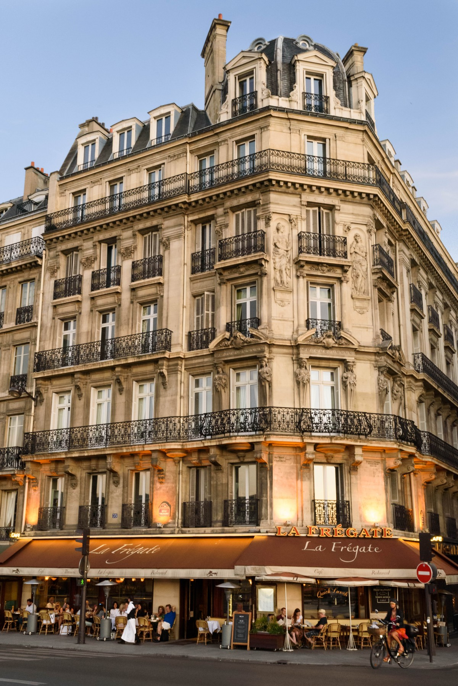
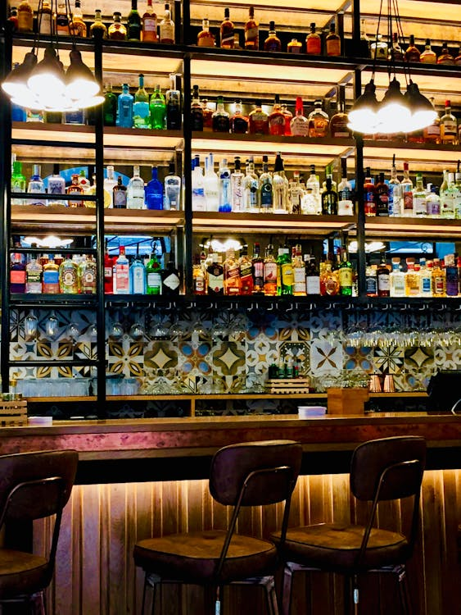
Introduction
A restaurant recommendation system is a tool that suggests dining options based on user preferences, location, cuisine, and reviews.
Leveraging AI, NLP and machine learning, it personalizes suggestions, enhancing customer experience.
By analyzing user data and trends, such systems ensure tailored, accurate recommendations, making dining decisions effortless and enjoyable.

Slide 3

Problem Statement
Finding the perfect restaurant can be overwhelming due to the vast number of options and varying user preferences. Existing methods often lack personalization and fail to adapt to individual tastes. A solution is needed to deliver tailored recommendations, simplifying decision-making while enhancing user satisfaction and dining experiences.

Slide 4

Literature Survey
Restaurant recommendation systems have gained significant attention in recent years, driven by advancements in artificial intelligence and the increasing availability of user data.
Content-based filtering (CBF) relies on restaurant attributes, such as cuisine, location, and price range, to suggest options matching user profiles. Lops et al. (2011) demonstrated that CBF is effective for individual preference modeling but can limit diversity in recommendations.

Slide 5
System Architecture
Restaurant Data: Collects restaurant attributes, including cuisine, price range, location, ratings, and reviews.
Data Preprocessing: Cleanses and normalizes input data, handling missing values and inconsistencies.
Feature Extraction: Extracts key features from user profiles, restaurant attributes, and reviews (e.g., cuisine types, sentiment from text).
Recommendation Interface: Displays suggested restaurants to users through a user-friendly app or web interface

Slide 6
Project Framework
Data Cleaning: Preprocesses and organizes raw data by removing inconsistencies and handling missing values.
TF-IDF Vectorization: Extracts relevant features from textual data, such as restaurant descriptions and user reviews.
Matrix Factorization: Identifies hidden patterns in user-restaurant interactions to predict preferences.
Model Serialization: Saves the trained model for efficient reuse and deployment.
Personalized Recommendation Generation: Provides tailored restaurant suggestions based on user preferences.

Slide 7

Results
The system leverages matrix factorization and TF-IDF techniques to analyze user preferences and restaurant attributes, delivering personalized and accurate recommendations. By combining these methods, it ensures relevance, efficiency, and adaptability, offering users tailored dining suggestions that enhance their overall experience and simplify the decision-making process.

Slide 8
Conclusion
The recommendation system combines machine learning and natural language processing (NLP) to deliver effective and scalable solutions for personalized restaurant suggestions. It analyzes user behavior and textual data to ensure accuracy and relevance. The system's capabilities can be further enhanced by integrating additional features, such as real-time data or external datasets, to improve recommendation quality.

