Slide 1



myFirstDashboard
View in Power BI
Last data refresh:
8/3/2024 12:37:35 PM UTC
Downloaded at:
8/3/2024 12:59:37 PM UTC

Slide 2
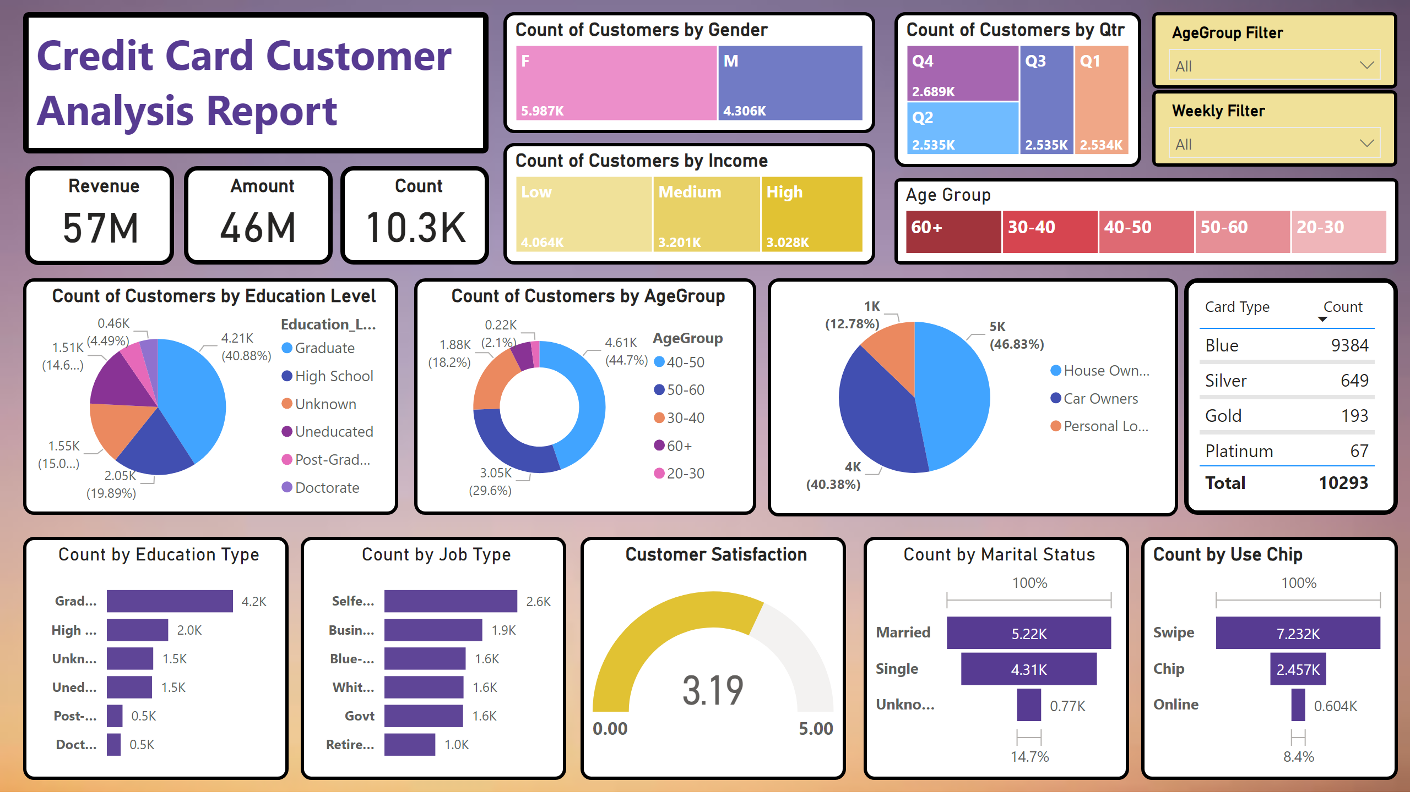
customer
Notes:
textbox
No alt text provided
Revenue
No alt text provided
Amount
No alt text provided
Count by Education Type
No alt text provided
Count by Job Type
No alt text provided
Count of Customers by AgeGroup
No alt text provided
Count
No alt text provided
Count of Customers by Education Level
No alt text provided
Count by Marital Status
No alt text provided
Count of Customers by Qtr
No alt text provided
Count by Use Chip
No alt text provided
Count of Customers by Income
No alt text provided
slicer
No alt text provided
Customer Satisfaction
No alt text provided
Count of Customers by Gender
No alt text provided
slicer
No alt text provided
tableEx
No alt text provided
pieChart
No alt text provided
Age Group
No alt text provided

