Slide 1



myFirstDashboard
View in Power BI
Last data refresh:
8/3/2024 12:37:35 PM UTC
Downloaded at:
8/3/2024 12:50:52 PM UTC

Slide 2
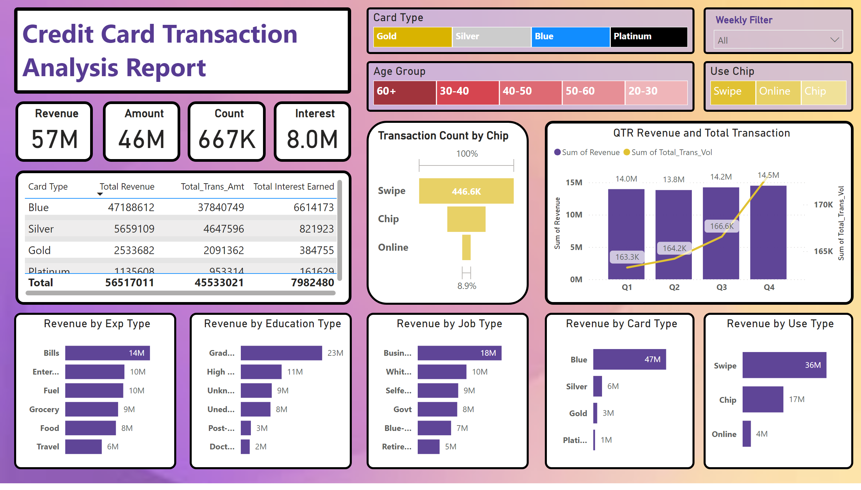
cc_analysis
Notes:
textbox
No alt text provided
QTR Revenue and Total Transaction
No alt text provided
Revenue by Exp Type
No alt text provided
Revenue by Education Type
No alt text provided
Revenue by Job Type
No alt text provided
Revenue by Card Type
No alt text provided
Revenue by Use Type
No alt text provided
tableEx
No alt text provided
Revenue
No alt text provided
Amount
No alt text provided
Interest
No alt text provided
Count
No alt text provided
slicer
No alt text provided
Use Chip
No alt text provided
Card Type
No alt text provided
Age Group
No alt text provided
Transaction Count by Chip
No alt text provided

