Slide 1

Multilingual Aspect-Based SentimentAnalysis
Al/ML Project Presentation for Restaurant Reviews
by ProjectTeam
Computer Science Department

Slide 2
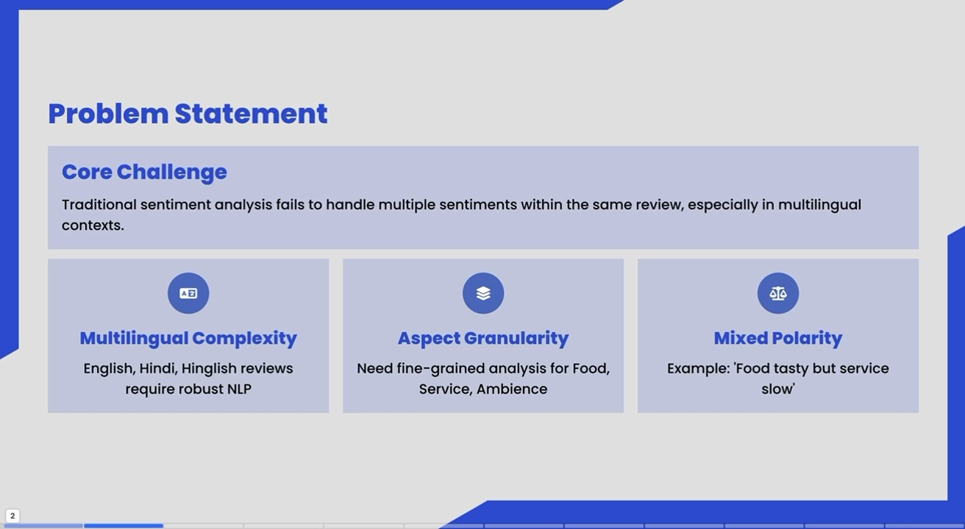
Problem Statement
Core Challenge
Traditionalsentiment analysis fails to handle multiple sentimentswithin thesame review, especiallyin multilingual contexts.
Multilingual Complexity
English, Hindi, Hinglish reviews require robust NLP
Aspect Granularity
Need fine-grained analysis for Food, Service,Ambience
Mixed Polarity
Example: 'Food tasty but service slow'

Slide 3
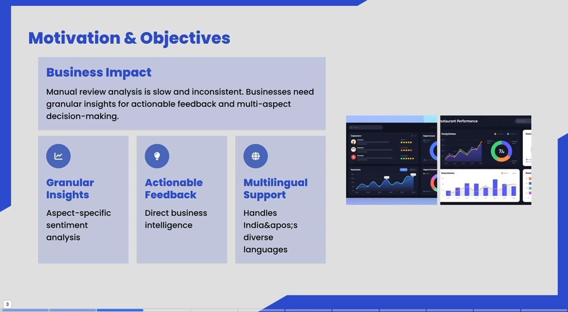
Motivation &Objectives
Business Impact
Manual review analysis is slow and inconsistent.Businesses need granular insightsforactionable feedback and multi-aspect decision-making.
estaurantPerformance
Granular Insights
Aspect-specific
sentiment
analysis
Actionable
Feedback
Direct business intelligence
Multilingual
Support
Handles
India&apos;s diverse
languages

Slide 4
Comprehensive multilingual dataset for robust ABSA training and evaluation
Total Reviews |  | 100%
English | 2,200 | 55%
Hindi | 1,000 | 25%
Hinglish | 800 | 20%
Aspects Tracked
Sentiment Classes

Slide 5
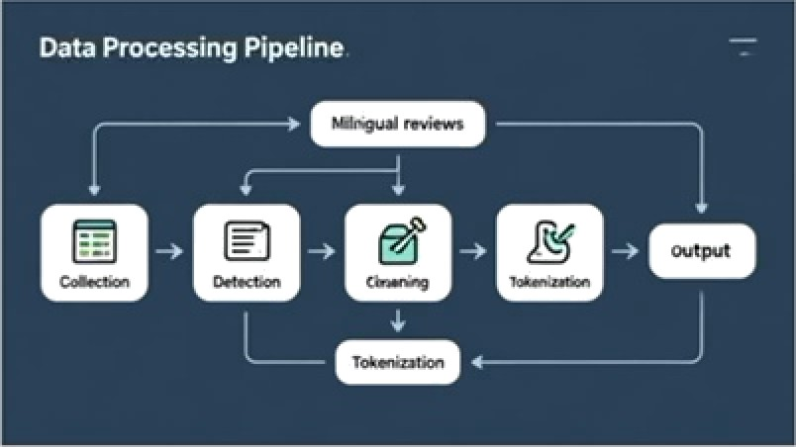

Data Preprocessing Pipeline
Text Cleaning
Remove special characters, URLs,
and normalize text
Tokerilzatloii
mBERT WordPiece tokenizotion and train-test split
Hinglish standardization and stopword removal

Slide 6
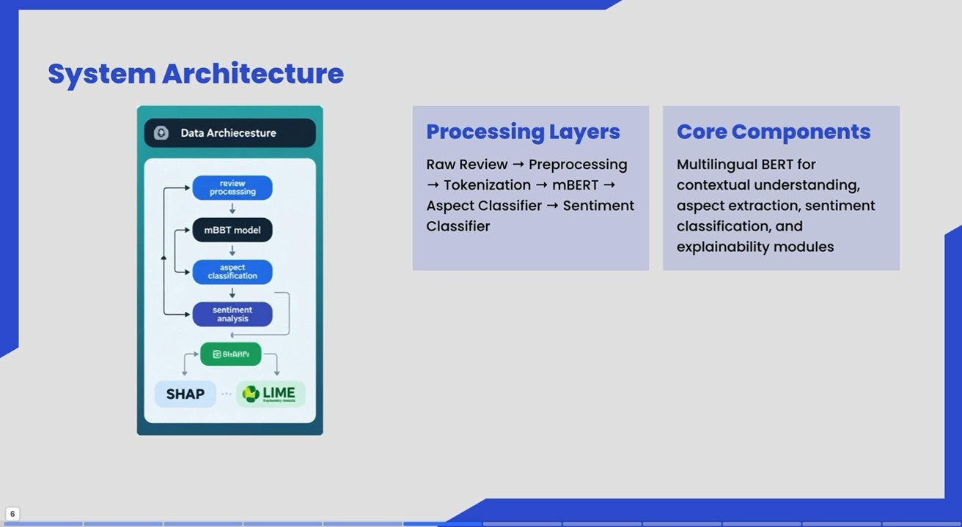
System Architecture
O
Core Components
Multilingual BERT for contextual understanding, aspect extraction, sentiment
classification, and
Data Archiecesture
Processing Layers
Raw Review
Preprocessing
review
processsing
Tokenization
Aspect Classifier Classifier
mBERT
Sentiment
mBBT model
explainability
modules
aspect
classification
sentiment analysis
SHAP-.LIME

Slide 7
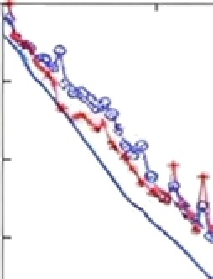





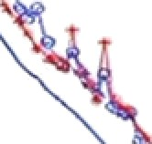



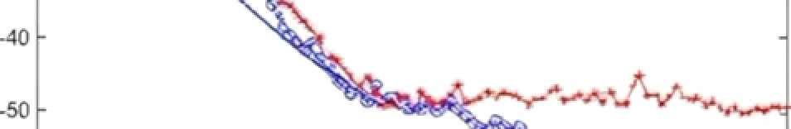
Model & Methodology
0
— -, — - — — .
-,
da n to s
.10
-20
’0
2n
40
60
10U
epochs
mBERT Architecture
Handles 104 languages effectively
Strong contextual understanding
Excellent for English-Hindi-HingIish
Training Configuration
Epochs: 5, LR: 3e-5
Optimizer: AdomW
Batch size: 16

Slide 8
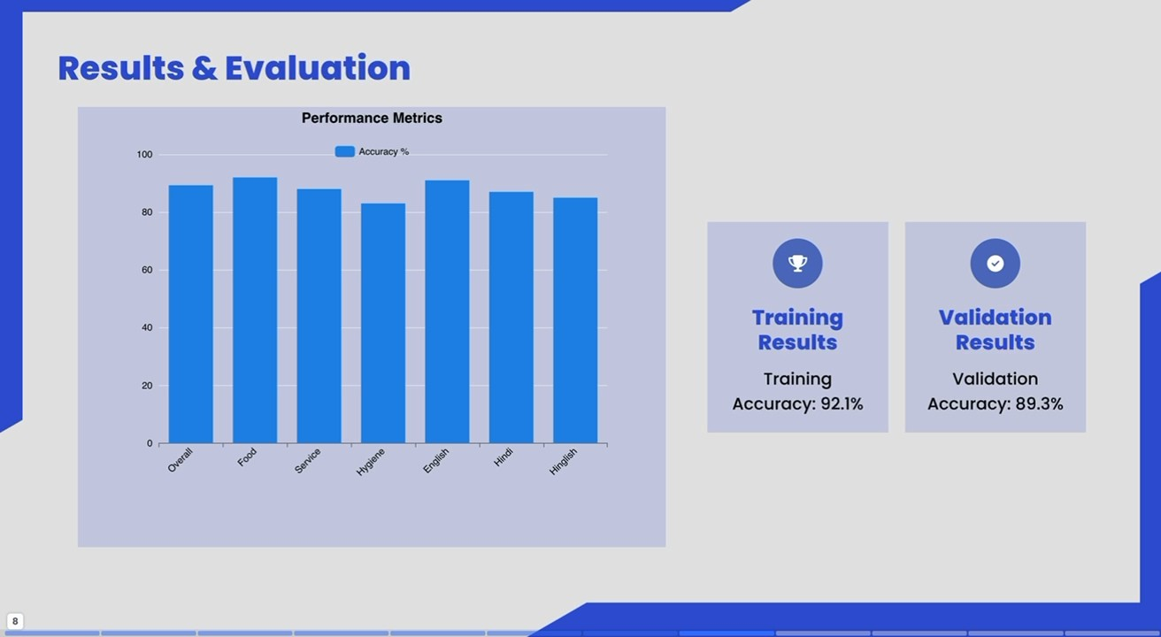
Results &Evaluation
Performance Metrics
100
Accuracy %
80
60
Validation
Results
40
Training
Results
Training Accuracy: 92.1%
Validation Accuracy: 89.3%
20

Slide 9
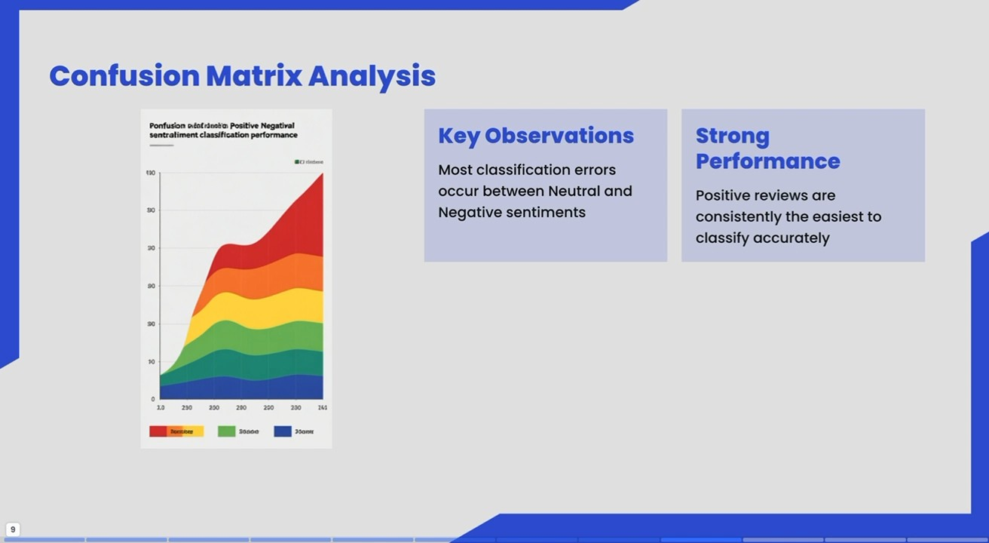
Confusion Matrix Analysis
Ponfusion aiotrdoata Positive Negatival sentraliment classification performance
Key Observations
Strong Performance
Positive reviews are consistentlythe easiest ^{to} classifyaccurately
Most classification
errors
occur between Neutral and
Negative sentiments
200
220
230
262

Slide 10
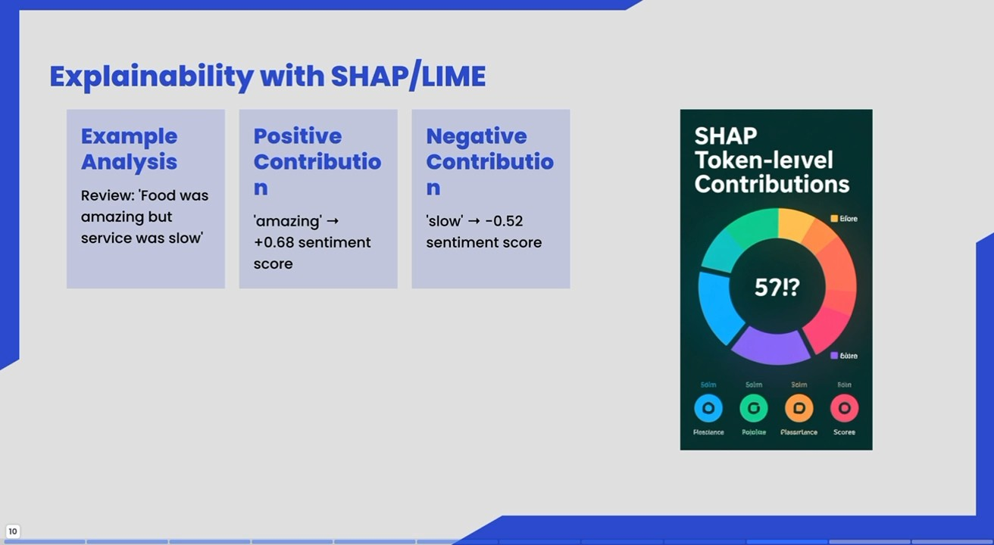
Explainability with sHAP/LIME
Example Analysis Review: 'Food was
amazing but service was slow
Positive Contributio
Negative Contributio
SHAP
Token-leivel Contributions
'amazing'
+0.68 sentiment
SCore
'slow' -0.52
sentimentscore
Elore
57!?
B6ösre
Solm
Soln Scim
Roscience
Potolae Plassrtance
Scoree
10

Slide 11
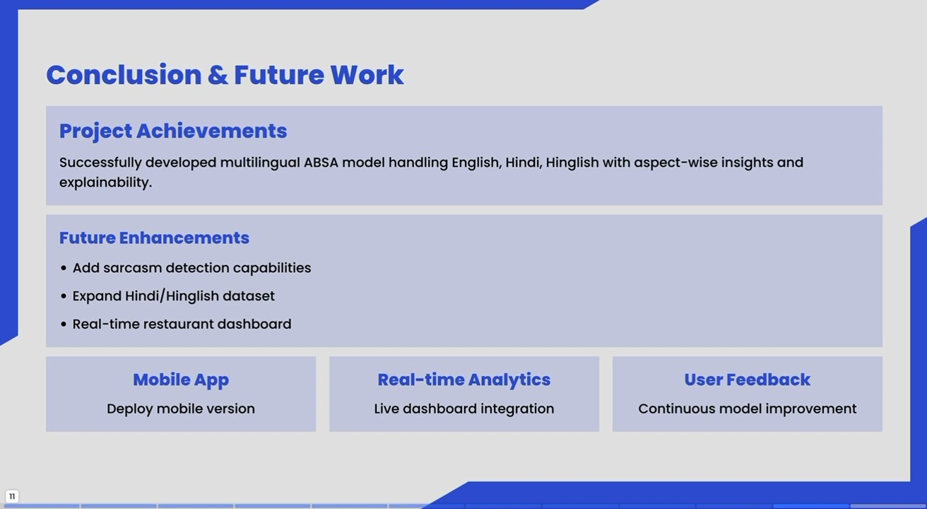
Conclusion & Future Work
ProjectAchievements
Successfully developed multilingualABSA model handling English, Hindi, Hinglish with aspect-wise insightsand
explainability.
Future Enhancements
Add sarcasm detection capabilities
•Expand Hindi/Hinglishdataset
•Real-time restaurant dashboard
Mobile App
Deploy mobile version
Real-time Analytics
^{Live} dashboard integration
User Feedback
Continuous model improvement

Slide 12
Thank You
Questions & Discussion Welcome

